Slide 1
Local Cyber Threat Intelligence
and Incident Response Workspace
MINOR PROJECT · PROJECT SHOWCASE
Aryaman Chaudhary
Anisha Sawant
RA2311030010222
RA2312703010021
Department of Networking and Communication
Notes:
Introduce CyberLens in one sentence: a local workspace that connects asset context, security observations, analyst review, and incident records.
Sources: frontend/public/brand/cyberlens-master.svg; docs/brand-guide.md; docs/architecture.md; student names and registration numbers supplied by the presenters.

Slide 2
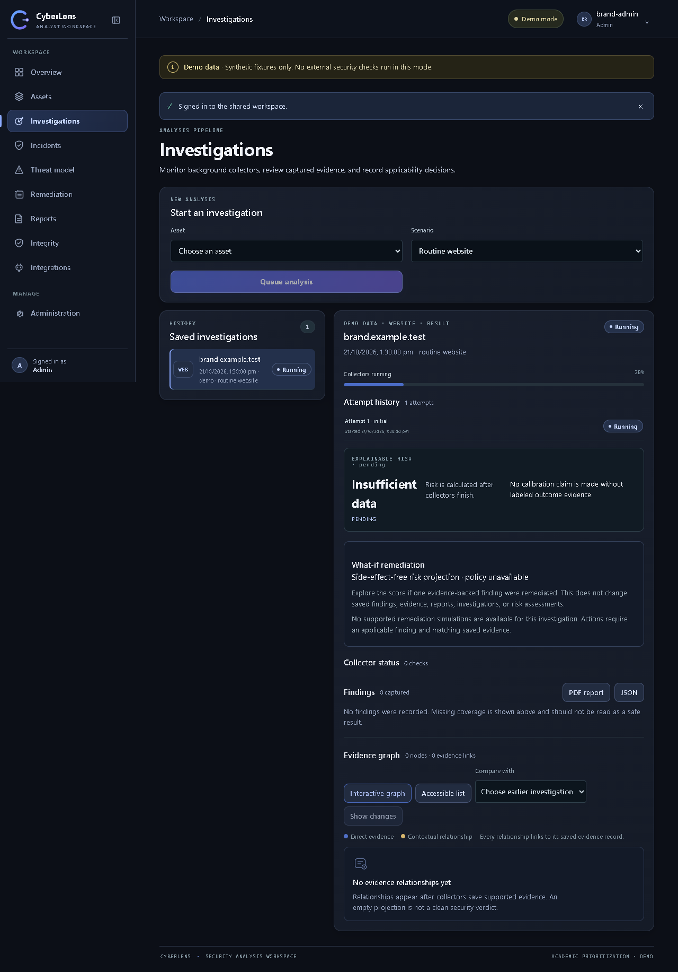
CyberLens at a glance
A local workspace for authorized, evidence-led security analysis.
01
Asset-linked investigations
Organize domains, IPs, URLs, emails, applications, and software components.
02
Evidence stays reviewable
Keep source, time, freshness, status, and evidence references with each result.
03
Response work stays connected
Link reviewed findings to cases, tasks, remediation plans, and saved reports.
Investigation workspace · synthetic Demo data
CYBERLENS / PROJECT SHOWCASE
02
Notes:
Point out the asset-to-investigation view. The screenshot is an authentic project interface capture using synthetic Demo data; it is not evidence of a live external scan.
Sources: docs/brand/screenshots/brand-app-expanded-desktop.png; docs/panel-demo.md; docs/architecture.md.

Slide 3
Problem statement
Security evidence is useful only when analysts can connect it to the right asset and decision.
Fragmented information
Manual correlation
Asset, vulnerability, reputation, and infrastructure details often live in separate tools.
Analysts spend time reconciling findings and context before they can prioritize work.
Unclear coverage
Disconnected response
A missing result can be mistaken for a clean result when provider failures are hidden.
Investigation findings need a review trail and a path into incident and remediation work.
The project focuses on a traceable analyst workflow—not automated verdicts.
CYBERLENS / PROJECT SHOWCASE
03
Notes:
Introduce the workflow gap CyberLens addresses: fragmented evidence, manual correlation, uncertain coverage, and disconnected follow-up. Emphasize that the product assists analyst review and does not issue a definitive security verdict.
Sources: README.md; docs/demo-and-viva.md; docs/architecture.md.

Slide 4
Project objectives
Build a traceable analyst workflow from inventory to documented follow-up.
01
Centralize asset context
02
Collect bounded evidence
Keep authorized assets and known software components in one workspace.
Run selected checks in background jobs and retain source status and freshness.
03
Separate matches from decisions
04
Support response records
Treat provider matches as candidates until an analyst reviews applicability.
Connect investigations to incidents, remediation work, and point-in-time reports.
Operating principle: analyst-led assessment for assets the team owns or is explicitly authorized to assess.
CYBERLENS / PROJECT SHOWCASE
04
Notes:
Describe the project objective as workflow integration rather than automated attack detection. Stress the authorization boundary and human review.
Sources: docs/architecture.md; docs/demo-and-viva.md; CyberLens_Minor_Project_Report.docx, Chapter 1.

Slide 5
Proposed solution & project scope
One workspace links authorized assets to collected evidence, analyst review, and response records.
INVENTORY
INVESTIGATE
REVIEW & RESPOND
•
Register assets and software
•
Run selected bounded collectors
•
Review applicability and risk trace
•
Record scoped website authorization
•
Preserve source status and freshness
•
Create incident and remediation work
•
Keep ownership context together
•
Correlate evidence with findings
•
Save point-in-time reports
SCOPE BOUNDARY
Authorized and bounded collection with analyst-led decisions; no exploitation or network-wide scanning.
CYBERLENS / PROJECT SHOWCASE
05
Notes:
Present the proposed solution as a shared workbench for an end-to-end analyst process. The collection scope is explicit and bounded; vulnerability candidates and provider observations remain subject to human review.
Sources: README.md; docs/architecture.md; docs/threat-model.md; docs/panel-demo.md.

Slide 6
System architecture
The API persists an investigation before background collectors begin.
Nginx frontend
Dispatcher
Redis + RQ
Static UI delivery
Outbox · reconciliation
Background queue
Analyst browser
Caddy gateway
outbox event
Evidence sources
React · TypeScript
Local HTTPS · 8443
Demo fixtures or
authorized Live checks
FastAPI service
PostgreSQL 16
Worker
Auth · API · reports
Assets · evidence · outbox
Collector jobs
saved results
PostgreSQL keeps the record; Redis carries the job; the worker writes evidence back to the database.
CYBERLENS / PROJECT SHOWCASE
06
Notes:
Walk left to right. The API writes the investigation and outbox event together. A separate dispatcher enqueues a stable RQ job; the worker runs collectors and persists results in PostgreSQL. Demo uses fixtures; Live uses configured sources only when authorized.
Sources: docs/architecture.md; docs/data-model.md; docs/panel-demo.md.

Slide 7
Investigation workflow
A queued job keeps collection separate from the user-facing request.
1 · Select asset
2 · Submit
3 · Dispatch
4 · Collect
Choose an authorized asset and scenario.
Save the investigation and first attempt.
Publish a stable job to the Redis queue.
Worker records each bounded source result.
7 · Report
6 · Respond
5 · Review
Save a PDF or JSON snapshot.
Track incidents and remediation actions.
Analyst checks evidence and applicability.
Database transaction → durable dispatch → worker collection → analyst review
CYBERLENS / PROJECT SHOWCASE
07
Notes:
Explain that investigation attempts have separate histories and that the outbox/reconciler helps recover delivery. A failed collector means unknown coverage, not a clean result. Analyst decisions are distinct from collected evidence.
Sources: docs/architecture.md; docs/demo-and-viva.md; CyberLens_Minor_Project_Report.docx, Chapter 3.

Slide 8
Key modules & evidence relationship graph
Assets, investigations, findings, and response records connect through stored evidence.
Investigation
Finding review
Attempts and history
Candidate + applicability
Asset
Evidence snapshot
Authorized inventory
Source, time, and status
Software / CVE
Incident / task
Versioned component data
Response work
Saved report
Point-in-time snapshot
Every relationship points to evidence; this is a PostgreSQL projection, not a separate graph database.
CYBERLENS / PROJECT SHOWCASE
08
Notes:
Use this conceptual graph to explain how the modules connect. The implementation stores a typed evidence-linked projection in PostgreSQL; it does not deploy a separate graph database. Change Radar distinguishes new, changed, no-longer-observed, and unknown relationships.
Sources: docs/architecture.md; docs/evidence-graph-interaction.md; docs/data-model.md; docs/known-limitations.md.

Slide 9
Technology stack
Containerized local services keep the interface, API, storage, and workers separate.
Frontend
React 18 · TypeScript · Vite · Nginx
Analyst interface and static delivery
API
Python 3.12 · FastAPI · Uvicorn
Authenticated endpoints, validation, health, reports
Persistence
PostgreSQL 16 · SQLAlchemy · Alembic
Durable records and schema migrations
Background jobs
Redis 7 · RQ · dispatcher · worker
Queue delivery and asynchronous collectors
Local runtime
Docker Compose · Caddy
Service orchestration and loopback HTTPS gateway
Provider API keys remain in backend configuration; they are not placed in the browser bundle.
CYBERLENS / PROJECT SHOWCASE
09
Notes:
Describe the core stack and why jobs are split into dispatcher and worker processes. The app runs as a local single-workspace profile; this is not a claim of public-production readiness.
Sources: docs/architecture.md; README.md; CyberLens_Minor_Project_Report.docx, Chapter 4.

Slide 10
External APIs & data sources
Live collectors query selected providers through the backend and save attributable evidence.
DOMAIN & WEB OBSERVATIONS
REPUTATION & BREACH
DNS + IANA RDAP
Bounded website / TLS observations
No key; website checks need authorization.
VirusTotal: existing reports · HIBP: explicit email lookup
VT / HIBP email lookups need provider keys.
XposedOrNot is opt-in and requires consent; HIBP password screening is keyless.
Backend collectors
Safe outbound client · provider adapters
VULNERABILITY INTELLIGENCE
FEEDS & THREAT KNOWLEDGE
NVD / CVE · CISA KEV · FIRST EPSS · OSV
NVD key optional; EPSS and OSV are keyless.
OSV sends package + version only.
Spamhaus DROP + CINS Army: local snapshots
OpenPhish: optional and terms-restricted
MITRE ATT&CK: Admin-triggered catalog sync.
PostgreSQL evidence
Source · time · status · freshness
DEMO: synthetic fixtures only; no external requests. LIVE: keys stay backend-only; provider access, quotas, freshness, and terms affect coverage.
CYBERLENS / PROJECT SHOWCASE
10
Notes:
Use the four source groups to explain which systems are actual APIs, direct protocol observations, or downloaded feeds. NVD API credentials are optional; VirusTotal and HIBP email lookup require their keys. HIBP password screening is a separate keyless range check. XposedOrNot and OpenPhish have additional consent/use restrictions. Feeds are refreshed into local snapshots and then matched locally. Demo makes no provider or website requests.
Sources: docs/setup.md; README.md#use-live-collectors; docs/api.md; docs/xposedornot.md; docs/openphish.md; docs/spamhaus-drop.md; docs/cins-army.md.

Slide 11
Evidence lifecycle
Each observation keeps its provenance and coverage status as it moves through review.
01
02
03
04
05
Collect
Record
Link
Review
Snapshot
›
›
›
›
A selected collector runs within its scope.
Source, time, status, and freshness are stored.
Evidence connects to findings and asset relationships.
An analyst confirms relevance and applicability.
Reports preserve the reviewed state at creation.
Coverage semantics
A failed, stale, or unrun source is unknown coverage—not evidence that the asset is safe. Evidence hashes help detect byte changes but do not prove authenticity.
CYBERLENS / PROJECT SHOWCASE
11
Notes:
Explain the evidence envelope and why the UI preserves statuses. CyberLens distinguishes provider observations, findings, applicability decisions, and saved snapshots. A no-match is not automatically a clean bill of health.
Sources: docs/architecture.md; docs/threat-model.md; README.md; docs/data-model.md.

Slide 12
Evidence, security & analyst review
Provider output is an observation to interpret—not an automatic verdict.
AUTHORIZED COLLECTION
TRACEABLE EVIDENCE
HUMAN DECISIONS
Scope checks to approved assets
Store source, time, status, and freshness
Review vulnerability applicability
Bound outbound requests and redirects
Link findings to supporting evidence
Show missing coverage as unknown
Keep provider credentials on the backend
Hashes detect byte changes; they do not prove authenticity
Keep the risk score explainable and explicitly uncalibrated
No exploitation · no network-wide scanning · no automatic containment or remediation
CYBERLENS / PROJECT SHOWCASE
12
Notes:
A no-match is not the same as unknown. Missing or failed sources stay visible as missing coverage. Vulnerability candidates do not affect vulnerability risk until an analyst marks them applicable. Checksums help detect stored-byte changes but do not establish chain of custody.
Sources: docs/threat-model.md; docs/known-limitations.md; docs/demo-and-viva.md.

Slide 13
Authentication & access control
Workspace access is role-based, session-backed, and recorded for later review.
IDENTITY
ROLE BOUNDARIES
ACCOUNTABILITY
•
Argon2 password hashing
•
Viewer: read workspace data
•
Login throttling shared through Redis
•
Cookie-backed server sessions
•
Analyst: protected investigation and response writes
•
User and role changes are audited
•
CSRF protection and session rotation
•
Admin: user and workspace administration
•
Tamper-evident append-only audit chain
Passwords and provider credentials are handled by the backend; roles limit who can make protected changes.
CYBERLENS / PROJECT SHOWCASE
13
Notes:
Summarize the protections implemented in the local workspace. Role permissions do not replace deployment security; the project is configured as a local single-workspace showcase, not a public multi-tenant service.
Sources: docs/architecture.md; docs/threat-model.md; docs/setup.md; docs/api.md.

Slide 14
Risk prioritization & analyst review
The risk view explains its inputs and keeps vulnerability context separate from analyst decisions.
01
02
03
04
Evidence
Candidate
Applicability
Assessment
Collect source observations and coverage status.
Create finding candidates with provider details.
Analyst checks whether the finding matches the asset.
Versioned policy records a score and its contributors.
How to describe the score
It is an academic prioritization score, not a probability of compromise or a calibrated industry metric. EPSS is shown separately and does not change the score. Missing coverage stays visible; it is never treated as zero risk.
CYBERLENS / PROJECT SHOWCASE
14
Notes:
Explain that the score is versioned and traceable to its inputs. CVSS, KEV, EPSS, source coverage, evidence, and analyst applicability are distinct fields; EPSS does not alter the current score. No calibration claim is made.
Sources: README.md, Risk score and source limitations; docs/api.md; docs/architecture.md.

Slide 15
Operating modes for the panel
Use the isolated offline Demo profile for a repeatable showcase.
DEMO
LIVE
•
Synthetic fixtures; no provider or website requests
•
Uses configured sources and explicit target authorization
•
Repeatable scenarios for success, vulnerability, and outage states
•
Results depend on provider access, quotas, freshness, and network
•
Separate Demo Compose project and data volumes
•
Local showcase profile—not a public deployment
RECOMMENDED DEMO PATH
Routine website → vulnerable app → applicability review → incident case → saved report
Identify all Demo findings as synthetic examples.
CYBERLENS / PROJECT SHOWCASE
15
Notes:
Recommend Demo for the review panel because it does not depend on keys or external availability. The interface visibly labels synthetic data. Live mode is optional and requires an explicitly authorized target and configured provider access.
Sources: docs/panel-demo.md; docs/demo-and-viva.md; docs/known-limitations.md.

Slide 16
Suggested conclave demo walkthrough
Show the end-to-end workflow using repeatable synthetic data.
01
Choose an asset
Open a routine website record and show its authorization context.
02
Start an investigation
Select the scenario and explain the queued background job.
03
Review evidence
Compare source status, freshness, candidate findings, and applicability.
04
Create response work
Link a reviewed item to an incident and remediation task.
05
Export a snapshot
Show the saved report as a point-in-time record.
State clearly: Demo findings are synthetic; no external security checks run in this profile.
CYBERLENS / PROJECT SHOWCASE
16
Notes:
Follow this short path during the presentation. Use the project Demo profile and identify the data as synthetic at each relevant screen. The sequence demonstrates product workflow; it is not a real scan or provider validation.
Sources: docs/panel-demo.md; docs/demo-and-viva.md; README.md.

Slide 17
Local deployment & run profile
Docker Compose keeps the showcase services together on the development machine.
USER INTERFACE
APPLICATION
DATA SERVICES
Browser opens the local workspace
FastAPI serves authenticated APIs
PostgreSQL stores workspace records
Caddy provides local HTTPS
Dispatcher publishes pending jobs
Redis supports queues and throttling
Nginx serves the built frontend
Worker runs collector tasks
Compose health checks gate startup
SHOWCASE ENTRY POINT
https://localhost:8443
CYBERLENS / PROJECT SHOWCASE
17
Notes:
Describe the local Compose profile at a high level. The gateway serves the browser entry point, while internal services communicate on the Compose network. This is a local single-workspace demonstration and not a public production deployment.
Sources: README.md; docs/setup.md; docs/architecture.md; docs/panel-demo.md.

Slide 18
Background jobs & failure handling
Durable delivery and explicit failure states help preserve a trustworthy investigation history.
TRANSACTIONAL OUTBOX
IDEMPOTENT DELIVERY
BOUNDED RECOVERY
The API saves the investigation and its queue event together in PostgreSQL.
The dispatcher uses a stable job ID, so a publish retry does not create a new logical run.
Transient failures may retry with limits; permanent configuration errors do not loop.
HONEST COVERAGE
A missing credential, quota limit, failed source, or stale feed is reported as unavailable/unknown—not silently converted to a safe result.
CYBERLENS / PROJECT SHOWCASE
18
Notes:
Explain the split between API request and background work. The transactional outbox and reconciler help recover delivery; retries are bounded and restricted to transient failures. Failed collectors leave coverage unknown.
Sources: docs/architecture.md; docs/data-model.md; docs/known-limitations.md.

Slide 19
Verification record & known limits
Documented local checks support the showcase workflow; they do not establish production readiness.
Recorded 26 October 2026
78
1
offline workflow + mocked UI/provider tests passed
real-backend smoke test passed
Isolated backend workflows and mocked presentation cases · 5.2 minutes
Isolated local login and dashboard · 7.6 seconds
Frontend TypeScript checks and production build passed.
No live-provider test was run. The risk score is not calibrated; deployment is local and single-workspace.
CYBERLENS / PROJECT SHOWCASE
19
Notes:
These figures are transcribed from the dated repository verification record. The 78-test run used isolated offline backend workflows and mocked UI/provider cases; the separate smoke test covered local login/dashboard. No live provider validation was performed.
Sources: docs/test-results.md; docs/ui-final-review-20261026.md; CyberLens_Minor_Project_Report.docx, Chapter 4.

Slide 20
Conclusion & future scope
CyberLens connects authorized assets, evidence, analyst decisions, and response records in one workspace.
01
02
03
Validate prioritization
Test providers deliberately
Harden deployment
Evaluate the academic score against a labeled, documented outcome dataset.
Run controlled integration checks with consent, quotas, and reproducible fixtures.
Plan managed secrets, backups, monitoring, and tenant isolation before shared hosting.
Asset → evidence → analyst decision → response record
Thank you · Questions
CYBERLENS / PROJECT SHOWCASE
20
Notes:
Conclude that CyberLens connects authorized assets, evidence, analyst decisions, and response work in one local workspace. Describe the three cards as future scope: validate prioritization, test provider integrations deliberately, and harden deployment before shared hosting. Invite questions.
Sources: docs/known-limitations.md; docs/architecture.md; docs/test-results.md.

