Slide 1
CYBERLENS
Local Cyber Threat Intelligence
and Incident Response Workspace
MINOR PROJECT · PROJECT SHOWCASE
Aryaman Chaudhary
Anisha Sawant
RA2311030010222
RA2312703010021
Department of Networking and Communication
Notes:
Introduce CyberLens in one sentence: a local workspace that connects asset context, security observations, analyst review, and incident records.
Sources: docs/brand-guide.md; docs/architecture.md; student names and registration numbers supplied by the presenters.

Slide 2
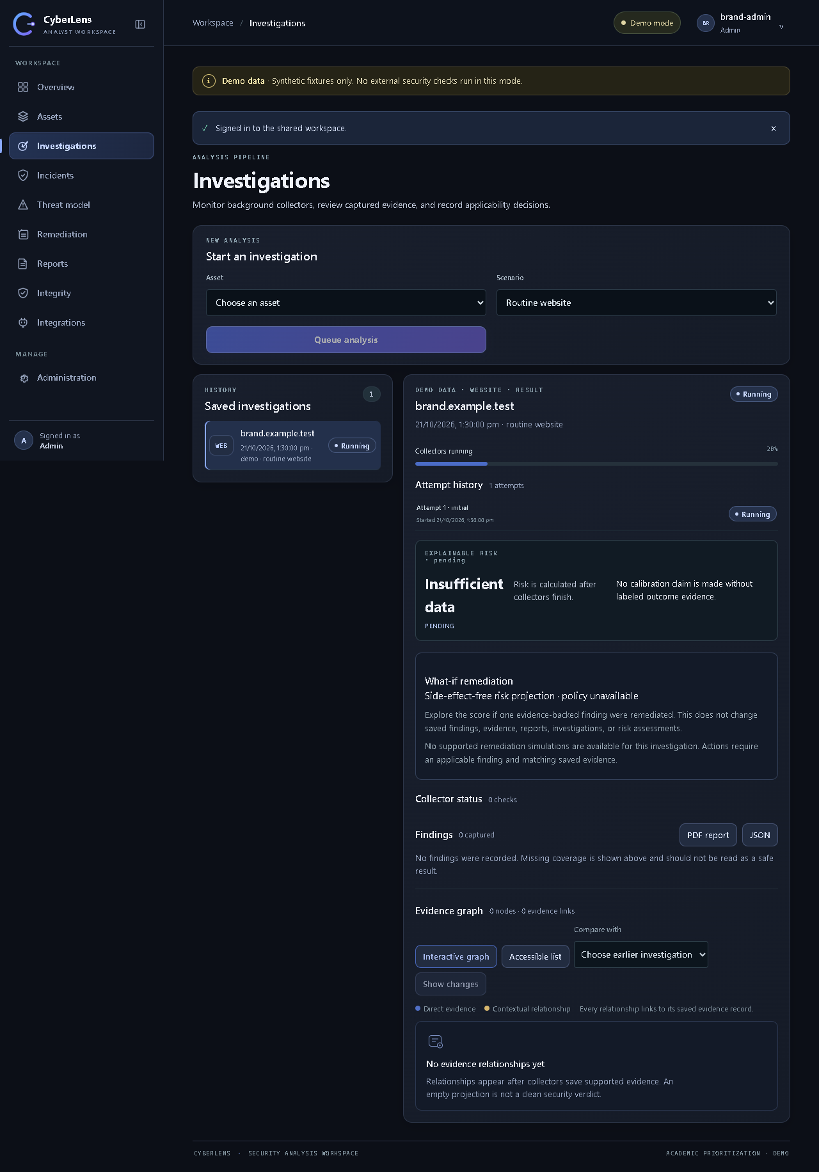
CyberLens at a glance
A local workspace for authorized, evidence-led security analysis.
01
Asset-linked investigations
Organize domains, IPs, URLs, emails, applications, and software components.
02
Evidence stays reviewable
Keep source, time, freshness, status, and evidence references with each result.
03
Response work stays connected
Link reviewed findings to cases, tasks, remediation plans, and saved reports.
Investigation workspace · synthetic Demo data
CYBERLENS / PROJECT SHOWCASE
02
Notes:
Point out the asset-to-investigation view. The screenshot is an authentic project interface capture using synthetic Demo data; it is not evidence of a live external scan.
Sources: docs/brand/screenshots/brand-app-expanded-desktop.png; docs/panel-demo.md; docs/architecture.md.

Slide 3
Project objectives
Build a traceable analyst workflow from inventory to documented follow-up.
01
Centralize asset context
02
Collect bounded evidence
Keep authorized assets and known software components in one workspace.
Run selected checks in background jobs and retain source status and freshness.
03
Separate matches from decisions
04
Support response records
Treat provider matches as candidates until an analyst reviews applicability.
Connect investigations to incidents, remediation work, and point-in-time reports.
Operating principle: analyst-led assessment for assets the team owns or is explicitly authorized to assess.
CYBERLENS / PROJECT SHOWCASE
03
Notes:
Describe the project objective as workflow integration rather than automated attack detection. Stress the authorization boundary and human review.
Sources: docs/architecture.md; docs/demo-and-viva.md; CyberLens_Minor_Project_Report.docx, Chapter 1.

Slide 4
System architecture
The API persists an investigation before background collectors begin.
Nginx frontend
Dispatcher
Redis + RQ
Static UI delivery
Outbox · reconciliation
Background queue
Analyst browser
Caddy gateway
outbox event
Evidence sources
React · TypeScript
Local HTTPS · 8443
Demo fixtures or
authorized Live checks
FastAPI service
PostgreSQL 16
Worker
Auth · API · reports
Assets · evidence · outbox
Collector jobs
saved results
PostgreSQL keeps the record; Redis carries the job; the worker writes evidence back to the database.
CYBERLENS / PROJECT SHOWCASE
04
Notes:
Walk left to right. The API writes the investigation and outbox event together. A separate dispatcher enqueues a stable RQ job; the worker runs collectors and persists results in PostgreSQL. Demo uses fixtures; Live uses configured sources only when authorized.
Sources: docs/architecture.md; docs/data-model.md; docs/panel-demo.md.

Slide 5
Investigation workflow
A queued job keeps collection separate from the user-facing request.
01
Select an authorized asset
The analyst chooses the asset and the appropriate investigation scenario.
02
Submit the investigation
The API saves the work item, first attempt, and outbox event transactionally.
03
Dispatch a stable job
The dispatcher publishes the attempt to the Redis-backed RQ queue.
04
Collect bounded evidence
A worker runs selected collectors and records each source result.
05
Review findings
The analyst checks evidence and confirms whether candidate findings apply.
06
Track response work
Cases, playbook tasks, and remediation plans record analyst actions.
07
Save a report snapshot
PDF or JSON output preserves the state captured at report creation.
CYBERLENS / PROJECT SHOWCASE
05
Notes:
Explain that investigation attempts have separate histories and that the outbox/reconciler helps recover delivery. A failed collector means unknown coverage, not a clean result. Analyst decisions are distinct from collected evidence.
Sources: docs/architecture.md; docs/demo-and-viva.md; CyberLens_Minor_Project_Report.docx, Chapter 3.

Slide 6
Key modules
Each module shares authenticated records, evidence references, and audit context.
01
Assets & authorizations
04
Findings & risk review
Inventory for domains, IPs, URLs, emails, apps, and components; scoped website permission records.
Candidate findings, analyst applicability decisions, score explanations, and revisions.
02
Investigations
05
Incidents & remediation
Background scenarios, attempts, collector status, retries, and historical comparisons.
Case timelines, playbook tasks, plans, actions, and control mappings.
03
Evidence graph & Change Radar
06
Reports & operations
Evidence-linked relationships with new, changed, no-longer-observed, and unknown states.
Saved PDF/JSON snapshots, provider status, integrity checks, and health endpoints.
CYBERLENS / PROJECT SHOWCASE
06
Notes:
Use the modules to show that CyberLens covers the full analyst record, not just a provider lookup. The graph is a PostgreSQL projection, not a separate graph database.
Sources: docs/architecture.md; docs/evidence-graph-interaction.md; docs/remediation.md; docs/api.md.

Slide 7
Technology stack
Containerized local services keep the interface, API, storage, and workers separate.
Frontend
React 18 · TypeScript · Vite · Nginx
Analyst interface and static delivery
API
Python 3.12 · FastAPI · Uvicorn
Authenticated endpoints, validation, health, reports
Persistence
PostgreSQL 16 · SQLAlchemy · Alembic
Durable records and schema migrations
Background jobs
Redis 7 · RQ · dispatcher · worker
Queue delivery and asynchronous collectors
Local runtime
Docker Compose · Caddy
Service orchestration and loopback HTTPS gateway
Provider API keys remain in backend configuration; they are not placed in the browser bundle.
CYBERLENS / PROJECT SHOWCASE
07
Notes:
Describe the core stack and why jobs are split into dispatcher and worker processes. The app runs as a local single-workspace profile; this is not a claim of public-production readiness.
Sources: docs/architecture.md; README.md; CyberLens_Minor_Project_Report.docx, Chapter 4.

Slide 8
Evidence, security & analyst review
Provider output is an observation to interpret—not an automatic verdict.
AUTHORIZED COLLECTION
TRACEABLE EVIDENCE
HUMAN DECISIONS
Scope checks to approved assets
Store source, time, status, and freshness
Review vulnerability applicability
Bound outbound requests and redirects
Link findings to supporting evidence
Show missing coverage as unknown
Keep provider credentials on the backend
Hashes detect byte changes; they do not prove authenticity
Keep the risk score explainable and explicitly uncalibrated
No exploitation · no network-wide scanning · no automatic containment or remediation
CYBERLENS / PROJECT SHOWCASE
08
Notes:
A no-match is not the same as unknown. Missing or failed sources stay visible as missing coverage. Vulnerability candidates do not affect vulnerability risk until an analyst marks them applicable. Checksums help detect stored-byte changes but do not establish chain of custody.
Sources: docs/threat-model.md; docs/known-limitations.md; docs/demo-and-viva.md.

Slide 9
Operating modes for the panel
Use the isolated offline Demo profile for a repeatable showcase.
DEMO
LIVE
•
Synthetic fixtures; no provider or website requests
•
Uses configured sources and explicit target authorization
•
Repeatable scenarios for success, vulnerability, and outage states
•
Results depend on provider access, quotas, freshness, and network
•
Separate Demo Compose project and data volumes
•
Local showcase profile—not a public deployment
RECOMMENDED DEMO PATH
Routine website → vulnerable app → applicability review → incident case → saved report
Identify all Demo findings as synthetic examples.
CYBERLENS / PROJECT SHOWCASE
09
Notes:
Recommend Demo for the review panel because it does not depend on keys or external availability. The interface visibly labels synthetic data. Live mode is optional and requires an explicitly authorized target and configured provider access.
Sources: docs/panel-demo.md; docs/demo-and-viva.md; docs/known-limitations.md.

Slide 10
Verification record & known limits
Documented local checks support the showcase workflow; they do not establish production readiness.
Recorded 26 October 2026
78
1
offline workflow + mocked UI/provider tests passed
real-backend smoke test passed
Isolated backend workflows and mocked presentation cases · 5.2 minutes
Isolated local login and dashboard · 7.6 seconds
Frontend TypeScript checks and production build passed.
No live-provider test was run. The risk score is not calibrated; deployment is local and single-workspace.
CYBERLENS / PROJECT SHOWCASE
10
Notes:
These figures are transcribed from the dated repository verification record. The 78-test run used isolated offline backend workflows and mocked UI/provider cases; the separate smoke test covered local login/dashboard. No live provider validation was performed.
Sources: docs/test-results.md; docs/ui-final-review-20261026.md; CyberLens_Minor_Project_Report.docx, Chapter 4.

Slide 11
Next steps
A clear base for further evaluation and controlled expansion.
01
02
03
Validate prioritization
Test providers deliberately
Harden deployment
Evaluate the academic score against a labeled, documented outcome dataset.
Run controlled integration checks with consent, quotas, and reproducible fixtures.
Plan managed secrets, backups, monitoring, and tenant isolation before shared hosting.
Asset → evidence → analyst decision → response record
Thank you
CYBERLENS / PROJECT SHOWCASE
11
Notes:
Close with the core contribution: CyberLens links assets, evidence, human review, and response documentation in one local workspace. State the three next steps as future work rather than completed features.
Sources: docs/known-limitations.md; docs/architecture.md; docs/test-results.md.

