Slide 1

Reforestation using Autonomous Seed Dispensing Quadcopter
CPG 150 :-
Harmandeep Singh
Aryaman Choudhary
Lekha Revankar
Yuvraj Brar
Under the mentorship of:
Dr. Rajkumar Tekchandani

Slide 2
Table of Content
Problem Definition & Scope
Problem Objectives
Literature Survey
Detail Design
Tech Stack Used
Cost Analysis
Project Snapshots
Methodology
Algorithm Used & Results
Project Working
Roles & Contribution
Future Scope

Slide 3
Problem Definition & Scope
Deforestation is proving to be a major contributor towards climate change.According to a report by TIME, around 15 billion trees and being cut down each year. It is reported that there has been a 46% reduction in the number of trees since the start of human civilization and only 400 billion trees exist in today’s world
Due to these activities mother nature is slowly losing its capacity to reforest. The existing tools and nursery supply chains are largely inadequate to fill the gap and this is the challenge our project “Reforestation using Autonomous Seed Dispensing Quadcopter” will address.
With our project we aim to provide a device to increase the rate and ease of reforestation in deforested or barren lands
Our device will provide a faster and more efficient alternative to manual plantation of seeds / saplings. This device can be used both for reforestation in deforested areas as well as be used in the agriculture sector for fast and more reliable sowing of crops/plantation.

Slide 4
Problem Objectives
● Make a fully functional quadcopter which processes live video feed
● Develop a Machine Learning model to detect suitable land without obstacles for seed
sowing
● Build an efficient and lightweight seed dispensing system
● Integrate the components to build the autonomous seed dispensing quadcopter

Slide 5
Literature Survey
Paper Title | Technology Used | Research Gaps
Seed Plant Drone for Reforestation: Erico Pinheiro et. al. | Mission Planner Software | The user must manually give the command to drop the seed
The New Method of forestation automation with UA V and through the Air Seedling Delivery Technique Verhuliesov et. al. | LIDAR and Photogammetry | The method although highly precise is very time and resource consuming
Rice Seed Sowing Drone for Agriculture Worakuldumrongdej et.al. | Spiral Spinning Mechanism for seed dispensing | The dispensed seeds are dropped on the land without penetration in the soil

Slide 6
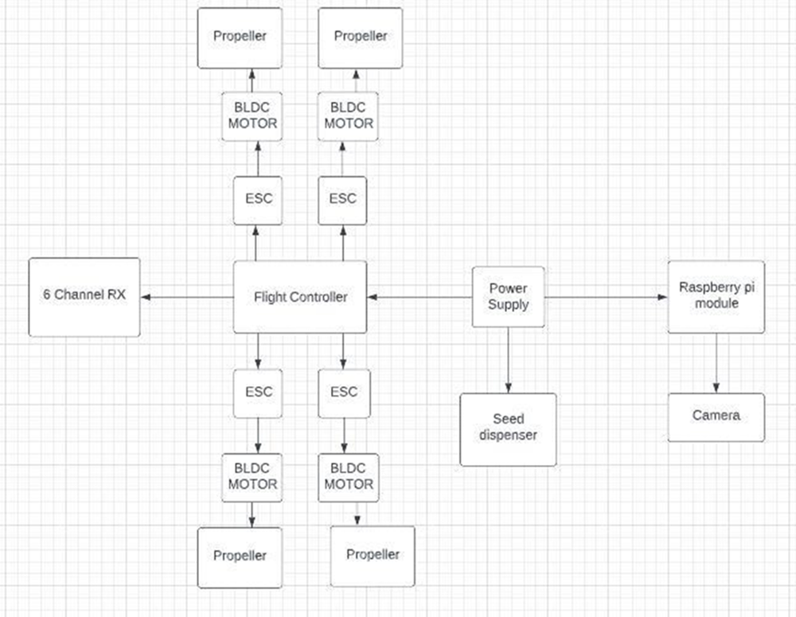
Detail Design ( Block Diagram)

Slide 7








Techniques and Tools Used

Slide 8
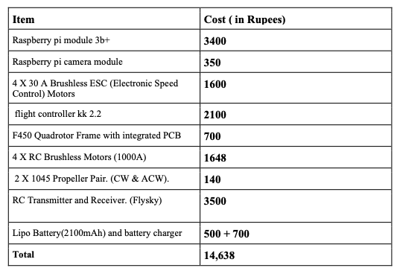
Cost Analysis

Slide 9
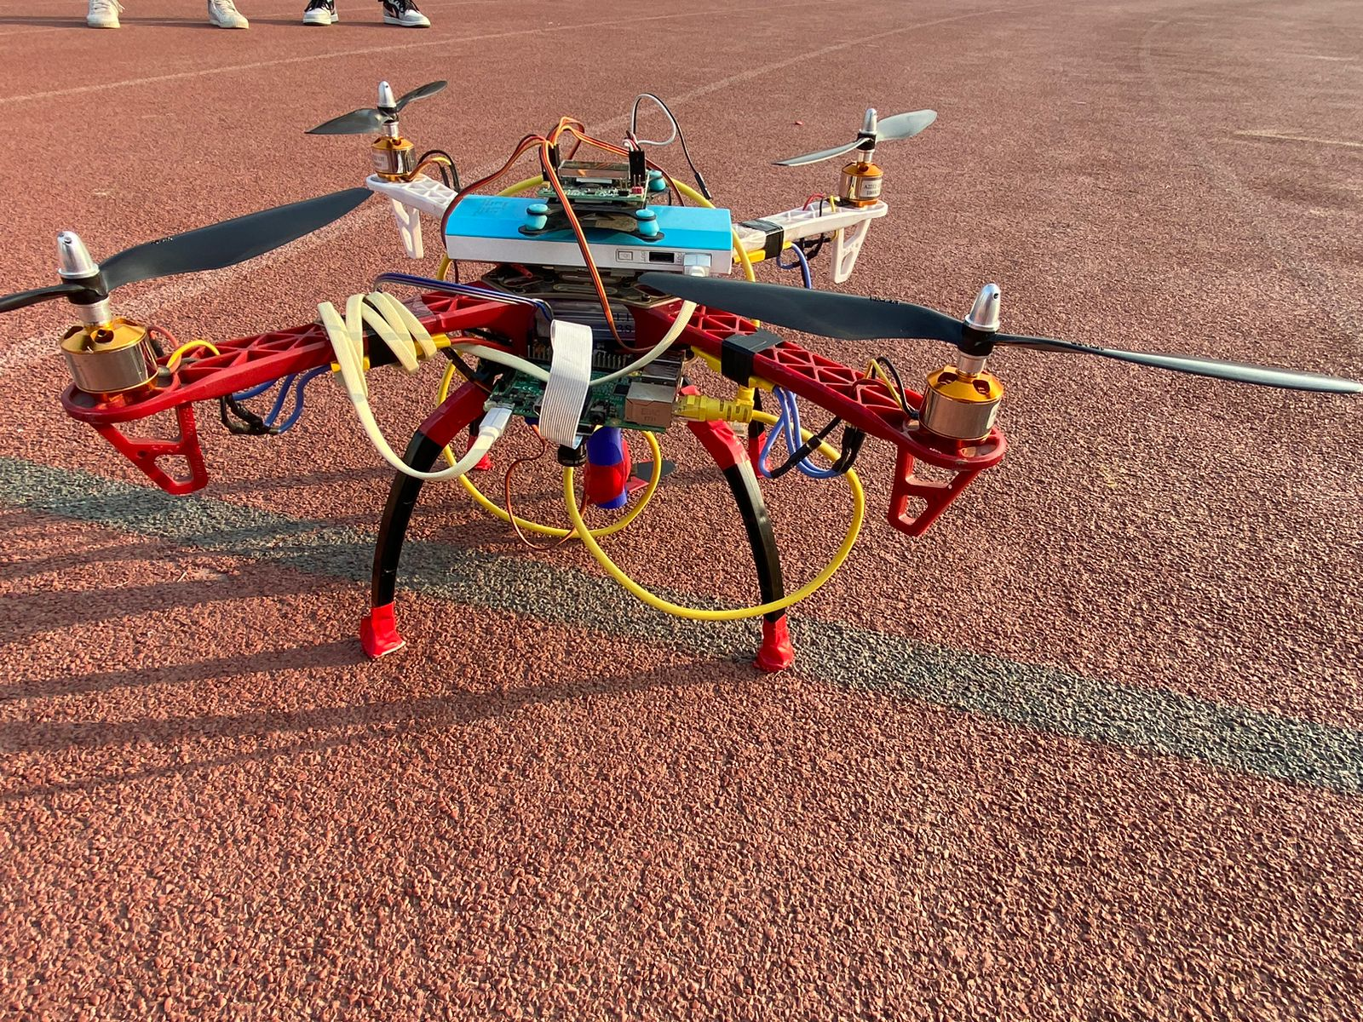
Project Snapshot

Slide 10
Methodology
Parts Assembly
Soldering
Test Flight
Calibration
Hardware Development
Final Product
Dataset collection
Model Development
Model comparison
Integration
Software Development
Designing
3D printing
Calibration &
Testing
Seed Dispenser Development

Slide 11
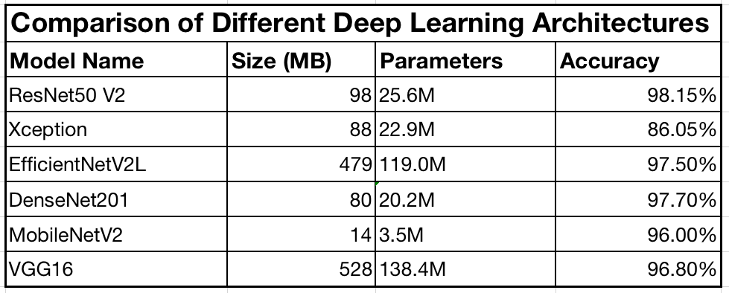
Algorithms Used

Slide 12
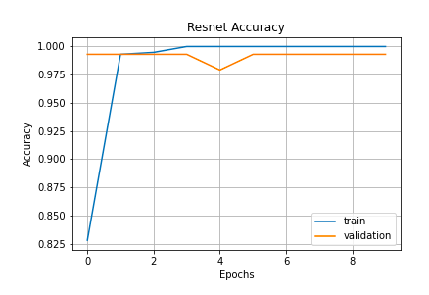
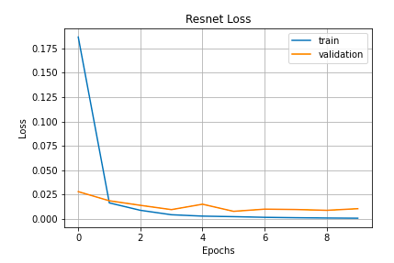
Resnet 50 Results

Slide 13
Project Working
All components are turned on using the battery and power bank
Initiate Manual Take-off
Quadcopter Clicks Photos and sends them for processing
Land Type is Detected via Machine Learning Model
If suitable a signal is sent to drop the seed
Else no action is taken and quadcopter moves to next piece of land

Slide 14
Roles and Contribution
Aryaman Choudary | Developing the Land Detection Algorithm Integrating the Components
Harmandeep Singh | Quadcopter assembling & Building Developing the Hardware Architecture
Lekha Revankar | Quadcopter Building Developing the Hardware Architecture
Yuvraj Brar | Developing seed dispenser Developing the Land Detection Algorithm

Slide 15
Future Scope
Autonomous Flight Planning
To increase the weight bearing capacity
Add an object Detection Algorithm
Improve Processing speed

Slide 16
Thank You
“The reward for our work is not what we get, but what we become ”
- Paulo Coelho

Slide 17
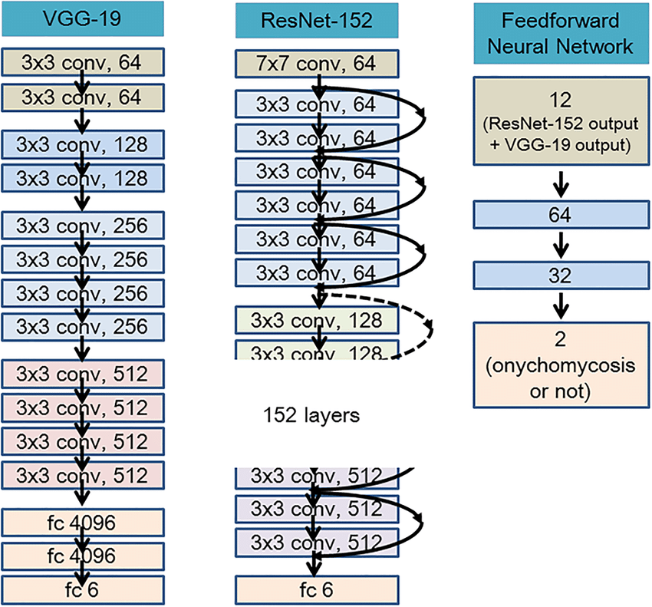
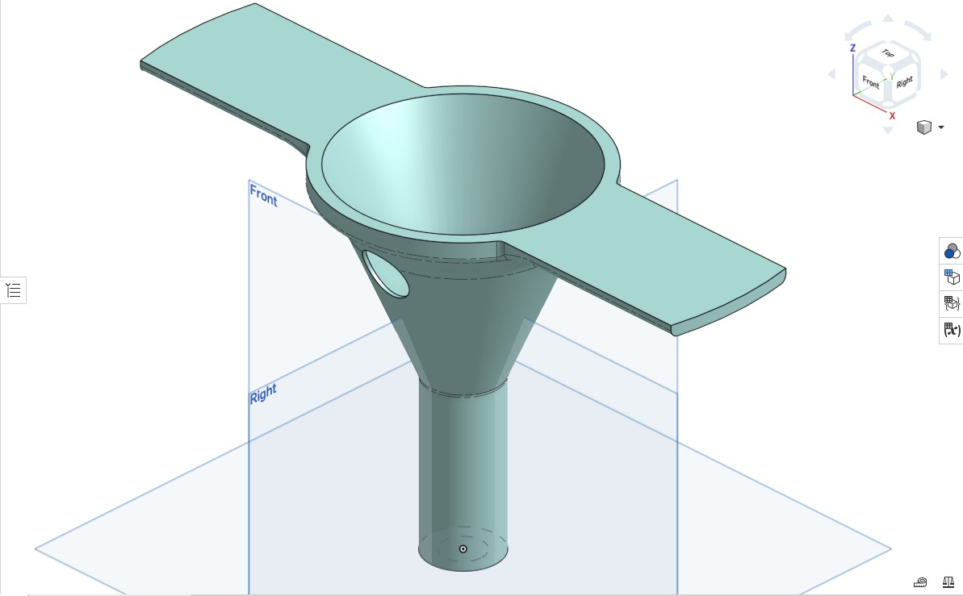
Appendix
ResNet Architecture
Funnel Design

