Slide 1
Fake Currency Detection

Slide 2

Signal and System Mini Project
Members: Aryaman Gokarn (25), Khushi Patni (47), Yuvraj Purohit (49)
Guide: Prof. Sukanya Kulkarni

Slide 3
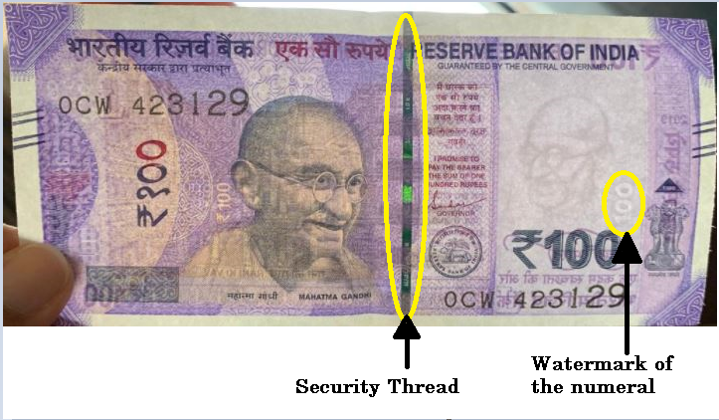
Parameters : the security thread and watermark of the numeral.

Slide 4
Image Processing
Step 1: Reading the image.
Step 2: Cropping and Resizing the image.
Step 3: Converting BGR to HSV image.
Step 4: Finding the Mask from the HSV image.
Step 5: Getting Final image by combining Mask with the Original Image.
(a) Numeral Step 6: Rotating the Resultant Image. Step 7: Applying image to text conversion using OCR. | (b) Security Thread Step 6: Converting the final image --> gray --> blur Step 7: Then blur --> canny --> getting the contours.

Slide 5
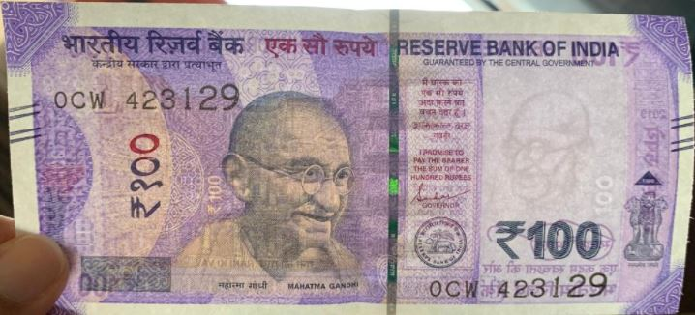
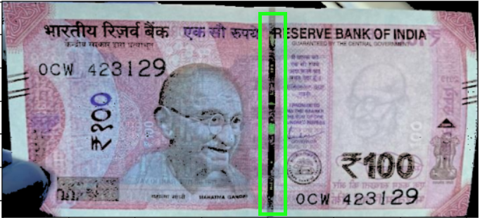
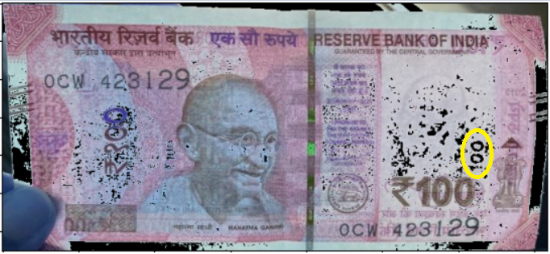
Original Note
Strip Detected
(b) Watermark of Numeral Detected

Slide 6
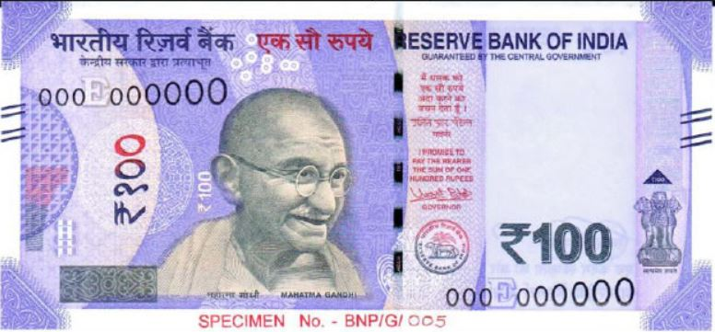
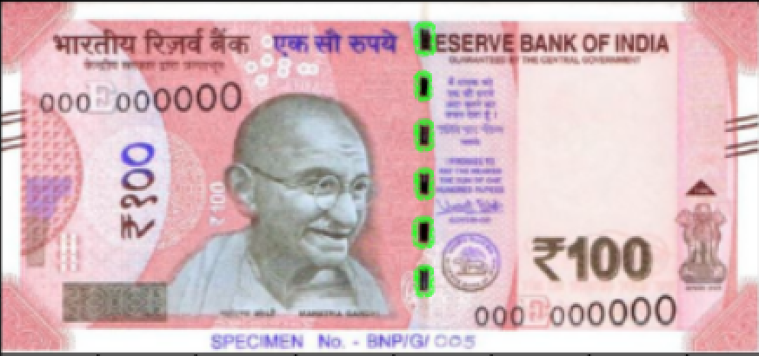
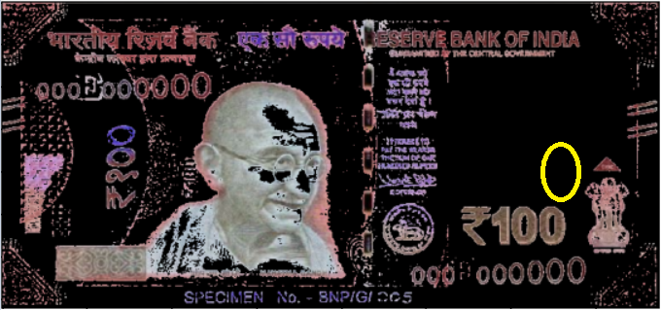
Fake Note
(a) Single Strip not Detected
(b) Watermark of Numeral not Detected

Slide 7
Output
Security Thread: If the number of contours detected is less than equal to 1 then the currency is REAL. Otherwise it is FAKE.
Watermark of Numeral: If the output detected using OCR is same as that of the currency then it is REAL. Otherwise it is FAKE.
The note will not counterfeit if both the parameters (security thread and watermark of the numeral) are detected correctly.
Otherwise, the note is Fake

Slide 8
THANK YOU!

