Slide 1
Analysis
Analysis include
Cropping
Edge detection
Threshold masking

Slide 2
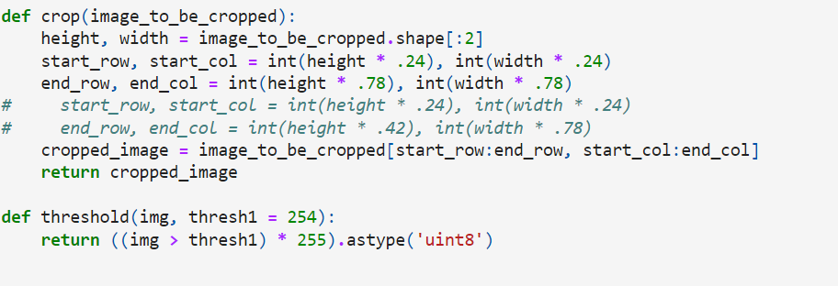
Cropping
This function takes an image as input and returns a cropped version of that image.
The purpose of this code is to crop the input image, specifically selecting a region of interest within the image defined by the percentage values (24% and 78%) of its height and width. By adjusting these percentage values, you can control the size and location of the crop within the image.

Slide 3
Edge detection
The method used for edge detection is the canny edge detection technique.
The Canny algorithm detects edges by looking for intensity gradients within the specified threshold range.
The general criteria for edge detection include:
Detection of edge with low error rate, which means that the detection should accurately catch as many edges shown in the image as possible
The edge point detected from the operator should accurately localize on the center of the edge.
A given edge in the image should only be marked once, and where possible, image noise should not create false edges.

Slide 4

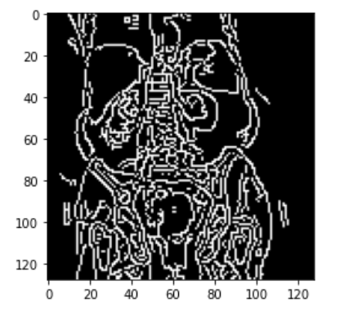
The function takes three arguments : the input image (Image), the lower threshold value for edge detection (100 in this case), and the higher threshold value for edge detection (200 in this case).
Pixels with gradient values below the lower threshold are considered non-edges, while pixels with gradient values above the higher threshold are considered edges.
Pixels with gradient values between the two thresholds are classified as edges if they are connected to pixels above the higher threshold.

Slide 5
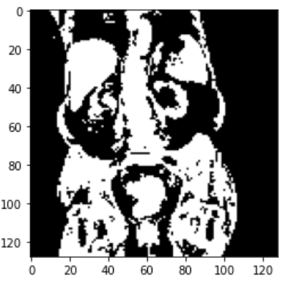
Threshold masking using OSTU method
Thresholding is a technique used to separate regions of an image based on pixel intensity
It converts a grayscale image into a binary image where pixels are either classified as foreground (white) or background (black) based on a specified threshold.
Otsu's method is employed to automatically determine an optimal threshold value based on the image's histogram.

Slide 6
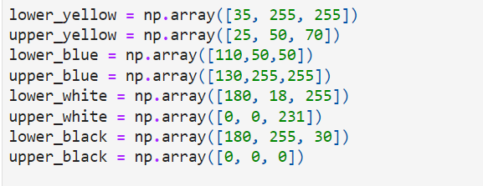
Mask of an image
HSV or Hue Saturation Value is used to separate image luminance from color information.
Hue, in the context of color and graphics, refers to the attribute of a visible light due to which it is differentiated from or similar to the primary colors
It is the attribute that permits colors to be classified as red, yellow, green, blue, or an intermediate color. Saturation pertains the amount of white light mixed with a hue.

