Slide 1
Splitting Data:
We usually split the data as:
Training Set and Testing Set
The split is done to evaluate how well the machine learning model can generalize to new and unseen data.

Slide 2
Training set-
The training set is used to train the model. It consists of input samples and their corresponding output labels.
The model learns from the training set by adjusting its internal parameters based on the input-output relationships in the data.

Slide 3
Testing set-
The testing set, on the other hand, is used to evaluate the performance of the trained model.
It consists of input samples that the model has not seen during training.
The model predicts the output labels for these samples, and their predictions are compared against the true labels to assess how well the model generalizes to unseen data.

Slide 4
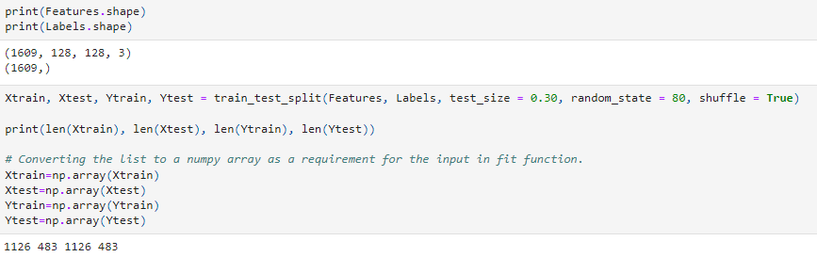
4D-array(1609 samples,128*128 pixels and 3 color channel rgb
Shape of labels 1D array with 1609 samples

Slide 5
CONVOLUTIONAL NEURAL NETWORK(CNN):
A Convolutional Neural Network (CNN) is a deep learning algorithm specifically designed for analyzing visual data such as images and videos.
It is a type of artificial neural network inspired by the organization and functionality of the visual cortex in the human brain.
The key component of a CNN is the convolutional layer. This layer performs a series of convolutions on the input image using a set of learnable filters, also known as kernels.

Slide 6
Each filter detects specific local features, such as edges, corners, or textures, by sliding across the image and computing dot products at each position.
The resulting feature maps preserve spatial relationships and highlight important patterns in the input image.
Typically, a CNN consists of multiple convolutional layers interleaved with activation functions (e.g., ReLU-Rectified Linear Unit), pooling layers (e.g., max pooling), and fully connected layers at the end.
We also use optimization algorithms like Adam(Adaptive Moment Estimation) which helps to provide efficient and adaptive learning rates during the training process.

Slide 7
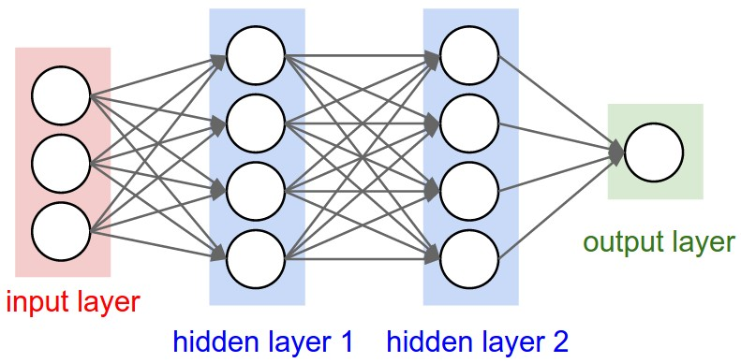

Slide 8
Epoch-
It is used to measure the progress of the training process.
We have a certain way in which we use epoch, which is:
Split your dataset
Define the number of epochs
Training loop
Validation
Repeat until convergence
Test the model

Slide 9
Support Vector Machine (SVM):
A Support Vector Machine (SVM) classifier is a supervised machine learning algorithm used for classification and regression tasks.
It is particularly effective for solving binary classification problems, where the goal is to separate data points into two distinct classes.
SVMs have several advantages, including their ability to handle high-dimensional data, handle nonlinear decision boundaries, and generalize well to unseen data (by using hyperplanes).

Slide 10
Other classifiers are:
Random forest
Naïve Bayes
Decision Trees
Logistic regression
K-Nearest Neighbours

Slide 11
Confusion matrix:
The confusion matrix is a tabular representation that summarizes the performance of a classification model.
It provides valuable insights into the true positive (TP), true negative (TN), false positive (FP), and false negative (FN) predictions made by the model.

Slide 12
True Positives (TP): These are the cases where the model correctly predicted the positive class.
True Negatives (TN): These are the cases where the model correctly predicted the negative class.
False Positives (FP): These are the cases where the model incorrectly predicted the positive class when it should have been negative. This is also known as a Type I error.
False Negatives (FN): These are the cases where the model incorrectly predicted the negative class when it should have been positive. This is known as a Type II error.

Slide 13
