Slide 1
GitShield AI
Final evaluation & project demonstration (DA3)
Heuristic repository-risk classification from GitHub metadata — what the models learn, and what they do not
Programming for Data Science · VIT Chennai · [Name / Reg. No.]
Notes:
Introduce the project: metadata-based risk categories, not a vulnerability scanner.

Slide 2
Problem and motivation
Question: can public repository metadata be summarised into an interpretable Low / Medium / High risk category?
Maintenance
Community
Exposure signals
recency, pull requests, archived status
forks, watchers, topics, maintainers
licence, code of conduct, stale code
Scope: the class is a heuristic, metadata-derived label. GitShield AI does not scan code, detect vulnerabilities, or verify that a repository is safe.

Slide 3
Architecture and methodology
SQLite
Preprocess
17 models
Evaluate
R Shiny
gitshield.db
80,489 repos
log1p, scale,
one-hot, top-20
MI features
12 classifiers
+ 5 tuned
bootstrap CIs,
McNemar + Holm,
error analysis
Plotly dashboard
reads CSV only
→
→
→
→
Python does all training and statistics; R reads exported CSVs. Same stratified 80:20 split (seed 42) as DA2.

Slide 4
Dataset and target construction
80,489 GitHub repositories (snapshot)
Train 64,391 / test 16,098 (stratified)
Target: terciles of repository_risk_score → ~1/3 per class
Score = 0.40·exposure + 0.25·(1−maintenance) + 0.20·(1−stability) + 0.15·(1−community)
Audit finding
The label can be recomputed exactly from DA2's input columns (max error 2.2e-16, all 80,489 rows).
Models receive the raw ingredients of the formula, not the composite scores themselves.

Slide 5
Experimental setup
Item | Choice
Test set | 16,098 held-out repositories, same for all models
Tuning | DA2 GridSearchCV (3-fold, macro-F1, 10k subsample); not repeated
Metrics | Accuracy, macro P/R/F1, per-class, one-vs-rest macro ROC-AUC
Uncertainty | 2,000 paired bootstrap resamples → 95% CIs
Tests | McNemar exact, Holm correction, 1-pp practical margin; 5-fold CV (Nadeau–Bengio)
Check | Re-computed results match stored DA2 values within 0.0011

Slide 6
Model comparison: MLP leads, tuning adds nothing
Best: MLP Neural Network
Accuracy 0.9504 [0.9473, 0.9538]
Macro-F1 0.9504 [0.9472, 0.9538]
ROC-AUC 0.9879
Tuned and untuned MLP differ by one test repository.

Slide 7
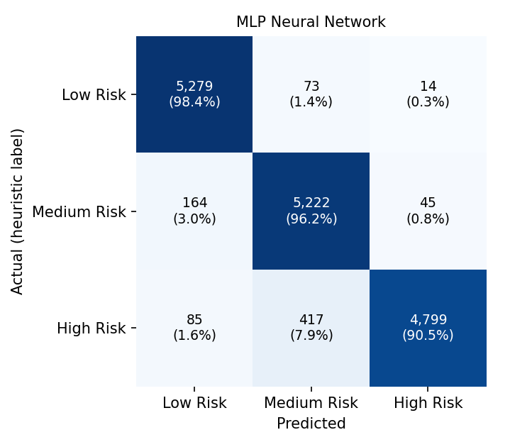
Statistical and error analysis
MLP vs HistGradientBoosting: +1.25 pp (95% CI 1.02–1.49), Holm p < 0.001: significant and ≥ 1 pp
MLP vs tuned MLP: no significant difference (Holm p = 1.00)
87.6% of errors are between adjacent classes
High Risk recall 0.905 vs precision 0.988: model under-calls High
Error rate 20.7% within 0.005 of a class cut-off
Statistical significance ≠ practical significance; neither implies generalisation to other populations.

Slide 8
Interactive dashboard (R Shiny + Plotly)
Overview
Model comparison
Classification
dataset, best model + CIs
6 metrics, tuned vs untuned
confusion matrix, per-class, errors
Feature importance
Repository explorer
Statistics & validity
model + method selectors
search, filters, scatter, table
CIs, tests, label audit
Live demo: Rscript DA3/dashboard/run.R · reads exported CSVs only; 64 server-logic checks pass.
Notes:
Demo order: Overview -> Model comparison (switch metric) -> Confusion matrix -> Repository explorer (filter High Risk + Misclassified) -> Statistics & validity (ablation).

Slide 9
Findings: what the high accuracy does and does not mean
The models learn the heuristic formula from its inputs.
Top features (days since update, licence, age) are formula ingredients.
Importance ≠ causation.
Without formula inputs accuracy drops to ~0.57–0.59.

Slide 10
Limitations, future scope and conclusion
Limitations
Future scope (proposed)
Heuristic, tercile-based labels
Predictors overlap the label formula
Single snapshot, ≥ ~5-star repositories
Test set used to rank 17 models
Validate on independent vulnerability labels
Vulnerability DB / dependency scanning
Temporal validation, calibration
Target that excludes its own inputs
The MLP is the best-supported model (macro-F1 0.9504), but the project shows a heuristic is reproducible by ML — not that GitShield AI detects insecure repositories.

