Slide 1
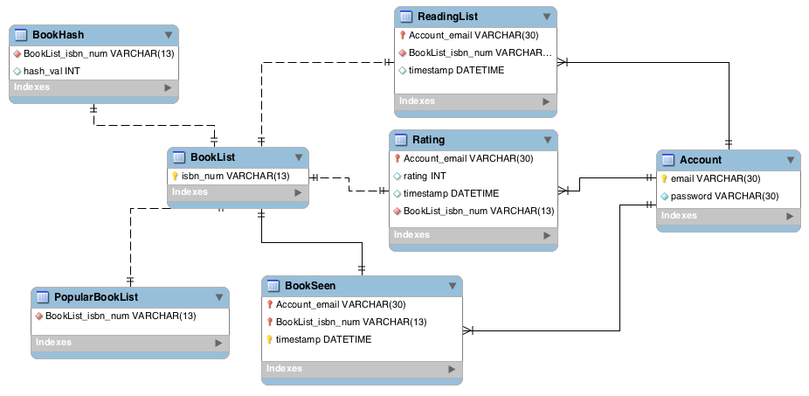
BookUpv1

Slide 2



BookUpv1
Book Up
Request
Response

Slide 3

BookUpv2

Slide 4
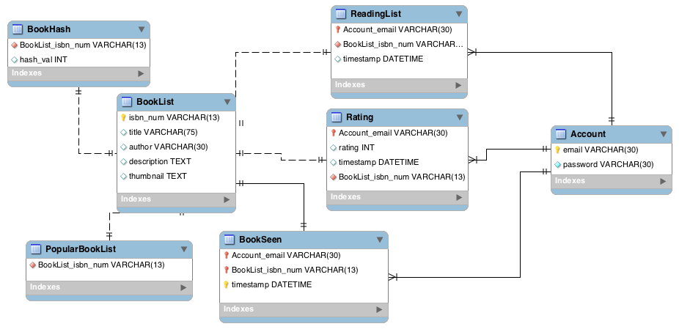
BookUpv2

Slide 5

BookUpv3

Slide 6
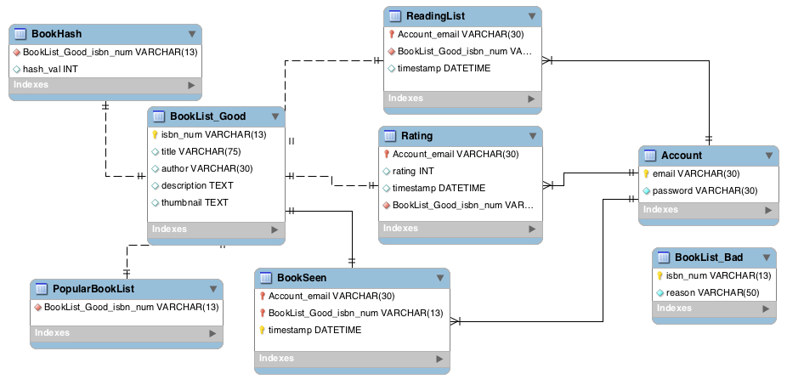
BookUpv3

Slide 7

BookUpv4

Slide 8
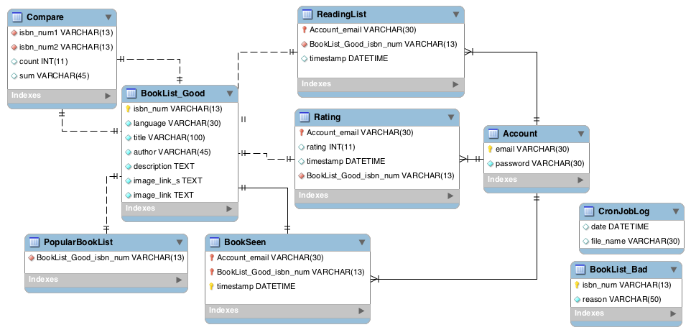
BookUpv4

