Slide 1
CLASSIFICATION AND SEGMENTATION OF GALAXIES USING MATHEMATICAL MORPHOLOGY
~team ANN
Nishant Ravinuthala and Arya Mihir Singh

Slide 2
Introduction
-In the domain of image processing, one of the many open challenges that are still of interest are the segmentation and classification of galaxies from multispectral images.
-This is because of the amorphous nature of galaxies and also because we can get lots of variations of the same galaxy image as galaxies emit radiation of different wavelengths.

Slide 3


Problem Statement
With technological progress in the field of image acquisition, it is possible for the astronomical community to make use of the massive amounts of data containing numerous new celestial objects.
Since galaxies are of special interest to the astronomers, making use for this immense corpus of data, efficiently, is needed.
Thus, the problem we are trying to solve is to segment out the galaxies from these images, automatically, and classify them which is still an open problem in the field.

Slide 4
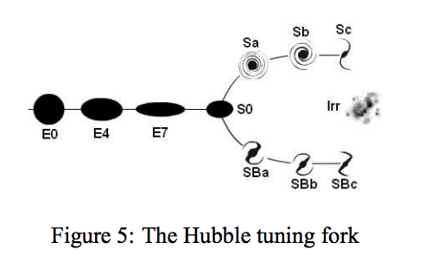

Slide 5
Till now, the methods used to solve the problem employed statistical approaches.
However, these approaches are computationally intensive.

Slide 6
Thus, the method used in the paper is that of mathematical morphology that can adapt to spatial relationships between pixels.
It is also computationally efficient.

Slide 7
Overview of Approach
The watershed transformation is used to separate out the galaxies from the multispectral galaxy images.
Once the segmentation is done, a viewpoint invariant morphological feature that is based on the top-hat operator is used to distinguish elliptical from spiral galaxies.

Slide 8
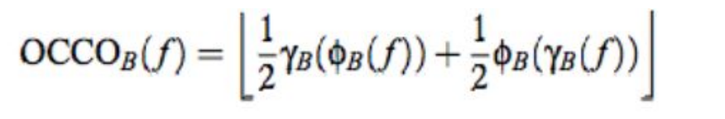
Detailed Procedure-Segmentation
Pre-Processing - Using mathematical morphology, we clean every channel of the image, the open close close open (OCCO) filter has been used for this purpose.
Watershed Transformation - The presence of a single galaxy, is realized in our case by means of the watershed transformation that segments out the galaxies and puts a boundary around them.

Slide 9
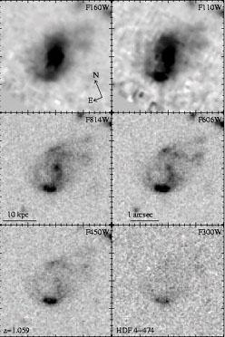
MULTI-SPECTRAL INPUT IMAGES

Slide 10
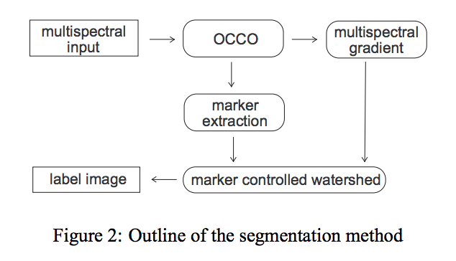

Slide 11
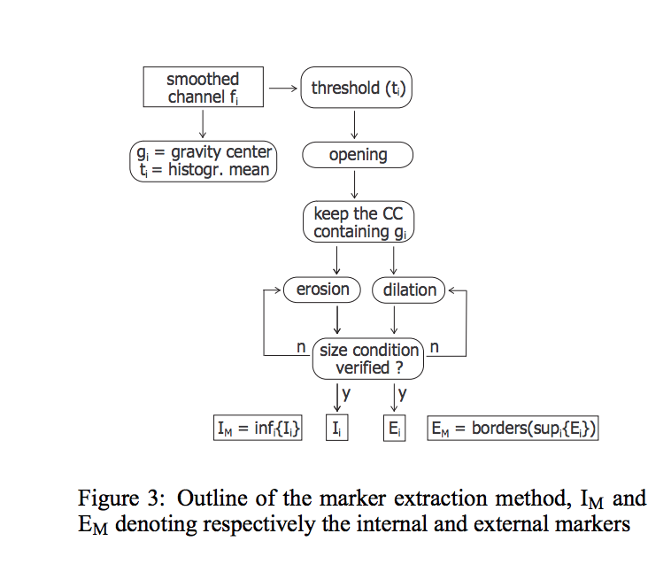
Watershed transformation-Marker extraction

Slide 12
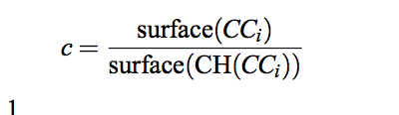
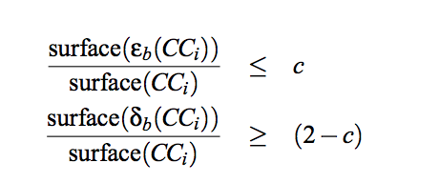
CCi = Connected component corresponding to the gravity center.
CH(CCi) = Convex Hull of CCi
(1)
(2)
The connected component image is eroded and dilated till it converges to these two relations.

Slide 13
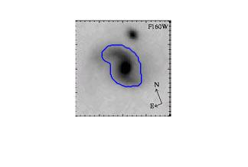
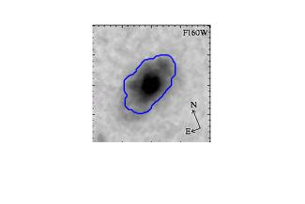
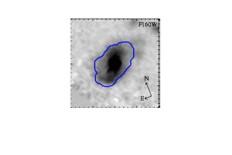
Spiral (segmented)
Elliptical (segmented)
Elliptical (segmented)

Slide 14
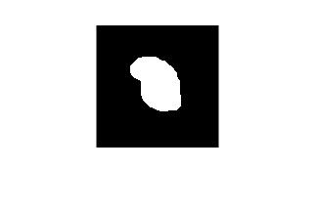
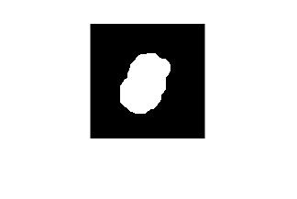
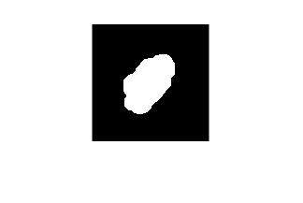
Mask (Spiral)
Mask (Elliptical)
Mask (Elliptical)

Slide 15
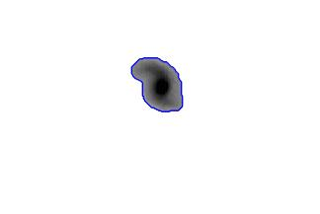
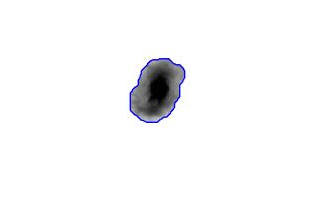
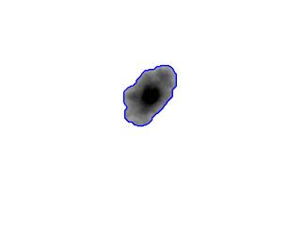
Masked (spiral), ecc = 0.9455
Masked (elliptical) , ecc = 0.8730
Masked (elliptical), ecc = 0.8462

Slide 16
Detailed Procedure- Classification
After obtaining pixels corresponding to the galaxy, we try to now use these pixels to classify the galaxy by morphological methods.
Previously used methods called spectral methods give less importance to the features that actually cause a distinction which were shape based properties.
Morphological approaches will thus be used to incorporate the shape based properties.
We classify the galaxies into two categories, spiral and elliptical.

Slide 17
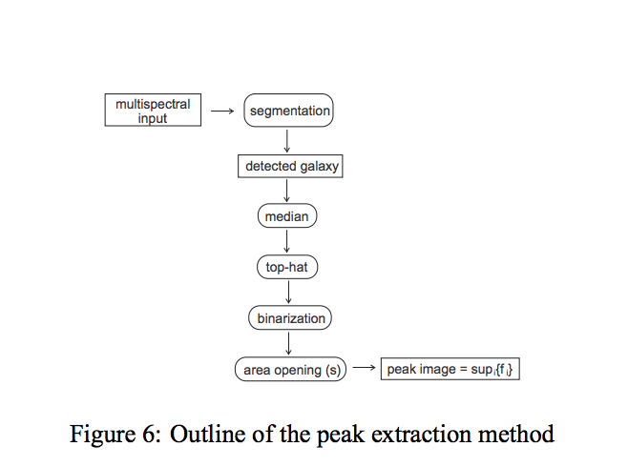
Classification - flow diagram

Slide 18
Problem with this method
Since the dataset was not that easily available. We couldn’t run it on many multi spectral galaxy images.
Of the dataset which was available to us, top hat transform wasn’t able to provide satisfactory results.
Size of SE to be used for top hat transform was not mentioned in the paper. So a lot of experimentation was required, which couldn’t be done, given our dataset.
So we came up with another approach.

Slide 19
New Proposed Method to Classify
We used eccentricities of the segmented out galaxies to classify.
Spiral galaxies will have lesser eccentricities than elliptical galaxies.
We used bounding boxes of connected components to get the ratio of sides of boxes and thus getting eccentricities.

Slide 20
New Proposed Method to Classify
We found out that (approximately) galaxies with eccentricity < 0.9 are elliptical and > 0.9 are spiral.

Slide 21
Masked (spiral), ecc = 0.9455
Masked (elliptical) , ecc = 0.8730
Masked (elliptical), ecc = 0.8462

Slide 22
Thanks!

