Slide 1
Infosys SpringBoard Virtual Internship Batch 11 Group 1 - ElectViz Election Data Visualization for Media
Under the supervision of :
Mrs.Nithyasri S J
Interns (Team B):
Arya Mishra
Kritika Balpande
Radha sri

Slide 2
Introduction
Electviz is data visualization project developed using power BI .
Electviz transform large scale election data into interactive and informative dashboard that present clear analysis and insights from raw election data in an engaging manner , thereby improving clarity, transparency, and understanding.
The problem addressed by the ElectViz project is the absence of an interactive and visual analytical system that can simplify complex election datasets while maintaining accuracy and depth of analysis.
By leveraging Power BI’s visualization and interactivity features, the project enables users to explore election data efficiently, supporting transparent, fact-based interpretation and enhanced political reporting.

Slide 3
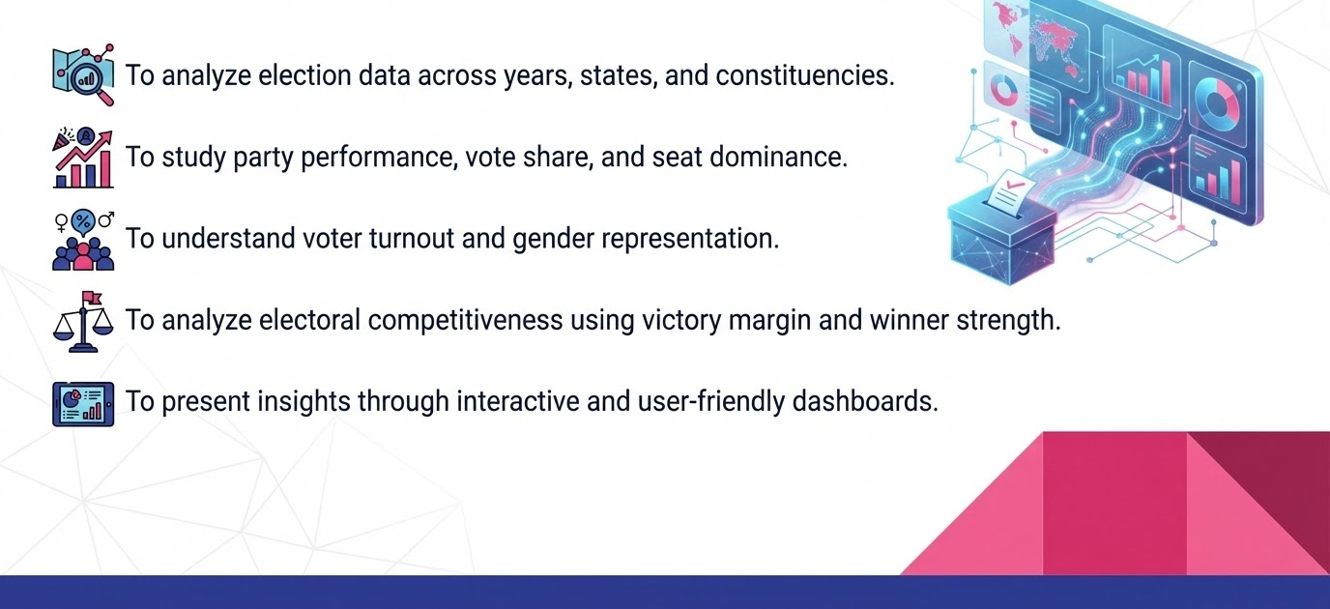
Objectives

Slide 4
Milestone 1 (Data Collection and Preprocessing )
The dataset collected from kaggle ‘Indian Election Dataset’.
Before creating dashboard we first preprocessed the data by handling null values and missing values , identifying duplicate rows and standardising values of categorical columns like state name and party name .
Also custom column creation like turnout% and winner.
Milestones
Milestone 2 (Dashboard creation started )
Dashboard development started in milestone 2 .The three dashboard i.e. election overview , party performance analysis and distribution of parliamentary constituency created in milestone 2.
1
2
3
Milestone 4
After year wise and state level analysis , the three dashboard i.e. candidate performance analysis , Gender wise analysis and electoral competitiveness to understand gender representation , party performance and competitive nature of election.
Milestone 3
After analysing party performance and distribution of parliamentary constituency . The two more dashboard i.e. Year wise analysis and state level analysis added .
4

Slide 5
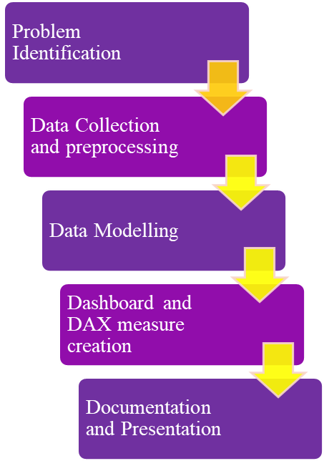
Project Execution
Problem Identification
The analysis and interpretation of election data pose significant challenges due to the large volume, complexity, and multidimensional structure of electoral datasets. This problem addressed by the ElectViz project which is the the interactive dashboard that can simplify complex election datasets into interactive visuals.
Data Collection
The dataset used for this project was sourced from Kaggle, titled “Indian Election Dataset” by Nandan Pandey.
This dataset contains detailed candidate-level election data.
01
02
05
Dashboard Creation and KPI calculation
Created a simple and elegant dashboard using different visuals and DAX measures like victory margin %.
Data Preprocessing
Before creating dashboard we first preprocessed the data by handling null values and missing values , identifying duplicate rows and standardising values of categorical columns like state name and party name .
Also custom column creation like turnout% and winner.
03
04
Documentation and presentation
After building the dashboard and analyzing insights, we documented the complete project including methodology, calculations, and findings, and prepared a structured presentation for demonstration.

Slide 6
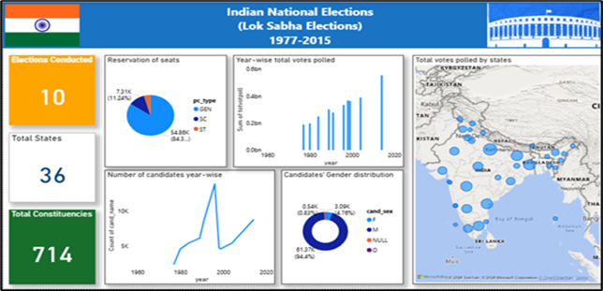
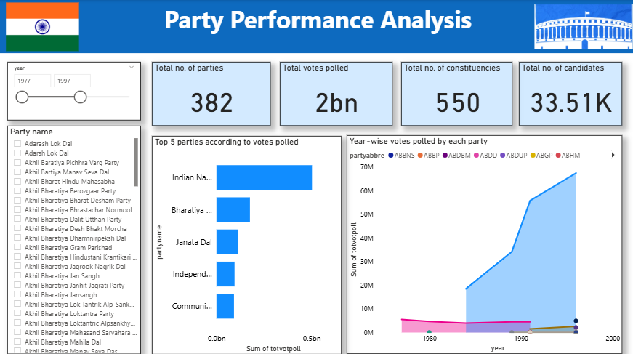
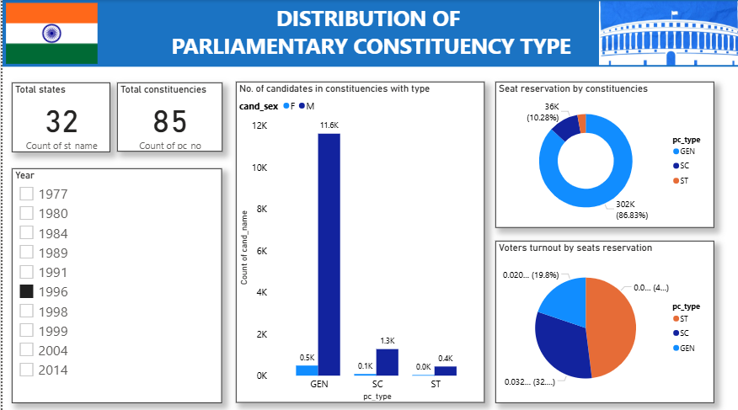
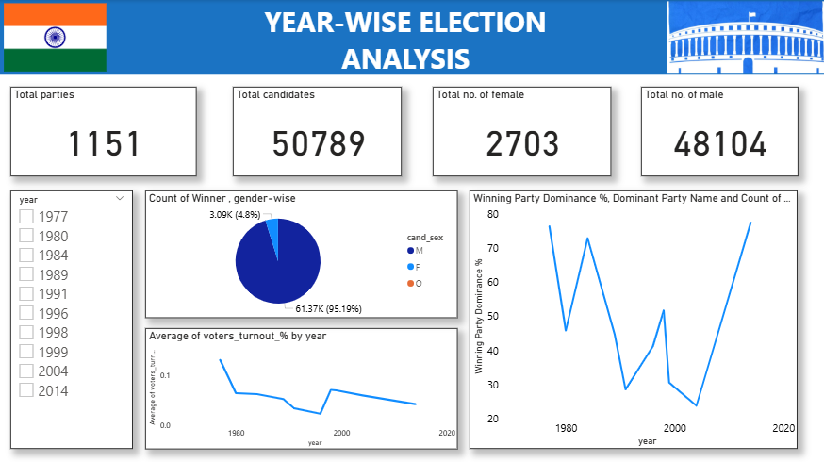
Dashboards

Slide 7
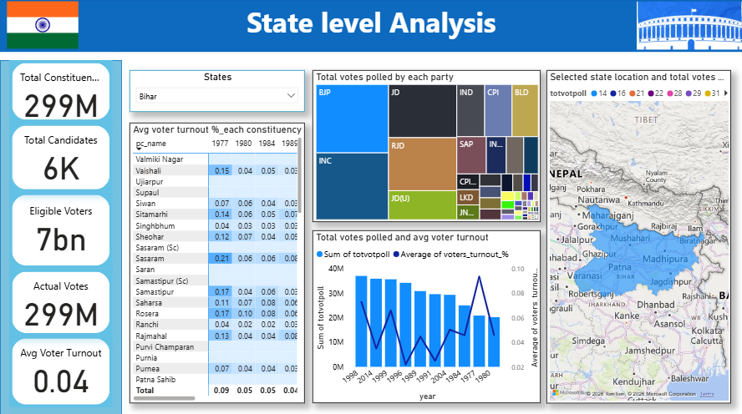
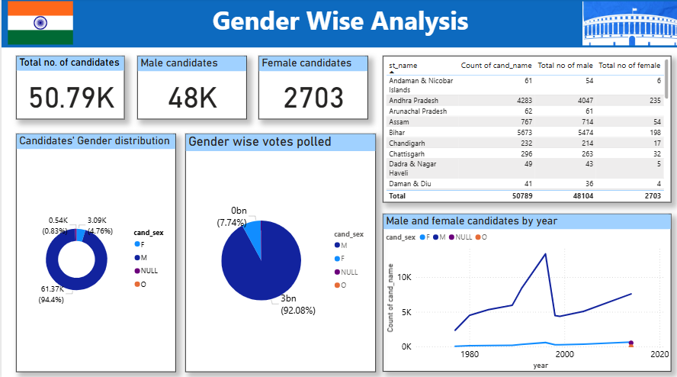
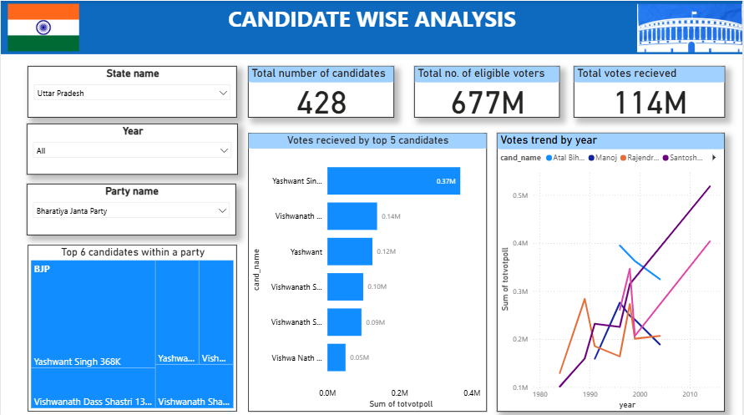
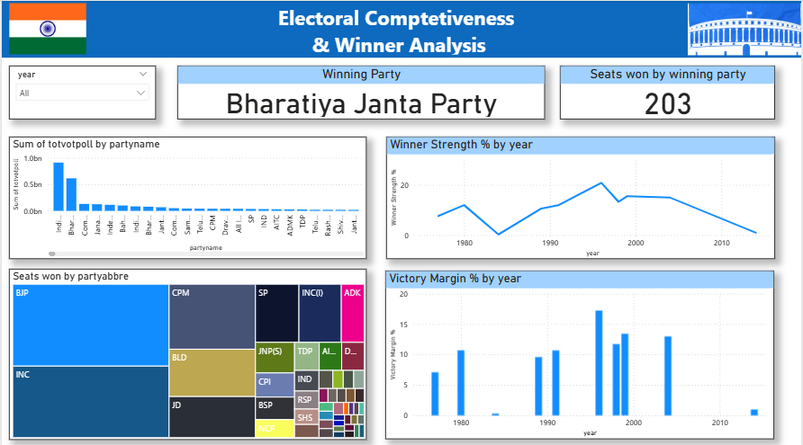
Dashboards(continued)

Slide 8

Challenges and Resolutions
Challenges | Resolution
High-volume, candidate-level election data increased processing and visualization complexity | Applied data aggregation and optimized DAX measures to enable efficient multi-level analysis
Lack of pre-defined winner, runner-up, and seat metrics in the dataset | Derived custom DAX calculations to identify winners, compute victory margins, and calculate seats won
Maintaining metric consistency across overview, party, state, and constituency dashboards | Standardized reusable measures and applied uniform filtering logic across all pages
Visual overcrowding due to large numbers of parties and candidates | Replaced dense charts with treemaps, tables, and trend-based visuals for improved clarity
Handling dynamic cross-filtering across multiple dimensions | Implemented context-aware slicers and validated visual interactions
Representing electoral competitiveness metrics in an interpretable manner | Translated complex metrics into KPIs and trend visuals for easier interpretation

Slide 9
Key Insights
The data shows high diversity in candidates, parties, electors, states, and constituencies.
Indian National Congress and Bharatiya Janata Party have remained the most dominant parties over the years.
SC and ST constituencies record a higher average voter turnout compared to General seats.
Voter turnout peaked in 1977, declined until 1996, and then stabilized after increasing from 1998 onwards.
Male candidates dominate participation, though female representation has consistently increased over time.
Winner strength varies across election years, reflecting changing electoral competitiveness.

Slide 10
Future Enhancements
Real-Time Data Integration Include recent and upcoming election data to support updated and near real-time election analysis.
Demographic and Socio-Economic Analysis Combine election data with demographic and economic indicators to gain deeper insights into voting behavior.
Predictive Election Modeling Apply predictive analytics and trend forecasting techniques to estimate future election outcomes.
Enhanced Interactivity Enable drill-through pages and interactive tooltips for detailed constituency-wise and candidate-wise analysis.
Cloud Deployment and Automation Publish dashboards on Power BI Service with automated refresh and role-based access for wider usability.

Slide 11
Conclusion
ElectViz successfully bridges the gap between raw electoral data and actionable public information by providing a centralized, automated visualization framework. By transforming complex datasets into intuitive, interactive dashboards featuring choropleth maps and swing-analysis charts, the platform overcomes the high latency and manual errors inherent in traditional reporting. The implementation of a robust data pipeline ensures that real-time insights enables newsrooms to identify critical "voter-shift" and "anti-incumbency" patterns instantly. Ultimately, this project offers a scalable, low-latency solution that enhances democratic transparency and provides broadcast-ready graphical insights for the digital age.

Slide 12
Acknowledgement
References
We would like to express our heartfelt gratitude to :
Infosys Springboard Team - for organizing this valuable internship opportunity.
Our Mentor - for her continuous support and feedback.
Our Teammates - for collaboration, encouragement, and insights
This internship has been a significant step in our professional growth and technical journey and we are grateful to be a part of this great learning experience.
Election Dataset(Indian Election Dataset/ Kaggle source)
“Indian Election Dataset” by Nanadan Pandey https://www.kaggle.com/datasets/awadhi123/indian-election-dataset
Microsoft Power BI Documentation
Infosys Springboard Virtual Internship course materials

Slide 13
Thankyou!

