Slide 1

IMAGE COLORIZATION (Capstone)
Aryamol K S
PGAWE01

Slide 2
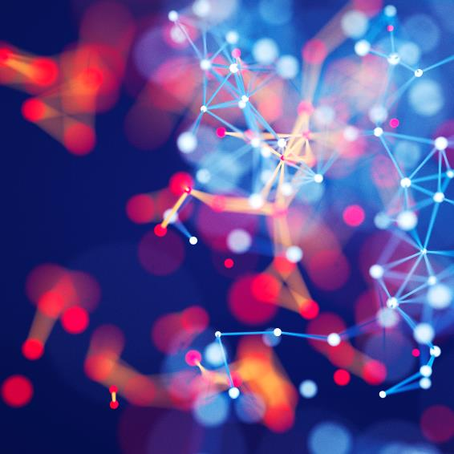

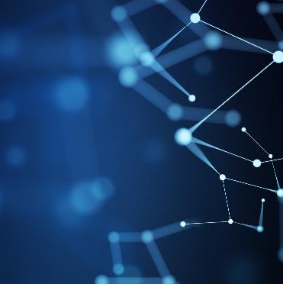
Problem Statement
The objective of this project is to turn B/ W images to colored.

Slide 3

Agenda / Process Break down
Data set selection
EDA
Auto encoder
VGG16

Slide 4
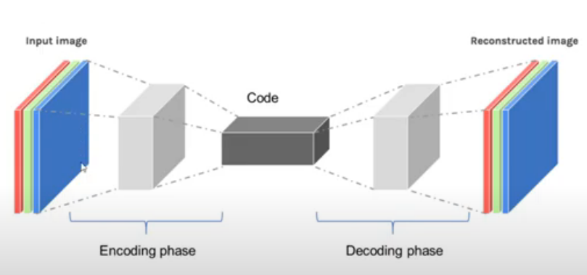
Core idea of the project
How the Autoencoder works:

Slide 5
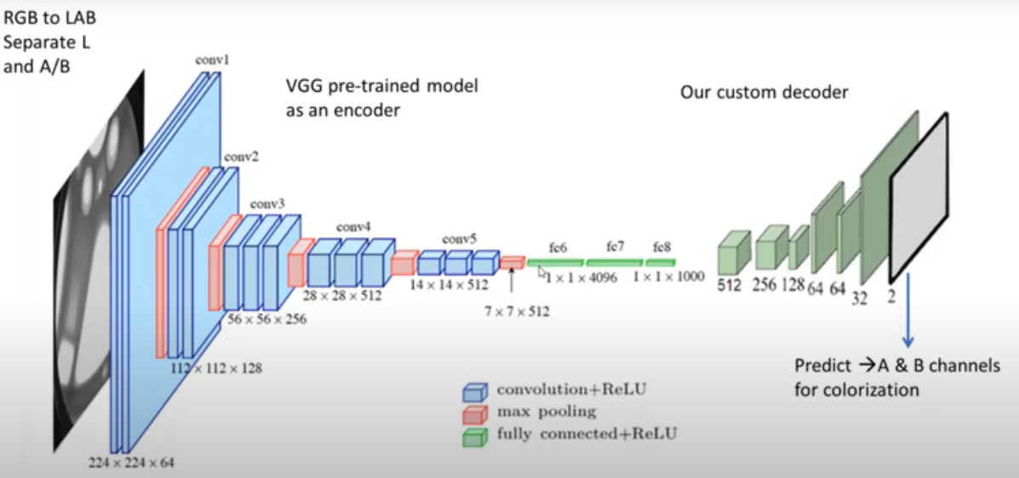
Core idea of the project Contd…
How VGG16 works:

Slide 6
What did we do in EDA?
Normalize each image by dividing by 255
Image gets resized

Slide 7
Cleaning Data
“train_datagen = ImageDataGenerator(rescale=1. / 255)”
“train=train_datagen.flow_from_directory(my_data,target_size=(256, 256), batch_size=100, class_mode = None) “

Slide 8
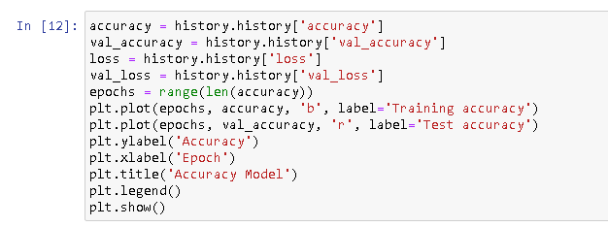
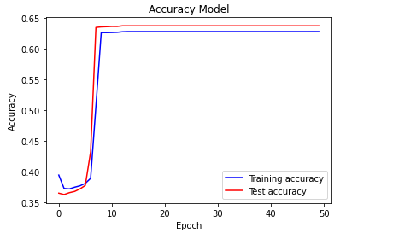
Plotting curve-Auto encoder

Slide 9

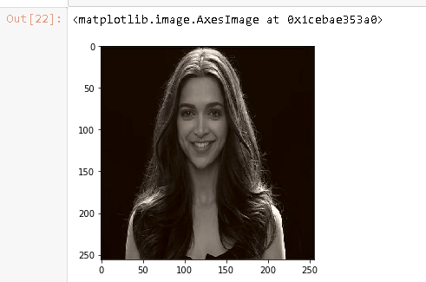
Output image-Auto encoder

Slide 10
Why do we pick VGG16?
VGG16 performs well in extracting features from images.
CNN gives convolution layers, pooling layers &activation layers, where VGG is a specific convolution n/w designed for classification and localization.

Slide 11
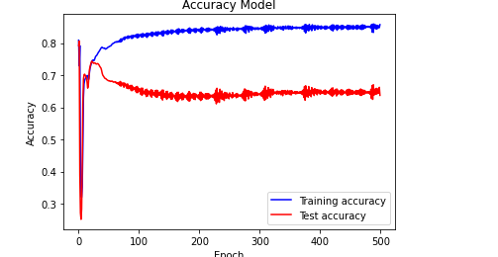
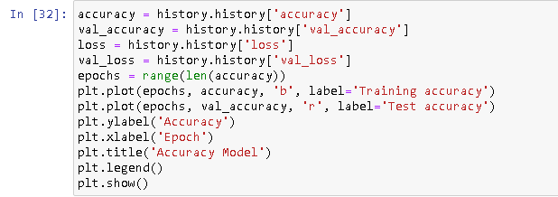
Plotting curve-VGG

Slide 12
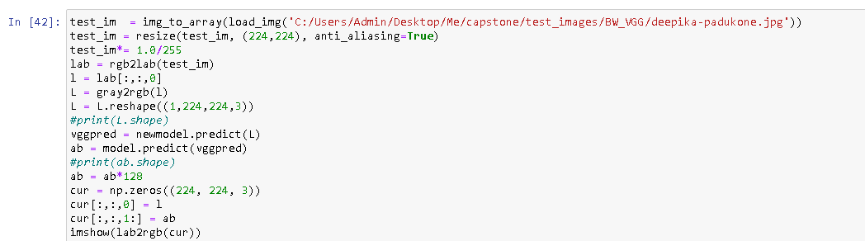
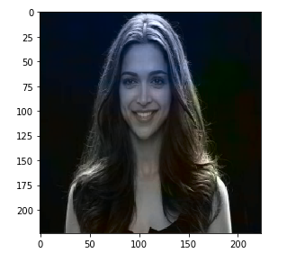
Output Image-VGG

Slide 13
Autoencoder vs VGG16

Slide 14
Conclusion
We can not recreate the image in 100% accuracy but my model is able to generate a colour pattern on the black & white images.

Slide 15

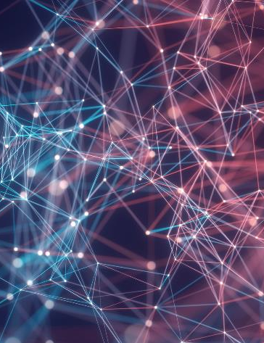
Thank You…!!

