Slide 1
Healthcare Answer Summarization using Perspective-aware NLP
Aditya Raj Jain(2022037)
Shubham(2022488)
Aryan Singla(2022112)
Group_98

Slide 2
Problem Statement, Scope, and Users
Goal: To develop a summarization system that generates concise, contextually accurate, and perspective-preserving summaries for healthcare-related answers. The aim is to assist users—particularly patients and caregivers—in quickly understanding complex medical information while ensuring that the original intent and expert viewpoint are retained.
Scope:
This study focuses on generating informative and patient-friendly summaries of healthcare responses using NLP. It investigates how perspective-aware summarization can improve content accessibility and evaluates performance using both traditional (BLEU, ROUGE) and semantic (BERTScore) metrics.
Target Users:
Healthcare Researchers: Those interested in AI applications for medical question-answering and summarization.
AI Practitioners/Developers: Developers working on medical chatbots, patient-support systems, or health-tech applications aiming to simplify and summarize professional medical content.
Patients and Caregivers: End-users who benefit from simplified and context-aware medical information tailored to their needs.

Slide 3
Related Work and Motivation
Motivation:
The internet is flooded with lengthy, complex medical answers.
Patients often lack time or literacy to read them all.
Related Work:
Traditional summarization focuses on open-domain text (e.g., CNN/DailyMail).
Prior work lacks:
Perspective awareness
Domain-specific understanding (medical context)
Reference Paper: No perspective, no perception!! Perspective-aware Healthcare Answer Summarization
Introduces PUMA dataset: 3167 CQA threads, 6193 perspective-aware summaries
Proposes PLASMA: a prompt-driven summarizer with energy-based loss and prefix tuning
Shows up to 21% improvement over baseline models

Slide 4
Dataset
Dataset Link
Contains:
Medical Questions: Natural language queries from users, covering a wide range of health topics (e.g., symptoms, diseases, treatments, diagnosis, medications).
Long-form Answers: Expert/doctor-written or community-provided detailed medical responses.
Gold Standard Summaries: Reference summaries for each answer, written to be concise, informative, and reflective of the key intent and perspective of the original answer.
Training instances: 2236 train, 959 validation, 640 test
Key features:
Real-world healthcare QA
Varied answer lengths and tones

Slide 5
Methodology
Model Used:
BART (facebook/bart-large) with LoRA (Low-Rank Adaptation)
Fine-Tuning Approach:
Abstractive Summarization: Generates concise summaries by rephrasing answers, making them more readable and informative.
Perspective-Preserving Strategy: Retains emotional tone and context of diverse perspectives (e.g., medical professionals, patients).
Why These Models were chosen:
BART:
Bidirectional and autoregressive design helps in generating fluent summaries from long, complex answers.
Handles varied input text, making it suitable for diverse healthcare responses.
LoRA:
Efficient fine-tuning by adding low-rank matrices, reducing computational resources needed for adaptation.
Enables rapid model adaptation to perspective-aware summarization without retraining all parameters.
Prompt Engineering:
Guides the model to maintain and reflect different perspectives (e.g., patient vs. doctor).
Ensures summaries align with emotional tone and medical context.
PEFT (Prompt-based Efficient Fine-Tuning):
Focuses fine-tuning on task-specific prompts to enhance the model's relevance to healthcare.
Reduces overfitting, improving domain-specific performance while maintaining efficiency.
Benefits:
Higher Relevance & Coherence: Better capture of medical context and user intent.
Multidimensional Summaries: Preserves diverse perspectives and emotional tones in summaries.

Slide 6
Experimental Setup
Experiments Conducted:
LoRA Experiment:
Model: BART with LoRA for efficient fine-tuning.
Purpose: Evaluate the impact of LoRA on model efficiency and performance, focusing on resource usage and perspective preservation.
Results: Tested if LoRA reduced memory usage while improving performance in generating perspective-aware summaries.
PEFT (Prompt-based Efficient Fine-Tuning) Experiment:
Model: BART with LoRA and PEFT applied for task-specific fine-tuning.
Purpose: Evaluate the effect of PEFT on domain-specific performance, particularly in perspective-aware summarization.
Results: Analyzed how PEFT influenced the model’s ability to efficiently adapt to the PUMA dataset without overfitting.
Comparison with PLASMA:
The BART model significantly outperforms the FLAN-T5 model across most metrics. BART achieves higher ROUGE-1 (28.31 vs. 23.23), ROUGE-2 (11.61 vs. 7.38), and METEOR (34.46 vs. 24.4) scores. The BLEU score for BART is also higher (5.22 vs. 4.05). These metrics suggest BART produces outputs with better n-gram overlap and overall quality compared to FLAN-T5. However, the FLAN-T5 model appears to have a slight edge in ROUGE-L (21.38 vs. 17.92), suggesting it may generate sequences with longer matching subsequences. For BERTScore, BART shows strong performance in recall (87.87), though FLAN-T5's overall BERTScore (86.9) is comparable to BART's F1 score (84.61), indicating both models achieve reasonable semantic similarity to reference texts, with possible tradeoffs between precision and recall.

Slide 7
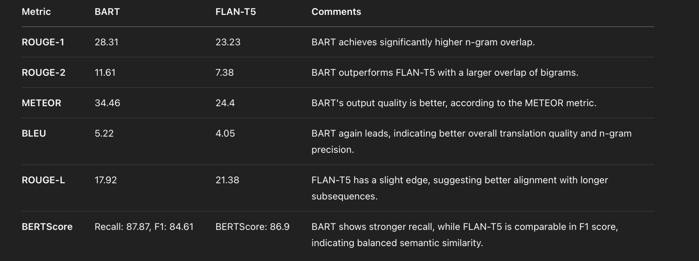
Results and Observations
Observations & Analysis: LoRA allowed parameter-efficient fine-tuning → lower memory usage. Generated summaries were more aligned with user-intent and emotional tone. Removing fine-tuning on perspective-based prompts led to reduced performance, especially in cases requiring a balanced representation of diverse viewpoints.

Slide 8
References and Future Work
Future Work:
Extend to multilingual or spoken QA formats.
Experiment with other PEFT techniques (e.g., prefix tuning, adapters) for more efficient training.
Adapt for spoken QA data (e.g., doctor-patient conversations or voice assistants).
References:
Naik, Gauri, et al. “No perspective, no perception!! Perspective-aware Healthcare Answer Summarization.”
SuryaKiran at MEDIQA-Sum 2023: Leveraging LoRA
for Clinical Dialogue Summarization

