Slide 1

Adaptive Resource Allocation Simulator in Multiprogramming Systems
A visual demonstration of dynamic resource allocation

Slide 2
Understanding the Foundation
Introduction to Multiprogramming & Resource Allocation
Multiprogramming
Why Adaptive resource allocation matters:
Allows a single CPU to execute multiple programs concurrently
The core problem in multiprogramming systems is balancing
resource demand with availability to maintain optimal performance
An adaptive approach ensures that resources are
always distributed to where they are needed most ,
improving overall system responsiveness
Creates illusion of parallelism
Improves CPU utilisation

Slide 3
Project Goal
To visually demonstrate dynamic resource allocation strategies within a multiprogramming system.
The Challenge: Managing Limited System Resources
Processes Compete for Resources
Finite Capacity
Need for Adaptive Scheduling
CPU: 100%
Multiple processes request CPU & memory
Memory: 2048 MB
Dynamically adjusts allocations
Ensures efficient performance
Requires intelligent management

Slide 4

System Architecture
System Architecture Overview
Our simulator is divided into three modules:
Module 1: Process Management
What this module covers:
Creating processes with CPU and memory requests
Assigning unique PIDs
Managing process states (Ready, Running, Waiting, Completed)
Deleting processes
Resetting the simulator
Why it's important: Foundation of the simulator — no processes means no allocation.

Slide 5


Module 2: Resource Allocation & Scheduling
What this module covers:
Why it's important:
Memory availability checks
Makes the simulator "smart" by preventing
resource over-allocation.
CPU percentage distribution
Moving processes between Ready/Running/Waiting
Updating progress
Ensuring realistic execution

Slide 6
Module 3: User Interface & Visualization
1
2
Interface Design
Usage Bars
Designing the Tkinter interface
CPU and memory usage bars
3
4
Process Table
Progress Tracking
Process table
Progress bars
5
6
Controls
Live Updates
Add/Delete/Reset buttons
Real-time updates
Why it's important: Makes the simulation interactive and understandable.

Slide 7




Process Lifecycle
Understanding Process States
Ready
Running
Waiting for CPU/memory
Actively executing
Waiting
Completed
Paused due to unavailable resources
Finished execution and released resources
State transitions occur based on CPU and memory availability.

Slide 8

Adaptive Allocation Algorithm
Memory Allocation Rule:
Process runs only if full memory is available
CPU Allocation Rule:
Scheduler uses a policy (Round Robin / SJF)
CPU time dynamically shared
Progress Rule:
Progress updates continuously
Upon completion, resources return to the system

Slide 9




What We Learned
Key Insights & Observations
CPU Control
Memory Limits
CPU usage never exceeds 100%
Memory always stays within 2048 MB
Dynamic Competition
Realistic Behavior
Processes dynamically compete for resources
Simulator accurately reflects OS behaviour

Slide 10
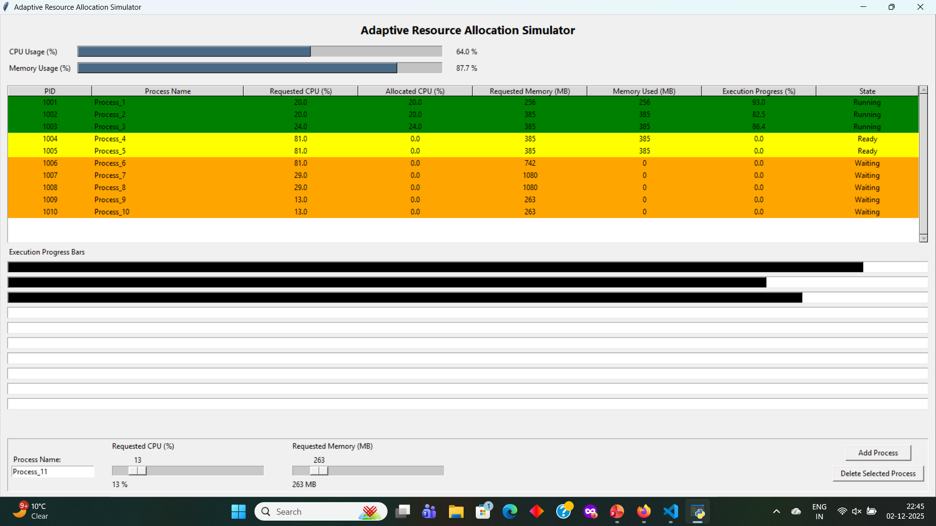
Screen Shots:

Slide 11
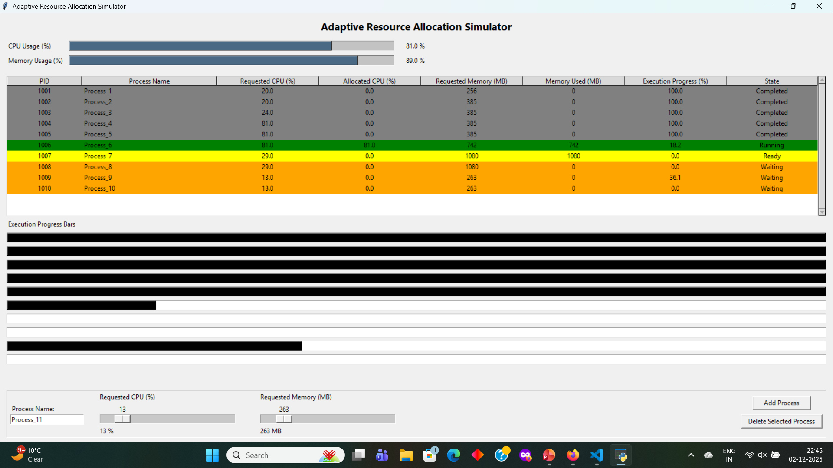

Slide 12

Final Thoughts
Conclusion
The Adaptive Resource Allocation Simulator demonstrates how operating systems efficiently manage multiple processes under limited CPU and memory. It visually shows real-time scheduling, resource sharing, and process state transitions — making complex OS concepts simple and intuitive.

