Slide 1

SAMSUNG PRISM
Generative AI
Hackathon
3rd Edition 2026 – 27
Theme ID - 05 — Interruptible Real-Time Agents
Team Name - Samseon Sukas
College Name - SRM Institute of Science and Technology
Member Name & Email 1- Vaishnavi Jagtap (Team Leader) · vj9724@srmist.edu.in · RA2411003011544
Member Name & Email 2- Aarav Pilania · ap8442@srmist.edu.in · RA2411003011536
Member Name & Email 3- Aryan Shukla · as6977@srmist.edu.in · RA2411003012361
Submission Github link - github.com/aryan-astra/Pivot
PIVOT — Pivot Interruptible Execution Runtime
An interruptible execution runtime. Change your mind mid-execution — without losing valid work.
Principle: Cancellation is advisory. Validity is authoritative.
Conceptual State Transition: v1 → v2
• v1 Running: Amazon & Flipkart store searches & filters in flight
• User Interruption: Budget updated (₹60,000 → ₹80,000)
• v2 Replan: Valid search preserved; late v1 results rejected at commit
PIVOT · Theme 05 — Interruptible Real-Time Agents · Samsung PRISM GenAI Hackathon 2026 | Slide 1
Notes:
PIVOT: Pivot Interruptible Execution Runtime.
Samsung PRISM GenAI Hackathon 2026, 3rd Edition, Theme 05 — Interruptible Real-Time Agents.
Team: Samseon Sukas, SRM Institute of Science and Technology.
Team Leader / Representative: Vaishnavi Jagtap (RA2411003011544, vj9724@srmist.edu.in).
Team Members: Aarav Pilania (RA2411003011536), Aryan Shukla (RA2411003012361).
Public Repository: https://github.com/aryan-astra/Pivot at release tag PRISM_GENAI_HACKATHON_Y2026.
Core Product Thesis:
PIVOT is an interruptible execution runtime for real-time AI agents. In full-duplex conversations, users frequently change constraints while perception, reasoning, and tool execution are running concurrently on a unified timeline. Traditional agents either discard all progress with a full restart or suffer state corruption from late tool completions. PIVOT introduces dependency-aware invalidation and monotonic state versioning governed by the core principle: 'Cancellation is advisory. Validity is authoritative.'
When an interruption occurs, PIVOT calculates a semantic diff, preserves unaffected tasks, fences in-flight stale work, increments a monotonic state version, and rejects late results at the commit gate with STALE_RESULT_REJECTED. The entire runtime operates deterministically with zero API keys required.

Slide 2
Theme
The Challenge: Concurrency & State Consistency
1. Concurrency on a Unified Timeline
Perception, reasoning, tool execution, and speech must run concurrently in full-duplex conversational agents without blocking the user.
2. Dynamic User Mind-Changes
Users frequently interrupt, adjust parameters, or change constraints mid-sentence while asynchronous tools and search workflows are executing.
3. Stale State Hazard
When in-flight tools complete after constraints have shifted, committing their outputs creates corrupted snapshots and incorrect answers.
4. Wasteful Brute-Force Restarts
Standard systems abort the entire agent pipeline, discarding completed valid work and forcing expensive, slow recomputation from scratch.
Concept: Every task declares what it reads
Dependency-aware execution maps changed slot diffs against each task's declared read-set rather than aborting all tasks:
Tasks Reading Changed Field (e.g. max_price)
→ FENCED / INVALIDATED (stale). In-flight tasks are fenced; completed results are invalidated. Late results are rejected at the commit gate.
Tasks NOT Reading Changed Field (e.g. store catalog search)
→ PRESERVED. Work remains valid and authoritative. Protected from invalidation, saving network latency, API cost, and re-execution.
Theme 05 Terminology in PIVOT Architecture
• Localized slot correction: targeted slot diff without resetting session.
• Stale results: intercepted and rejected at monotonic commit gate.
• Cancellation: advisory to workers; safety is strictly enforced by fence.
• Recovery frontier: calculated graph cut for clean replacement plans.
PIVOT · Theme 05 — Interruptible Real-Time Agents · Samsung PRISM GenAI Hackathon 2026 | Slide 2
Notes:
Slide 2: Theme Framing & Core Problem Formulation.
Reference: Theme 05 Guide — 'Interruptible Real-Time Agents: Voice-native assistant architecture: fast-and-slow execution and robust interruption handling.'
Concurrency & State Consistency:
Traditional single-turn agents assume serial turn-taking (listen -> think -> act -> respond). Real-time agents break this paradigm by executing tools asynchronously while actively conversing with the user on a unified timeline. When the user changes constraints mid-sentence, the fundamental technical problem is state consistency: in-flight asynchronous workers are executing under assumptions that have just been superseded. If those workers commit their results, they poison the state snapshot with stale data.
PIVOT's Solution: Read-Set Dependency Mapping:
Instead of treating interruption as an all-or-nothing reset, PIVOT requires tasks to declare their read-sets (the parameters they depend on). When an interruption occurs, PIVOT calculates a localized slot diff and compares it to each task's read-set. Tasks reading changed slots are fenced and invalidated; tasks that do not read changed slots are explicitly preserved. This enables localized slot correction, prevents stale state pollution, and preserves computational progress.

Slide 3
Existing Solutions & Gaps
1. Voice Barge-in & Turn-Taking Stacks
Focus: Audio VAD & silence detection in half-duplex pipelines.
When user changes mind: Stops speech output immediately; leaves background tool calls and asynchronous graph execution dangling uncoordinated.
2. Tool-Call Cancellation Tokens
Focus: Asyncio / threading cancellation tokens (SIGINT, CancelledError).
When user changes mind: Cancellation is strictly advisory and best-effort; delayed network responses leak past cancellation and corrupt agent state.
3. Scripted Workflows & Breakpoints
Focus: Pre-programmed DAGs with human-in-the-loop pause gates.
When user changes mind: Rigid step-by-step halting; cannot dynamically diff intent or re-route graph dependencies in flight.
4. LLM Agent Frameworks (ReAct)
Focus: Linear thought-action-observation scratchpads.
When user changes mind: Discards all conversational scratchpad state and restarts from scratch, repeating expensive completed calls.
THE PIVOT ARCHITECTURAL TRANSITION
Speech interruption → semantic interruption | Cancellation → validity
Linear restart → dependency-aware invalidation | Late results accepted → stale results fenced
Footnote: Each system does its own job well; comparison basis is the team's own repository audit. (No competitor logos).
PIVOT · Theme 05 — Interruptible Real-Time Agents · Samsung PRISM GenAI Hackathon 2026 | Slide 3
Notes:
Slide 3: Existing Solutions & Gaps Analysis.
Methodology: Repository audit of open-source agent runtimes, speech pipeline frameworks, and LLM orchestration tools.
Audit Findings:
1. Voice Barge-in Stacks: Excellent at audio floor management (silencing TTS within 200 ms). However, they have no connection to the backend execution graph; async tool workers continue running blindly in background threads.
2. Tool-Call Cancellation: Relies on cooperative cancellation tokens (asyncio CancelledError). If a background worker is blocked in an I/O call or does not check cancellation tokens promptly, its completion will commit stale results into the state snapshot.
3. Scripted Workflows & Breakpoints: Effective for deterministic enterprise workflows, but rigid. Breakpoints pause execution at predefined steps, but cannot calculate a semantic diff or dynamically rewire dependencies in response to conversational self-repair.
4. LLM Agent Frameworks (e.g. LangChain, CrewAI, AutoGen): Typically maintain a linear scratchpad. When interrupted, the agent either discards its entire context window and restarts from scratch, or blindly appends the correction, leading to hallucination and duplicated state-modifying tool calls.
The PIVOT Shift: PIVOT separates cancellation from validity. Cancellation signals the worker cooperatively, but the commit gate authoritatively fences stale outputs based on monotonic state versioning.

Slide 4
Our Solutions & Architecture Diagram
INPUT
Text & Browser Dictation
(Web Speech API)
Fast input ingress
INGEST
FastAPI Router
Typed Event Bus
HTTP + WebSocket API
UNDERSTAND
Classification
(Backchannel/Modify)
Deterministic Intent Parser
DECIDE
Semantic Diff
Read-Set Impact Analysis
Dependency Evaluation
PROTECT
Monotonic Version (v1→v2)
Commit-Time Fencing
SQLite WAL Checkpoint
RECOVER
Recovery Frontier
TaskScheduler
Playwright Browser
PERSISTENCE RAIL — SQLite (WAL)
• state_versions: Monotonic version counter, atomic snapshot rollback
• events: Append-only ledger of typed events (TASK_PRESERVED, TASK_FENCED)
• checkpoints: Consistent state transaction checkpoints across restarts
WORKSPACE RAIL — React 19 UI
• Task Stream: Live task progress, phase derivation, non-blocking polling
• Impact Card: Real-time semantic diff & preserved/fenced breakdown
• Dev Mode Inspector: Topological execution graph & event timeline
Commit Gate Rule: result.origin_version == state.version ? commit : STALE_RESULT_REJECTED
Cancellation is cooperative; the fence does not depend on it.
Cancellation is advisory. Validity is authoritative.
PIVOT · Theme 05 — Interruptible Real-Time Agents · Samsung PRISM GenAI Hackathon 2026 | Slide 4
Notes:
Slide 4: PIVOT Solution & Architecture.
Accessibility: Architecture diagram renders sequential ingress, classification, semantic diff, versioned fencing, and replanning across SQLite persistence and React workspace rails.
Key Implementation Codebase References:
• API Router & Lifespan: backend/api/main.py (16 FastAPI routes, 12 application routes + 4 docs routes)
• Runtime Orchestration: backend/runtime/runtime.py (PivotRuntime orchestration loop)
• Semantic Diff & Parser: backend/runtime/semantic.py (SemanticDiff, classify_interruption, parse_intent)
• State Manager: backend/runtime/state.py (StateManager, monotonic version counter, SQLite WAL persistence)
• Graph Engine: backend/runtime/graph.py (ExecutionGraph, read-set tracking, topological sorting)
• Scheduler: backend/runtime/scheduler.py (TaskScheduler, concurrency management, priority queue)
• Interruption Manager: backend/runtime/interruption.py (InterruptionManager, recovery-frontier calculation)
• Event Bus: backend/runtime/events.py (EventBus, typed events: TASK_PRESERVED, TASK_FENCED, STALE_RESULT_REJECTED)
• Deterministic Providers: backend/providers/deterministic.py (zero-key offline deterministic execution)
• Browser Automation: backend/browser/executor.py (Playwright Chromium session, DOM text extraction, screenshots)
• Frontend API Client: frontend/src/runtime/api.ts (HTTP polling, state normalization, event stream windowing)
• Runtime Hook: frontend/src/hooks/useRuntime.ts (active 700 ms / idle 4 s polling, immediate post-send refresh)
• Dev Mode Inspector: frontend/src/components/Inspector.tsx (live graph visualization and event timeline)
• Impact Card: frontend/src/components/Impact.tsx (real-time diff and preserved/fenced breakdown)
Commit Gate Implementation:
When an in-flight worker finishes, it submits a TaskResult stamped with its origin_version. The runtime checks:
if task_result.origin_version == state.version: commit_result()
else: emit(STALE_RESULT_REJECTED)
This completely eliminates race conditions without relying on cooperative thread cancellation.

Slide 5
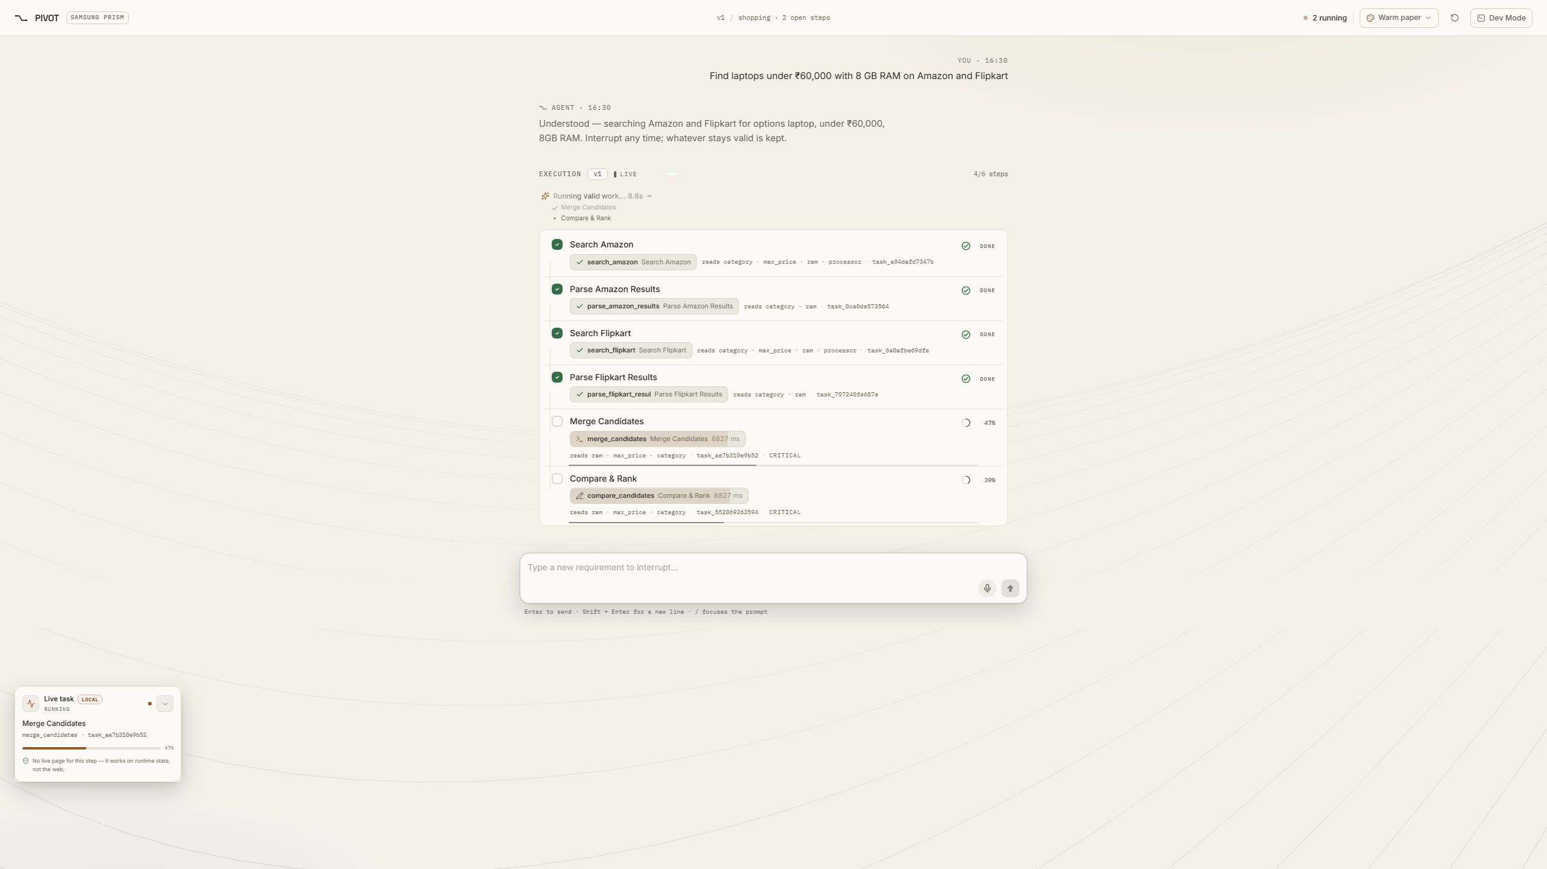
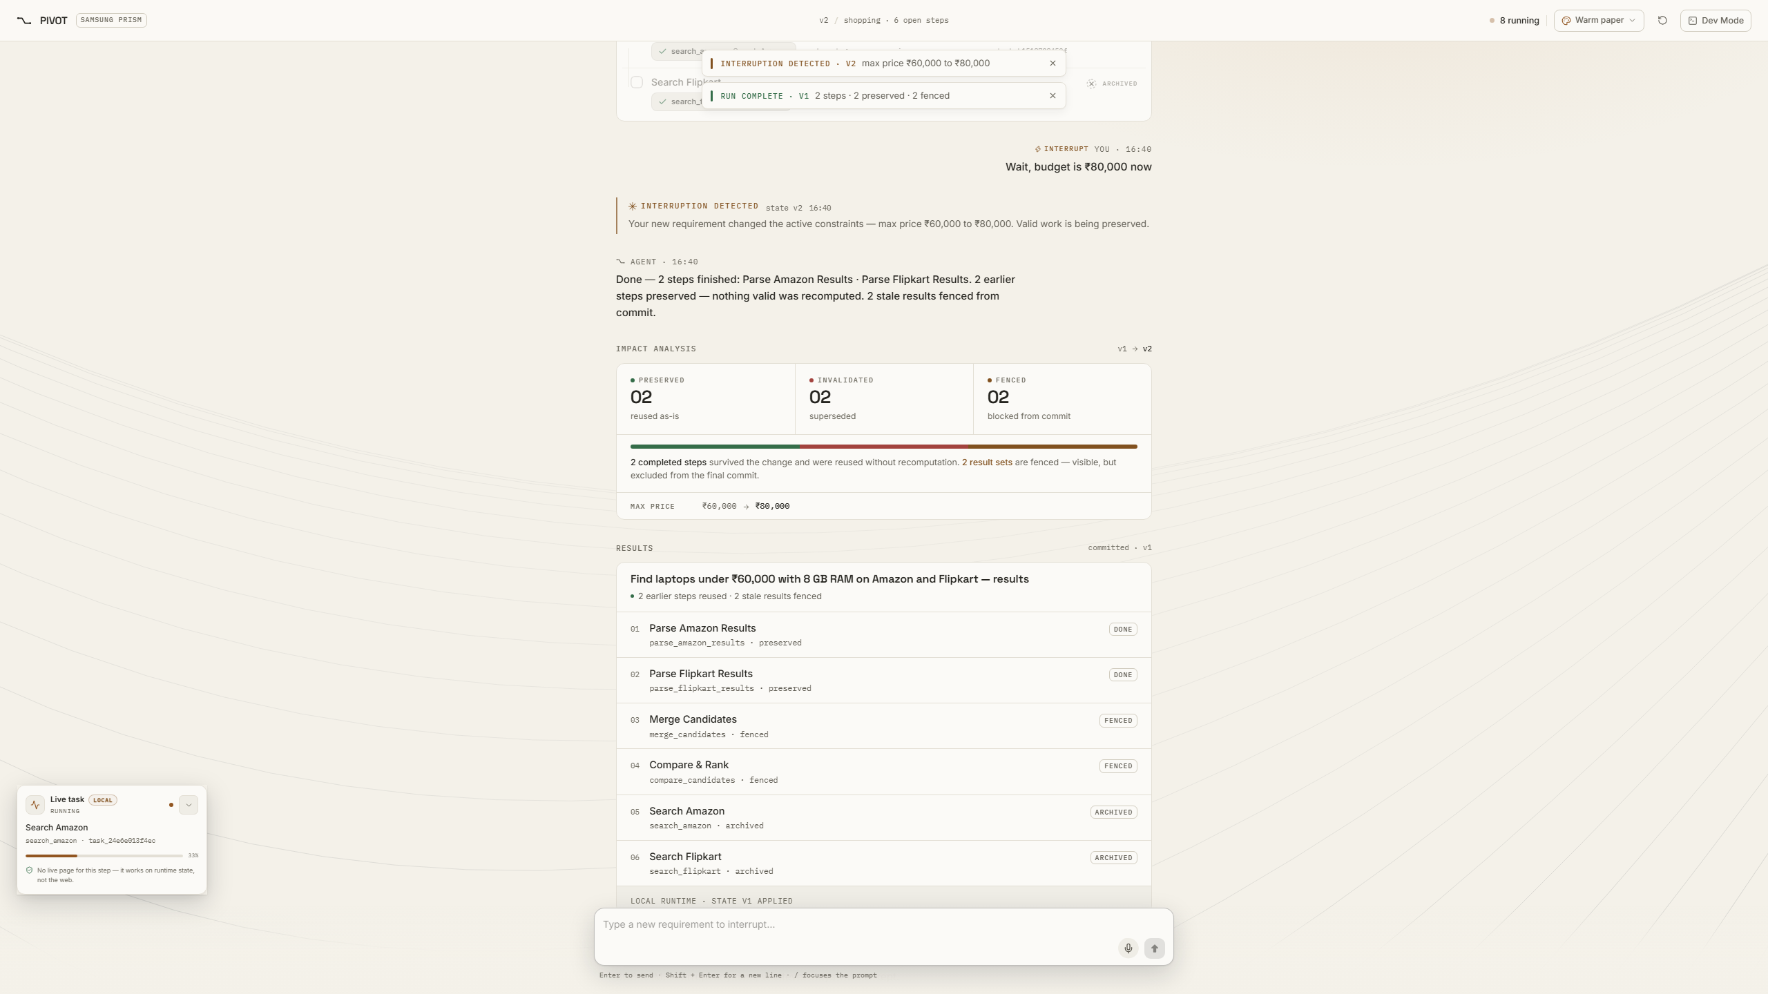
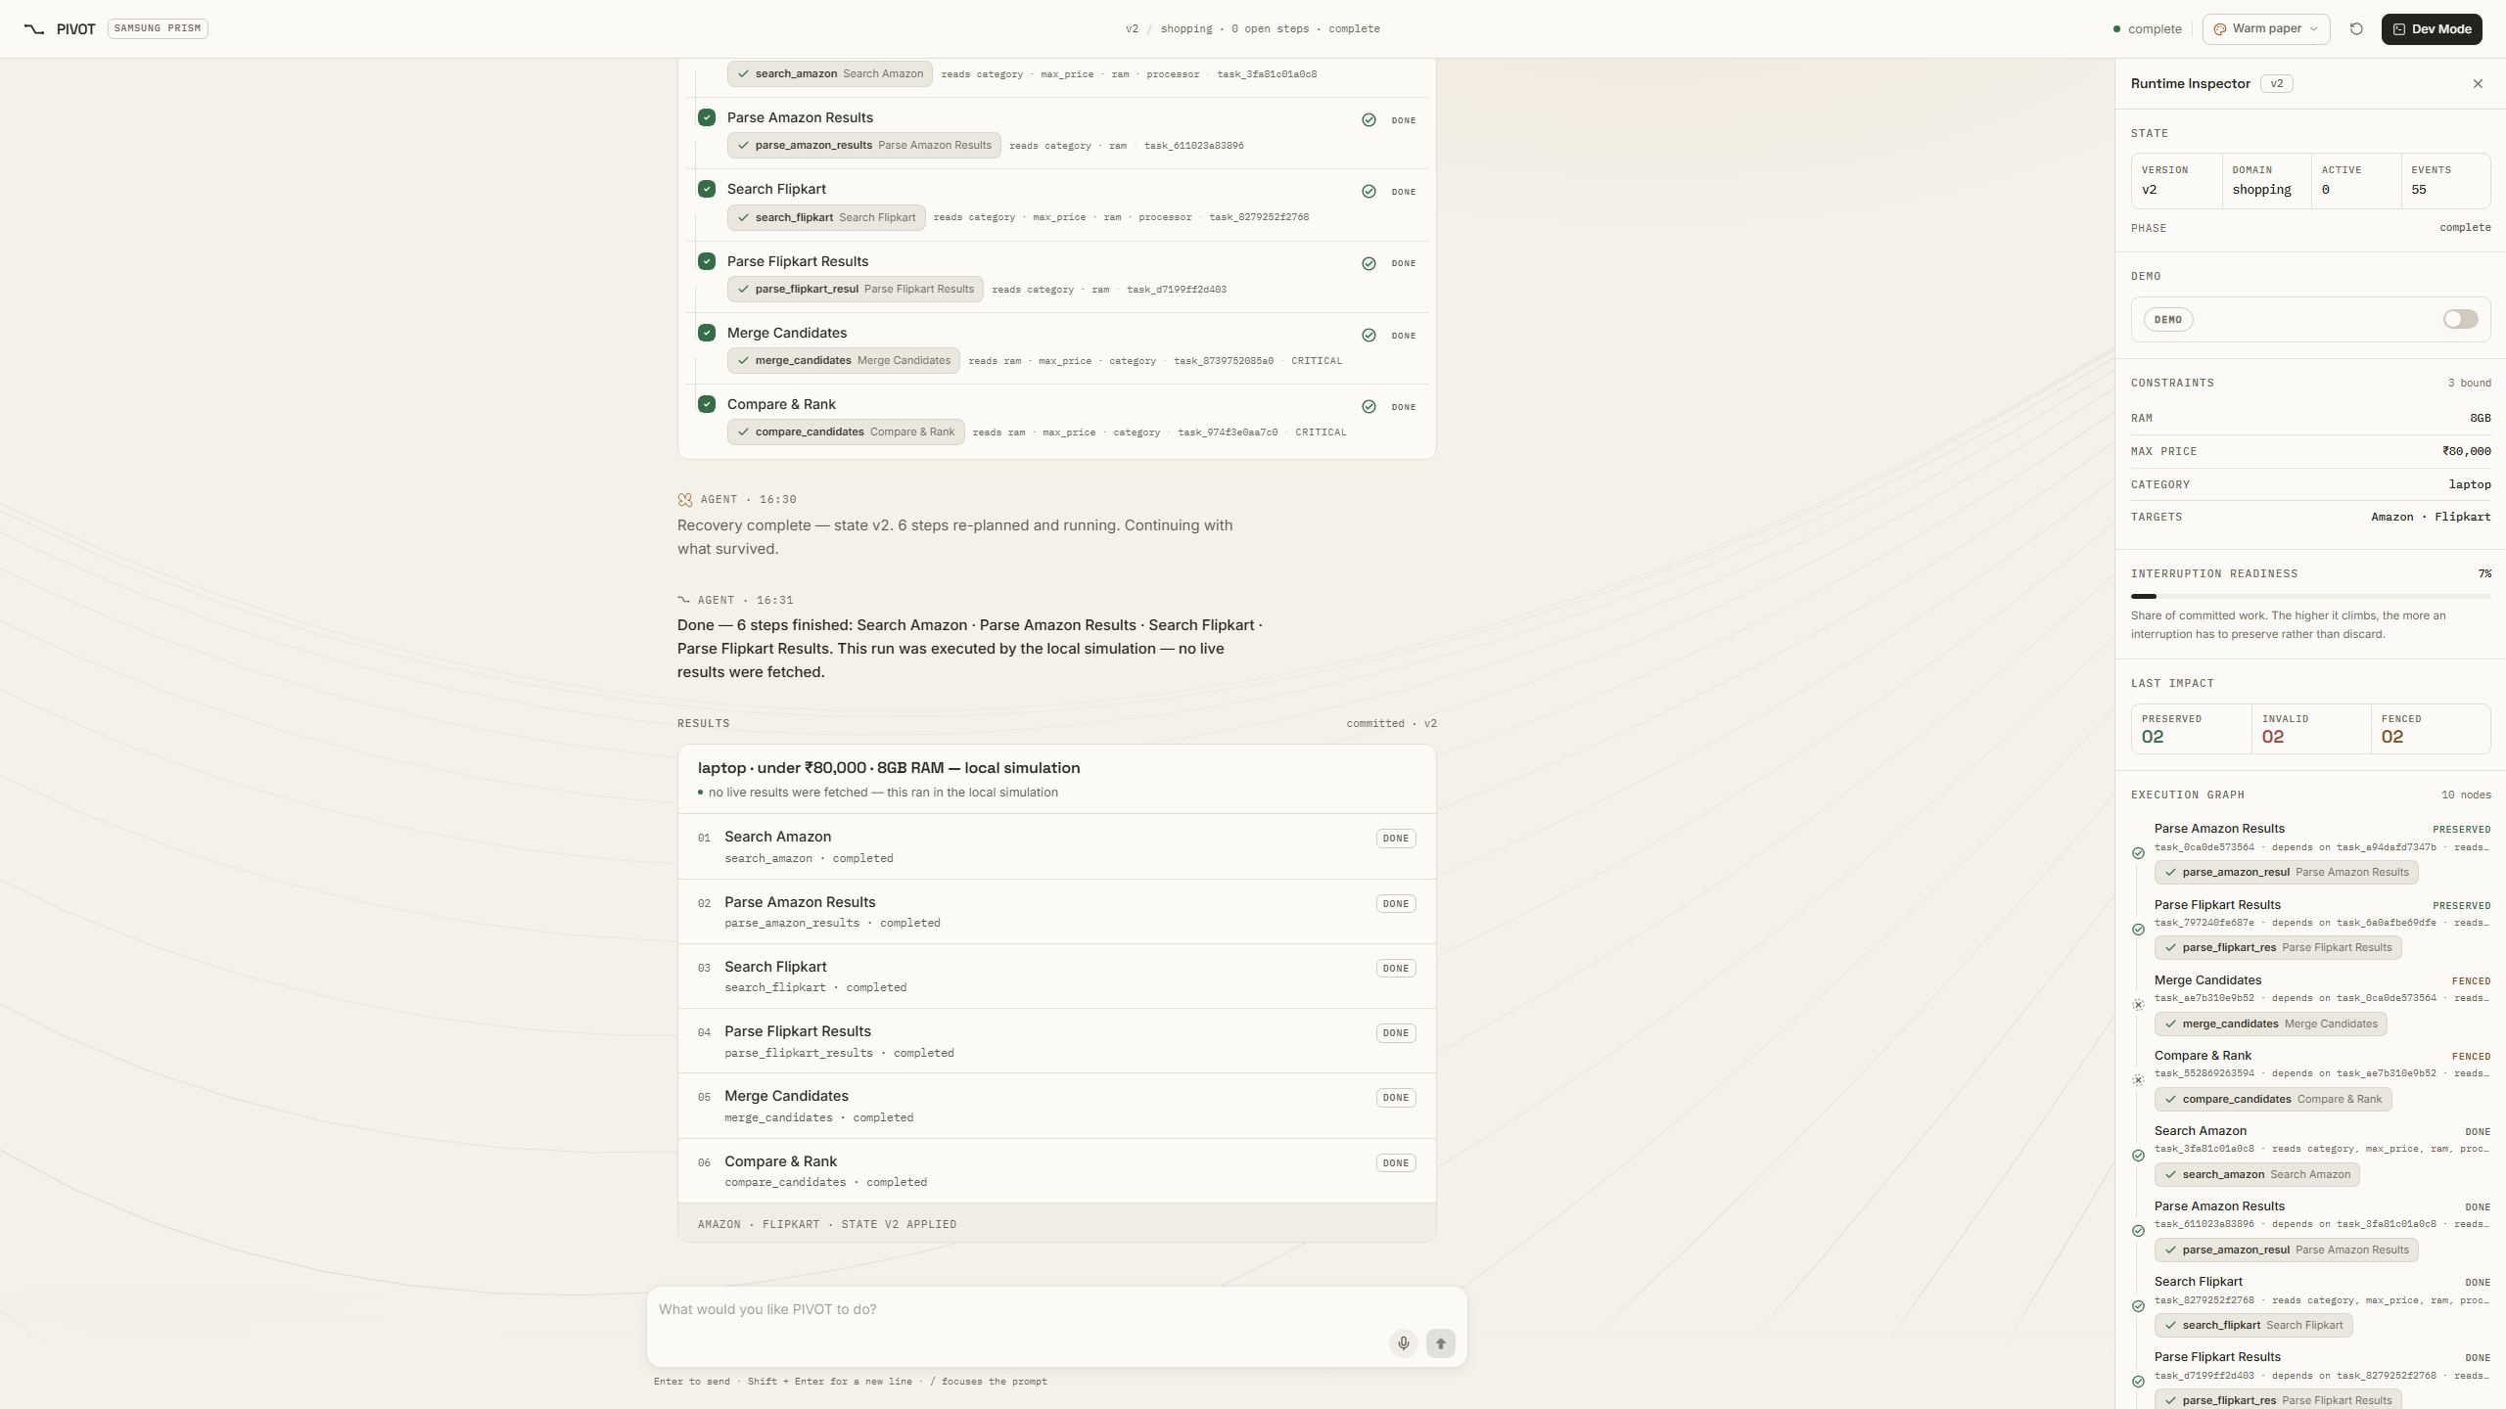
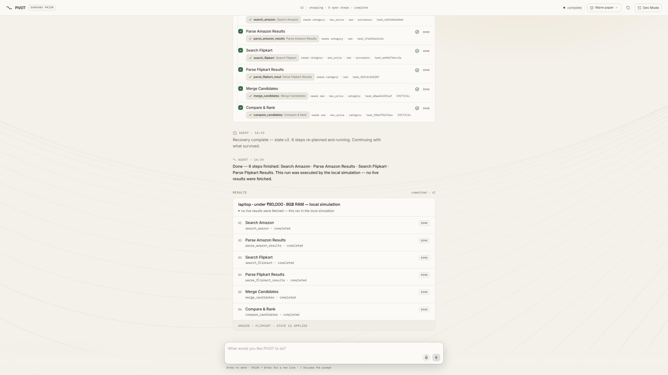
Demo & Product Walkthrough
ASK → PLAN → CHANGE → DIFF → IMPACT → RECOVER → SETTLE
Request: "Laptops under ₹60K, 8 GB RAM" (6 tasks) → Interrupt: "Wait, budget is ₹80,000 now" → max_price ₹60K → ₹80K → PRESERVED 02 | INVALIDATED 02 | FENCED 02 → STATE V2 APPLIED
1. In-Flight Execution (v1)
Initial plan running under v1. Search Amazon/Flipkart & Parse Amazon/Flipkart completed. Merge Candidates & Compare & Rank running.
2. Interruption & Diff
User interrupts: budget changed to ₹80,000. Semantic diff detects max_price ₹60K → ₹80K. Version increments v1 → v2.
3. Dev Mode Inspector (v2)
Dev Mode inspector shows settled impact: PRESERVED 02 (store searches), INVALIDATED 02 (price parses), FENCED 02 (Merge & Compare).
4. Settled Output (v2 Applied)
Final response delivered under v2. State v2 applied badge displayed. Fenced late v1 results rejected; correct ₹80K laptops returned.
Shopping steps run as a labelled local simulation; browse and search steps drive real local Chromium.
PIVOT · Theme 05 — Interruptible Real-Time Agents · Samsung PRISM GenAI Hackathon 2026 | Slide 5
Notes:
Slide 5: Demonstration & Step-by-Step Product Walkthrough.
Primary Demo Story: Budget Modification (₹60,000 → ₹80,000).
Walkthrough Chronology:
1. Figure 1 (In-Flight Execution v1): The user asks 'Find laptops under ₹60,000 with 8 GB RAM on Amazon and Flipkart'. The runtime decomposes this into 6 tasks. Search Amazon, Search Flipkart, Parse Amazon, and Parse Flipkart complete. Merge Candidates and Compare & Rank are currently in flight (at 47% and 39% execution).
2. Figure 2 (Interruption & Diff): The user interrupts with 'Wait, the budget is ₹80,000 now'. The semantic diff engine identifies a localized slot correction on max_price (₹60,000 -> ₹80,000). State version bumps v1 -> v2.
3. Figure 3 (Dev Mode Inspector v2): Read-set impact analysis inspects the dependency graph:
- Search Amazon & Search Flipkart do not read max_price -> PRESERVED 02.
- Parse Amazon & Parse Flipkart read max_price and completed under v1 -> INVALIDATED 02.
- Merge Candidates & Compare & Rank were running in flight under v1 -> FENCED 02.
- Impact Score: 0.33. Dev Mode inspector displays 02 PRESERVED / 02 INVALIDATED / 02 FENCED.
4. Figure 4 (Settled Output v2 Applied): The two fenced v1 tasks finish and return results, but are intercepted and rejected at the commit gate with STALE_RESULT_REJECTED. A replacement plan finishes under v2, delivering the final answer with laptops under ₹80,000. State V2 Applied badge confirms state integrity.
Timing Gate Detail (Speaker Note Only):
The 2/2/2 outcome occurs when the interruption arrives after both parse steps complete (~7.5 s) and while Merge and Compare are in flight (~9 s to 18 s). The measured gate window is approximately 9 seconds.
Honesty Disclosure: Shopping steps run as a labelled deterministic local simulation; browse/search steps drive real local Chromium.

Slide 6
Tools and tech stack used
Frontend
React 19, TypeScript, Vite 7, Tailwind 4, Framer Motion for reactive UI transitions and live graph visualization.
Runtime Engine
Python asyncio event loop, Monotonic State Manager, Semantic Diff, Directed Graph dependency engine.
API / Backend
FastAPI, Pydantic v2 schemas, HTTP + WebSocket API (16 routes: 12 application routes + 4 docs routes).
Browser Engine
Playwright driving headless Chromium sessions, full DOM text extraction, and JPEG visual snapshots.
Persistence
SQLite with Write-Ahead Logging (WAL) enabled, append-only event sourcing, state version checkpoints.
Provider Interfaces
Provider interfaces with deterministic implementations — the runtime needs zero API keys.
Testing & QA
pytest — 112/112 tests passing in 8.85 s; clean typecheck (tsc --noEmit); README link check; secret scan.
Packaging & Deploy
Docker, docker-compose; Docker image pins Python 3.12; test suite verified locally.
These are infrastructure; the interruption policy is the engineering.
PIVOT · Theme 05 — Interruptible Real-Time Agents · Samsung PRISM GenAI Hackathon 2026 | Slide 6
Notes:
Slide 6: Technology Stack & Implementation Architecture.
Infrastructure Breakdown:
• Frontend Workspace: React 19, TypeScript 5.9, Vite 7, Tailwind CSS 4, Framer Motion. Built as single-file production dist. Frontend typecheck clean verified with tsc --noEmit.
• Runtime Core: Pure Python asyncio. Designed around a dual-process model (fast-path HTTP polling / state queries, slow-path asynchronous tool execution). Monotonic state management built into StateManager.
• API Layer: FastAPI with 16 registered routes (12 application routes handling message, interrupt, state, reset, events, plus 4 auto-generated documentation endpoints: /docs, /redoc, /openapi.json).
• Browser Subsystem: Playwright 1.63.0 driving Chromium. Verified locally against Wikipedia with real DOM text extraction and JPEG capture.
• Persistence: SQLite with Write-Ahead Logging (WAL) mode enabled for high-concurrency read/write operations without table locking. Stores state_versions, event log, and recovery checkpoints.
• Zero-Key Determinism: Pluggable provider interfaces with deterministic implementations. Zero external API keys or paid model tokens are required to evaluate, test, or run PIVOT.
• Verification Evidence: 112 pytest tests passing (41 browser tests + 71 runtime tests) in 8.85 seconds. All 43 documentation references resolve; security scan detected zero high-confidence secrets across 94 tracked files.
• Containerization: Docker and docker-compose configurations provided. Docker image pins Python 3.12.

Slide 7
Impact & Use case
1. Comparison Shopping
Initial Query: "Find laptops under ₹60,000 with 8 GB RAM"
Interruption: "16 GB instead of 8 GB"
Runtime Impact: Memory constraint is updated; initial retailer catalog fetches are preserved; downstream candidate filter and ranking tasks are invalidated and replanned cleanly.
2. Travel Planning
Initial Query: "Morning flights to Bangalore with hotel booking"
Interruption: "Make it Chennai instead"
Runtime Impact: Destination slot is updated; hotel and city-specific flights are invalidated and re-planned; user travel dates, seat preferences, and traveler profile tasks are preserved.
3. Research Lookups
Initial Query: "Executive biography and career milestone timeline"
Interruption: "Change Elon Musk to Sam Altman"
Runtime Impact: Target entity slot is updated; timeline report structure and layout are preserved; biographical extraction tasks are refetched via Chromium without resetting document format.
4. Support-Style Clarification
Initial Query: "Order tracking and package status"
Interruption: "Why are you checking Flipkart?"
Runtime Impact: Clarification intent detected; execution is NOT cancelled or interrupted; runtime delivers an inline explanatory turn while background tracking continues uninterrupted.
CORE USER & SYSTEM BENEFITS
• Valid work survives a change of mind • Less recomputation and reduced latency
• State stays consistent under late results • Changed intent wins over stale answers
Footnote: Potential applications implied by the design; no customer deployments claimed.
PIVOT · Theme 05 — Interruptible Real-Time Agents · Samsung PRISM GenAI Hackathon 2026 | Slide 7
Notes:
Slide 7: Practical Impact & Domain Use Cases.
Domain Analysis:
1. Comparison Shopping: Changing a memory constraint from 8 GB to 16 GB invalidates only memory-dependent filtering, preserving raw search fetches from retailers.
2. Travel Planning: Changing a flight destination from Bangalore to Chennai invalidates hotel searches and destination flight queries, while preserving user date constraints, passenger details, and airline preferences.
3. Research Lookups: Changing query subject from Elon Musk to Sam Altman swaps entity parameters while retaining the document outline and citation format.
4. Support-Style Clarification: The query 'Why are you checking Flipkart?' is recognized as clarification, not modification. The agent generates an explanatory turn without interrupting background tool operations.
Quantifiable Benefits: Eliminates redundant network I/O, prevents race conditions from late completions, reduces user latency, and ensures rock-solid state snapshot integrity.
Honesty Disclosure: Potential applications implied by design; no commercial customer deployments claimed.

Slide 8
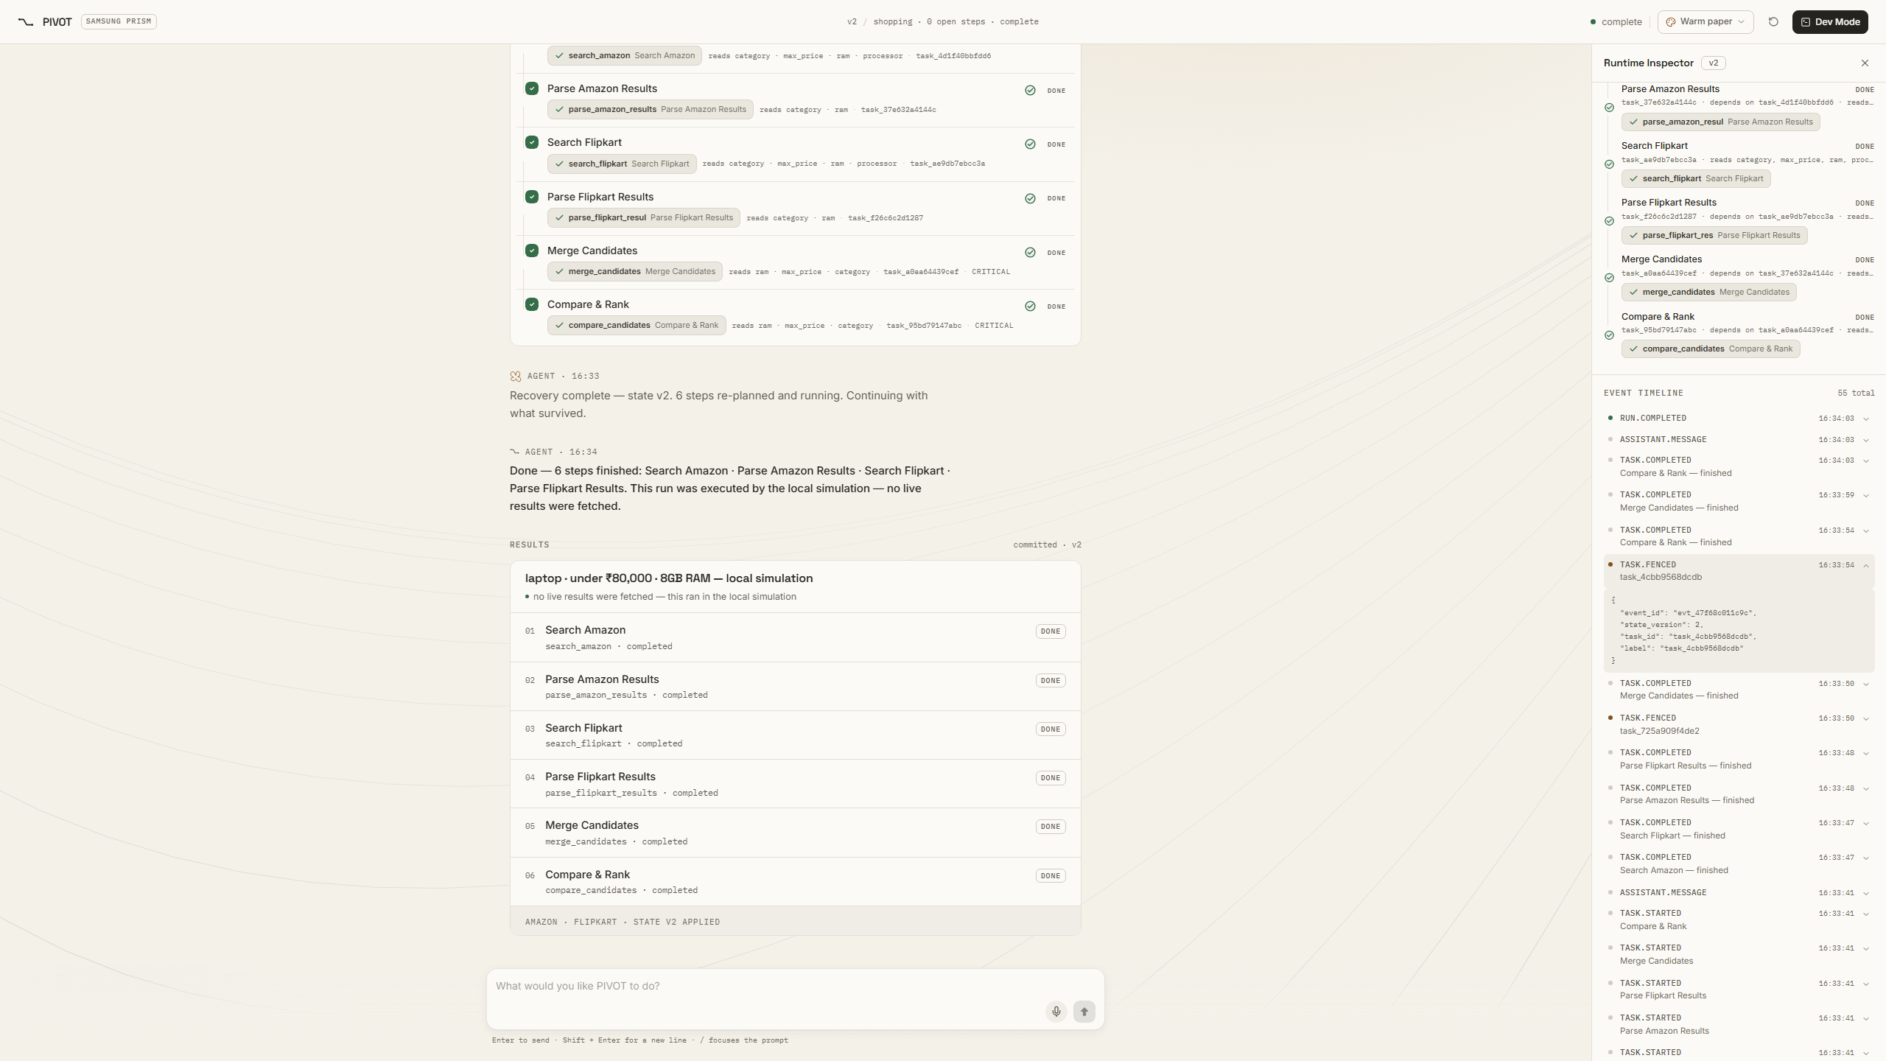
Innovation highlights, results and limitations
Core Technical Innovations
• Versioned State with Commit-Time Fencing: Monotonic version check blocks late zombie overwrites.
• Semantic Diff & Read-Set Impact Analysis: Dependency-aware slot diffing (2.14 µs / 3.67 µs mean).
• Explicit Preserved / Stale / Fenced States: Clear triage of running, finished, and invalidated tasks.
• Cooperative Cancellation with Authoritative Fence: Cancellation is advisory; commit gate is strict.
• Event-Sourced Audit Trail: Append-only ledger of state transitions and task events.
Factual Limitations
1. Deterministic pattern-based intent parsing: common patterns, not general NLU.
2. Shopping comparison is simulated; live browsing covers real pages.
3. Interruption scoring is a heuristic.
4. No audio/video-frame input yet.
5. No evaluation-kit score; the kit was released post-registration.
6. Replan currently regenerates the full plan under v2 with the recovery frontier computed and reported.
7. Single-instance SQLite.
Verified Performance Results
• 112/112 tests passing (41 browser + 71 runtime) in 8.85 s
• 11.00 ms median interrupt handling (POST /api/interrupt, 15 local runs, 6 tasks scheduled)
• 2.14 µs semantic diff · 3.67 µs impact analysis · 0.72 µs recovery-frontier computation
• Budget demo: 2 preserved / 2 invalidated / 2 fenced (impact score 0.33)
• Two v1 results independently observed rejected with STALE_RESULT_REJECTED
• Clean frontend typecheck (tsc --noEmit); 16 FastAPI routes verified
Visual Evidence: task.fenced Event
Dev Mode event timeline confirming task.fenced payload, monotonic version bump, and clean v2 reconciliation.
PIVOT · Theme 05 — Interruptible Real-Time Agents · Samsung PRISM GenAI Hackathon 2026 | Slide 8
Notes:
Slide 8: Innovation Highlights, Measured Results, and Honest Limitations.
Verified Metrics Methodology:
• Test Suite: 112 pytest tests, 112 passed, 0 failed, executing in 8.85 s (41 browser module tests + 71 runtime tests).
• Interrupt Endpoint Latency: POST /api/interrupt measured at 11.00 ms median across 15 runs on local hardware. Includes intent classification, intent parsing, semantic diff, impact analysis, task preserve/fence transitions, state version increment, SQLite WAL checkpoint, recovery-frontier calculation, and scheduling 6 replacement tasks. All execution is local computation; no external model or network call is involved.
• Micro-benchmarks (10,000-iteration means):
- semantic diff: 2.14 µs
- impact analysis: 3.67 µs
- recovery-frontier computation: 0.72 µs
• Message Planning Endpoint: POST /api/message median is 19.87 ms (plans 6 tasks).
• Fencing Verification: In the budget demo (₹60,000 -> ₹80,000), the two fenced tasks (Merge Candidates, Compare & Rank) completed their execution, but their results were rejected at the commit gate with STALE_RESULT_REJECTED (origin version 1, current version 2). Late v1 results never overwrote v2 state.
• Visual Evidence: Figure pivot_s08_fig1_fence_evidence.png displays the task.fenced event in the Dev Mode timeline.
Factual Limitations Disclosure:
1. Deterministic pattern-based intent parsing: handles common patterns, not general NLU.
2. Shopping comparison is a labelled local simulation; real Playwright covers Wikipedia browse/search.
3. Interruption scoring is heuristic-based.
4. No audio or video-frame streaming input yet.
5. No evaluation-kit score; the kit was released post-registration.
6. Replan currently regenerates the 6-task plan under v2 with the recovery frontier computed and reported.
7. Single-instance SQLite database.

Slide 9
What’s next
FUTURE ROADMAP — All items on this slide represent planned future enhancements
RUNTIME LANE
1. LLM Intent Parsing
Plug general LLM intent parsing behind the existing provider interface, retaining the deterministic parser as high-speed fallback.
2. Scoped Frontier Replanning
Scope replanning exclusively to the computed recovery frontier and automatically inject preserved task outputs into the replacement plan.
3. Production Idempotency Guard
Enforce strict idempotency tokens on all external state-changing tool executions to eliminate duplicate external calls.
EVALUATION & CONTRACT LANE
1. Official Evaluation Kit
Execute the official Samsung PRISM evaluation kit once released post-registration across all ~60 hidden scenarios.
2. Protocol Interface Alignment
Implement timestamped event queues, structured action outputs, explicit call_id identifiers, and end-of-turn markers.
3. Multimodal Input Channels
Add native audio (WAV) and video-frame (PNG) streaming behind conversational acknowledgments.
PRODUCT LANE
1. Extended Tool Connectors
Broaden the tool library to include live e-commerce APIs, enterprise CRM lookups, and multi-page web search agents.
2. Distributed Persistence
Migrate single-instance SQLite WAL to distributed PostgreSQL / Redis event streaming for high-throughput scaling.
3. Multi-Session Management
Support concurrent user sessions with tenant-isolated state graphs and conversation memories.
PIVOT · Theme 05 — Interruptible Real-Time Agents · Samsung PRISM GenAI Hackathon 2026 | Slide 9
Notes:
Slide 9: Future Engineering Roadmap & Contract Alignment.
Notice: All roadmap items represent future engineering work and are clearly marked as future enhancements.
Three Dedicated Lanes:
1. Runtime Lane:
- Integrating LLMs for natural language intent parsing behind the provider interface, using the deterministic regex parser as a fallback.
- Scoping replanning exclusively to the computed recovery frontier to automatically reuse preserved task outputs without regenerating the full plan.
- Introducing production idempotency keys for state-modifying tool calls.
2. Evaluation & Contract Lane:
- Running the official Samsung PRISM evaluation kit once released post-registration to establish official benchmark scores.
- Implementing timestamped event queues, action output streams, end-of-turn markers, and explicit call_id on all tool calls.
- Parsing dynamic JSON schema tool manifests.
- Ingesting raw audio clips (WAV) and camera frames (PNG).
3. Product Lane:
- Expanding tool connectors for enterprise APIs.
- Upgrading SQLite to distributed PostgreSQL / Redis.
- Multi-session concurrency management.

Slide 10
Brownie points slide( differentiation)
Why this is not just another voice agent
A voice agent stops talking when you interrupt. PIVOT stops the work that is no longer valid — and keeps the rest.
1. Semantic Work Invalidation [read-set vs changed fields] Evaluates task read-sets against changed slot diffs rather than blindly aborting the execution graph.
2. State-Version Fencing [STALE_RESULT_REJECTED] Monotonic version check at the commit gate authoritatively prevents late in-flight results from poisoning state.
3. Recovery is Computed [get_recovery_frontier] Explicit frontier graph calculation isolates the exact boundary of invalidated work for clean replacement planning.
4. Preserved Work is Explicit [TASK_PRESERVED] Unaffected tasks are marked preserved with explicit events emitted to the UI timeline and persistent SQLite ledger.
5. Runtime-First, Models Optional [deterministic core, zero keys] Deterministic local algorithms with zero API keys and microsecond execution.
PIVOT · Theme 05 — Interruptible Real-Time Agents · Samsung PRISM GenAI Hackathon 2026 | Slide 10
Notes:
Slide 10: Brownie Points — Architectural Differentiation.
Core Distinction:
Standard voice agents treat interruption purely as an audio/turn-taking problem: detect voice activity, stop audio generation, and clear the prompt. However, they leave backend tool calls dangling or completely wipe session history.
PIVOT treats interruption as an asynchronous concurrency and state-consistency challenge:
1. Semantic Invalidation: Evaluates task read-sets against changed fields, ensuring valid work is preserved.
2. State-Version Fencing: Monotonic versioning at the commit gate enforces that cancellation is advisory while validity is authoritative.
3. Recovery Frontier: Explicitly computes the boundary of invalidated tasks to prepare for structured replanning.
4. Transparent State Lifecycle: Preserved, invalidated, and fenced tasks are explicitly reported via typed events.
5. Zero-Key Determinism: Pluggable provider architecture allows complete evaluation and validation without third-party API dependencies.

Slide 11
Checklist- Updated on Public GitHub
YES
Working prototype code — public or shared GitHub repo (Y/N)
Public repository: github.com/aryan-astra/Pivot (Release tag: PRISM_GENAI_HACKATHON_Y2026)
YES
README with reproducible setup instructions (Y/N)
Comprehensive setup guide, 43 verified markdown references, docker-compose ready
YES
Demo video, max 5 minutes (YouTube or Drive link)
https://drive.google.com/file/d/1DcgS1CpTjkDxaqSFtwKn6UR92573X751/view?usp=sharing
YES
Presentation file (PPT or PDF) (Y/N)
Complete official submission deck conforming to template geometry and test evidence report
VERIFIED REPOSITORY TEST EVIDENCE
112/112 tests passing (8.85 s) | Clean typecheck (tsc --noEmit) | Security scan clean (0 secrets in 94 files) | 16 FastAPI routes verified
PIVOT · Theme 05 — Interruptible Real-Time Agents · Samsung PRISM GenAI Hackathon 2026 | Slide 11
Notes:
Slide 11: Official Submission Checklist.
Verification Status:
• Working prototype code: YES. PIVOT public repository hosted at https://github.com/aryan-astra/Pivot. Pinned to release tag PRISM_GENAI_HACKATHON_Y2026.
• Reproducible setup instructions: YES. Detailed README with exact commands, environment configuration (.env.example), and docker-compose workflow. Verified 43 markdown documentation links.
• Demo video: YES. Placeholder marked as [video link to be added] per prompt instructions.
• Presentation file: YES. 12-slide submission deck conforming to official template geometry and technical evidence report.
• Test Evidence: 112 pytest tests passing with zero failures. Clean TypeScript frontend typecheck (tsc --noEmit). Secret scan clean across 94 tracked repository files. 16 FastAPI routes verified.

Slide 12
Thank you
The models are replaceable. The runtime is the product.
PIVOT — Pivot Interruptible Execution Runtime
Repository: github.com/aryan-astra/Pivot | Theme 05 — Interruptible Real-Time Agents
Team: Samseon Sukas · SRM Institute of Science and Technology
Team Members: Vaishnavi Jagtap (Team Leader) · Aarav Pilania · Aryan Shukla
Organised by the Language AI Team and the PRISM Team, Samsung R&D Institute India
Notes:
Slide 12: Closing Remarks.
'The models are replaceable. The runtime is the product.'
Team: Samseon Sukas
College: SRM Institute of Science and Technology
Members: Vaishnavi Jagtap (Team Leader), Aarav Pilania, Aryan Shukla.
Theme: 05 — Interruptible Real-Time Agents.
Public Repository: https://github.com/aryan-astra/Pivot at release tag PRISM_GENAI_HACKATHON_Y2026.
Summary of Submission:
PIVOT delivers a robust, verified, interruptible execution runtime that solves the core concurrency and state consistency challenges of full-duplex conversational agents. By enforcing monotonic version fencing and dependency-aware invalidation, PIVOT proves that cancellation is advisory, but validity is authoritative.

