Slide 1
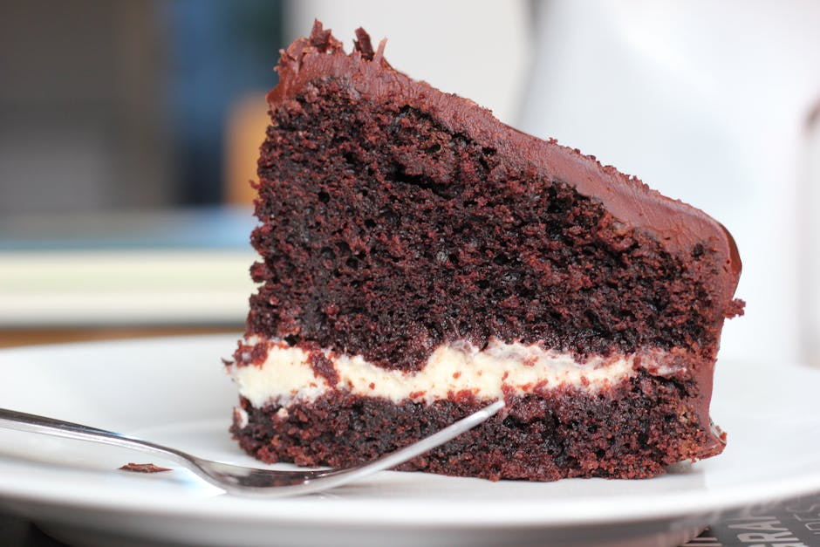
Introduction: The Perfect Chocolate Cake
Discover the secrets to a moist and flavorful chocolate cake.
Step-by-step guide from ingredients to final masterpiece.
Impress your family and friends with your baking skills!

Slide 2
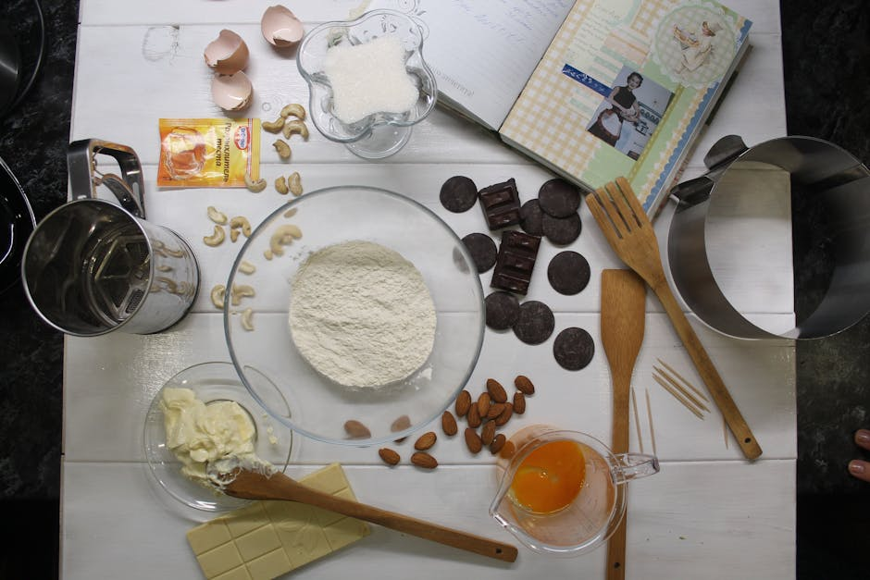
Essential Ingredients
All-purpose flour, unsweetened cocoa powder, sugar
Baking soda, baking powder, salt
Eggs, milk, vegetable oil (or melted butter), vanilla extract
Hot water or hot coffee (enhances chocolate flavor)

Slide 3
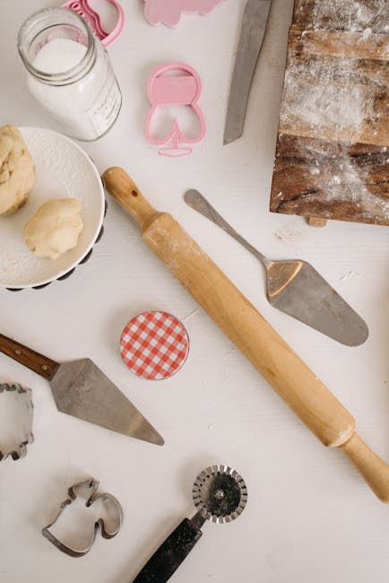
Key Equipment
Mixing bowls (large and medium)
Whisk, spatula, measuring cups and spoons
Electric mixer (optional, but helpful)
Round cake pans (8 or 9-inch), parchment paper
Oven, cooling rack

Slide 4
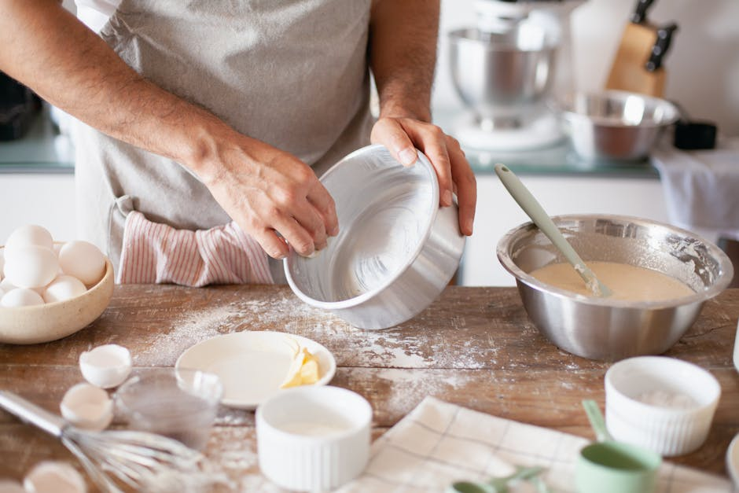
Preparation is Key
Preheat your oven to 350°F (175°C).
Grease and flour your cake pans, or line with parchment paper.
Ensure all ingredients are at room temperature for best results.

Slide 5
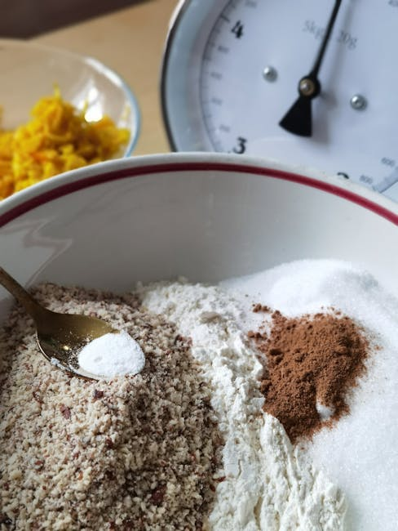
Mixing Dry Ingredients
In a large bowl, whisk together flour, sugar, cocoa powder, baking soda, baking powder, and salt.
Make sure there are no lumps and ingredients are well combined.

Slide 6
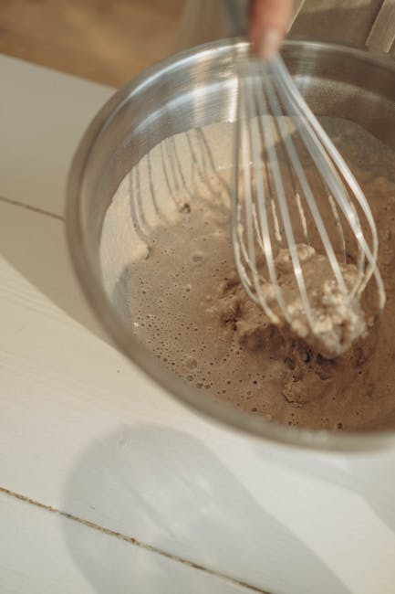
Combining Wet Ingredients
In a separate bowl, whisk together eggs, milk, oil/melted butter, and vanilla extract.
Pour the wet mixture into the dry ingredients.

Slide 7
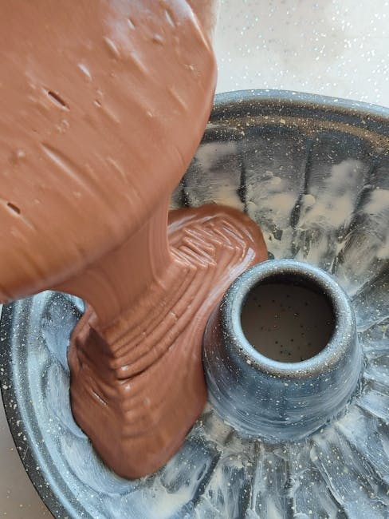
The Batter & Baking
Gently mix until just combined – do not overmix!
Stir in the hot water or coffee last; batter will be thin.
Pour evenly into prepared cake pans.
Bake for 30-35 minutes, or until a toothpick inserted comes out clean.

Slide 8
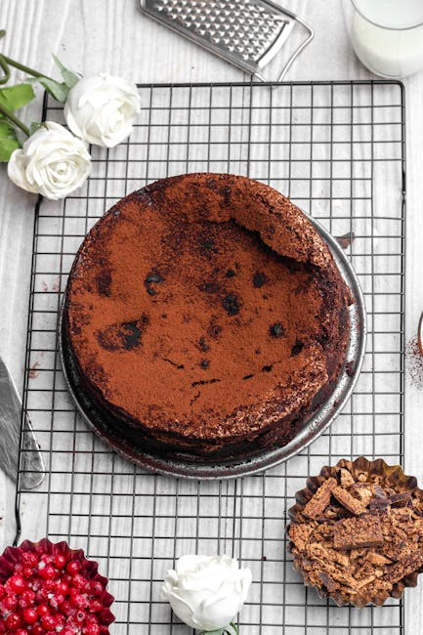
Cooling & Frosting
Let cakes cool in pans for 10-15 minutes, then invert onto a wire rack to cool completely.
Prepare your favorite chocolate frosting or buttercream.
Once cakes are completely cool, frost and decorate as desired.

Slide 9
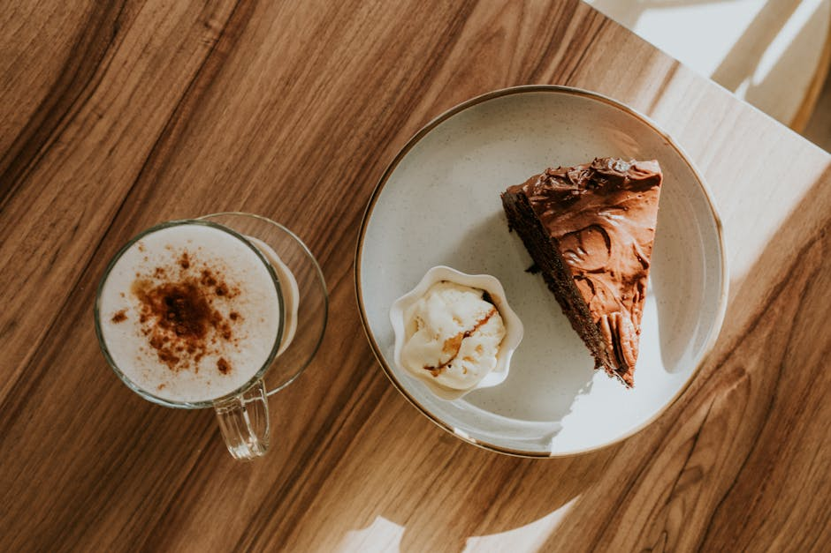
Serving Your Delicious Creation
Slice and serve your homemade chocolate cake.
Pair with a scoop of vanilla ice cream or fresh berries for an extra treat.
Enjoy the fruits of your labor!

Slide 10
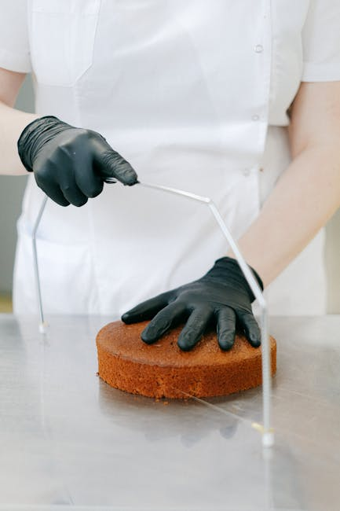
Tips for Success
Measure ingredients accurately, especially flour and cocoa.
Do not overmix the batter – this can lead to a tough cake.
Use good quality cocoa for the best chocolate flavor.
Patience is key during the cooling process; don't rush it!

