Slide 1
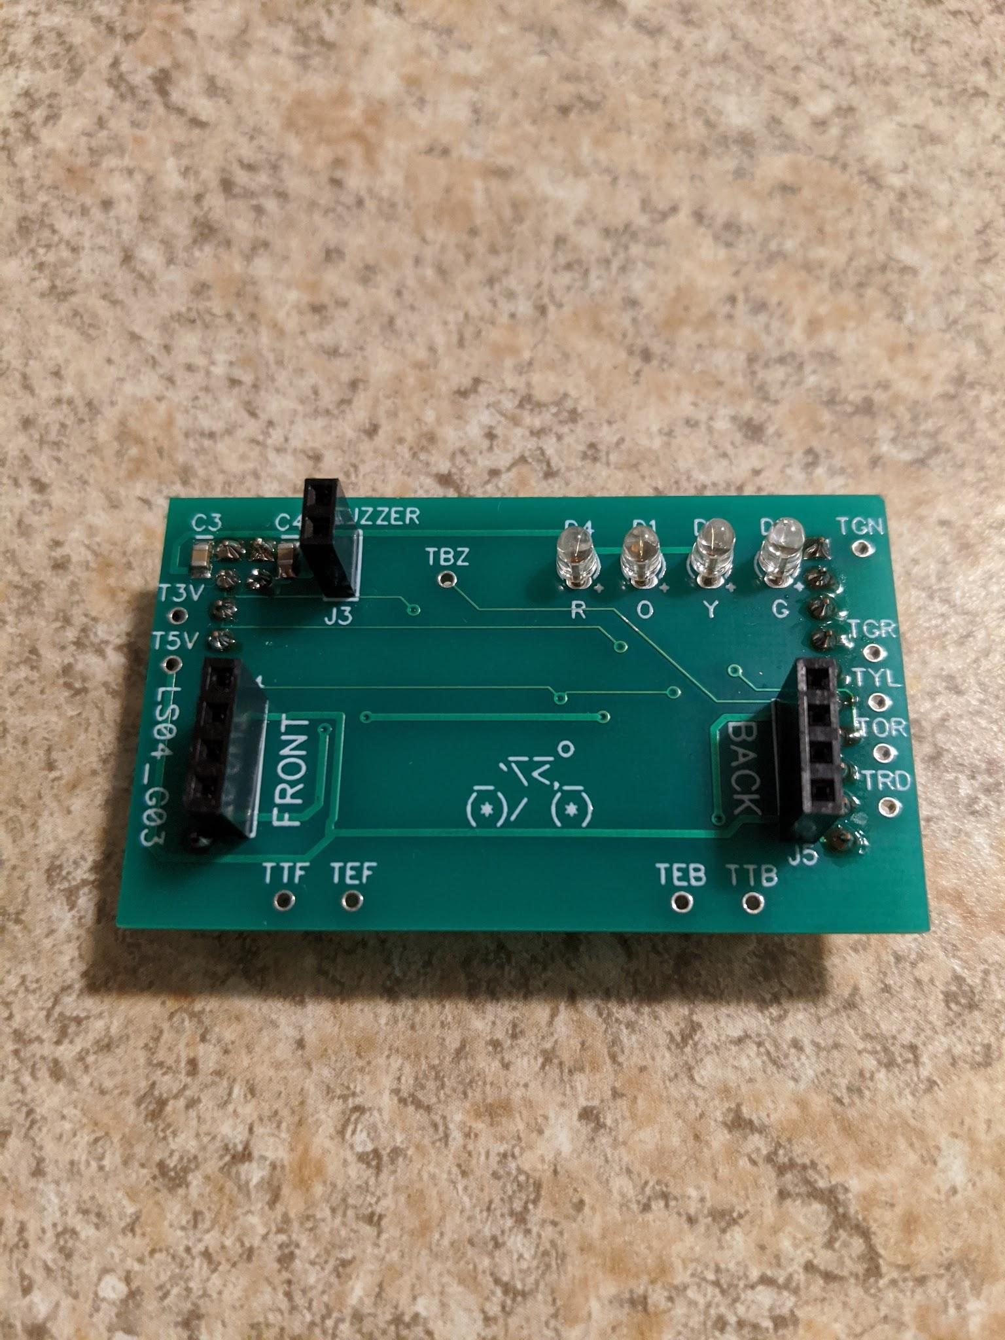
Bicycle Hazard Detector
https://docs.google.com/presentation/d/12mOB0h7efJ7zUC08j8yv7rgC93sBjMT1T7Izqy3oXpQ/edit?usp=sharing
Aryan Goyal & Andy Joshi
LS04, G03

Slide 2
Design Outline
Goal: create a device to monitor and warn cyclists of surrounding hazards
Basic requirements:
Two modes - setup mode and user mode
Use buzzer to warn pedestrians if the cyclist is within a specific distance threshold
Use different colored LEDs to warn cyclist if hazards behind are within a specific distance threshold
Use software to control the sensor measurement timing, sensor reading stability, user input, and actuators/indicators

Slide 3
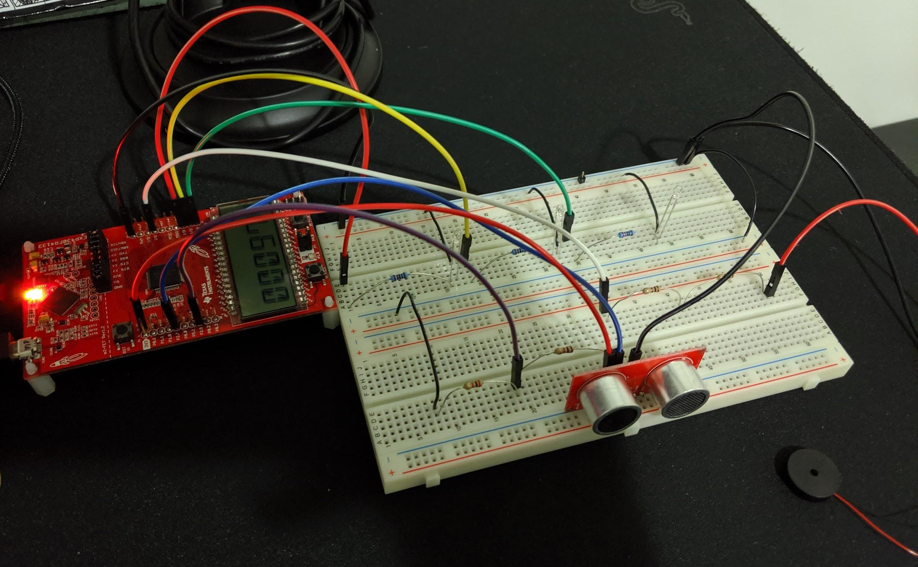
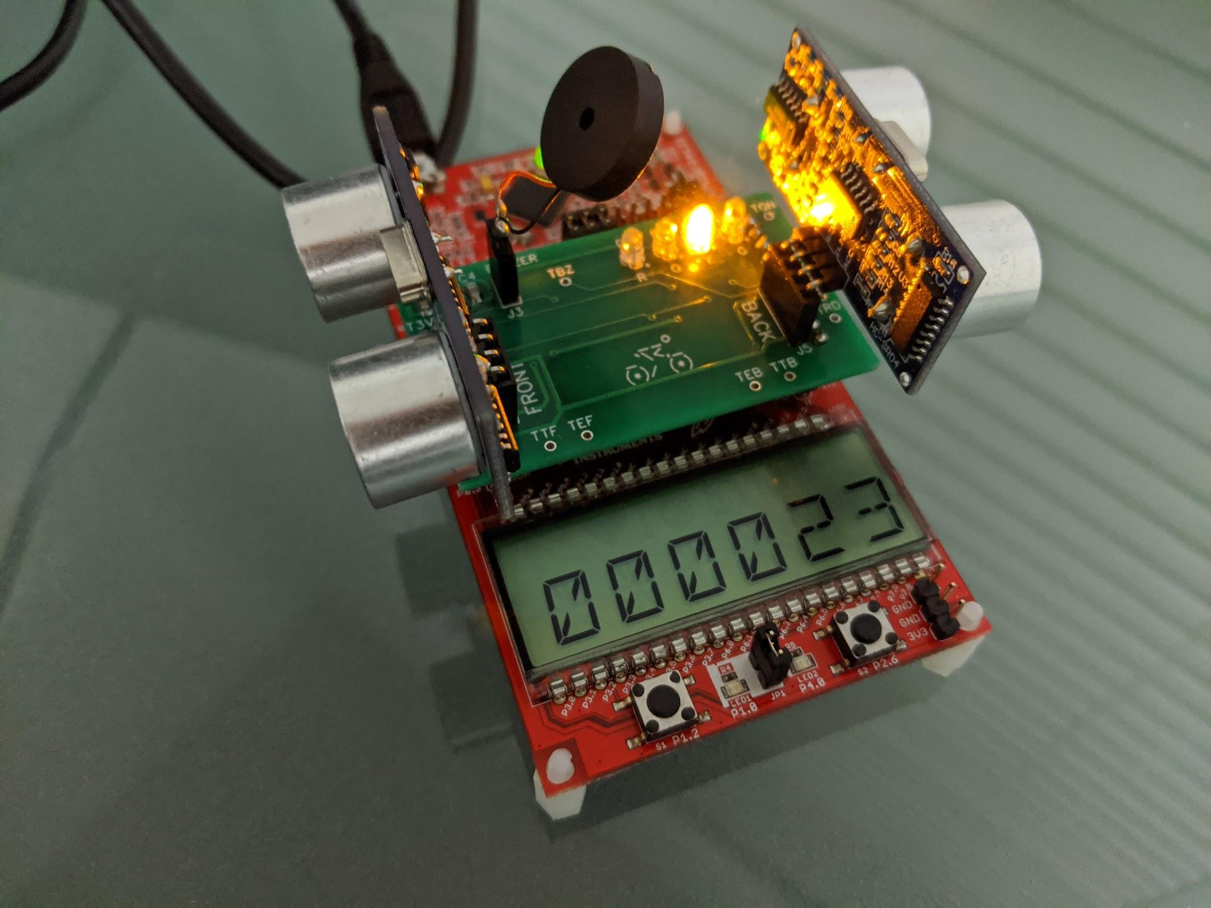
Stages
Feasibility Model
Prototype
Production Model

Slide 4
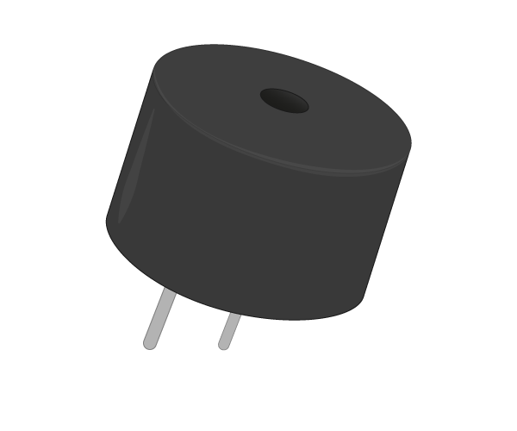
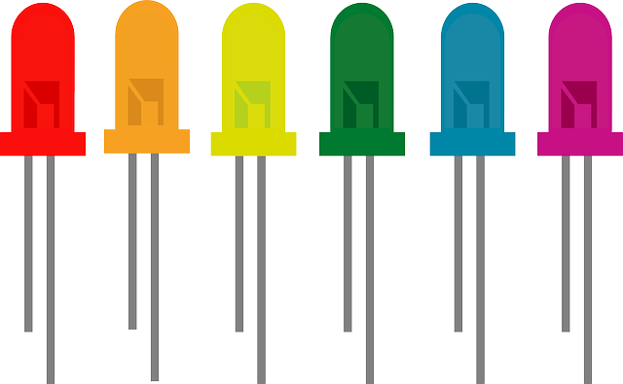
Feasibility Model
Goal: test each component of the model and demonstrate its function
Read push button presses to turn on-board LEDs on and off
Used periodic polling for reading button presses
Used a single ultrasonic sensor to measure the distance of objects
Displayed the measurement on the LCD display
Used a buzzer to beep at high and low tones depending on the ultrasonic reading
Wired three LEDs that lit up at different ultrasonic reading thresholds
https://www.raspberrypi.org/learning/images/components/piezo-buzzer.png
https://pixabay.com/vectors/led-light-bulbs-colorful-rainbow-306562/

Slide 5
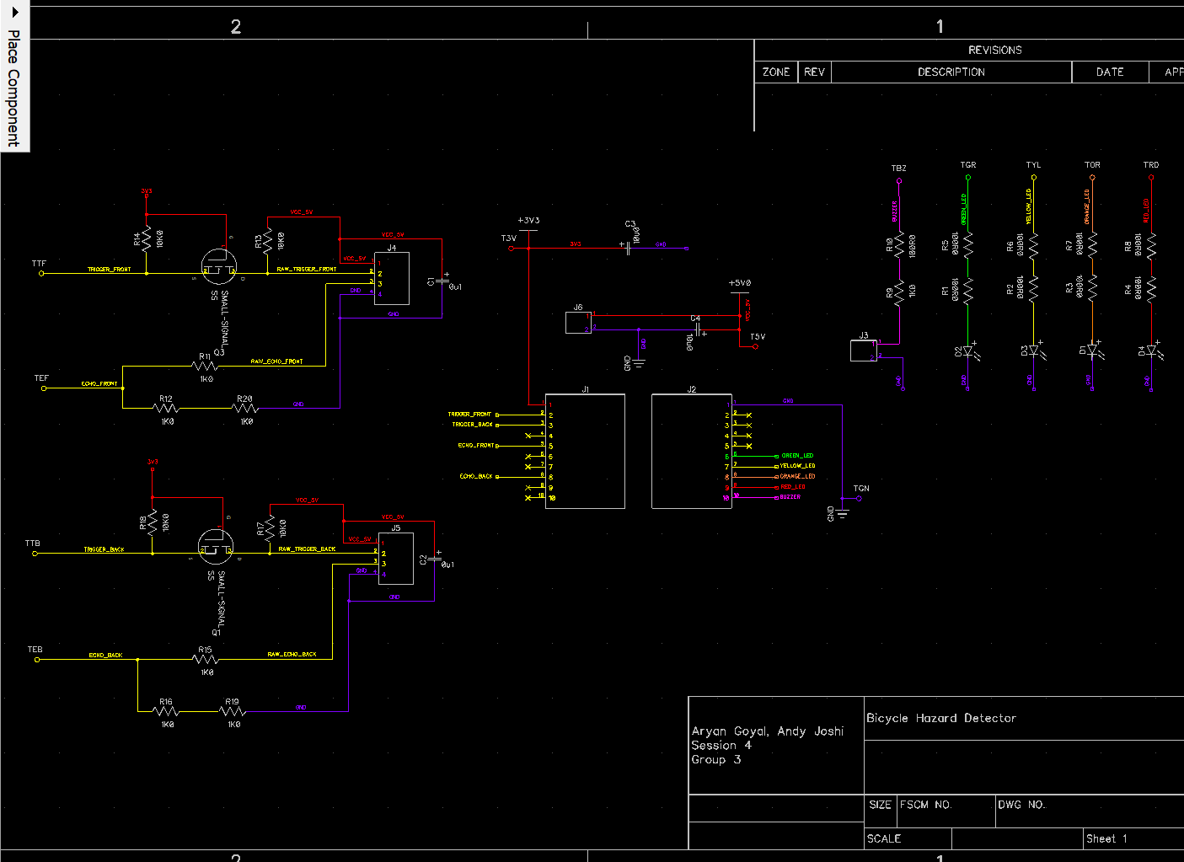
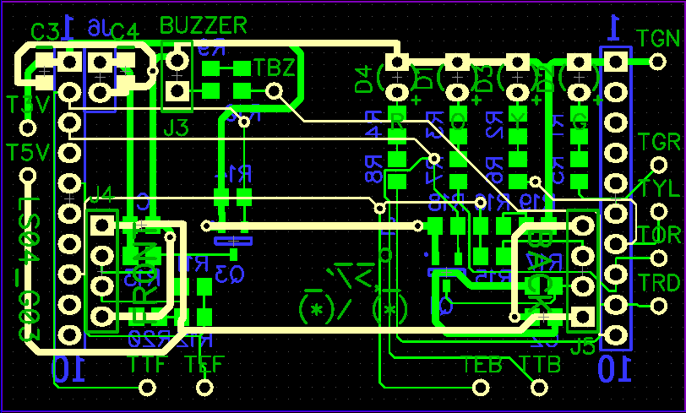
Prototype
Goal: build and demo a model that meets all functional requirements
Read push button presses to enable setup mode and user mode
Kept periodic polling for reading button presses
Used a front ultrasonic sensor and a back ultrasonic sensor to measure proximity of nearby hazards
Displayed the reading of the back sensor on the LCD display
Attached buzzer to beep at high and low tones depending on the front ultrasonic reading
Soldered four LEDs that lit up at different back ultrasonic reading thresholds

Slide 6

Hurdles
https://image.flaticon.com/icons/png/512/1039/1039393.png
Embedded programming and using driverlib API took time to understand
Learning new software for designing the schematic and PCB introduced a learning curve
Generating a schematic without any connection errors was tricky due to a component library problem
Finding space to work in the lab around the time of major deadlines
Required rushing early to secure a spot
Access to professional help and advice was tough to secure
Spent hours debugging an issue with the front ultrasonic sensor

Slide 7
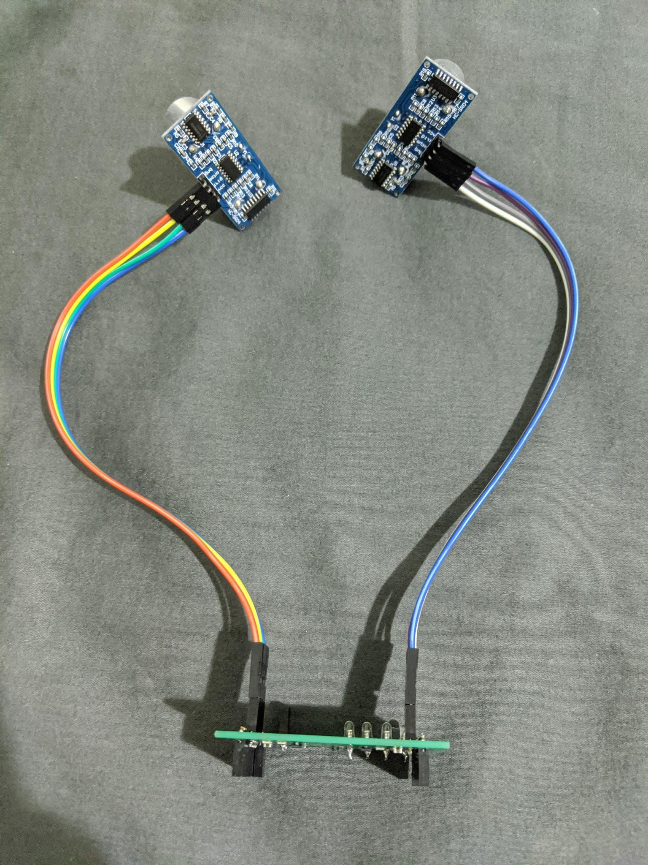
The Consumer Product Version
Auto-routing was used originally but manual routing would be superior (especially for the power net)
Use a pin other than RXD for sending a trigger pulse to the front ultrasonic sensor
Add hysteresis for sensor value thresholds to reduce the flickering of LEDs
Secure the buzzer to the board using an adhesive to prevent it from dangling loosely
Run wires from the ultrasonic connectors and position them away from the board (for real-world use)
Use interrupts for push-buttons and a timer for the ultrasonic sensors

Slide 8

Insights
https://cdn.pixabay.com/photo/2016/05/05/17/42/magnifying-glass-1374389_960_720.png
Difficult to design the hardware completely in-advance before writing any software
Easier to co-develop the software and hardware if possible
Debugging problems that involve both hardware and software can be complex
Isolating the issue is key
Learning curves are inevitable when using new software APIs and design tools
Be patient and ask questions
Issues become increasingly tougher to fix and debug for hardware development
Thoroughly check your design at each stage

Slide 9

Skills Developed
Project delivery management with respect to a specific timeline
Planning hardware ahead of time to address software limitations
Soldering
Through-hole components using the solder wire and an iron
Surface-mount components using the solder paste and the blower
Schematic and PCB design
Embedded software programming in C
Debugging and troubleshooting
Isolating the cause of a problem and using electrical instrumentation
https://maxcdn.icons8.com/Color/PNG/512/Industry/soldering_iron-512.png

Slide 10

Tips for the Next Batch
Go with the simpler solution
Aside from the lab instructor and TA’s, use your peers for support
Work in the lab as much as possible
Avoid peak hours in the lab (a.k.a. before major deadlines)
Submit part orders in advance to avoid long queues for getting important components
Programming a great deal of the final software in the feasibility stage
Saves valuable time during prototype stage
https://www.mygoodclient.com/img/icons/friends_icon_colored.png

