Slide 1
Legacy Cipher Migration Framework for Industrial Control Systems
A protocol-translation gateway from classical ciphers to AES-256-GCM for smart-grid telemetry, and a study of the vulnerabilities of the transition
[Student Name 1] ([Enrolment No. 1]) [Student Name 2] ([Enrolment No. 2]) [Student Name 3] ([Enrolment No. 3])
Guide: [Faculty Name] | [Course Code] - [Course Name] | School of Computer Science Engineering & Technology, [University Name]
Notes:
Presenter: all members introduce themselves. One sentence: we built a gateway that moves legacy grid telemetry from classical ciphers to AES-256-GCM, and we measured what can go wrong during that migration.

Slide 2
Agenda and presenters
01
02
03
04
05
Problem and background
Legacy ciphers and how they fall
AES engine and secure envelope
Gateway, migration and evaluation
Results, demo and conclusion
All members
Member 1
Member 2
Member 3
All members
Notes:
Presenter: Member 1. Walk through the five parts and who presents each. Emphasise that every member owns one technical module end to end.

Slide 3
Grid telemetry still runs on legacy links
SCADA master polls RTUs in substations every few seconds
RTUs report voltage, current, frequency, power and breaker status, and execute breaker commands
Many links still use classical ciphers - or no encryption
Devices cannot all be replaced at once: legacy and modern cryptography coexist for years
15-30 years
service life of field equipment
1.2-19.2 kbaud
typical legacy serial and radio links
~225,000
customers lost power in the 2015 Ukraine grid attack
Notes:
Presenter: Member 1. Explain SCADA, RTUs and telemetry. Legacy links used substitution/transposition scrambling or nothing. Devices live for decades so the migration is gradual: legacy and modern crypto coexist. Ukraine 2015 shows the consequences of attackers controlling breakers.

Slide 4
Problem statement and measurable objectives
Build a protocol-translation gateway that wraps legacy, unencrypted or classically encrypted grid telemetry into AES-encrypted payloads - and identify, demonstrate and quantify the vulnerabilities of the transition, with measured mitigations.
O1
Implement six legacy ciphers correctly
O2
Implement AES-128/192/256 and GCM from first principles
O3
Translate legacy telemetry to AES-GCM without data loss or delay
O4
Break every legacy cipher from captured traffic
100 % of textbook vectors; 0 round-trip failures on 10,000 frames per cipher
100 % of FIPS-197 / GCM vectors; bit-identical to library on 500 cases
0 corrupted readings in all 4 modes; median gateway latency < 1 ms
key recovered from <= 3 frames in < 1 s for each cipher
O5
Secure configuration blocks forged, replayed, tampered and downgraded frames
O6
Identify and quantify transition vulnerabilities with mitigations
O7
Keep the secure envelope within legacy-link budgets
0 % acceptance in every STRICT / PINNED / GCM scenario
>= 8 vulnerabilities, each with a measured mitigation
overhead <= 64 B/frame; 8-device scan at 9600 baud < 2 s cycle
Notes:
Presenter: Member 2. Read the problem statement. Then point out that every objective has a numeric target; slide 21 shows each one was met.

Slide 5
Existing approaches and the research gap
Approach | Works with legacy RTU? | Integrity | Limitation
Classical cipher (status quo) | n/a | none | broken from 1-2 frames
DNP3 Secure Authentication | no - firmware upgrade | HMAC | no confidentiality
IEC 62351 / Modbus-TCP Security | no - needs TLS stack | TLS | not for serial devices
AGA-12 / IEEE 1711.2, YASIR | yes - inline modules | yes | transition risks not quantified
LCMF (this project) | yes - translation gateway | AES-256-GCM + policy | last mile until RTU upgrade (TV1)
Gap: the risks of the migration itself - last mile, downgrade, replay laundering, AES misuse, nonce reuse, key provenance - are rarely measured.
Notes:
Presenter: Member 3. Secure protocols (DNP3-SA, IEC 62351, Modbus/TCP Security) need new device firmware. Bump-in-the-wire retrofits (AGA-12 / IEEE 1711.2, YASIR) protect the link but nobody quantifies the risks while old and new coexist. That is our gap.

Slide 6
Legacy ciphers and how they fall
Member 1 - Legacy Cipher Suite, Cryptanalysis & Result Visualisation
Notes:
Presenter: Member 1 (Member 1). Module: lcmf.classical and lcmf.analysis.cryptanalysis.

Slide 7
Six legacy ciphers on one telemetry frame
Plaintext | RTU01SEQ1001VLT10791CUR1812FRQ5000PWR03217BRKCCHK000
Caesar (k=3) | UWX34VHT4334YOW43AC4FXU4B45IUT8333SZU3654AEUNFFKN333
Additive (k=17) | 8ABHI9V7IHHIC2AIHOQITB8IPIJW87MHHH6D8HKJIOS81TTY1HHH
Affine (a=5, b=8) | V5A4902Q9449F15943D9SAV989E7VQT444LKV4JE93NVWSSHW444
Vigenere (key='GRIDLOCK' (L=8)) | XA23C6G07H846ZVB6OH4N8TBEIAI247A6HXZ2E5C7OJUVQERQH83
Playfair (keyword='SUBSTATION' (6x6)) | VBBZYTNW2112WKD71673NBV0723EVR6Z3RYRXV1Y326TVJFRNJJ13R3R
Columnar (key='BREAKER' (cols=7)) | 007803CRQTURWB0U00150K0SV1201H119102CT11RQRR0ELCFP7K
Key spaces over Z36: Caesar 1 - Additive 36 - Affine 432 - Columnar 7! = 5,040 - Vigenere 36^8 - Playfair 36! (about 2^138)
Notes:
Presenter: Member 1. All ciphers share one interface and a 36-symbol alphabet A-Z0-9 so digits are enciphered losslessly; Playfair uses a 6x6 square. Each RTU uses a different cipher.

Slide 8
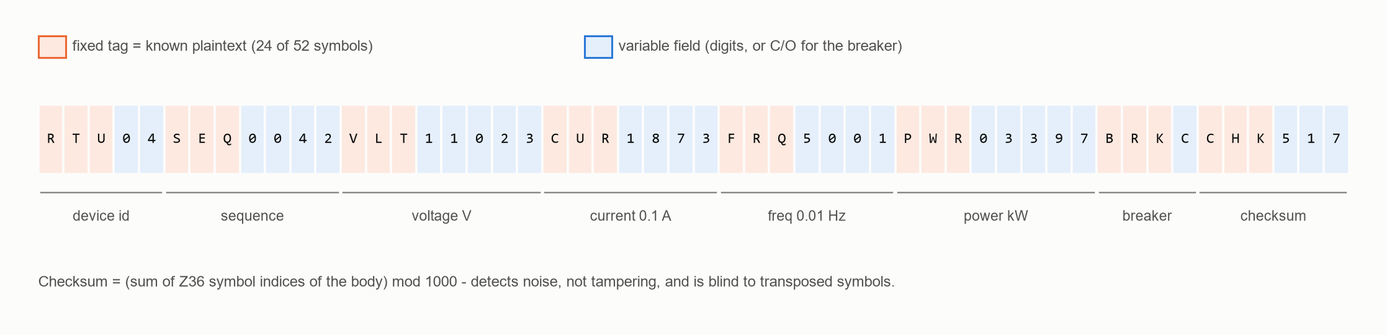
Fixed frame grammar = free known plaintext
<= 2 frames
and <= 85 ms to recover every legacy key - even Playfair's 2^138
Notes:
Presenter: Member 1. 24 of 52 symbols are fixed tags. Any key that decrypts a capture into a valid frame with a valid checksum is the key. The chart shows nominal key space - which turns out to be irrelevant.

Slide 9
Cryptanalysis results: every key recovered
Cipher | Attack | Frames | Keys tried | Time (ms) | Recovered key
Caesar | exhaustive key search | 1 | 36 | 0.6 | 3
Additive | exhaustive key search | 1 | 36 | 0.6 | 17
Affine | exhaustive key search | 1 | 432 | 7.5 | (5, 8)
Vigenere | template constraint propagation + checksum | 1 | 8 | 0.2 | GRIDLOCK
Playfair | keyword dictionary (178 words) | 1 | 178 | 5.0 | SUBSTATION
Columnar | exhaustive permutation search (L<=7) | 2 | 5,912 | 84.7 | [3, 0, 2, 5, 4, 1, 6]
56.3%
of a new Playfair frame decrypted from ONE known frame (90.5% after 20) - no key needed
Finding
The legacy checksum is a plain sum: it cannot detect transposed digits, so a wrong Columnar key still gave checksum-valid frames.
Notes:
Presenter: Member 1. Walk the table. Highlight Vigenere: constraint propagation needs only 8 candidate checks. Playfair codebook: one known frame already decrypts over half of a new frame. Mention the finding that the legacy checksum is blind to transpositions.

Slide 10
AES engine and secure envelope
Member 2 - Modern Cryptography Engine, Secure Envelope & Experiment Validation
Notes:
Presenter: Member 2 (Member 2). Module: lcmf.modern and gateway.envelope.

Slide 11
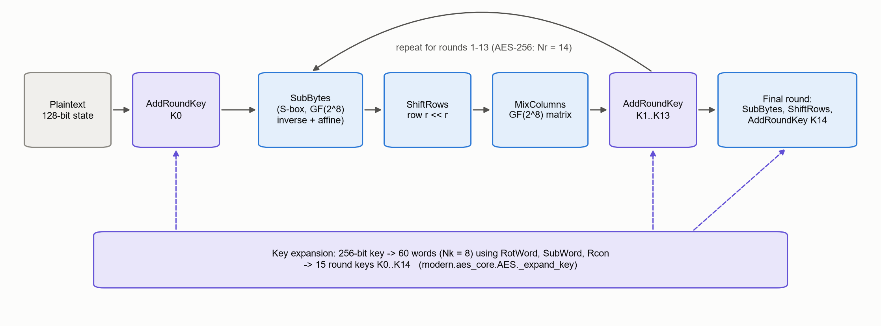
AES-256 and GCM from first principles
15/15
500/500
70,000
published test vectors pass (FIPS-197, GCM, textbook)
random cases bit-identical to the library
telemetry round trips, 0 failures
Notes:
Presenter: Member 2. S-box derived from GF(2^8) inverses, not copied. Key schedule for 128/192/256. GCM with GHASH in GF(2^128). Validated against FIPS-197 and the GCM spec, and bit-identical to the cryptography library. Production uses the library for constant-time AES-NI.

Slide 12
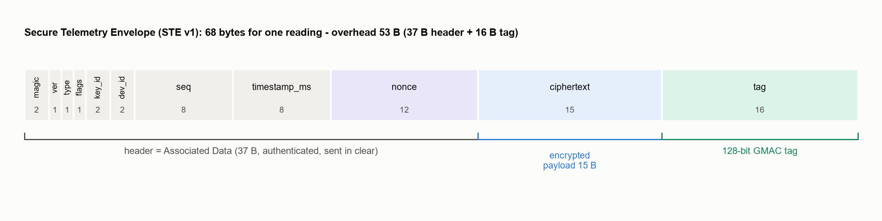
Secure Telemetry Envelope: 68 bytes per reading
1
AAD
2
Nonce
3
HKDF
4
Replay
37-byte header authenticated by the GCM tag
sender id || 64-bit counter, reserved and persisted before use
one key per device, direction and generation from a random master
64-entry sliding window plus 30 s timestamp freshness
Notes:
Presenter: Member 2. Header is authenticated as AAD so device id, sequence and timestamp cannot be changed. Nonce = sender id || 64-bit counter, persisted before use. HKDF gives each device and direction its own key. 64-entry replay window plus timestamps.

Slide 13
Choosing AES is not enough (TV4-TV7)
TV4
Malleable modes
TV5
ECB patterns
100% vs 0%
3 ciphertexts
blind breaker flip: AES-CTR without MAC vs AES-GCM
for 1,440 status messages: breaker state inferred with 100% balanced accuracy (GCM: 50.0%)
TV6
Nonce reuse
TV7
Legacy-derived keys
630 reuses
101 guesses
after reboots with RAM counters: 100% plaintext recovered; persistent counters: 0
to find SHA-256("GRIDLOCK") from one envelope; HKDF random master: not found
Notes:
Presenter: Member 2. Four ways a migration to AES fails: malleable modes, ECB, nonce reuse after reboot, and keys derived from old legacy passwords. Each has a measured mitigation in the framework.

Slide 14
Gateway, migration and evaluation
Member 3 - Smart-Grid Simulation, Gateway & System Evaluation
Notes:
Presenter: Member 3 (Member 3). Module: lcmf.grid, lcmf.gateway, transition_system, cli.

Slide 15
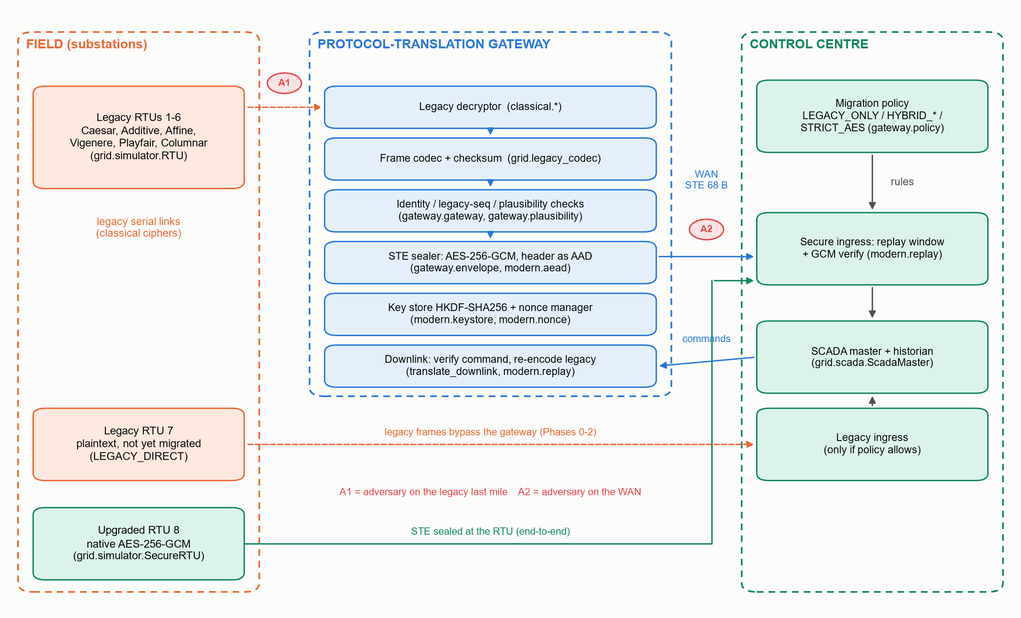
Architecture of the migration gateway
Notes:
Presenter: Member 3. Field: legacy RTUs 1-6 with different ciphers, RTU 7 unencrypted, RTU 8 upgraded. Gateway pipeline: legacy decrypt, parse and checksum, identity / sequence / plausibility checks, AES-GCM seal. Control centre: policy, replay window, GCM verify. A1 and A2 are the attacker positions.

Slide 16
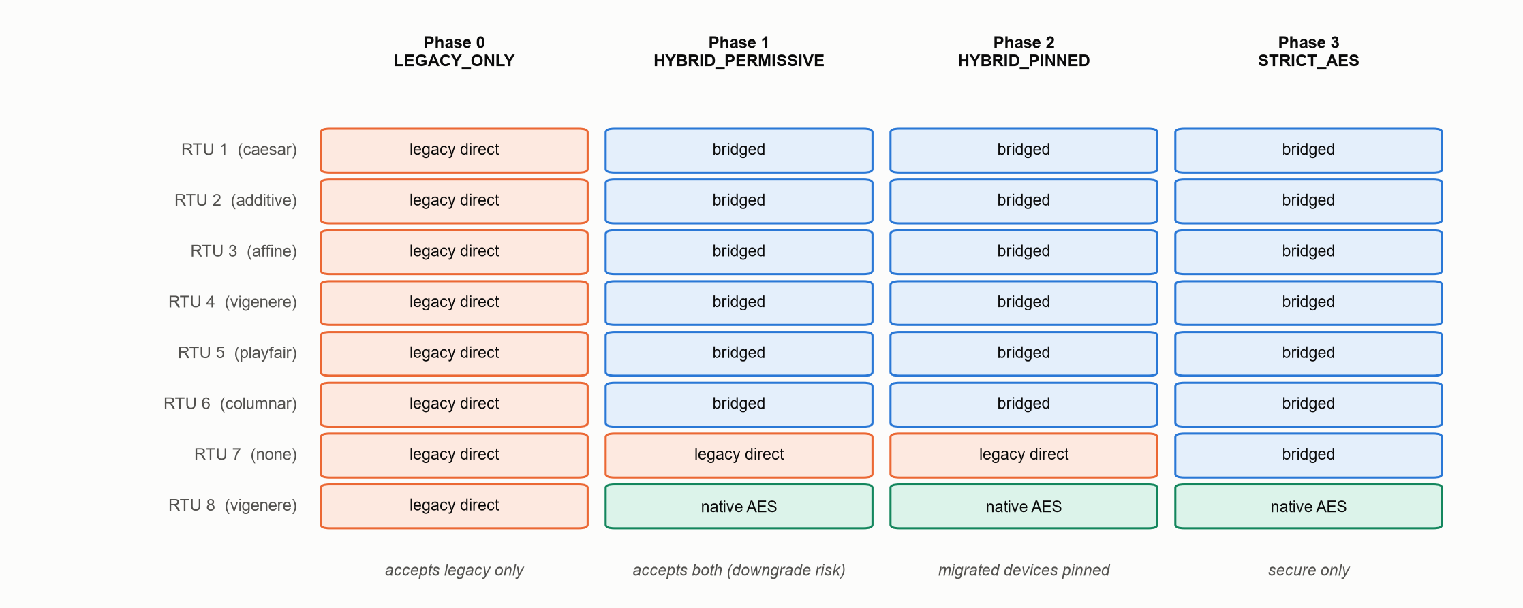
Four migration phases - and a downgrade trap
100%
forged legacy frames accepted in HYBRID_PERMISSIVE
0%
accepted once migrated devices are pinned (HYBRID_PINNED)
Legacy direct = talks legacy to SCADA | Bridged = legacy RTU behind the gateway | Native AES = upgraded RTU
Notes:
Presenter: Member 3. Real migrations are gradual. If the control centre accepts both protocols from everyone, an attacker can strip the envelope and send a legacy frame (downgrade). Pinning migrated devices blocks it while still serving the unmigrated RTU.

Slide 17
The legacy last mile: trust and freshness laundering
TV1 - false data injected on the serial link
TV3 - replay
Defence | Gross | Stealthy
Gateway only | 100% | 100%
Gateway + plausibility | 0% | 100%
Native AES at RTU | 0% | 0%
Scenario | Accepted
WAN replay of legacy frames - none (legacy) | 100%
WAN replay of secure envelopes - 64-bit seq + window + timestamp | 0%
Last-mile replay through the gateway - stateless gateway | 100%
Last-mile replay through the gateway - legacy sequence tracking at gateway | 0%
Eavesdropper on the last mile already read 100% of the readings later sent inside AES envelopes.
A strong MAC can certify weak data: the gateway moves the trust boundary but does not remove the legacy link.
Notes:
Presenter: Member 3. TV1: the attacker breaks the legacy key behind the gateway and rewrites frames; the gateway seals the lie into a valid envelope. Plausibility stops gross forgeries, not stealthy ones; only native AES at the RTU closes it. TV3: a stateless gateway turns old legacy frames into fresh envelopes; tracking the legacy sequence number fixes it.

Slide 18
Correct and fast enough for real time
14,400
35 µs
+53 B
frames delivered in 4 modes, 0 corrupted
worst median latency (target < 1 ms)
envelope overhead per reading (+30.8%)
Notes:
Presenter: Member 3. Integrity: 14,400 frames across all four modes with zero corrupted readings. Latency: median tens of microseconds per frame. Overhead: 53 bytes; an 8-RTU scan at 9,600 baud still fits a 2 s cycle; 1,200 baud already overruns even with legacy frames.

Slide 19
Every transition vulnerability, before and after mitigation
Notes:
Presenter: all - each member comments on their experiments. Orange = vulnerable configuration, blue = mitigated. Every mitigation drops attack success to zero, except stealthy false data on the legacy last mile (TV1), which needs the RTU itself to be upgraded.

Slide 20
Live demonstration
> python -m lcmf demo --interactive
guided walk-through of all modules
> python -m lcmf cipher affine encrypt RTU01SEQ0001 --a 5 --b 8
any legacy cipher, any key
> python -m lcmf attack
every legacy key recovered
> python -m lcmf simulate --mode STRICT_AES --polls 3
gateway + SCADA in a migration phase
> python -m lcmf experiments
regenerates every number in the report
> python -m pytest
automated test suite
Notes:
Presenter: Member 3 drives the keyboard, the others narrate their module as it appears. Run the guided demo; if time permits show python -m pytest (all tests pass) and python -m lcmf simulate --mode STRICT_AES.

Slide 21
All seven objectives met
ID | Objective | Measured result | Status
O1 | Implement six legacy ciphers correctly | 6/6 vectors; 0 failures in 70,000 round trips | Met
O2 | Implement AES-128/192/256 and GCM from first principles | 9/9 vectors; 500/500 identical | Met
O3 | Translate legacy telemetry to AES-GCM without data loss or delay | 0 corrupted of 14,400; worst median 34.9 us | Met
O4 | Break every legacy cipher from captured traffic | 6/6 keys; max 2 frames; max 85 ms | Met
O5 | Secure configuration blocks forged, replayed, tampered and downgraded frames | max acceptance 0.0 % across 6 scenarios | Met
O6 | Identify and quantify transition vulnerabilities with mitigations | 8 vulnerabilities (TV1-TV8) measured | Met
O7 | Keep the secure envelope within legacy-link budgets | 53 B overhead; scan 567 ms | Met
Notes:
Presenter: Member 2. Read the measured column - every number is generated by the experiment runner, none is typed by hand.

Slide 22
Conclusion: a migration playbook for utilities
1
2
3
4
5
6
Inventory legacy links, rank by exposure
Gateways next to RTUs, with plausibility and sequence tracking
Run HYBRID_PINNED; pin each device when migrated
Fresh random master keys + persistent nonce counters
Replace RTUs on the most exposed links first
Switch to STRICT_AES; delete legacy keys
Future scope
Embedded gateway on real serial/radio links - Modbus RTU and DNP3 adapters with IEC 62351 on the control side - keys in an HSM/TPM - state-estimation or ML detection of stealthy false data - post-quantum key establishment
Notes:
Presenter: Member 1. Summarise: classical ciphers give no protection for structured telemetry; the transition has its own risks; each has a tested mitigation. Then the six-step playbook. Future scope: embedded hardware, real Modbus/DNP3, HSM keys, ML anomaly detection, post-quantum key exchange.

Slide 23
Contribution of each team member
M1
[Student Name 1]
M2
[Student Name 2]
M3
[Student Name 3]
[Enrolment No. 1]
[Enrolment No. 2]
[Enrolment No. 3]
Legacy Cipher Suite, Cryptanalysis & Result Visualisation
Modern Cryptography Engine, Secure Envelope & Experiment Validation
Smart-Grid Simulation, Gateway & System Evaluation
Designed the Z36 alphabet abstraction and the common ClassicalCipher interface
Implemented Caesar, Additive, Affine, Vigenere, Playfair (5x5 and 6x6) and Columnar transposition
Verified all ciphers against published textbook vectors and 70,000 telemetry round trips
Built the cryptanalysis module: exhaustive search, template-constrained Vigenere attack, Playfair dictionary and codebook attacks, Friedman/Kasiski/chi-squared tools
Implemented AES-128/192/256 from first principles (GF(2^8) arithmetic, derived S-box, key expansion)
Implemented ECB, CBC, CTR and GCM (GHASH in GF(2^128)); cross-validated against the cryptography library
Designed the 68-byte Secure Telemetry Envelope with header-as-AAD
Implemented HKDF key store, persistent nonce manager and anti-replay window
Built the 11 kV feeder model, legacy RTUs, upgraded RTU, SCADA master and network simulator
Implemented the bidirectional protocol-translation gateway and the four migration modes
Implemented the plausibility filter and legacy-sequence tracking mitigations
Designed and ran system transition experiments TV1-TV3 and TV8
1,269 lines of code | Slides 6-9 (legacy ciphers and how they fall)
1,184 lines of code | Slides 10-13 (AES engine, envelope, crypto pitfalls)
1,321 lines of code | Slides 14-18 and 20 (gateway, migration, transition vulnerabilities, live demo)
Notes:
Presenter: all. Each member owned one module end to end - design, code, tests, report chapters and slides - and the analysis, integration and documentation were shared.

Slide 24
Thank you - questions?
Code, results, report and slides are generated from one repository: python -m lcmf demo
Key references: NIST SP 800-82 Rev. 3 - NISTIR 7628 - FIPS 197 - NIST SP 800-38D - IEEE 1711.2 - IEC 62351 - Lee et al., Ukraine grid attack analysis (2016)
Notes:
All members take questions. Key references: NIST SP 800-82r3, NISTIR 7628, FIPS 197, SP 800-38D, IEEE 1711.2, IEC 62351.

