Slide 1
CI/CD of Machine Learning Models using ML-Flow

Slide 2
What is MLOps?
MLOps stands for Machine Learning Operations. MLOps is a core function of Machine Learning engineering, focused on streamlining the process of taking machine learning models to production, and then maintaining and monitoring them.
Why do we need MLOps?
Productionizing machine learning is difficult. The machine learning lifecycle consists of many complex components such as data ingest, data prep, model training, model tuning, model deployment, model monitoring, explainability, and much more.
What is the use of MLOps?
MLOps is a useful approach for the creation and quality of machine learning and AI solutions. By adopting an MLOps approach, data scientists and machine learning engineers can collaborate and increase the pace of model development and production, by implementing continuous integration and deployment (CI/CD) practices with proper monitoring, validation, and governance of ML models.

Slide 3
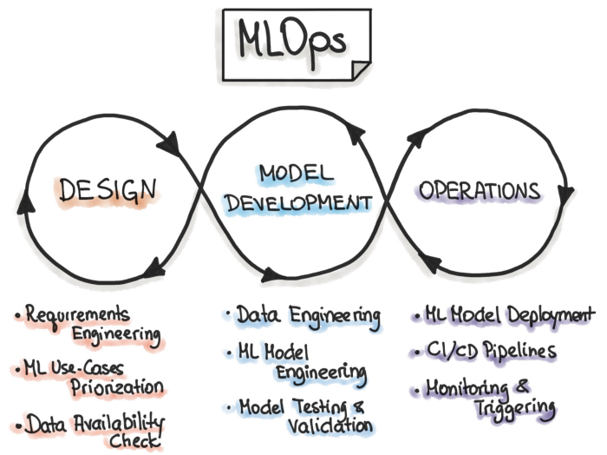

Slide 4
COMPONENTS OF MLOPS

Slide 5
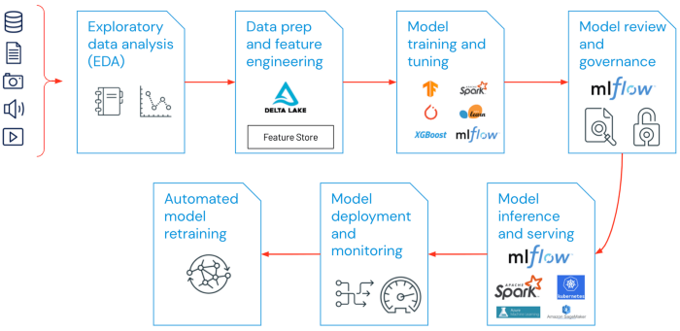

Slide 6
What are the best practices for MLOps?
Exploratory data analysis (EDA) — Iteratively explore, share, and prep data for the machine learning lifecycle by creating reproducible, editable, and shareable datasets, tables, and visualizations.
Data Prep and Feature Engineering- Iteratively transform, aggregate, and de-duplicate data to create refined features. Most importantly, make the features visible and shareable across data teams, leveraging a feature store.
Model training and tuning — Use popular open-source libraries such as sci-kit-learn and hyperopt to train and improve model performance. As a simpler alternative, use automated machine learning tools such as AutoML to automatically perform trial runs and create reviewable and deployable code.
Model review and governance- Track model lineage, model versions, and manage model artifacts and transitions through their lifecycle. Discover, share, and collaborate across ML models with the help of an open-source MLOps platform such as MLflow.

Slide 7
What are the best practices for MLOps?
Model inference and serving — Manage the frequency of model refresh, inference request times, and similar production-specifics in testing and QA. Use CI/CD tools such as repos and orchestrators (borrowing DevOps principles) to automate the pre-production pipeline.
Model deployment and monitoring — Automate permissions and cluster creation to production registered models. Enable REST API model endpoints.
Automated model retraining — Create alerts and automation to take corrective action In case of model drift due to differences in training and inference data.

Slide 8
MLFLOW

Slide 9
What is MLflow and Why Should You Use It?
MLflow is an MLOps tool that can be used to increase the efficiency of machine learning experimentation and productionalization.
MLflow is organized into four components (Tracking, Projects, Models, and Registry).
MLflow is designed to work with any machine learning library, determine most things about your code by convention, and require minimal changes to integrate into an existing codebase. It aims to take any codebase written in its format and make it reproducible and reusable by multiple data scientists.

Slide 10
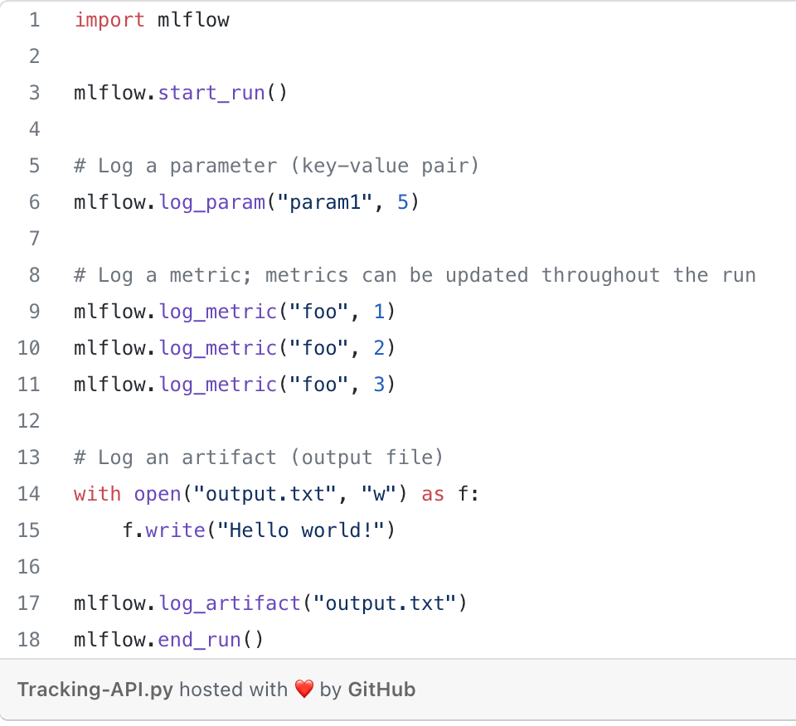
MLFLOW Tracking
The MLflow Tracking API lets you log metrics and artifacts (files from your data science code) in order to track the history of your runs.

Slide 11
API COMPONENTS
Viewing the Tracking UI
By default, wherever you run your program, the tracking API writes data into a local ./mlruns directory. You can then run MLflow’s Tracking UI.
Loading a Saved Model
After a model has been saved using MLflow Models within MLflow Tracking you can easily load the model in a variety of flavors (python_function, sklearn, etc.). We need to choose a model from the mlruns folder for the model path.
model_path = './mlruns/0/<run_id>/artifacts/model'
mlflow.<model_flavor>.load_model(modelpath)
Adding or Updating an MLflow Model Description
At any point in a model’s lifecycle development, you can update a model version’s description using update_model_version().
client = MlflowClient()
client.update_model_version(
name="ElasticnetWineModel",
version=1,
description="This model version is a scikit-learn elastic net"
)

Slide 12
API COMPONENTS
Renaming an MLflow Model
In addition to adding or updating a description of a specific version of the model, you can rename an existing registered model using rename_registered_model().
client = MlflowClient()
client.rename_registered_model(
name="ElasticnetWineModel",
new_name="ElasticnetWineModel2"
)
Transitioning an MLflow Model’s Stage
Over the course of the model’s lifecycle, a model evolves — from development to staging, to production. You can transition a registered model to one of the stages: Staging, Production, or Archived.
client = MlflowClient()
client.transition_model_version_stage(
name="ElasticnetWineModel",
version=3,
stage="Production"
)

Slide 13
API COMPONENTS
Listing and Searching MLflow Models
You can fetch a list of all registered models in the registry with a simple method.
from pprint import pprint
client = MlflowClient()
for rm in client.list_registered_models():
pprint(dict(rm), indent=4)
Deleting MLflow Models
You can either delete specific versions of a registered model or you can delete a registered model and all its versions.
# Delete versions 1,2, and 3 of the model
client = MlflowClient()
versions=[1, 2, 3]
for version in versions:
client.delete_model_version(
name="ElasticnetWineModel",
version=version
)
# Delete a registered model along with all its versions
client.delete_registered_model(name="ElasticnetWineModel")

Slide 14
THANKS!
Any questions?
You can find me at aryan.jadon@sjsu.edu

