Slide 1
CIS 1921 — FINAL PROJECT
Constraint-Based Training, Nutrition & Health Schedule Optimizer
Planning a student's whole week — workouts, meals, sleep, hydration — as one optimization problem.
Aryan Jeena · Aadithya Srinivasan
April 28, 2026

Slide 2
1 · THE PROBLEM
Real students don’t plan one thing at a time.
If you actually want to train, you have to plan workouts, meals, and sleep at the same time. They depend on each other.
But the standard tools split the problem in half.
What you usually get
A meal-tracking app picks food. A calendar app schedules events. Neither one knows about the other, so you end up with weeks that look fine on paper — meal prep finishes 15 minutes before a heavy squat session, or your only free hour at the dining hall is right after a hard workout when you can’t eat much. The plan is technically valid but practically useless.
2 / 9

Slide 3
2 · WHAT WE BUILT
Four optimizers, all on the same problem, so we can compare them fairly.
Each one accepts the same inputs (the user, the food list, the workout list) and returns the same shape of output.
1.
2.
3.
4.
Nutrition only
Two-stage
Joint CP-SAT
Warm-start hybrid
LP / MIP
MIP, then CP-SAT
single CP-SAT model
two-stage seeds joint
Pick foods to hit calorie + protein + budget. Doesn't know about time at all. The classic diet problem.
First pick the foods, then place them on the calendar with workouts and sleep. The standard textbook decomposition.
One model decides foods AND placement at the same time. Can trade a small macro miss for a better-timed schedule.
Run two-stage first as a hint, then let the joint solver refine it. Same model as #3, just smarter starting point.
3 / 9

Slide 4
2 · WHAT WE BUILT
How the model thinks about the week.
TIME LIVES IN INTEGERS
WHAT THE SOLVER DECIDES
7 days × 48 half-hour slots = 336 slots/week.
Servings of each food, where each meal sits, when each workout starts, when sleep begins.
We work in integer slots, integer cents, and integer grams because CP-SAT needs integer math anyway and it makes the tests easy to write. Half-hour slots are fine enough to express a real schedule (lifts, meals, sleep) and coarse enough that the search stays fast.
It honors hard rules — calorie band, protein floor, weekly budget, no two activities at once, recovery between hard workouts, sleep window — and it minimises a soft cost: macro deviation, money spent, missed peri-workout meals, missed hydration, day preferences. Hard things are constraints. Soft things are the score.
4 / 9

Slide 5
3 · LIVE DEMO
Switching to the terminal — let's run it.
1. Run all four solvers on a balanced student
$ .venv/bin/python scripts/run_demo.py
2. Solve a denser week with the joint optimizer + render the schedule
$ .venv/bin/python -m src.app.cli solve --preset dense_training --solver joint_cpsat --figure
3. Open the rendered weekly plan
$ open reports/figures/schedule_dense_training_joint_cpsat.png
What you'll see: every solver hits its goal in seconds, then we'll look at the actual seven-day plan that comes out — meals in the right windows, seven workouts spread across the week with recovery gaps between hard sessions, sleep blocks each night, hydration spaced through the day. All from one model.
5 / 9

Slide 6
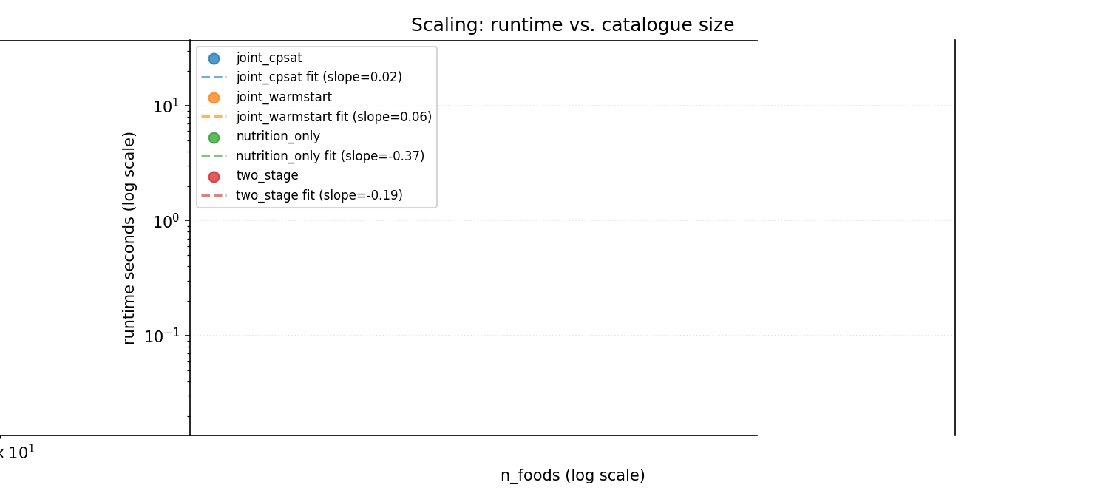
4 · KEY RESULTS
How fast does it run as the food list grows?
TAKEAWAYS
• Nutrition-only stays fast no matter how big the food list gets — it's a textbook diet problem. • Joint CP-SAT is great up to about 80 foods. After that the search space starts to bite. • The warm-start hybrid catches up on the harder, larger instances by giving CP-SAT a feasible plan to start from.
6 / 9

Slide 7
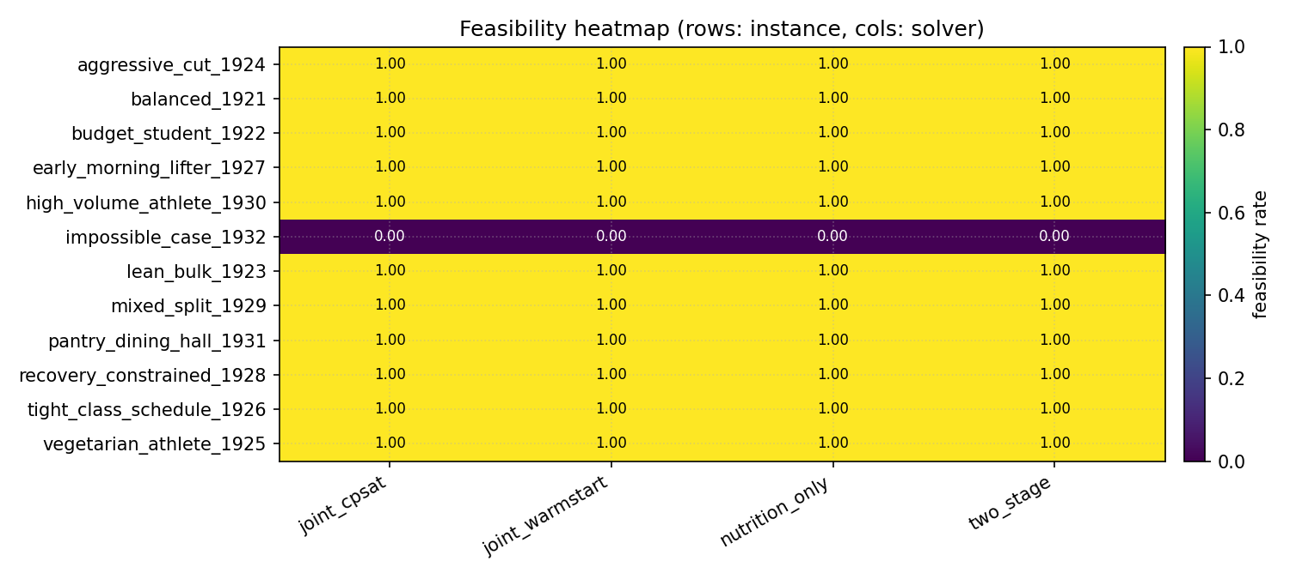
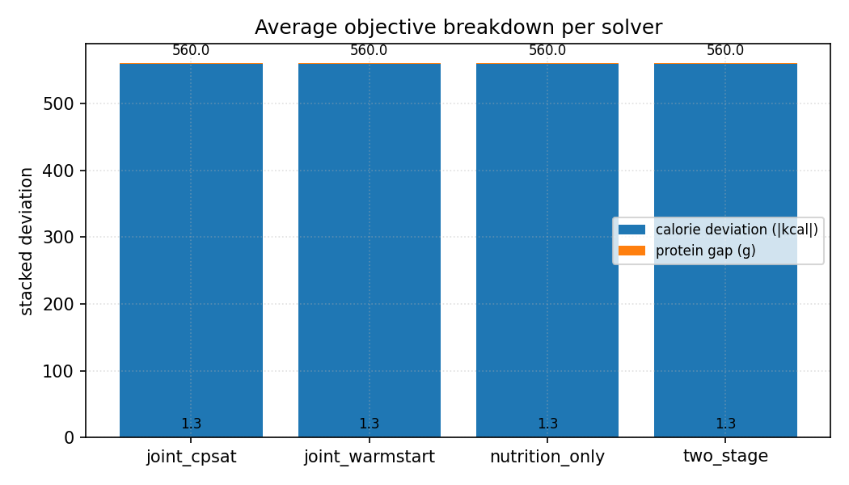
4 · KEY RESULTS
Where the joint solver beats the baselines.
Which solvers find a feasible plan for which instance
What the solver is actually paying penalty for
When the schedule gets tight, the two-stage decomposition can commit to foods that the calendar can't fit. The joint solver handles those cases by trading a small macro miss for a feasible week. On loose problems both solvers tie — that's expected.
7 / 9

Slide 8
4 · KEY RESULTS
What we learned.
Joint beats two-stage when the schedule is tight.
If the user has limited free hours and lots of workouts, two-stage picks foods first and then realises the calendar can't fit them. The joint solver doesn't get into that bind because it sees both decisions at once.
Warm-starting helps on the hard cases, not the easy ones.
Big food lists with tight constraints — the joint solver is much faster from a hint. Small loose instances — running two-stage first is wasted time.
When the problem is infeasible, our solver tells you why.
We use CP-SAT's assumption literals to point at the smallest set of constraints the user has to relax — calorie band, budget, workouts, or scheduling overlaps. Saves users from staring at an empty plan.
Hydration was almost free.
We added it as a soft objective with sliding-window spacing. It never blew up the runtime, even on the largest instances.
8 / 9

Slide 9
5 · WRAP
Future work, what's in the box, thank you.
WHERE WE'D GO NEXT
WHAT'S IN THE REPO
Scale past 200 foods.
• Around 5,000 lines of Python, mostly solver code
Column generation or a Benders-style decomposition would handle bigger food lists.
• 37 unit tests, all passing
Re-plan during the week.
• Four solver implementations on a shared interface
Missed a workout? Re-solve the remaining days from where you actually are.
• Six pre-made user scenarios + a synthetic generator
• Penn Dining + USDA + curated food data
Hook into real Penn Dining.
Cookie-aware scraper for the live menu — currently using a curated sample.
• A streamlit UI and a command-line tool
• Final report with runtime, feasibility, and objective figures
Thank you — questions?
github.com/aryan-jeena/CIS1921Project · Aryan Jeena & Aadithya Srinivasan
9 / 9

