Slide 1


ClaimGuard
Agentic AI & anomaly detection for healthcare payment integrity
Cotiviti Intern Performance Demonstration · Topic 2
Aryan Amit Nagwekar · Rutgers University, M.S. Electrical & Computer Engineering
Notes:
Open here. One line: 'I'm Aryan, M.S. ECE at Rutgers. I chose Topic 2 — agentic AI and anomaly detection for payment integrity — because it's the heart of what Cotiviti does. I'll walk through the analysis, then demo a working prototype called ClaimGuard.' Keep it to ~15 seconds.

Slide 2

Healthcare loses billions to improper payments
$14.9B
$50–100B
$12B
FWA recoveries reported by CMS in 2023
Estimated Medicaid improper payments per year
System waste Cotiviti targets across its book
Two structural problems
“Pay-and-chase.” Most recovery happens after money has already left the door — slow, costly, and abrasive to providers.
Siloed teams. Claims, policy, special investigations, and prior-auth operate separately; the context to explain a flag often surfaces only in meetings.
Notes:
Frame the stakes. The numbers are large and real (CMS 2023 FWA recoveries; Medicaid improper-payment range; Cotiviti's own $12B waste estimate). Then the two structural problems: pay-and-chase is reactive, and siloed teams make flags hard to explain. This sets up why agentic, explainable AI matters.

Slide 3




Pattern recognition is moving to agentic AI
Classification, time-series anomaly detection, and chain-reasoning over claims for Treatment, Payment & Operations (TPO).
Pay-and-chase → prevention
Regulatory tailwind
ML, generative AI, and agents screen claims before payment, not after.
CMS and HHS are scaling AI from post-pay audit to pre-pay screening.
Agentic coordination
Explainability as a requirement
Agents reason across the silos that slow human payment-integrity teams.
Traceable, defensible rationale and human-in-the-loop are now expected.
Notes:
Define the concept in one breath, then give four trends. The fourth — explainability and governance as a requirement, not a nice-to-have — is the one to land on, because it's the bridge to my recommendation and my demo. Cite that federal AI-governance expectations now demand traceable decisions.

Slide 4


Opportunities & threats
Opportunities
Threats
Expand investigator throughput without adding headcount
Prevent improper payments pre-pay — fewer clawbacks, less abrasion
Fuse claim, policy, contract & history context in one pass
Explainable risk scores strengthen review, appeals & audit
False positives on sparse data → provider abrasion
Black-box agents create compliance & litigation risk
Bad actors adopt the same generative & agentic tooling
Outputs only as good as data integration & monitoring
Notes:
Two columns, balanced. Spend a beat on the link between the first threat (false positives on sparse data) and a known behavior in my own demo — the statistical layer over-flags on low counts. That's deliberate honesty and it sets up why human-in-the-loop and a feedback loop matter.

Slide 5


Recommendation: govern the agents, not just the claims
Detection is commoditizing. The durable differentiator is trustworthy, auditable agentic decisions — every determination carrying a chain-of-reasoning, a policy citation, a confidence score, a replayable audit trail, and a human override.
Build a governance & observability layer for payment-integrity AI
1. Pilot pre-pay review
2. Close the feedback loop
Run agentic review on a narrow, high-yield edit set to prove ROI without broad abrasion risk.
Analyst overrides retrain the agents and tune anomaly thresholds — accuracy compounds, false positives fall.
Notes:
This is the thesis slide — slow down here. The dark banner is the core argument: in the agentic era, raw detection commoditizes; what wins is governed, defensible decisions. Then the two pilot actions. Note that action 2 directly answers the false-positive threat from the previous slide. Tie it explicitly to Cotiviti's position as the trusted payment-integrity partner.

Slide 6



ClaimGuard: how it works
A deterministic core for reliability, an LLM agent for explanation — with a fallback so the demo never breaks.
→
→
→
→
Claims
Rules + Anomaly
LLM Agent
Audit Log
Human Review
Synthetic CPT / ICD claim lines
NCCI/MUE edits & peer-outlier stats
Reason · score · recommend action
Structured, replayable decision events
Approve or override each flag
Why this design: deterministic rules and statistics make the verdict reproducible; the agent adds plain-language reasoning and a citation. If the model is unavailable, a deterministic fallback produces the same fields — a flawless live run beats an ambitious one that breaks.
Notes:
Walk the pipeline left to right in one sentence each. Emphasize the agent node (highlighted) and the audit + human-review tail — that's the governance story made concrete. Close on the 'why this design' line: reproducible core + explainable agent + fallback = a demo that can't break on camera.

Slide 7
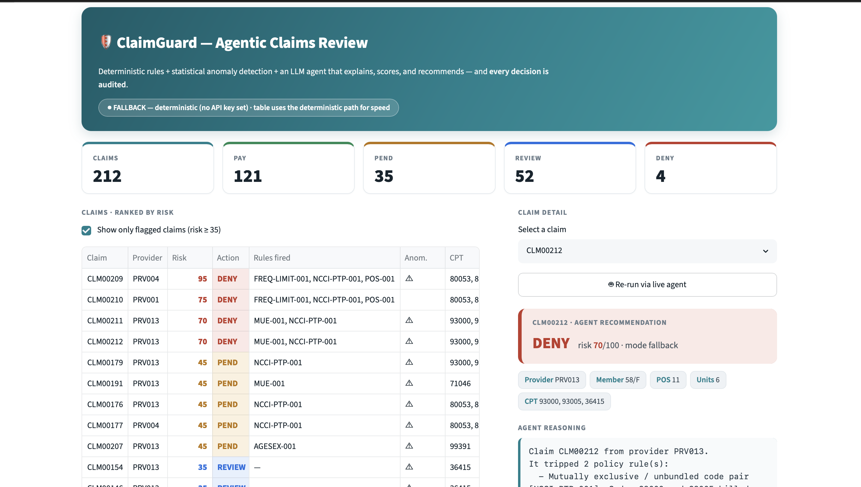
Live: the system at a glance
KEY POINT
212 claims triaged and ranked by risk in one view.
Every claim gets an action: PAY, PEND, REVIEW, or DENY.
Color-coded risk and the rules each claim tripped — an investigator sees the worst cases first.
Notes:
Screen-share the live app here, not just the screenshot. Point at the KPI row (212 / PAY / PEND / REVIEW / DENY), then the risk-ranked table. Mention the FALLBACK pill honestly: 'the table runs the deterministic path for speed; the live LLM agent runs per-claim.'

Slide 8
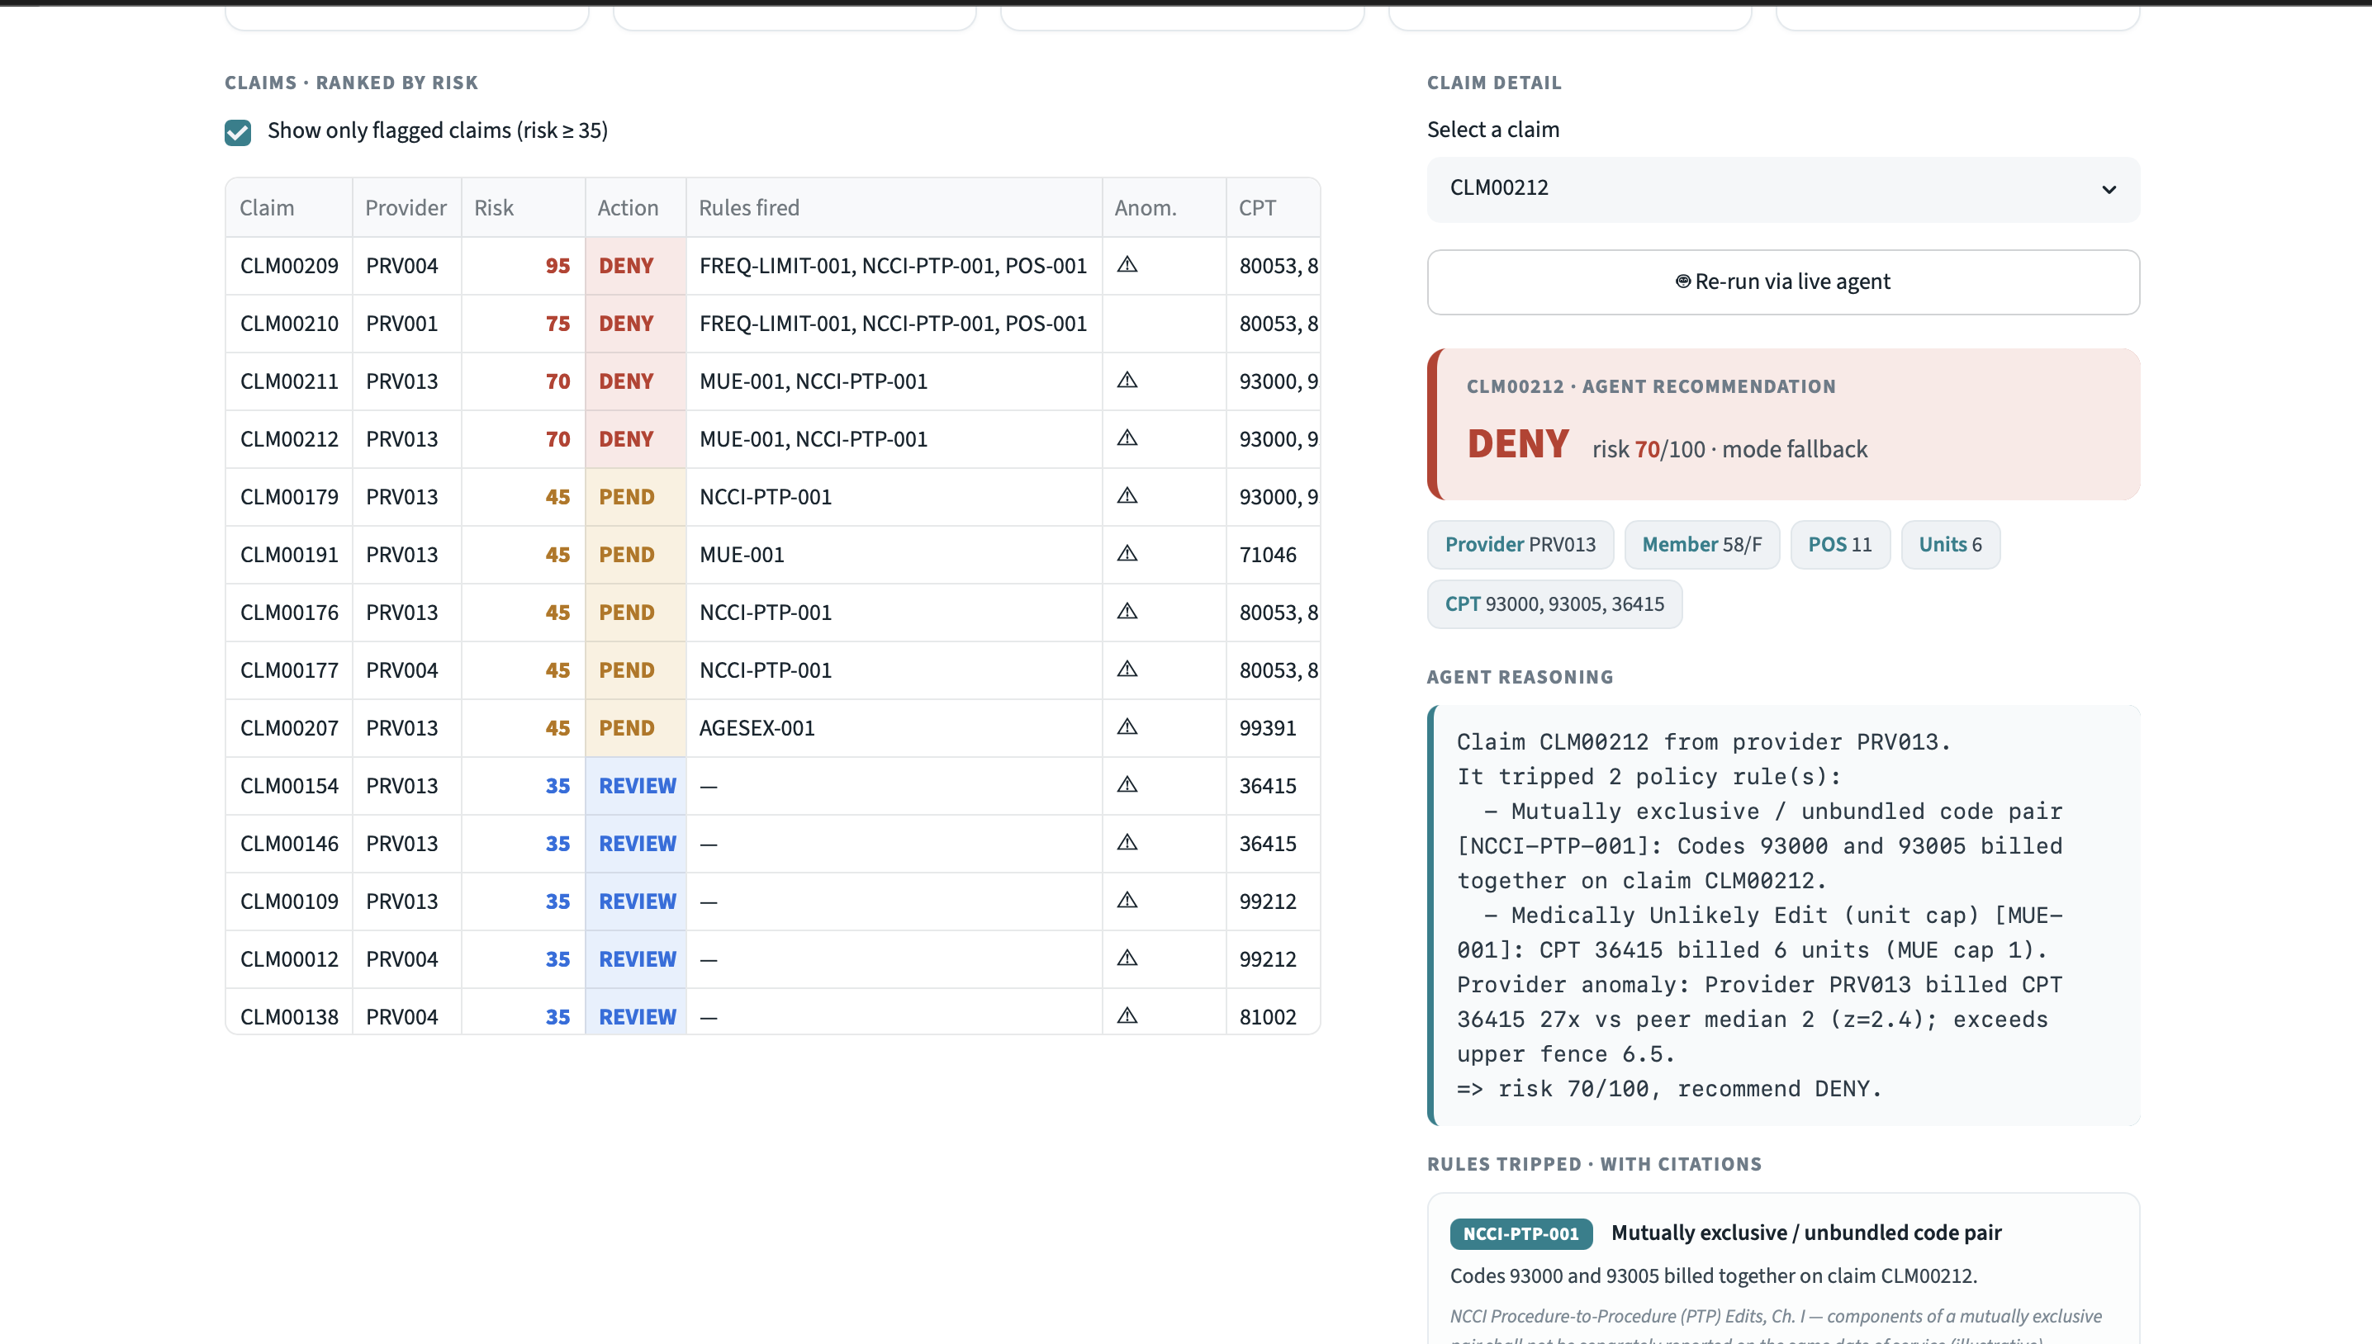
Live: the agent explains its reasoning
KEY POINT
Select a flagged claim and the agent shows its work.
Two policy rules tripped (unbundling + unit cap), plus a provider anomaly: 36415 billed 27× the peer median (z = 2.4).
→ risk 70/100, recommend DENY — a transparent chain, not a black-box score.
Notes:
This is the chain-reasoning money shot. Read the reasoning box aloud: two rules tripped, then the provider-anomaly signal at 27x peer median, leading to risk 70 and a DENY. Stress that a reviewer can see exactly WHY — that's what makes the decision defensible.

Slide 9
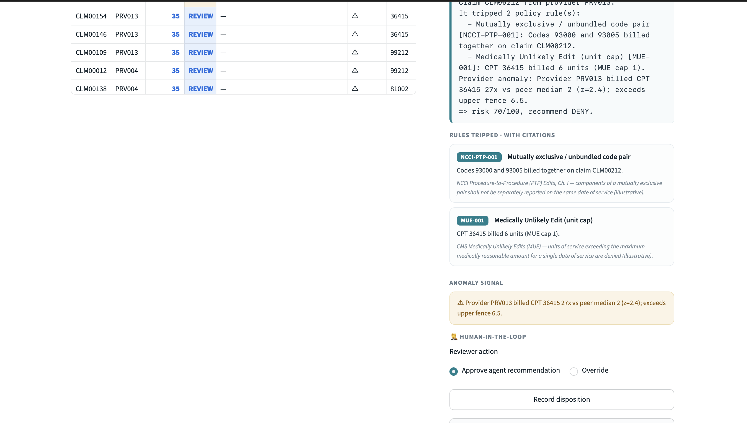
Live: governed by design
KEY POINT
Each rule carries a citation — NCCI PTP and CMS MUE (illustrative).
The anomaly signal is shown explicitly, with its statistical basis.
A human approves or overrides every flag, and the decision is written to a replayable audit event.
Notes:
Land the governance thesis. Point to the citation cards, the anomaly callout, and the human-in-the-loop approve/override with 'Record disposition.' Say: 'this is the governance layer from my recommendation, working — citation, confidence, human override, and an audit trail on every decision.'

Slide 10

Why this matters for Cotiviti
Squarely on mission
Agentic anomaly detection for payment, treatment & operations is the core of Cotiviti's payment-integrity work.
Defensible & audit-ready
Governed decisions survive appeals and regulatory scrutiny, and reduce the provider abrasion that erodes trust.
A sellable capability
“Governed agentic payment integrity” answers the exact trust question Cotiviti's 200+ payers are starting to ask.
Aryan Amit Nagwekar · Rutgers University · ClaimGuard prototype + full report on GitHub
Notes:
Close strong and short. Three reasons this matters to Cotiviti specifically: it's on-mission, it's defensible/audit-ready, and it's a sellable capability as payers adopt agents. End by pointing to the repo with the working code, the report, and this deck. Thank them.

