Slide 1
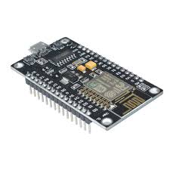
NodeMCU is an open source firmware for which open source prototyping board designs are available. The name "NodeMCU" combines "node" and "MCU" (micro-controller unit). Strictly speaking, the term "NodeMCU" refers to the firmware rather than the associated development kits.

Slide 2
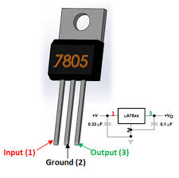
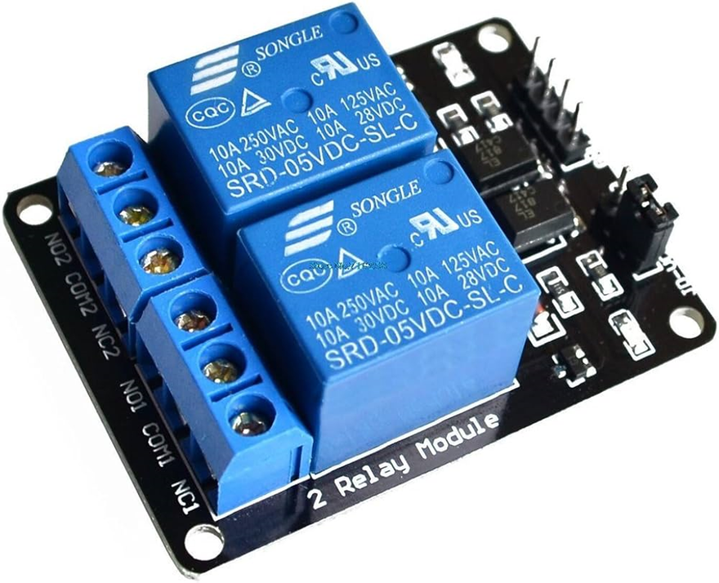
7805 voltage regulator is an integrated circuit designed to maintain a constant output voltage despite changes in input voltage and load. Specifically, the 7805 is a positive voltage regulator that ensures a stable +5V output, making it a popular choice for powering various electronic components and circuits
2 Channels Relay Module is a convenient board which can be used to control high voltage, high current load such as motor, solenoid valves, lamps and AC load.

Slide 3
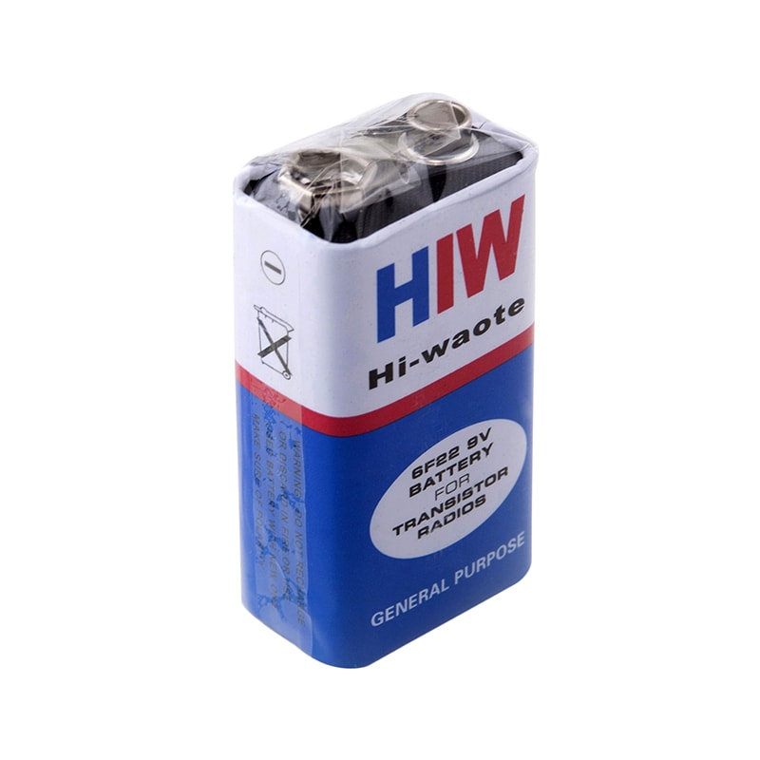
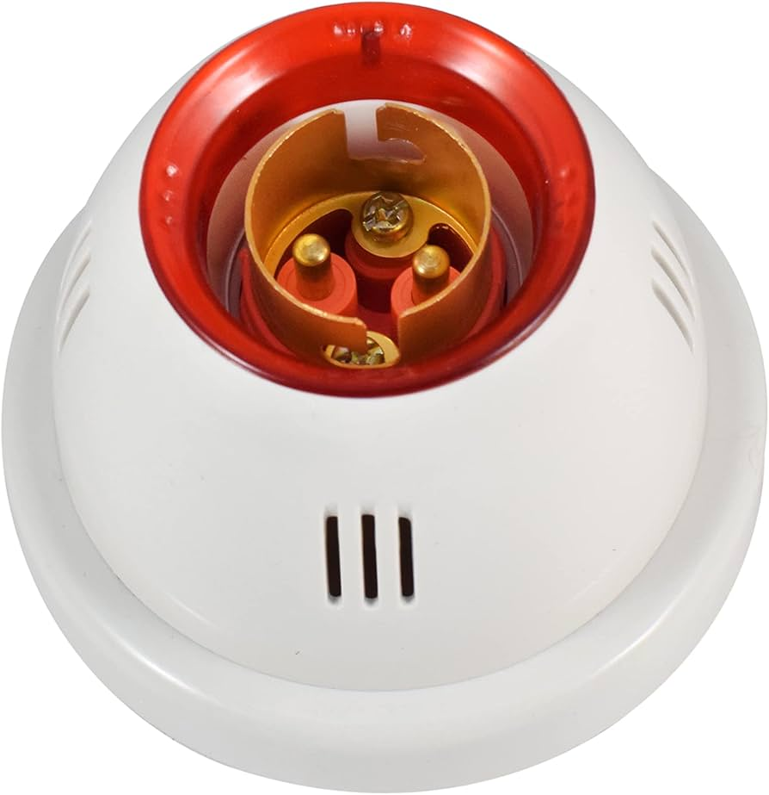
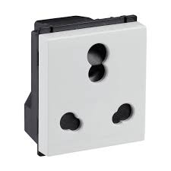
9-volt battery
3-pin socket
Bulb holder

