Slide 1

SMART INDIA HACKATHON 2026
TITLE PAGE
Problem Statement ID – SIH26055
Problem Statement Title- Smart Scan strategy for Electronic Warfare
Theme- Clean & Green Technology
PS Category- Software
Team ID-
Team Name- PUSHPAK
Simulation-only scope: no RF hardware, no interception, no jamming, no weapon control.
Notes:
Read the six fields, then stop. Do not narrate this slide. The Theme really is Clean & Green Technology - that is what the portal lists for SIH26055, odd as it looks against an electronic-warfare brief, so do not let anyone talk you into changing it. The problem statement belongs to DRDO, under the Department of Defence Production and IDEX, so expect a signals person on the panel.

Slide 2
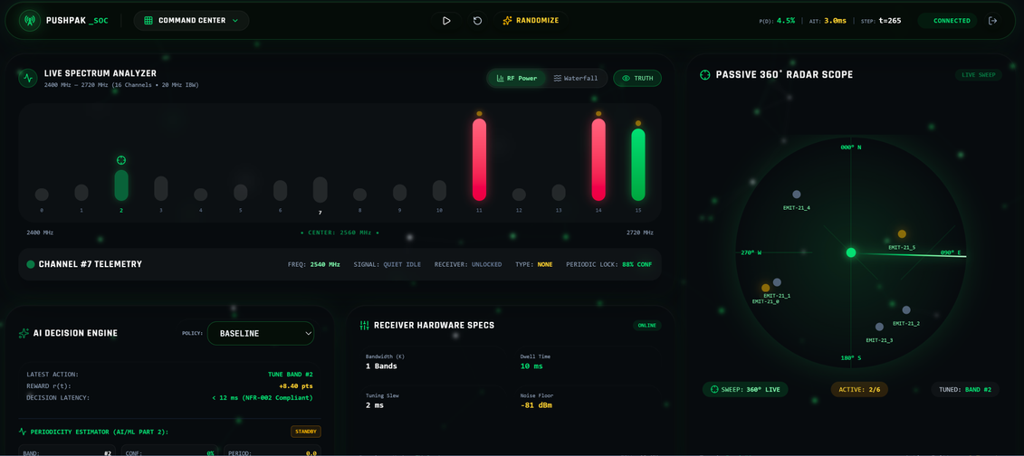
PUSHPAK
Intelligent RF Spectrum Scan Strategy
Detailed explanation of the proposed solution
3.2×
3.7×
2.9×
A machine-learning Electronic Support receiver scheduler — the expected solution, built end to end.
Simulated RF environment carrying truth information for every band at every time slot.
Bandwidth-limited receiver with dwell time, tuning delay and detection threshold.
Bandit trained on hits and misses; periodicity estimator for optimal interception of periodic scans.
Detection rate
High-priority
Scan efficiency
Measured against the round-robin sweep on an identical spectrum — Scenario B, 5 seeds.
How it addresses the problem
Detection rate rises 0.107 → 0.345 on the same spectrum and seeds.
Listening efficiency rises 0.198 → 0.573 of dwell spent on live air.
High-priority detection rises 0.101 → 0.375.
A decision returns in 6.6 ms p95 over HTTP, against a 50 ms budget.
Innovation and uniqueness of the solution
Phase folding, not median inter-arrival — we observe our own detections, never the emitter, so the gaps measure our scan schedule.
Confidence corrected for the look-elsewhere effect — non-periodic emitters stay at the nominal 5%, not 99%.
Coverage versus density is a tunable reward weight, retuned per mission rather than fixed.
Working prototype — live spectrum analyser, AI decision engine and passive radar scope.
2
Notes:
One sentence for the idea: the receiver stops sweeping and starts choosing. The three orange tiles are measured, not projected, and the screenshot is our running dashboard. If a judge asks for the single most novel part, it is phase folding: we never see the emitter, only our own detections of it, so the gaps between them measure our scan schedule rather than the signal.

Slide 3
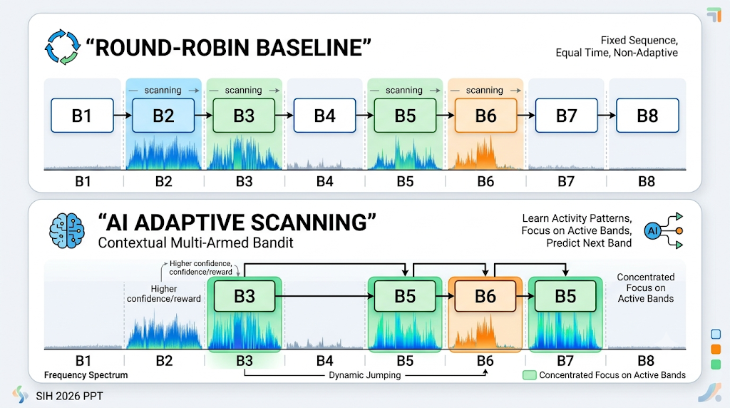
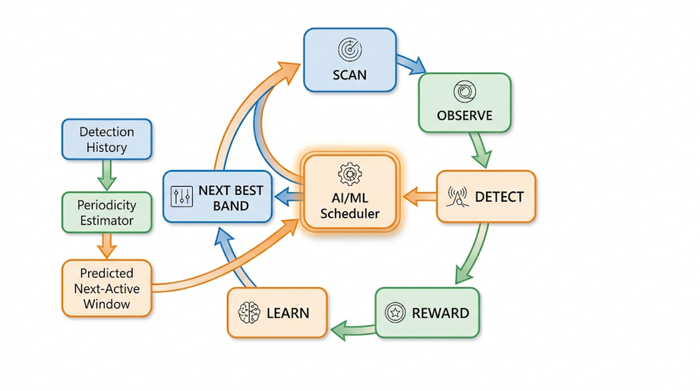
PUSHPAK
TECHNICAL APPROACH
Technologies
Frontend: React 18 + TypeScript — real-time spectrum and metrics dashboard
Backend: Java 21 + Spring Boot 3 — APIs, simulation and scheduler services
AI/ML: Python 3.12 + FastAPI — contextual bandit, Q-learning, DQN/PPO
Database: PostgreSQL + Flyway — simulations, scan events and results
Real-Time: WebSocket — live spectrum, decisions and metrics
Deployment: Docker / Docker Compose — reproducible setup
Implementation
Build RF simulator with configurable bands and 5 emitter behaviours.
Model receiver with bandwidth K, dwell time and tuning delay.
Implement baseline using deterministic round-robin scanning.
Develop ML scheduler using a contextual multi-armed bandit.
Add periodicity estimator to predict next-active windows.
Train on hits and misses through a Detection → Reward → Learning loop on every step.
Replay the Turing synthetic radar dataset — the dataset named in the problem statement.
Compare Baseline vs ML on the figures of merit the problem statement names.
Verified: 167 + 77 tests · 87% / 96% coverage · decision p95 6.6 ms
3
Notes:
Point at the top diagram first: the baseline visits every band in a fixed order including the empty ones, and the learned policy concentrates on bands that are actually live. The lower diagram is the per-step loop. If asked about latency, be precise: 6.6 ms is p95 measured over a real HTTP socket, not an in-process call, and the budget is 50 ms.

Slide 4
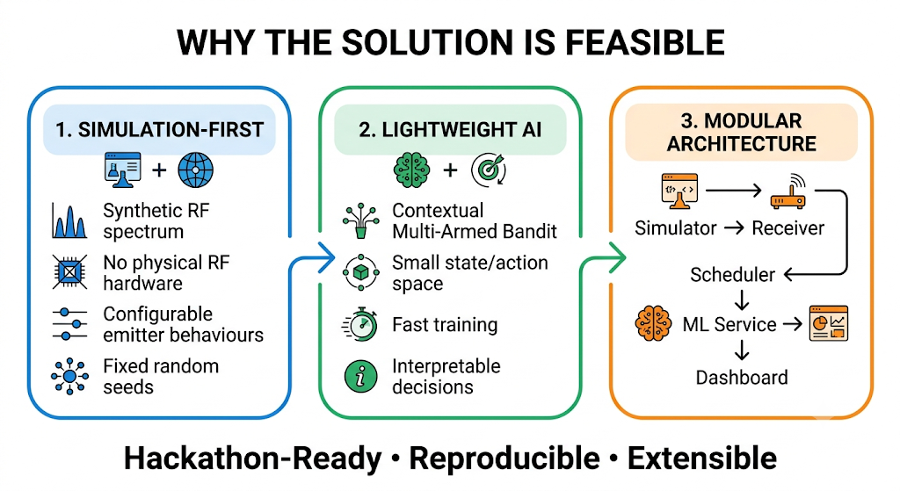
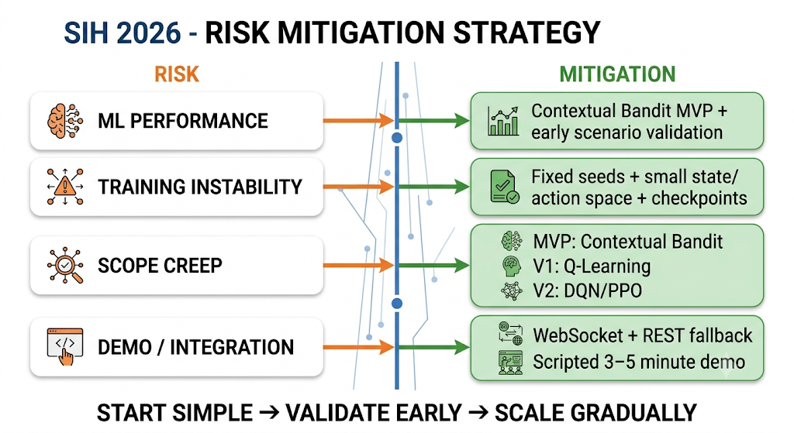
PUSHPAK
FEASIBILITY AND VIABILITY
Feasibility Analysis
Simulation-first: no physical RF hardware; the system runs in a synthetic environment.
Already running: four services, one command each, Dockerised, on H2 or Postgres.
Verified: 167 scheduler tests and 77 estimator tests, at 87% and 96% coverage.
Reproducible: fixed seeds give every policy an identical spectrum.
Lightweight ML: the bandit needs no pre-training; DQN and PPO sit behind a flag.
Potential Challenges and Risks
ML does not win every metric — at the default weight it catches fewer distinct bursts than the sweep, 0.174 against 0.413.
Raw average intercept time ranks the better policy worse, because it averages only the bursts caught.
Periodicity does not yet help end to end — it is never told when a band was heard and found silent.
Strategies to Overcome Challenges
One reward weight slides along it. At w5 = 20, burst coverage reaches 0.423 and censored intercept time 577, beating the sweep's 588 — the mission picks the operating point.
Report censored intercept time beside the raw figure, charging undetected bursts the full episode.
Named fix: carry scanned-but-empty observations in the contract. The test stays in the suite, disabled with the reason.
4
Notes:
This is the slide that wins the room. Every other team claims their model beats the baseline on everything. Say the weakness out loud before a judge finds it: we lose distinct-burst coverage to the sweep, and here is the single reward weight that trades one for the other. The third risk is still open. Do not hide it. It is diagnosed, the fix is named, and the failing test is still in the suite rather than deleted.

Slide 5
PUSHPAK
IMPACT AND BENEFITS
For Spectrum Monitoring:
ROUND-ROBIN SWEEP vs AI ADAPTIVE SCANNING (%)
Listening efficiency rises 0.198 → 0.573 — over half of dwell now lands on live air instead of one fifth.
Smarter allocation for a receiver that hears only 2 of 16 bands at any instant.
For Detection Performance:
Probability of detection rises 0.107 → 0.345, a 3.2× gain on identical spectra.
High-priority detection rises 0.101 → 0.375, a 3.7× gain.
Average intercept time falls 2.34 → 0.59 steps on the bursts we catch.
False alarms are unchanged at 0.070 against 0.068 — the gain is not bought with false alarms.
For Research & Evaluation:
FIGURES OF MERIT — SCENARIO B, 5 SEEDS, 1000 STEPS
Objective Baseline versus ML comparison across 7 scenarios with fixed seeds.
One script reproduces every number on this slide from a clean checkout.
Figure of merit | Random | Round-robin | Ours
Probability of detection (Pd) | 0.104 | 0.107 | 0.345
Probability of false alarm (Pfa) | 0.069 | 0.068 | 0.070
High-priority detection | 0.109 | 0.101 | 0.375
Scan efficiency | 0.190 | 0.198 | 0.573
Avg intercept time, caught ↓ | 2.46 | 2.34 | 0.59
Avg intercept time, censored ↓ | 660.7 | 587.8 | 826.1
Distinct bursts caught | 0.340 | 0.413 | 0.174
For Future Development:
Modular architecture supports new emitter models and receiver constraints.
Q-Learning, DQN and PPO are already built and verified behind a flag.
↓ lower is better. Green marks the two rows the sweep still wins at our default reward weight — we report them rather than dropping them.
5
Notes:
Lead with the chart. Same spectrum, same seeds, same receiver, only the scheduler changed. Every row in the table below is a figure of merit the problem statement names by hand, which is why intercept time is there twice. Then point at the two green cells yourself, before anyone asks. The censored intercept time is the one that matters to the brief, and at reward weight 20 it drops to 577 against the sweep's 588, so the frontier is ours to choose rather than a wall.

Slide 6
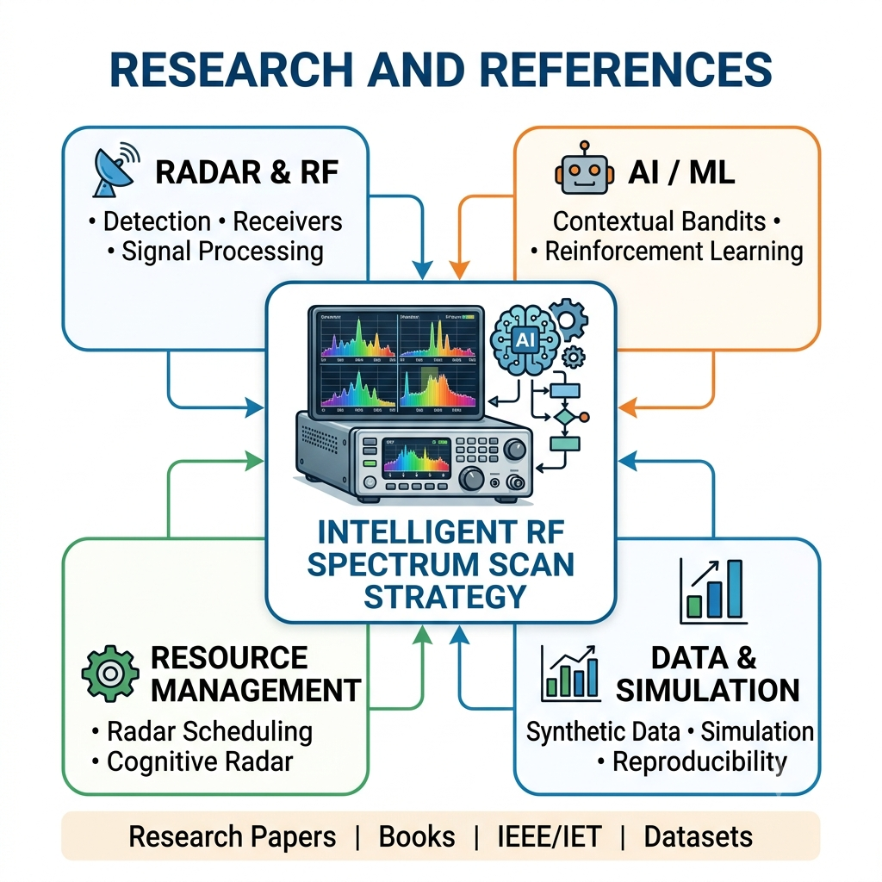
PUSHPAK
RESEARCH AND REFERENCES
Research Papers
1. Gunn et al. — The Turing Synthetic Radar Dataset (the dataset named in the problem statement)
turing.ac.uk/news/publications/turing-synthetic-radar-dataset
2. Hashmi et al. — Artificial Intelligence Meets Radar Resource Management
doi.org/10.1049/rsn2.12337
3. Lu et al. — Constrained Deep Reinforcement Learning for Cognitive Radar Resource Management
Prior Art
US 10,523,342 B1 — Autonomous reinforcement learning method of receiver scan schedule control. BAE Systems.
Method
1. Sutton and Barto — Reinforcement Learning: An Introduction, 2nd ed. MIT Press, 2018.
2. Auer, Cesa-Bianchi and Fischer — Finite-time analysis of the multiarmed bandit problem. Machine Learning 47, 2002.
3. Mardia and Jupp — Directional Statistics. Wiley, 2000 (Rayleigh test).
Prototype and source
Repository: github.com/aryan-stack-cloud/sih Demo video: [ add your link ]
Books
scripts/compare.py reproduces every number in this deck from a clean checkout.
1. Paul Hannen — Radar and Electronic Warfare Principles for the Non-Specialist.
2. Merrill I. Skolnik — Radar Handbook, 3rd edition.
Simulation-only: no RF hardware, no interception, no jamming, no weapon control.
6
Notes:
Two things to land. First, the patent: somebody has tried reinforcement learning on receiver scan scheduling before, we found it, and our delta is the periodicity feature feeding the reinforcement-learning state. Saying nobody has done this is how a team loses a technical judge. Second, if asked whether the numbers are reproducible, the answer is one script from a clean checkout.

