Slide 1

AI Question
Paper Generator
GENERATIVE AI
PRESENTED BY
GID : 2 PS : 8

Slide 2

Objectives
To design an AI-based system that automatically generates structured question papers aligned with Bloom’s taxonomy and difficulty levels.
  Automate paper generation
  Ensure cognitive balance
  Maintain academic standards

Slide 3

BLOOM’S TAXONOMY
BLOOM’S TAXONOMY CLASSIFIES LEARNING OBJECTIVES INTO COGNITIVE LEVELS.
COGNITIVE LEVELS:
REMEMBER
UNDERSTAND
APPLY
ANALYZE
EVALUATE
CREATE
WE MAP:
EASY → REMEMBER, UNDERSTAND
MEDIUM → APPLY, ANALYZE
HARD → EVALUATE, CREATE

Slide 4

EXISTING SYSTEM LIMITATIONS
CURRENT APPROACHES:
MANUAL PAPER CREATION
RANDOM QUESTION BANKS
STATIC TEMPLATES
NO INTELLIGENT DIFFICULTY CONTROL
  NO COGNITIVE-LEVEL TAGGING
GAP IDENTIFIED:
No AI-DRIVEN SYSTEM THAT GENERATES DYNAMICALLY STRUCTURED, BLOOM-ALIGNED QUESTION PAPERS.

Slide 5

PROPOSED SOLUTION
  Fine-Tuned AI-Based Question Paper Generator
System accepts :
Subject
Unit
Total marks
Bloom distribution
Difficulty %
Outputs :
Structured question paper
Answer key
Features :
Bloom-level alignment
Difficulty control
Unit-wise generation
Structured formatting
Answer key generation

Slide 6

WHY FINE TUNING
07
  INSTEAD OF ONLY PROMPT ENGINEERING:
Learns academic structure
Consistent formatting
Pattern understanding
Reduced randomness
Better alignment to university standards
We fine-tune a language model using
{GPT-3.5 Turbo}
Past university question papers
Annotated Bloom levels
  Difficulty labels
  BENIFITS

Slide 7

DATASET COLLECTION
Data preprocessing:
  Text extraction from PDFs having images
  Differentiating content and tokens
  Cleaning & normalization
  Bloom taxonomy labeling
  Difficulty tagging
Dataset converted into structured JSON format for training.
Dataset Source
http://103.97.164.116:8072/MediaLinks/UniversityPaper/

Slide 8
USER INPUT -
SUBJECT
UNIT + SYLLABUS
TOTAL MARKS
BLOOM - DISTRIBUTION
SYSTEM ARCHITECTURE
BACKEND PROCESSING -
PROMPT STRUCTURING
FINE-TUNED MODEL INVOCATION
FINE-TUNED LLM
↓
StRUCTURED QUESTION PAPER + ANSWER KEY
↓
PDF EXPORT MODULE

Slide 9
WHY
NOT
DIRECT PROMPTING
LLM
CollEGE-SPECIFIC TRAINING
FINE-TUNED ON PREVIOUS PAPERS TO MATCH OUR UNIVERSITY PATTERN AND STANDARDS
BAlANCED & STRUCTURED OUTPUT
ENSURES PROPER BLOOM’S TAXONOMY COVERAGE AND DIFFICULTY DISTRIBUTION
AccuratE & RELEVANT CONTENT
GENERATES UNIT-BASED, NON-REPETITIVE QUESTIONS WITH CONSISTENT FORMAT

Slide 10

EXPECTEDOUTCOMES
Automated paper generation
Reduced faculty workload
Consistent cognitive balance
Scalable academic solution
AI-powered educational support system

Slide 11
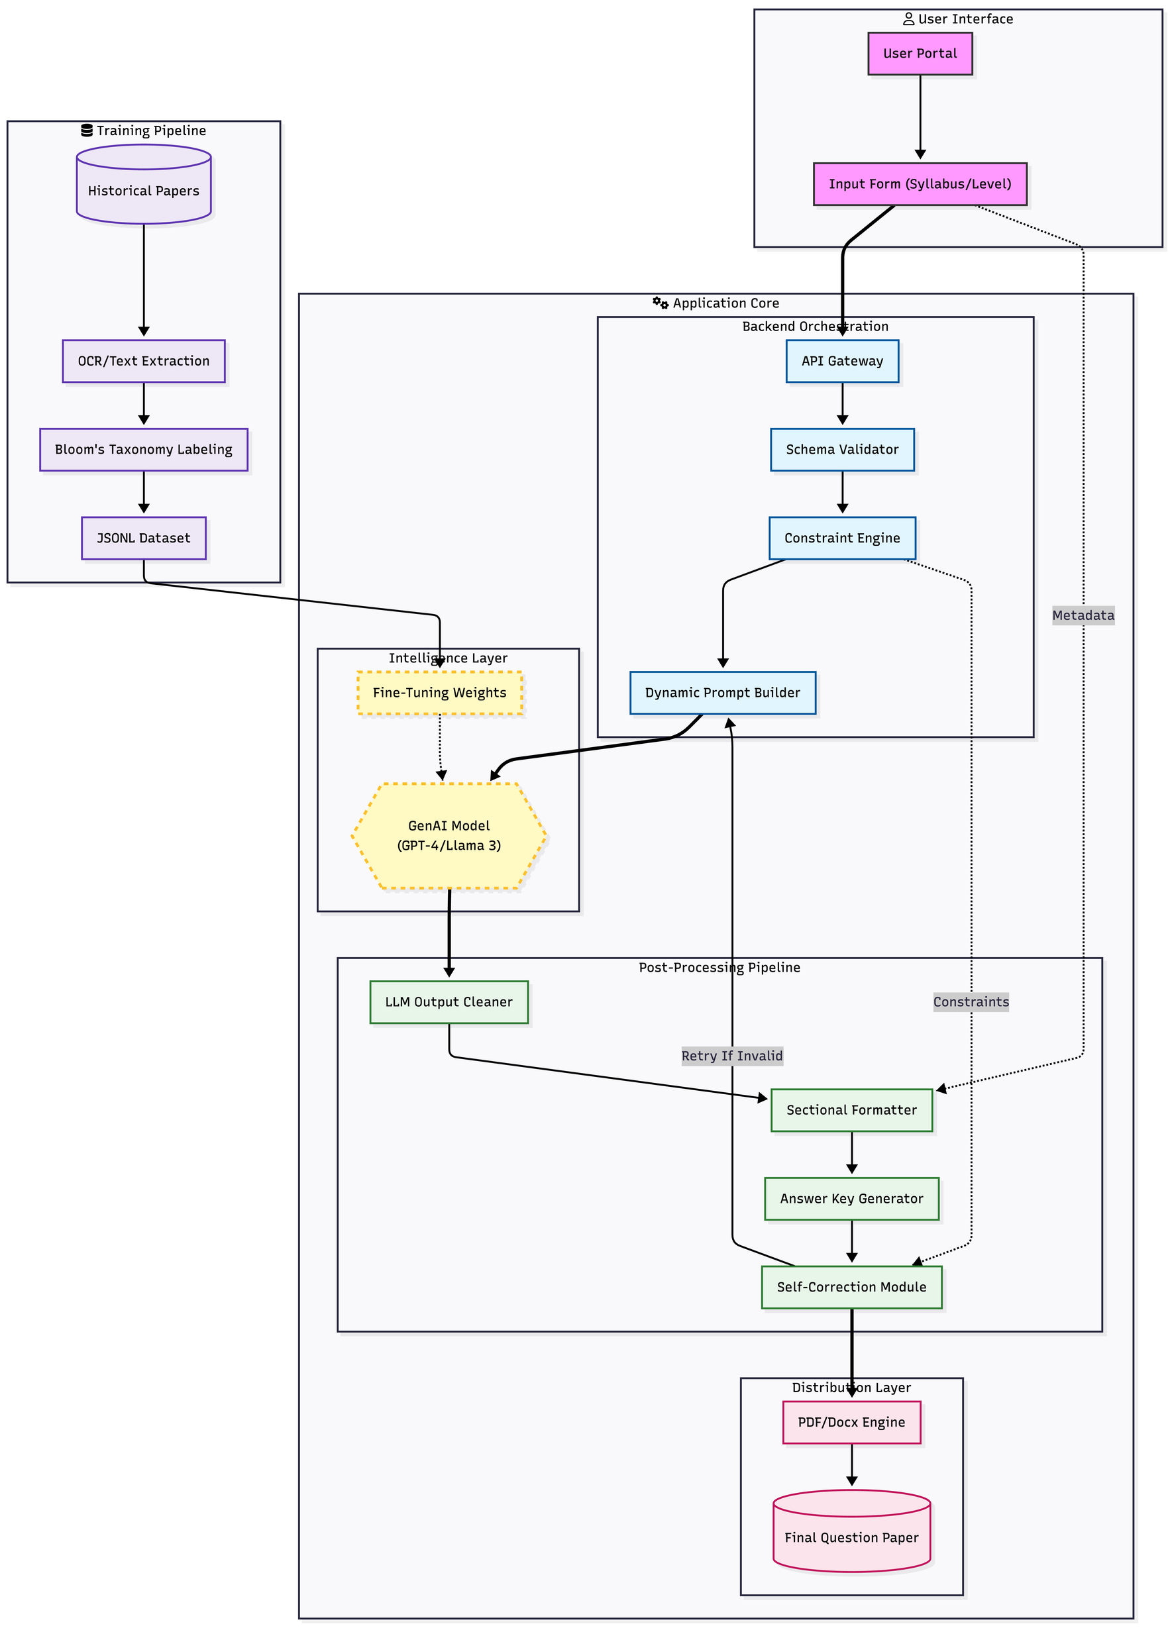

Slide 12


Slide 13
{
"Batch": "TY Mechanical",
"subject": "Manufacturing Engineering",
"unit": 4,
"unit_name": "Jigs and Fixtures",
"question": "(a) What are the principles of clamping?",
"marks": 5,
"difficulty": "Easy",
"bloom_level": "Understand",
"year": 2023
}

