Slide 1

DATABASE MANAGEMENT SYSTEM
BCSC0003
By
Suman Kumar Bhattacharyya Assistant Professor
Computer Engineering and Application Department

Slide 2
Today we will discuss
ER Model Concepts
Notation for ER Diagram
Mapping Constraints
Key

Slide 3
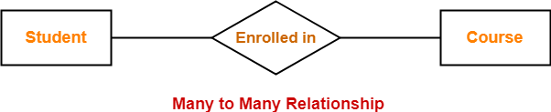
.
ER Model Concepts

Slide 4
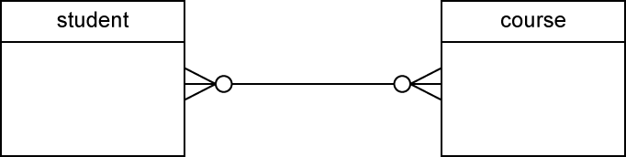
ER Model Concepts
In this example,
One student can enroll in any number (zero or more) of courses.
One course can be enrolled by any number (zero or more) of students

Slide 5
Cardinality Ratios
One to One Relationship (1:1)
A single entity instance in one entity class is related to a single entity instance in another entity class.
For example:
Each student fills one seat and one seat is assigned to only one student. Each professor has one office space.

Slide 6
Cardinality Ratios
One to Many Relationship (1:M)
A single entity instance in one entity class (parent) is related to multiple entity instances in another entity class (child)
For example:
One instructor can teach many courses, but one course can only be taught by one instructor.
One instructor may teach many students in one class, but all the students have one instructor for that class.

Slide 7
Cardinality Ratios
Many to Many Relationship (M:M)
Each entity instance in one entity class is related to multiple entity instances in another entity class; and vice versa.
For example:
Each student can take many classes, and each class can be taken by many students.
Each consumer can buy many products, and each product can be bought by many consumers.
The detailed Crow's Foot Relationship symbols can be found here. Crow's Foot Relationship Symbols

Slide 8
Attributes
Attributes are facts or description of entities.
They are also often nouns and become the columns of the table.
For example, for entity student, the attributes can be first name, last name, email, address and phone numbers.

Slide 9

Attributes
Multivalued Attribute
If an attribute can have more than one value it is called a multi-valued attribute.
It is important to note that this is different from an attribute having its own attributes.
For example, a teacher entity can have multiple subject values.

Slide 10
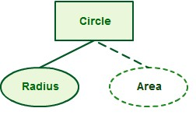
Attributes
Derived Attribute
An attribute based on another attribute. This is found rarely in ER diagrams.
For example, for a circle, the area can be derived from the radius.

Slide 11
Attributes
Primary Key
Primary Key* or identifier is an attribute or a set of attributes that uniquely identifies an instance of the entity.
For example, for a student entity, student number is the primary key since no two students have the same student number. We can have only one primary key in a table. It identify uniquely every row and it cannot be null.

Slide 12
Attributes
Foreign key
A foreign key+ (sometimes called a referencing key) is a key used to link two tables together.
Typically you take the primary key field from one table and insert it into the other table where it becomes a foreign key (it remains a primary key in the original table).
We can have more than one foreign key in a table.
Weak entity uses a foreign key combined with its attributed to form the primary key.

Slide 13
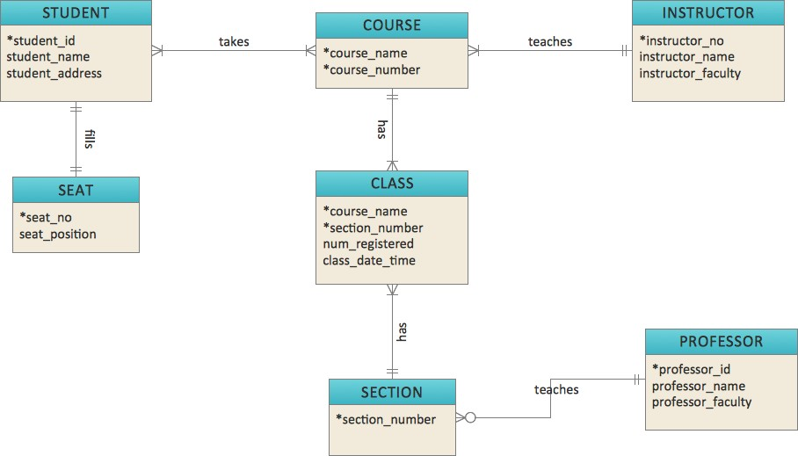
Example,

Slide 14
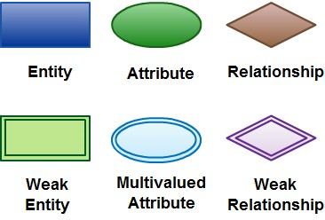
Notation for ER Diagram

Slide 15
How to Draw ER Diagrams
3 steps,
Identify all the entities in the system. An entity should appear only once in a particular diagram. Create rectangles for all entities and name them properly.
Identify relationships between entities. Connect them using a line and add a diamond in the middle describing the relationship.
Add attributes for entities. Give meaningful attribute names so they can be understood easily.

Slide 16
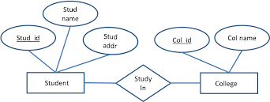
Example of ER diagram

Slide 17
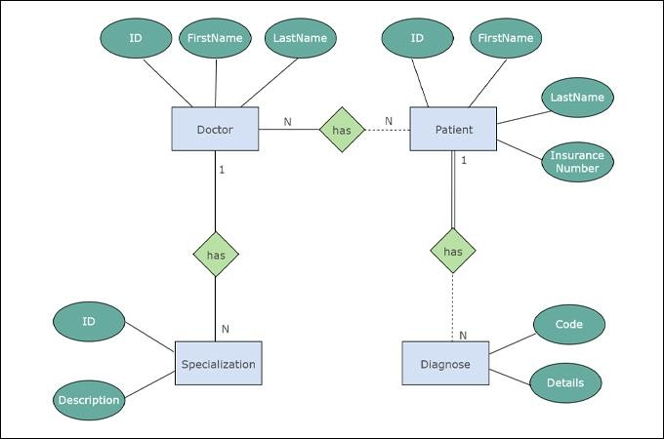

Slide 18

Thanks
GLA University, CAE Department
25

