Slide 1

DATABASE MANAGEMENT SYSTEM BCSC0003
By
Suman Kumar Bhattacharyya
Assistant Professor
Computer Engineering and Application Department

Slide 2
Today we will discuss
Schema
Instances
3. Data Independence

Slide 3
Schemas
Design of a database is called the schema.
Schema is of three types:
Physical schema,
logical schema and
view schema.

Slide 4
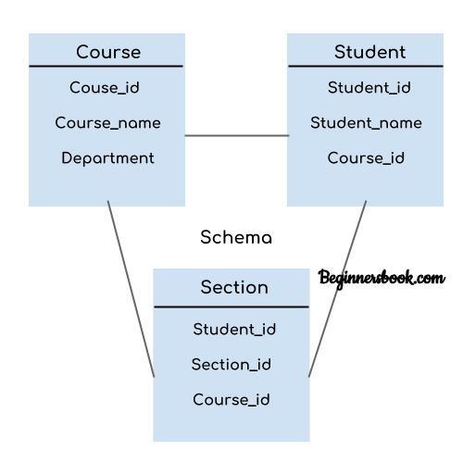
Schemas

Slide 5
Schemas
In the previous diagram, we have a schema that shows the relationship between three tables: Course, Student and Section.
The diagram only shows the design of the database, it doesn’t show the data present in those tables.
Schema is only a structural view(design) of a database as shown in the diagram.

Slide 6
Schemas
The design of a database at physical level is called physical schema, how the data stored in blocks of storage is described at this level.
Design of database at logical level is called logical schema, programmers and database administrators work at this level, at this level data can be described as certain types of data records gets stored in data structures, however the internal details such as implementation of data structure is hidden at this level (available at physical level).
Design of database at view level is called view schema. This generally describes end user interaction with database systems.

Slide 7
Instances
The data stored in database at a particular moment of time is called instance of database.
Database schema defines the variable declarations in tables that belong to a particular database.
The value of these variables at a moment of time is called the instance of that database.

Slide 8
Instances
A database instance is a state of operational database with data at any given time.
It contains a snapshot of the database.
Database instances tend to change with time.
A DBMS ensures that its every instance (state) is in a valid state, by diligently following all the validations, constraints, and conditions that the database designers have imposed.

Slide 9
Instances
For example,
Lets say we have a single table student in the database, today the table has 100 records, so today the instance of the database has 100 records.
Lets say we are going to add another 100 records in this table by tomorrow so the instance of database tomorrow will have 200 records in table.
In short, at a particular moment the data stored in database is called the instance, that changes over time when we add or delete data from the database.

Slide 10
Instances
Instance – the actual content of the database at a particular point in time
Eg. EMP
SSN | NAME | FNAME
1 | AMIT | PRAKHAR
2 | RAJ | JAI

Slide 11
Data independence
Data independence can be explained using the three-schema architecture.
Data independence refers characteristic of being able to modify the schema at one level of the database system without altering the schema at the next higher level.

Slide 12
Data Independence
There are two types of data independence:
Logical Data Independence
Physical Data Independence
Logical Data Independence
Logical data independence refers characteristic of being able to change the conceptual schema without having to change the external schema.
Logical data independence is used to separate the external level from the conceptual view.
If we do any changes in the conceptual view of the data, then the user view of the data would not be affected.
Logical data independence occurs at the user interface level.

Slide 13
Data Independence
Physical Data Independence
Physical data independence can be defined as the capacity to change the internal schema without having to change the conceptual schema.
If we do any changes in the storage size of the database system server, then the Conceptual structure of the database will not be affected.
Physical data independence is used to separate conceptual levels from the internal levels.
Physical data independence occurs at the logical interface level.

Slide 14
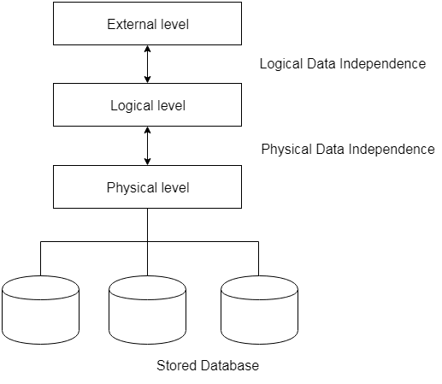
Data Independence

Slide 15

Thanks

