Slide 1

Notes:
1st slide (Mandatory)

Slide 2
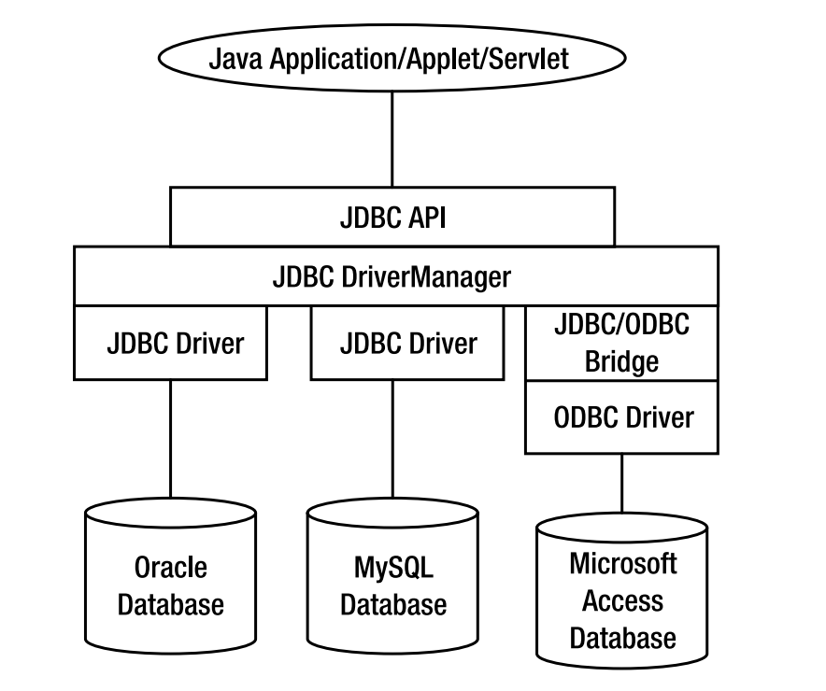


Slide 3
Prepared Statement
Using PreparedStatement in place of Statement interface will improve the performance of a JDBC program
PreparedStatement is inherited from Statement; the difference is that a PreparedStatement holds precompiled SQL statements
Notes:
Note :
PreparedStatement is inherited from Statement; the difference is that a PreparedStatement holds precompiled SQL statements.
If you execute a Statement object many times, its SQL statement is compiled each time. PreparedStatement is more efficient
because its SQL statement is compiled only once, when you first prepare the PreparedStatement.
After that, each time you execute the SQL statement in the PreparedStatement, the SQL statement does not have to be recompiled.

Slide 4
Prepared Statement
If you execute a Statement object many times, its SQL statement is compiled each time. PreparedStatement is more efficient because its SQL statement is compiled only once, when you first prepare the PreparedStatement.
After that, each time you execute the SQL statement in the PreparedStatement, the SQL statement does not have to be recompiled
Notes:
Note :
PreparedStatement is inherited from Statement; the difference is that a PreparedStatement holds precompiled SQL statements.
If you execute a Statement object many times, its SQL statement is compiled each time. PreparedStatement is more efficient
because its SQL statement is compiled only once, when you first prepare the PreparedStatement.
After that, each time you execute the SQL statement in the PreparedStatement, the SQL statement does not have to be recompiled.

Slide 5
PreparedStatement Object
PreparedStatement Parameters
A PreparedStatement does not have to execute exactly the same
query each time. You can specify parameters in the PreparedStatement SQL string and supply the actual values for these
parameters when the statement is executed.
The following slide shows how to supply parameters and execute a PreparedStatement.

Slide 6
How to Create a PreparedStatement?
1. Register the driver and create the database connection
2. Create the prepared statement,
- identifying variables witha question mark (?)

Slide 7
How to Create a PreparedStatement?
PreparedStatement pstmt =
conn.prepareStatement("update STUDENT
set SUPERVISOR = ? where ID = ?");
PreparedStatement pstmt =
conn.prepareStatement("select SUPERVISOR from
STUDENT where ID = ?");
Notes:
Notes :
Once the connection object is obtained, the prepareStatement method is called on it
to obtain the PreparedStatement object. However, in this case, while creating it,
itself, the SQL statement is provided as a parameter to the method. The
variable portions of the SQL statement are provided as a question mark (?) so
that the values can be supplied dynamically before execution of the
statement.

Slide 8
How to execute PreparedStatement?
Supply values for the variables
pstmt.setXXX(index, valu);
Specifying Values for the Bind Variables
You use the PreparedStatement.setXXX() methods to supply values for the
variables in a prepared statement. There is one setXXX() method for each
Java type: setString(), setInt(), and so on.
Notes:
Note:
You must use the setXXX() method that is compatible with the SQL type of
the variable. In the example on the slide, the first variable is updating a
VARCHAR column, so we need to use setString() to supply a value for the
variable. You can use setObject() with any variable type.
Each variable has an index. The index of the first variable in the prepared
statement is 1, the index of the second is 2, and so on. If there is only one
variable, its index is one. The index of a variable is passed to the setXXX()
method.

Slide 9
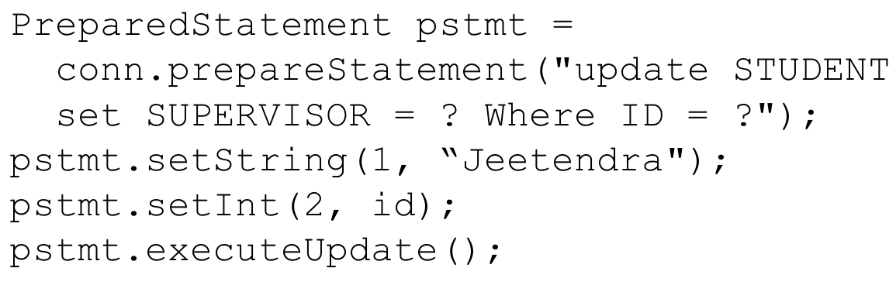
How to execute PreparedStatement?
Execute the statement
pstmt.executeQuery();
pstmt.executeUpdate();

Slide 10

//Example 1 on PreparedStatement
/* This class is executed in the following manner :
if you want to create the table, you will execute as java JCreate table1
where table1 is the name of the table. The table table1 is created with the
following columns empid, empname, dept, joindate, salary */
import java.sql.*;
class JCreate {
public static void main(String args[]) throws SQLException {
JdbcCalls e = new JdbcCalls();
e.create(args);
}
}
1
2
3
4
5
6
7
8
9
10
11
12
13
14
15
16
17
18
19
20
21
22

Slide 11
import java.sql.*;
class ConnectionClass {
Connection con;
Connection connectionFactory()
{
try {
Class.forName("oracle.jdbc.driver.OracleDriver");
con=DriverManager.getConnection("Jdbc:Oracle:thin:
@localhost:1521:ORCL","scott","tiger");
}
catch(Exception e)
{
System.out.println(e);
}
return con;
}
}
1
2
3
4
5
6
7
8
9
10
11
12
13
14
15
16
17
18
19
20
21
22

Slide 12
class JdbcCalls {
Connection con;
JdbcCalls()
{
ConnectionClass x = new ConnectionClass(); con=x.connectionFactory();
}
void create(String[] args) throws SQLException
{
String tablename = args[0];
PreparedStatement pst = con.prepareStatement("Create table"+tablename+" (empid number(4), empname varchar(20),
dept varchar2(10), joindate date, salary number(10,2))");
pst.executeUpdate();
System.out.println(“Table created successfully”);
}
}
1
2
3
4
5
6
7
8
9
10
11
12
13
14
15
16
17
18
19
20
21
22

Slide 13
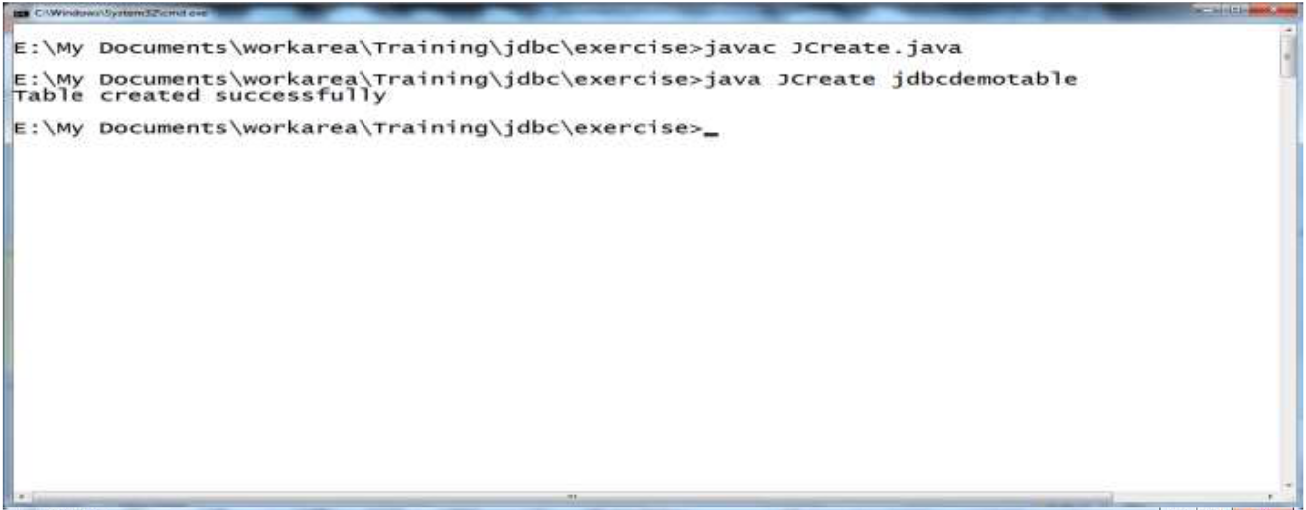
Example 1 on PreparedStatement (Contd..)

Slide 14
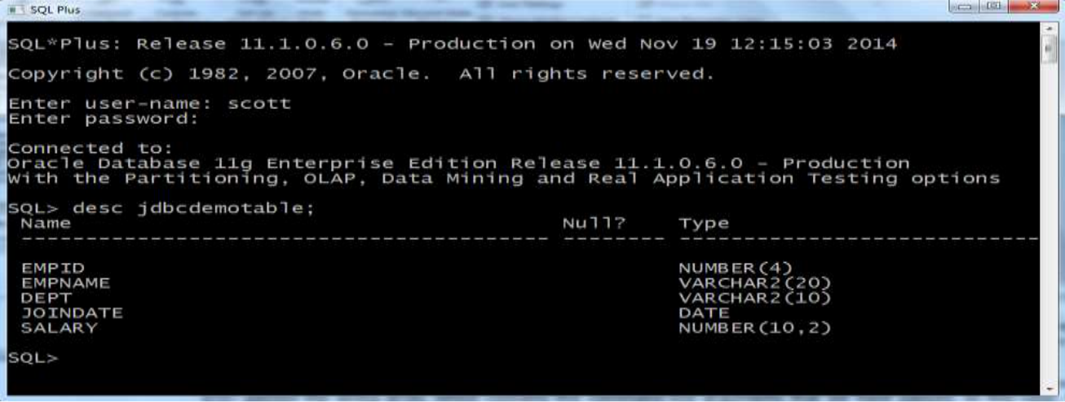
Example 1 on PreparedStatement (Contd..)

Slide 15
//Example 2 on PreparedStatement
/* This class is executed in the following manner :
If you want to insert a row within the table, you will execute as
java JInsert jdbcdemotable 1001 anish admin 23-dec-2008 50000.00 */
import java.sql.*;
class JInsert {
public static void main(String args[]){
try {
JdbcCalls e = new JdbcCalls();
e.insert(args);
}
catch(SQLException e){
System.out.println(e.toString());
}
}
}
class JdbcCalls {
Connection con;
JdbcCalls() {
ConnectionClass x = new ConnectionClass();
con = x.connectionFactory();
}
1
2
3
4
5
6
7
8
9
10
11
12
13
14
15
16
17
18
19
20
21
22

Slide 16
void insert(String[] args) throws SQLException {
String tablename = args[0];
int empid = Integer.parseInt(args[1]);
String empname = args[2];
String dept = args[3];
String dat=args[4];
Float salary = Float.parseFloat(args[5]);
PreparedStatement pst = con.prepareStatement("insert into
"+tablename+" values(?,?,?,?,?)");
pst.setInt(1, empid);
pst.setString(2, empname);
pst.setString(3, dept);
pst.setString(4, dat);
pst.setFloat(5, salary);
pst.executeUpdate();
System.out.println(“Record inserted successfully”);
}
1
2
3
4
5
6
7
8
9
10
11
12
13
14
15
16
17
18
19
20
21
22

Slide 17
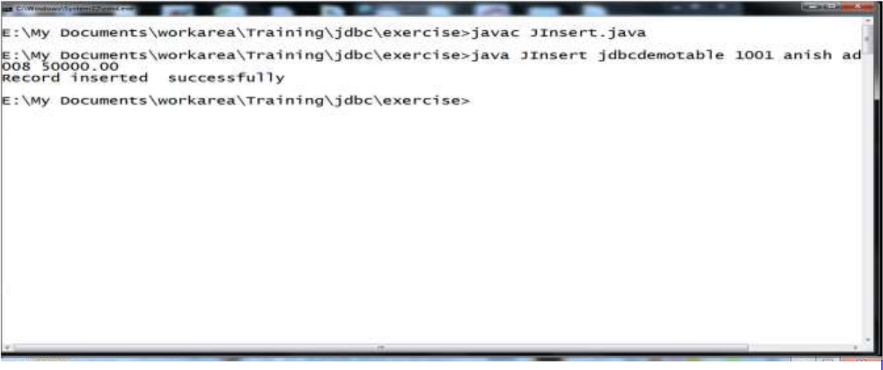
Example 2 on PreparedStatement (Contd.).

Slide 18
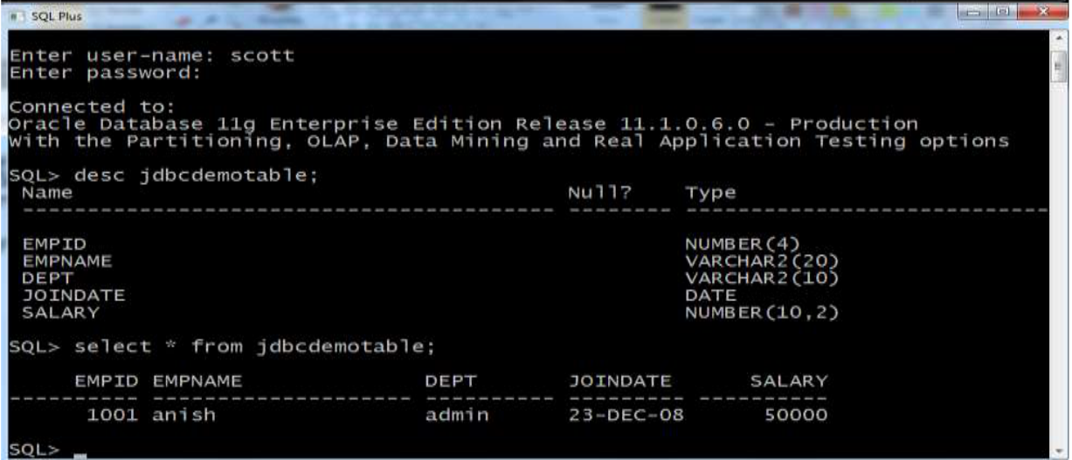
Example 2 on PreparedStatement (Contd.).

Slide 19
ResultSetMetaData Object
ResultSetMetaData is an interface which contains methods to
get information about the types and properties of the columns
in the ResultSet object
ResultSetMetaData object provides metadata, including:
Number of columns in the result set
Column type
Column name
Notes:
Note :
In JDBC, you use the ResultSet.getMetaData() method to return
a ResultSetMetaData object, which describes the data coming
back from a database query. This object can be used to
find out about the types and properties of the columns
in your ResultSet.

Slide 20
How to obtain ResultSetMetadata?
1. To get the ResultSetMetaData object
ResultSetMetaData rsmd = rset.getMetaData();
2. Use the object’s methods to get the metadata
ResultSetMetaData rsmd = rset.getMetaData();
for (int i = 1; i <= rsmd.getColumnCount(); i++) {
String colname = rsmd.getColumnName(i);
int coltype = rsmd.getColumnType(i);
...
}

Slide 21
//Example on ResultSetMetaData
import java.sql.*;
class MakeConnection4
{
Connection conn;
Statement stmt;
ResultSet rs;
ResultSetMetaData rsmd;
MakeConnection4()
{
try{
Class.forName("oracle.jdbc.driver.OracleDriver");
conn = DriverManager.getConnection("Jdbc:Oracle:thin:
@localhost:1521:orcl","scott","tiger");
stmt = conn.createStatement();
rs = stmt.executeQuery("Select * from emp");
1
2
3
4
5
6
7
8
9
10
11
12
13
14
15
16
17
18
19
20
21
22

Slide 22
rsmd = rs.getMetaData();
int noc = rsmd.getColumnCount();
System.out.println("Number Of Columns : "+noc);
for(int i=1;i<=noc;i++){
System.out.print("Column "+i+" ="+rsmd.getColumnName(i)+"; ");
System.out.print("Column Type =
"+rsmd.getColumnType(i)+"; ");
System.out.println("Column Type Name =
"+rsmd.getColumnTypeName(i)+";");
}
}
catch(Exception e){
e.printStackTrace();
}
}
}
public class RSMetaDataExample {
public static void main(String args[]) {
new MakeConnection4();
}
}
1
2
3
4
5
6
7
8
9
10
11
12
13
14
15
16
17
18
19
20
21
22

Slide 23
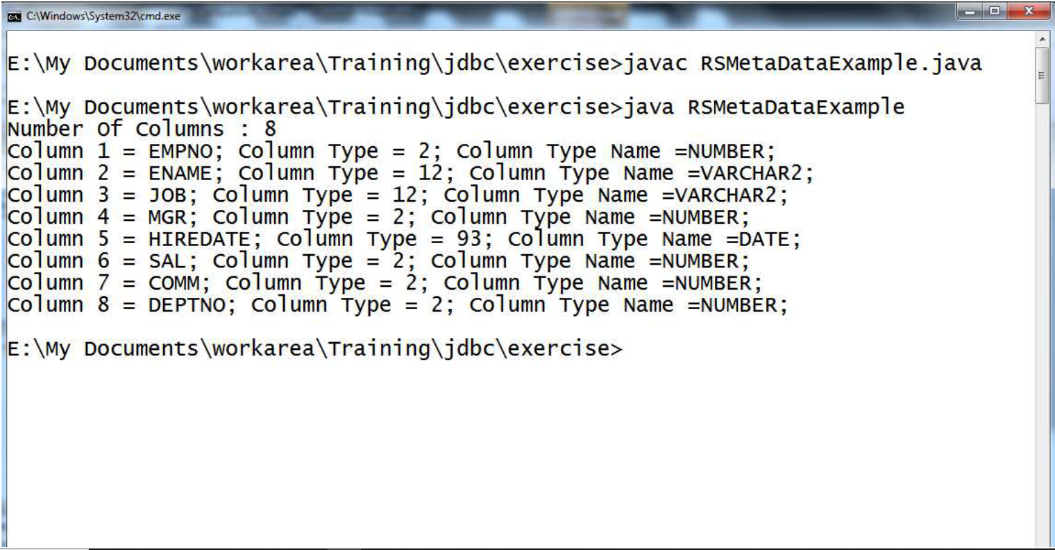
Example on ResultSetMetaData (Contd.).

Slide 24
DatabaseMetaData Object
To know which type of driver we are using and whether is it compatable or JDBC complaint or not. It is used to know all details about database provider as well.
Obtaining a DatabaseMetaData Instance
DatabaseMetaData databaseMetaData = connection.getMetaData();
Notes:
Note :
This interface is generally implemented by the database vendor and provided along with the native JDBC driver.
Native JDBC drivers are built on top of the database.
By implementing this interface, database vendors provide comprehensive information about the database as a whole, such as table name, indexes, product name, version, and so forth.
There are a number of methods declared in this interface to retrieve various metadata information associated with the database.

Slide 25
DatabaseMetaData Object
Database Product Name and Version
int majorVersion = databaseMetaData.getDatabaseMajorVersion();
int minorVersion = databaseMetaData.getDatabaseMinorVersion();
String productName = databaseMetaData.getDatabaseProductName(); String productVersion = databaseMetaData.getDatabaseProductVersion();
Database Driver Version
int driverMajorVersion = databaseMetaData.getDriverMajorVersion();
int driverMinorVersion = databaseMetaData.getDriverMinorVersion();

Slide 26
//Example on DatabaseMetaData
import java.sql.Connection;
import java.sql.DatabaseMetaData;
import java.sql.DriverManager;
import java.sql.SQLException;
class Dbmd{
public static void main(String args[]){
try{
Class.forName("oracle.jdbc.driver.OracleDriver");
Connection con = DriverManager.getConnection ("jdbc:oracle:thin:@localhost:1521:
xe","system","oracle");
DatabaseMetaData dbmd = con.getMetaData();
System.out.println("Driver Name: "+dbmd.getDriverName());
System.out.println("Driver Version: "+
dbmd.getDriverVersion());
System.out.println("UserName: "+dbmd.getUserName());
1
2
3
4
5
6
7
8
9
10
11
12
13
14
15
16
17
18
19
20
21
22

Slide 27
System.out.println("Database Product Name: "+
dbmd.getDatabaseProductName());
System.out.println("Database Product Version: "+
dbmd.getDatabaseProductVersion());
con.close();
}
catch(Exception e){
System.out.println(e);
}
}
}
1
2
3
4
5
6
7
8
9
10
11
12
13
14
15
16
17
18
19
20
21
22

Slide 28
Example on DatabaseMetaData (Contd.).
Result :
Output:Driver Name: Oracle JDBC Driver
Driver Version: 10.2.0.1.0XE
Database Product Name: Oracle
Database Product Version: Oracle Database 10g Express Edition
Release 10.2.0.1.0 -Production

Slide 29

THANK YOU
Notes:
Thank you slide

