Slide 1

Notes:
1st slide (Mandatory)

Slide 2

Store image in Oracle database
setBinaryStream()
Method of PreparedStatement is used to set Binary information into the parameterIndex.
Image representations:
Digitized (sampled) representation of field-based spatial data
Notes:
Note:
You can store images in the database in java by the help of PreparedStatement interface.

Slide 3
setBinaryStream method
1) public void setBinaryStream(int paramIndex,InputStream stream) throws SQLException
2) public void setBinaryStream(int paramIndex,InputStream stream,
long length) throws SQLException

Slide 4

//Example to store image in the database
public class DatabaseImageExample {
public static void main(String args[]){
try{
Class.forName("com.mysql.jdbc.Driver");
Connection con = DriverManager.getConnection( "jdbc:mysql://localhost/demo","root","root");
File file = new File("E:\\image.png");
FileInputStream fis = new FileInputStream(file);
PreparedStatement ps=con.prepareStatement("insert into image_table (name,image) values(?,?)");
ps.setString(1,"image 1");
ps.setBinaryStream(2,fis,(int)file.length());
ps.executeUpdate();
ps.close();
fis.close();
con.close();
}
catch(Exception e){e.printStackTrace();}
}
}
1
2
3
4
5
6
7
8
9
10
11
12
13
14
15
16
17
18
19
20
21
22
Notes:
Note:
Above example will take image from location E:\\image.png and save it into database table.
Actually you can’t see the image directly in the table.
You have to retrieve it from database and then save it to some location. Below example shows how you can do this.

Slide 5
Retrieve image from database
getBlob() method of PreparedStatement is used to get Binary information, it returns the instance of Blob.
getBytes() method on the blob object, we can get the array of binary information that can be written into the image file.
getBlob() method of PreparedStatement
public Blob getBlob()throws SQLException
Notes:
Note:
To help of PreparedStatement we can retrieve and store the image in the database.

Slide 6
//Example : Retrieve image from database
import java.io.*;
import java.sql.*;
public class DatabaseImageExample
{
public static void main(String args[])
{
try{
Class.forName("com.mysql.jdbc.Driver");
Connectioncon = DriverManager.getConnection
("jdbc:mysql://localhost/demo","root","root");
File file = new File("E:\\image1.png");
FileOutputStream fos = new FileOutputStream(file);
byte b[];
Blob blob;
PreparedStatement ps=con.prepareStatement("select * from image_table");
ResultSet rs = ps.executeQuery();
1
2
3
4
5
6
7
8
9
10
11
12
13
14
15
16
17
18
19
20
21
22

Slide 7
while(rs.next())
{
blob=rs.getBlob("image");
b=blob.getBytes(1,(int)blob.length());
fos.write(b);
}
ps.close();
fos.close();
con.close();
}
catch(Exception e)
{
e.printStackTrace();
}
}
}
1
2
3
4
5
6
7
8
9
10
11
12
13
14
15
16
17
18
19
20
21
22
Notes:
Note:
Above example will take image from location E:\\image.png and save it into database table.
Actually you can’t see the image directly in the table.
You have to retrieve it from database and then save it to some location. Below example shows how you can do this.
Above example will fetch image from database and save it at location E:\\image1.png.

Slide 8
Store file in Oracle database
setCharacterStream() method of PreparedStatement is used to set character information into the parameterIndex.
Syntax:
public void setBinaryStream(int paramIndex,InputStream stream)throws SQLException
public void setBinaryStream(int paramIndex,InputStream stream,long length)throws SQLException

Slide 9
//Example to Store file in the database
PreparedStatement psmnt = (PreparedStatement)
con.prepareStatement(&quot;INSERT INTO DB.images VALUES(?,?)&quot;);
psmnt.setInt(1, 5);
File f = new File(&quot;test.jpg&quot;);
psmnt.setBlob(2, new FileInputStream(f), f.length());
psmnt.executeUpdate();
System.out.println(&quot;Image saved in DB&quot;);
1
2
3
4
5
6
7
8
9
10
11
12
13
14
15
16
17
18
19
20
21
22

Slide 10
Retrieve file from Oracle database
getClob() method of PreparedStatement is used to get file information from the database.
Syntax:
public Clob getClob(int columnIndex)
{
// Code
}

Slide 11
//Example to Retrieve file in the database
//retrieving it
Statement stmt = (Statement) con.createStatement();
ResultSet rs = stmt.executeQuery(&quot;SELECT * FROM DB.images&quot;);
int count = 0;
while (rs.next())
{
InputStream is = rs.getBinaryStream(&quot;photo&quot;);
BufferedImage image = ImageIO.read(is);
//the image is read in store it back again as a file
ImageIO.write(image, &quot;jpg&quot;, new
FileOutputStream(&quot;recived&quot; + count + &quot;.jpg&quot;));
count++;
}
1
2
3
4
5
6
7
8
9
10
11
12
13
14
15
16
17
18
19
20
21
22

Slide 12
CallableStatement Object
A CallableStatement object is used for calling the stored procedure from JDBC program
A callable statement can contain variables that you supply each time you execute the call
When the stored procedure returns, computed values (if any) are retrieved through the CallableStatement object

Slide 13
CallableStatement Object
The way to access stored procedures using JDBC is through the CallableStatement class which is inherited from the PreparedStatement class.
CallableStatement is like PreparedStatement in that you can specify parameters using the question mark (?) notation, but it contains no SQL statements
Notes:
Note:
Both functions and procedures take parameters represented by identifiers. A function executes some procedural logic and it returns a value that can be any data type supported by the
database. The parameters supplied to the function do not change after the function is executed
A procedure executes some procedural logic but does not return any value. However, some of the parameters supplied to the procedure may have their values changed after the
procedure is executed
• Note: Calling a stored procedure is the same whether the stored procedure was written originally in Java or in any other language supported by the database, such as PL/SQL. Indeed,
a stored procedure written in Java appears to the programmer as a PL/SQL stored procedure

Slide 14
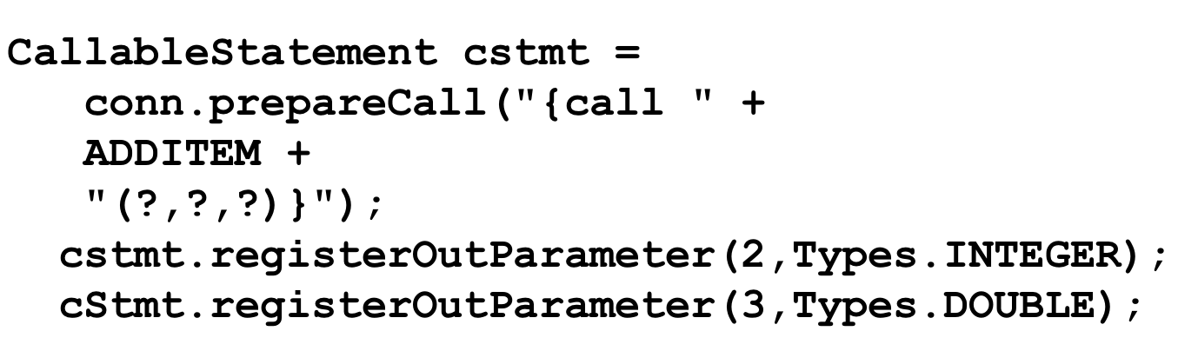
How to Create a CallableStatement?
Register the driver and create the database connection
Notes:
Note:
Register the driver and create the database connection
On connection object prepareCall() method is used to
call the stored procedure
Create the callable statement, identifying variables with
a question mark (?)

Slide 15
How to Create a CallableStatement?
Creating a Callable Statement :
First you need an active connection to the database in order to obtain a CallableStatement object
Next, you create a CallableStatement object using the prepareCall() method of the Connection class. This method typically takes a string as an argument.

Slide 16
How to Create a CallableStatement?
The syntax for the string has two forms. The first form includes a result parameter and the second form does not:
{? = call proc (...) } // A result is returned into a variable
{call proc (...) } // Does not return a result
Notes:
Note:
In the example in the slide, the second form is used, where the stored procedure in question is ADDITEM
Note that the parameters to the stored procedures are specified using the question mark notation used earlier in
PreparedStatement. You must register the data type of the parameters using the registerOutParameter() method of
CallableStatement if you expect a return value, or if the procedure is going to modify a variable (also known as an OUT
variable)
In the example in the slide, the second and third parameters are going to be computed by the stored procedure, whereas
the first parameter is an input (the input is specified in the next slide). Parameters are referred to sequentially, by number. The
first parameter is 1
To specify the data type of each OUT variable, you use parameter types from the Types class. When the stored
procedure successfully returns, the values can be retrieved from the CallableStatement object

Slide 17
How to execute a CallableStatement?
To pass the input parameters
cstmt.setXXX(index, value);
CallableStatement should be executed, as:
cstmt.execute();
To get the output parameters
var = cstmt.getXXX(index);
Notes:
Note:
1. Set the IN parameters - Use the setXXX() methods to supply values for the IN parameters. There is one setXXX() method
for each Java type: setString(), setInt(), and so on. You must use the setXXX() method that is compatible with the SQL type
of the variable.
2. You can use setObject() with any variable type. Each variable has an index. The index of the first variable in the callable
statement is 1, the index of the second is 2, and so on. If there is only one variable, its index is 1
3.Execute the call to the stored procedure - Execute the procedure using the execute() method
4. Get the OUT parameters - Once the procedure is completed, you retrieve OUT variables, if any, using the getXXX() methods.
Note that these methods must match the types you Registered.

Slide 18
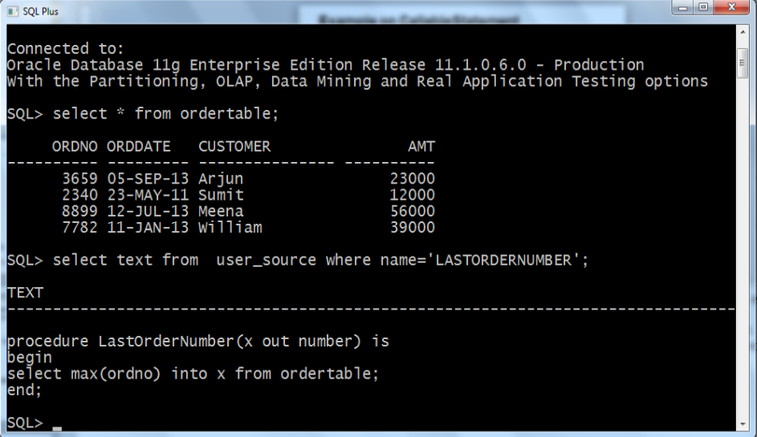
Stored Procedure and the ordertable

Slide 19
//Example on CallableStatement
import java.sql.*;
class ExCallable
{
public static void main (String args[])
{
new ExCall();
}
}
class ExCall {
ExCall() {
int lastOrderNumber;
Connection conn;
try {
ConnectionClass x = new ConnectionClass();
conn=x.connectionFactory();
String query ="{ CALL LastOrderNumber (?)}" ;
1
2
3
4
5
6
7
8
9
10
11
12
13
14
15
16
17
18
19
20
21
22

Slide 20
CallableStatement cstatement = conn.prepareCall(query);
cstatement.registerOutParameter(1, Types.INTEGER);
cstatement.execute();
lastOrderNumber = cstatement.getInt(1);
System.out.println("The last order number :"+lastOrderNumber);
cstatement.close();
conn.close();
}
catch (SQLException error)
{
System.out.println("Cannot connect to database "+ error);
}
}
}
1
2
3
4
5
6
7
8
9
10
11
12
13
14
15
16
17
18
19
20
21
22

Slide 21
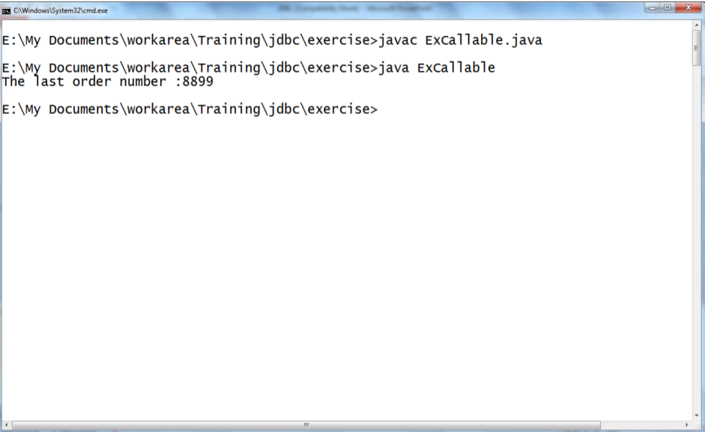
Example on CallableStatement (Contd.).

Slide 22
Using Transactions
With JDBC drivers new connections are, by default , in auto commit mode
Turn Auto Commit Off :
Use con.setAutoCommit(false);
To control transactions, when you are not in autocommit mode:
con.commit(): Commit a transaction
con.rollback(): Roll back a transaction
Turn Auto Commit On :
Use con.setAutoCommit(true);

Slide 23
Using Transactions
Transactions with JDBC
With JDBC, database transactions are managed by using the Connection object. When you create a Connection obj ect, by default in autocommit mode, meaning that, after executing every statement by default it is commited
Notes:
Note :
If autocommit mode has been disabled, its SQL statements are grouped into transactions, which must be terminated by calling
either commit() or rollback(). commit() makes permanent all changes since the previous commit or rollback and releases
any database locks held by the connection
rollback() drops all changes since the previous commit or
rollback and releases any database locks. commit() and
rollback() should only be called when in non-autocommit mode

Slide 24
Using Transactions
You can change the autocommit mode by using setAutoCommit() method.
Here is a full description of autocommit mode:
If a connection is in autocommit mode, all its SQL statements will be executed and committed as individual transactions.
If a statement returns a result set, the statement completes when the last row of the result set has been retrieved, or the result set has been closed
Notes:
Note :
If autocommit mode has been disabled, its SQL statements are grouped into transactions, which must be terminated by calling
either commit() or rollback(). commit() makes permanent all changes since the previous commit or rollback and releases
any database locks held by the connection
rollback() drops all changes since the previous commit or
rollback and releases any database locks. commit() and
rollback() should only be called when in non-autocommit mode

Slide 25
//Example on Transactions
import java.sql.*;
public class ExTransaction{
public static void main (String args[]){
new ExTransact();
}
}
class ExTransact {
Connection con;
ExTransact(){
try{
ConnectionClass x = new ConnectionClass();
con=x.connectionFactory();
con.setAutoCommit(false);
Statement statement1 = null;
try
{
statement1 = con.createStatement();
statement1.executeUpdate("update Employee set name='John' where id=123");
}
1
2
3
4
5
6
7
8
9
10
11
12
13
14
15
16
17
18
19
20
21
22

Slide 26
finally {
if(statement1 != null)
{
statement1.close();
}
}
Statement statement2 = null;
try{
statement2 = con.createStatement();
statement2.executeUpdate("update Employee set name='Gary' where id=456");
}
finally {
if(statement2 != null) {
statement2.close();
}
}
con.commit();
}
catch(Exception e) {
con.rollback();
}
1
2
3
4
5
6
7
8
9
10
11
12
13
14
15
16
17
18
19
20
21
22

Slide 27
finally
{
if(con != null) {
con.close();
}
}
}
}
1
2
3
4
5
6
7
8
9
10
11
12
13
14
15
16
17
18
19
20
21
22

Slide 28


Question 1
Which of the following method has to be invoked on the Connection object to get CallableStatement object ?
A)
prepareCall
B)
prepareStatement
C)
createCallable
D)
prepareCallable
Notes:
Question + Large Options (2Lines)

Slide 29
Question 2
Which of the following statements can be used to turn autocommit off (where conn is the reference to the Connection object) ?
A)
conn.setAutoCommit(“true”);
B)
conn.setAutoCommit(true);
C)
conn.setAutoCommit(“false”);
D)
conn.setAutoCommit(false);
Notes:
Question + Large Options (2Lines)

Slide 30

THANK YOU
Notes:
Thank you slide

