Slide 1

Notes:
1st slide (Mandatory)

Slide 2

Introduction

Slide 3

What we will learn?
Multithreading
Exception Handling
JDBC
Networking
Servlets
Notes:
Title + Image + Text

Slide 4

Have you heard about Multitasking?
If yes! Then what is MultiThreading
Notes:
Title + Text

Slide 5
Multitasking
Multiprocessing
Multithreading

Slide 6
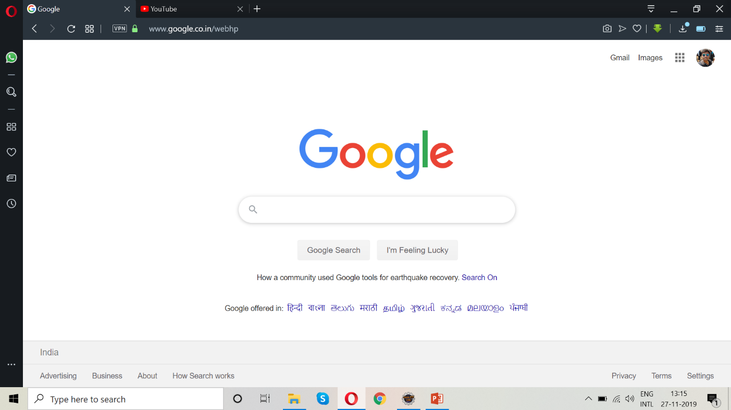
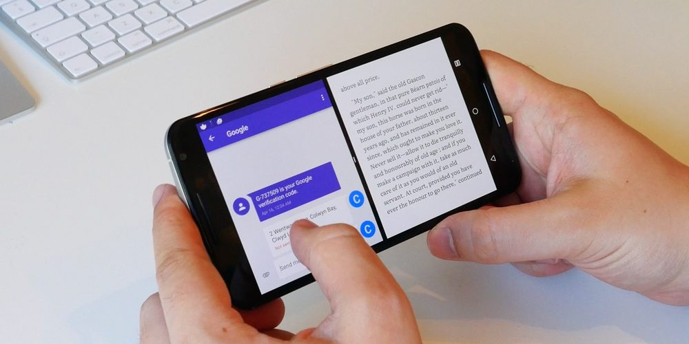
Notes:
Title + Bullets
No more than 4 points. Please use another similar slide incase you have more points.

Slide 7
Multitasking vs Multithreading
Doing two or more different processes at a time – Multitaksing
Ex: using split screen in mobile phone
Doing two or more different tasks inside a same process – Multithreading
Ex: using 2 or more tabs in a Web browser

Slide 8
Need for Multithreading:
To save time
To do multiple processes at a same time
Developing games

Slide 9
Realtime use of Multithreading:
Consider the game PUBG
We speak about PUBG as a realtime example for Multithreading but why? Or where is it implemented with Multithreading?
There may be 2 or more players playing simultaneously inside a same Arcade mode within the same time, where each player can shoot other player and so on..
Notes:
Tell them some more examples about booking a bus ticket at a same time by different person

Slide 10
Exception Handling
What is Exception?
What is Exception Handling?
Exceptions are a disruption that occurs to damage the normal flow of a program or an event, handling those exceptions without damaging other process is known as Exception Handling
Notes:
Anything that happens unpredicted or it happens beyond the scene is called Exception.

Slide 11
Need for Exception Handling
What happens if exceptions are not captured?
Flow of the program will be damaged
Solution for a problem should be designed in such a way that the exceptions are predicted before it was implemented
Notes:
Anything that happens unpredicted or it happens beyond the scene is called Exception.

Slide 12
Realtime problem of Exception Handling
What is the value of a?
int a = 10/2
What is the value of b?
int b = 24/4
What is the value of c?
int c = 3/0
Notes:
Anything that happens unpredicted or it happens beyond the scene is called Exception.

Slide 13
If you say the answer is undefined. Think again.
Yes you are right! But what about a compiler?

Slide 14


It Throws Exception, to capture this exception we go for exception handling

Slide 15
What is JDBC?
Java DataBase Connectivity
A connection between Java program and a Database

Slide 16
Need for JDBC
Can we use variables to store username and password?
If yes think about the processing speed of the program where it handles large number of users!
Whenever we stop a program, manually entered data will not be stored

Slide 17
Need for JDBC
In this case we need a platform to store and retrieve all the informations in a short span of time
So, we go with Database

Slide 18
Realtime Application of JDBC?
Gmail
Facebook etc…
Notes:
Here speak about all the user reg forms and login procedure. Speak how the values are getting stored in database and how it is retrieved back.
All signin forms require username and password. Only if this is validated it will allow us to access the site or information. In this case we use database as our storage medium which reduces our effect.

Slide 19
Networking & Servlets?
What is the name of the University you are studying now?
VIT-University
Notes:
Now say students that since you asked a qn they gave a answer to you
Now go to the next slide

Slide 20
Need of Networking & Servlets?
Whenever we get an answer for anything it means there was a Question raised behind it?
Will you agree this?

Slide 21
If yes! Then see what is Networking
What is Response and Request?
Response – Getting a proper answer from other
Request – Asking a Question to others

Slide 22
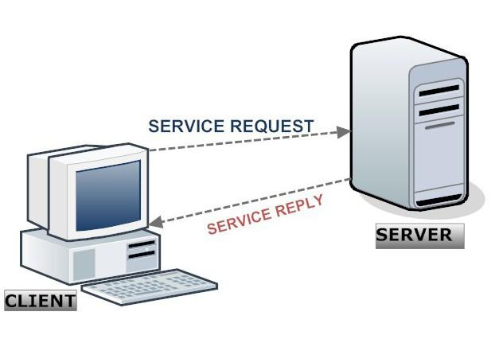
How to communicate with Database?
What is a Server?
program that is dedicated to managing network resources
Acts as a connector between UI and Database
Notes:
Tell students how a request is sent and received. Show a live demo using facebook website or youtube. Show with url

Slide 23
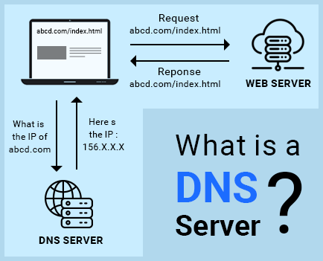
Realtime application of Networking
What happens when you type www.google.com on your browser?
Notes:
Speak about DNS server and tell how the url works in background

Slide 24

THANK YOU
Notes:
Thank you slide

