Slide 1


Slide 2

Terminologies
Multiprocessing
Task is divided and executed parallel, over multiple processors(CPU).
Multiprogramming
Multitasking
Multithreading
multiple programs to be executing over a single CPU.
Notes:
Definition of Multiprogramming
An operating system has the ability to multiprogram where it can involve multiple programs to be executing over a single CPU. Multiprogramming is an essential aspect of the operating system which can significantly induce CPU utilization. It arranges the jobs (code and data) in a way that the CPU will always have one job to execute. Here the concept is that operating system stores multiple jobs in the memory at the same time. As the main memory can short out for accommodating all jobs. So, the disks are used for storing the CPU jobs initially.
The group of jobs in the memory could be the subset of the jobs residing in the job pool. To process these jobs the operating systems selects one of them and starts to execute it in the memory. Ultimately, if any of the jobs have to wait for a specific time period for some other task to finish like I/O operation or other instruction, the CPU switches to the other job for that period. It stops CPU for being idle till only one job is left as it switches from one to the other job if it transitions to waiting state. Regardless, in a non-multiprogramming system, the CPU must be resting in an idle state.
Definition of Multitasking
Multitasking is viewed as the logical extension of the multiprogramming, as it implements the same approach of switching between the jobs but here switching is very often. This frequent switching facilitates the user to interact with each program while it is running. Multitasking systems need an interactive computer system to permit communication between the users and the system.
The user gives instructions to the computer system or to the program directly using some input devices like a mouse or keyboard. Consequently, the result of the input is immediate where the response time is less and could range in milliseconds to seconds. It permits multiple users to share common resources simultaneously. As the action or command in the multitasking system is often short and requires little CPU time for each user. Since the switching in these systems is very fast, the users are not able to notice it, and it gives the perception of a dedicated system.

Slide 3
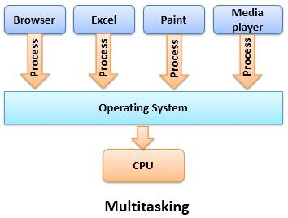
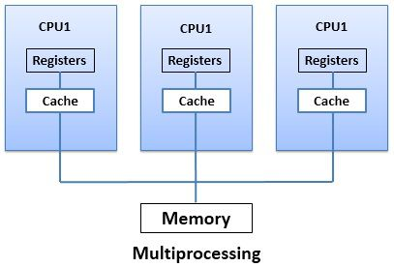
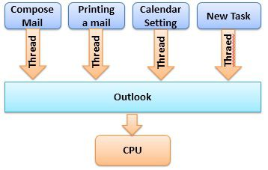
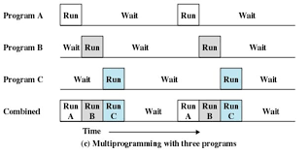
Multithreading

Slide 4
Comparison Chart – Multiprogramming Vs Multitasking
BASIS FOR COMPARISON | MULTIPROGRAMMING | MULTITASKING
Basic | Enables multiple programs to utilize CPU simultaneously. | A supplementary form of the multiprogramming system also supports user interaction.
Objective | Improvement in CPU utilization. | Minimize the response time.
Switching | Occurs when the currently running process stops. | Carried out each time after the time slice of process is finished.
Complexity | Simple | Complex
Notes:
Key Differences Between Multiprogramming and Multitasking
The multitasking supports user communication which is not provided in a multiprogrammed system.
Multiprogramming is mainly implemented to increase CPU utilization by arranging programs in such a way that the CPU will always have one program to execute. On the contrary, the aim of the multitasking is to improve the response time through sharing the computing resources among the multiple users.
In multiprogramming, the context switching is done when the currently executing process halts and the CPU is allocated to some other process. As against, in multitasking systems, the switching occurs when the time slice of currently executing process gets over.
The multitasking systems are more complicated as compared to multiprogramming systems. It also offers more protection and separation to the co-resident programs.
Multiprogramming and multitasking are the aspects of a computer system. However, these are also the types of operating system. The prior difference between multiprogramming and multitasking is that the multiprogramming is based on preemptive scheduling where the major pondering point is the CPU idleness. On the other hand, in the multitasking system, the CPU jobs have equal time interval for processing and it emphasis on responsiveness.
The multiprogramming system is advantageous in terms of utilization of the system resources such as CPU, memory and peripheral devices. Although it does not employ any interaction between users. Inversely, the multitasking system combines CPU scheduling and multiprogramming, so that each user will get a small part of the time-shared computer where communication between users also takes place.

Slide 5
Comparison Chart – Multitasking Vs Multithreading
COMPARISON | MULTITASKING | MULTITHREADING
Basic | Multitasking: CPU execute multiple tasks at the same time. | Multithreading: CPU execute multiple threads of a process simultaneously.
Switching | CPU switches between programs frequently. | CPU switches between the threads frequently.
Memory and Resource | System has to allocate separate memory and resources to each program that CPU is executing. | System has to allocate memory to a process, multiple threads of that process shares the same memory and resources allocated to the process.
Notes:
Multitasking is a logical extension to multiprogramming, and on the other hand, Multithreading is thread-based multitasking. The basic difference between Multitasking and multithreading is that Multitasking allows CPU to perform multiple tasks (program, process, task, threads) simultaneously whereas, Multithreading allows multiple threads of the same process to execute simultaneously.

Slide 6
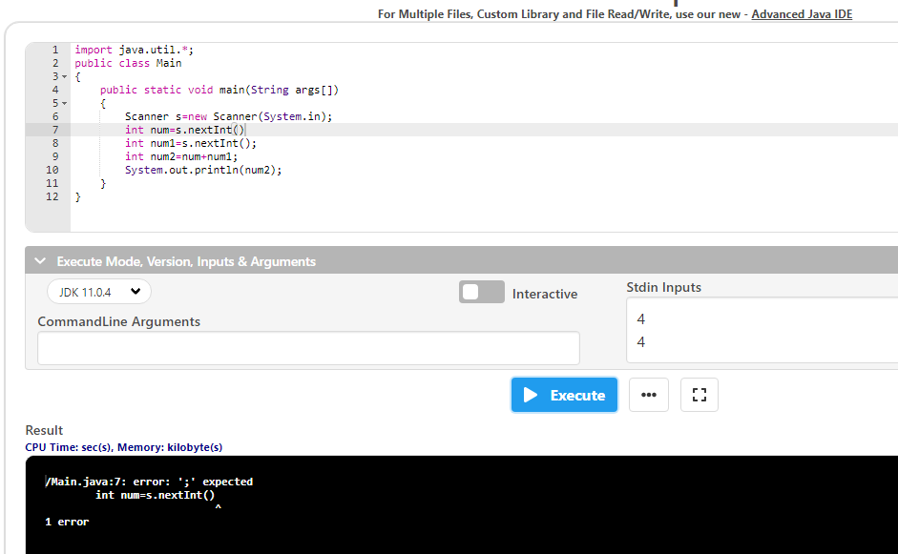
Notes:
Description:
/Main.java:7: error: ';' expected
int num=s. nextInt()
^1 error
Here semicolon is missing so this error can be occurred.

Slide 7
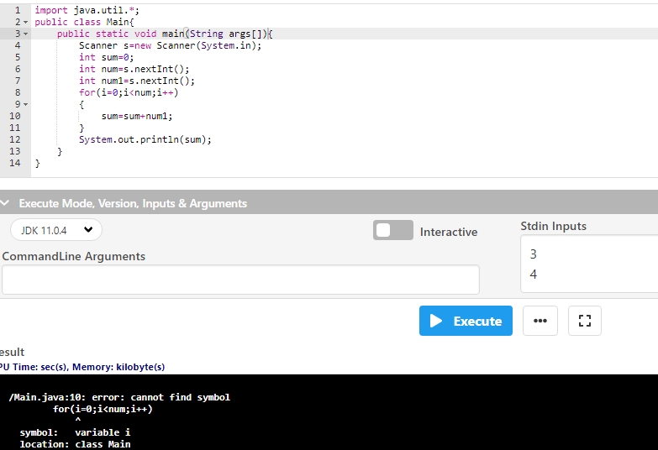
Notes:
Description:
/Main.java:10: error: cannot find symbol
for(i=0;i<num;i++)
^
symbol: variable i
location: class Main
Here , “i” has been not initialized .

Slide 8

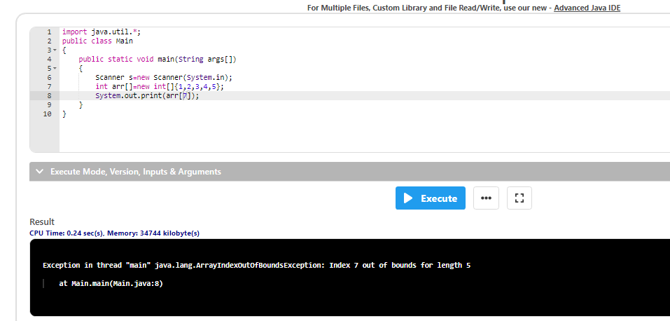
Thread

Slide 9

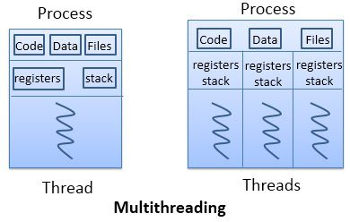
Multithreading
Notes:
Thread:
A thread, in the context of Java, is the path followed when executing a program.
All Java programs have at least one thread, known as the main thread, which is created by the Java Virtual Machine (JVM) at the program’s start, when the main() method is invoked with the main thread.

Slide 10


Why do we use threads ?
Notes:
Description:
i) performing some specific task.
Example : Here, man doing some specific work , speaking to some one.
ii) Mainly used for multitasking :
perform various tasks simultaneously.
Example : Here , man doing multiple tasks with simultaneously.

Slide 11
multithreading is a specialized form of multitasking
two distinct types of multitasking
Process – based
Thread-based
Notes:
Description:
A Java program may have muiltple threads running concurrently to provide the ability of multitasking to the user.
process-based : This multitasking is the more familiar form. A process is, in essence, a program that is executing. Thus, process-based multitasking is the feature that allows your computer to run two or more programs concurrently. For example, process-based multitasking enables you to run the Java compiler at the same time that you are using a text editor. In process- based multitasking, a program is the smallest unit of code that can be dispatched by the scheduler.
thread-based : This multitasking environment, the thread is the smallest unit of dispatchable code. This means that a single program can perform two or more tasks simultaneously. For instance, a text editor can format text at the same time that it is printing, as long as these two actions are being performed by two separate threads. Thus, process-based multitasking deals with the “big picture,” and thread-based multitasking handles the details.

Slide 12
Thread Process
Single thread process
Multi thread process
T2
Threads of execution
T3
T 1
T1
Single instruction stream
Multi instruction stream
Notes:
Description:
Single thread :
Single threaded processes contain the execution of instructions in a single sequence.
In other words, one command is processes at a time.
Multi thread:
The opposite of single threaded processes are multithreaded processes.
Thread of execution is multi instruction stream.
These processes allow the execution of multiple parts of a program at the same time.
These are lightweight processes available within the process.

Slide 13


Real time example:
Notes:
Description:
You may be having your breakfast while reading this answer. Also, may be you're listening to a song.
Thus, you are performing three different tasks in parallel.
Similarly, for processes to run in parallel on a computer, threads are used.
Multithreading in Java gives the ability to execute code by different threads to perform tasks in parallel or as a separate task without waiting for other to complete.

Slide 14
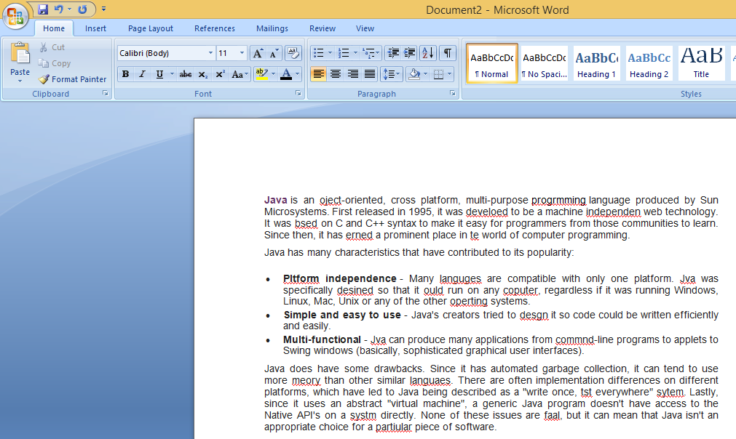
Real time application:
MS word
Typing [Spell Check]
Threads
Unit of a process
Notes:
Description:
MS word-Main process
Typing [Spell check]-Sub process
Sub process – Threads
Threads – Unit of a process
You are typing a paragraph on MS word. But in background one more thread running and checking your spelling mistakes.
As soon as you do a type the other thread notifies you about the type And makes your life easy.

Slide 15
Thread class
Class - java.lang.Thread
Thread Class Hierarchy:
Java.lang.object
Java.lang.Thread
Implements Runnable
Notes:
Description:
In Java the java.lang.Thread class is used to create thread-based code, imported into all Java applications by default.

Slide 16






Life cycle of a Thread
New Thread
Start
Leaving “ Not Runnable” state
Runnable
Thread Scheduled
Running
Sleep
Terminated
Not Runnable
Dead
Notes:
Description:
The java.lang.Thread class contains a static State enum-which defines its potential states. During any given point of time, the thread can only be in one of these states:
New:
The thread is in new state if you create an instance of Thread class but before the invocation of start() method.
Runnable:
The thread is in runnable state after invocation of start() method, but the thread scheduler has not selected it to be the running thread.
Running:
The thread is in running state if the thread scheduler has selected it.
Non-Runnable (Blocked):
This is the state when the thread is still alive, but is currently not eligible to run.
Terminated:
A thread is in terminated or dead state when its run() method exits.

Slide 17
Thread - Methods
New
Blocked
t.notify()
notify all()
t.start()
t.sleep(),
t.wait()
Run methods
ends
t.run()
Running
Terminated
Ready
Notes:
start() : This method of thread class is used to begin the execution of thread. The result of this method is two threads that are running concurrently: the current thread (which returns from the call to the start method) and the other thread (which executes its run method).
run() : This method can be called using the start() method or by calling the run() method itself. But when you use run() method for calling itself, it creates problems.
sleep() : This method of Thread class is used to sleep a thread for the specified amount of time.
Wait() :method causes the current thread to wait indefinitely until another thread either invokes notify() for this object or notifyAll().
notify() :It wakes up one single thread that called wait() on the same object. It should be noted that calling notify() does not actually give up a lock on a resource. It tells a waiting thread that that thread can wake up. However, the lock is not actually given up until the notifier’s synchronized block has completed.
notifyAll() :This method wakes up all threads that are waiting on this object's monitor. A thread waits on an object's monitor by calling one of the wait methods.
The awakened threads will not be able to proceed until the current thread relinquishes the lock on this object. The awakened threads will compete in the usual manner with any other threads that might be actively competing to synchronize on this object;

Slide 18
main thread
When a Java program starts executing:
The main thread begins running
The main thread is immediately created when main() commences execution
Notes:
Description:
Information about the main or any thread can be accessed by obtaining a reference to the thread using a public, static method in the Thread class called currentThread( ) .

Slide 19

//Predict the Output
import java.lang.Thread; //Thread package
public class Main
{
public static void main(String args[])
{
Thread t = Thread.currentThread();
System.out.println("Current Thread :" + t);
try
{
Thread.sleep(1);
}
catch (InterruptedException e)
{
System.out.println("Main Thread Interrupted");
}
}
}
1
2
3
4
5
6
7
8
9
10
11
12
13
14
15
16
17
18
19
20
21
22
Notes:
Description:
Current Thread Syntax:
Thread[Thread name,Priority,Thread group]
Default thread Priority is “5”.
try:
The try statement allows you to define a block of code to be tested for errors while it is being executed.
Catch:
The catch statement allows you to define a block of code to be executed, if an error occurs in the try block.
Sleep:
The sleep() method of Thread class is used to sleep a thread for the specified amount of time.
Output:
Current Thread :Thread[main,5,main]

Slide 20
Creating thread
Thread creating by extending the thread class
This can be achieved in any of the following two ways :
java.lang.Thread
extending the Thread class
implementing the Runnable interface
Notes:
Description:
A thread can be created by instantiating an object of type Thread.
Note : Thread class also implements Runnable interface.

Slide 21
//Predict the Output
import java.util.*;
class Test extends Thread
{
public void run()
{
System.out.println("thread is running...");
}
}
public class Main
{
public static void main(String args[])
{
Test create=new Test(); //Object creation
create.start();
}
}
1
2
3
4
5
6
7
8
9
10
11
12
13
14
15
16
17
18
19
20
21
22
Notes:
Output:
Thread is running...
Description:
Here , create Threads by extending the Thread class:
Instantiate the class that extends Thread
This class must override run() method
The code that should run as a thread will be part of this run() method
We must call the start() method on this thread
start( ) in turn calls the thread’s run( ) method

Slide 22
//Predict the Output
import java.util.*;
class Test extends Thread
{
public void run()
{
System.out.println("Process Error");
}
}
public class Main
{
public static void main(String args[])
{
Test create=new Test();
create.start();
create.run();
create.run();
}
}
1
2
3
4
5
6
7
8
9
10
11
12
13
14
15
16
17
18
19
20
21
22
Notes:
Output:
Process Error
Process Error
Process Error
Description:
To call the run() method, start() method is used. On calling start(), a new stack is provided to the thread and run() method is called to introduce the new thread into the program.

Slide 23
//Predict the Output
import java.util.*;
class Test extends Thread
{
public void run()
{
System.out.println(" thread passed ");
}
}
public class Main
{
public static void main(String args[])
{
Test create=new Test();
create.start();
create.start();
}
}
1
2
3
4
5
6
7
8
9
10
11
12
13
14
15
16
17
18
19
20
21
22
Notes:
Output:
thread passed
Exception in thread "main" java.lang.IllegalThreadStateException
at java.base/java.lang.Thread.start(Thread.java:794)
at Main.main(Main.java:15)
Description:
When a thread is in running state, and you try to start it again, or any method try to invoke that thread again using start() method, exception is thrown.

Slide 24
//Predict the Output
import java.util.*;
public class Main
{
public static void main(String args[])
{
Thread t = Thread.currentThread( );
System.out.println("Current Thread :" + t);
t.setName("Void");
System.out.println("Current thread :" +t);
try
{
Thread.sleep(1);
}
catch (InterruptedException e)
{
System.out.println("Main Thread Interrupted");
}
}
}
1
2
3
4
5
6
7
8
9
10
11
12
13
14
15
16
17
18
19
20
21
22
Notes:
Output:
Current Thread :Thread[main,5,main]
Current thread :Thread[Void,5,main]
Description:
The setName() method of thread class is used to change the name of the thread.

Slide 25
//Predict the Output
import java.lang.Thread;
class example extends Thread {
public void run() {
try{
System.out.println (Thread.currentThread());
}
catch (Exception e) {
System.out.println ("Exception is caught");
}
}
}
public class Main{
public static void main(String[] args) {
int n = 4;
for (int i=0; i<4; i++)
{
example object = new example();
object.start();
}
}
}
1
2
3
4
5
6
7
8
9
10
11
12
13
14
15
16
17
18
19
20
21
22
Notes:
Sample Output:
Thread[Thread-0,5,main]
Thread[Thread-1,5,main]
Thread[Thread-2,5,main]
Thread[Thread-3,5,main]

Slide 26
//Predict the Output
import java.lang.Thread;
import java.util.Scanner;
class example extends Thread
{
public void run()
{
try
{
System.out.println (Thread.currentThread());
}
catch (Exception e)
{
System.out.println ("Exception is caught");
}
}
}
1
2
3
4
5
6
7
8
9
10
11
12
13
14
15
16
17
18
19
20
21
22

Slide 27
public class Main
{
public static void main(String[] args)
{
Scanner s=new Scanner(System.in);
int num=s.nextInt();
for (int i=0; i<num; i++)
{
example object = new example();
object.start();
}
}
}
1
2
3
4
5
6
7
8
9
10
11
12
13
14
15
16
17
18
19
20
21
22
Notes:
Sample Input:
5
Sample Output:
Thread[Thread-0,5,main]
Thread[Thread-1,5,main]
Thread[Thread-2,5,main]
Thread[Thread-3,5,main]
Thread[Thread-4,5,main]

Slide 28
//Predict the Output
import java.lang.Thread;
import java.util.Scanner;
class example extends Thread
{
public void run()
{
try
{
System.out.println (Thread.currentThread());
}
catch (Exception e)
{
System.out.println ("Exception is caught");
}
}
}
1
2
3
4
5
6
7
8
9
10
11
12
13
14
15
16
17
18
19
20
21
22

Slide 29
public class Main
{
public static void main(String[] args)
{
Scanner s=new Scanner(System.in);
int num=s.nextInt();
for (int i=0; i<num; i++)
{
example object = new example();
object.start();
object.setName(“Priya");
object.setPriority(6);
}
}
}
1
2
3
4
5
6
7
8
9
10
11
12
13
14
15
16
17
18
19
20
21
22
Notes:
Description:
setPriority:
The setPriority() method of thread class is used to change the thread's priority.
setName:
Java Thread setName() method. The setName() method of thread class is used to change the name of the thread.
Sample Input:
5
Sample Output:
Thread[Priya,6,main]
Thread[Priya,6,main]
Thread[Priya,6,main]
Thread[Priya,6,main]
Thread[Priya,6,main]

Slide 30
//Predict the Output
import java.lang.Thread;
import java.util.Scanner;
class example extends Thread
{
public void run()
{
try
{
System.out.println (Thread.currentThread());
}
catch (Exception e)
{
System.out.println ("Exception is caught");
}
}
}
1
2
3
4
5
6
7
8
9
10
11
12
13
14
15
16
17
18
19
20
21
22

Slide 31
public class Main
{
public static void main(String[] args)
{
Scanner s=new Scanner(System.in);
int num=s.nextInt();
String L1=s.next();
int num2=s.nextInt();
for (int i=0; i<num; i++)
{
example object = new example();
object.start();
object.setName(L1);
object.setPriority(num2);
}
}
}
1
2
3
4
5
6
7
8
9
10
11
12
13
14
15
16
17
18
19
20
21
22
Notes:
Sample Input:
4
Swathi
5
Sample Output:
Thread[Swathi,5,main]
Thread[Swathi,5,main]
Thread[Swathi,5,main]
Thread[Swathi,5,main]

Slide 32
//Predict the Output
import java.util.*;
class example extends Thread
{
public void run()
{
try
{
System.out.println (Thread.currentThread());
System.out.println (Thread.currentThread().getId());
}
catch (Exception e)
{
System.out.println ("Exception is caught");
}
}
}
1
2
3
4
5
6
7
8
9
10
11
12
13
14
15
16
17
18
19
20
21
22
Notes:
Description:
Thread.getId():
This method returns the identifier of this Thread. The thread ID is a positive long number generated when this thread was created.
The thread ID is unique and remains unchanged during its lifetime. When a thread is terminated, this thread ID may be reused.

Slide 33
public class Main
{
public static void main(String[] args)
{
Scanner s=new Scanner(System.in);
int num=s.nextInt();
for (int i=0; i<num; i++)
{
example object = new example();
object.start();
}
}
}
1
2
3
4
5
6
7
8
9
10
11
12
13
14
15
16
17
18
19
20
21
22
Notes:
Output:
Thread[Thread-0,5,main]
8
Thread[Thread-1,5,main]
9
Thread[Thread-2,5,main]
10
Thread[Thread-3,5,main]
11
Thread[Thread-4,5,main]
12

Slide 34
//Predict the Output
import java.util.*;
class Test {
public static void m1() {
System.out.println("Hello Visitors");
}
}
class Create extends Test
{
public void run() {
System.out.println("Child Thread");
}
}
public class Main{
public static void main(String[] args) {
Create t = new Create();
t.m1();
Thread t1 = new Thread(t);
t1.start();
System.out.println("Main thread");
}
}
1
2
3
4
5
6
7
8
9
10
11
12
13
14
15
16
17
18
19
20
21
22
Notes:
Sample Output:
Compilation Error
Description:
Here, Can’t extends the Test class in the Create class , so output is “Compilation Error” .

Slide 35
//Predict the Output
import java.util.*;
class Test {
public static void m1() {
System.out.println("Hello Visitors");
}
}
class Create extends Test implements Runnable
{
public void run() {
System.out.println("Child Thread");
}
}
public class Main{
public static void main(String[] args) {
Create t = new Create();
t.m1();
Thread t1 = new Thread(t);
t1.start();
System.out.println("Main thread");
}
}
1
2
3
4
5
6
7
8
9
10
11
12
13
14
15
16
17
18
19
20
21
22
Notes:
Sample Output:
Hello Visitors
Main thread
Child Thread
Description:
Runnable interface is a type of functional interface which is designed to provide a common protocol for objects that wish to execute code while they are active.
The Runnable interface should be implemented by any class whose instances are intended to be executed by a thread. The class must define a method run. It is used to create thread.
public void run(): is used to perform action for a thread.

Slide 36
//Predict the Output
import java.lang.Runnable;
class Methods implements Runnable
{
public void run() {
try{
System.out.println (Thread.currentThread());
}
catch (Exception e) {
System.out.println ("Exception is caught");
}
}
}
public class Main {
public static void main(String[] args) {
int num = 4;
for (int i=0; i<4; i++) {
Thread object = new Thread(new Methods());
object.start();
}
}
}
1
2
3
4
5
6
7
8
9
10
11
12
13
14
15
16
17
18
19
20
21
22
Notes:
Output:
Thread[Thread-0,5,main]
Thread[Thread-1,5,main]
Thread[Thread-2,5,main]
Thread[Thread-3,5,main]
Description:
Here , create a new class which implements java.lang.Runnable interface and override run() method. Then we instantiate a Thread object and call start() method on this object.

Slide 37
//Predict the Output
import java.lang.Runnable;
public class Main
{
public static void main(String[] args)
{
System.out.println(Thread.currentThread());
System.out.println("Creating Runnable Instance");
Runnable runnable = new Runnable()
{
@Override
public void run()
{
System.out.println(Thread.currentThread().getName());
}
}
System.out.println("Creating a Thread Instance");
Thread thread = new Thread(runnable);
System.out.println("Launching a Thread");
thread.start();
}
}
1
2
3
4
5
6
7
8
9
10
11
12
13
14
15
16
17
18
19
20
21
22
Notes:
Description:
Here , first step is to create a class that implements the Runnable interface.Now, you need to override the run method in the Runnable class . Next, you need to pass the Runnable object as a parameter to the constructor of the Thread class object while creating it. Now, this Thread object is capable of executing our Runnable class.
Finally, you need to invoke the Thread object’s start method.
Output:
Compilation Error
Description:
/Main.java:15: error: ';' expected
}
^1 error

Slide 38
//Predict the Output
import java.lang.Runnable;
public class Main
{
public static void main(String[] args)
{
System.out.println(Thread.currentThread());
System.out.println("Creating Runnable Instance");
Runnable runnable = new Runnable()
{
@Override
public void run()
{
System.out.println(Thread.currentThread().getName());
}
};
System.out.println("Creating a Thread Instance");
Thread thread = new Thread(runnable);
System.out.println("Launching a Thread");
thread.start();
}
}
1
2
3
4
5
6
7
8
9
10
11
12
13
14
15
16
17
18
19
20
21
22
Notes:
Description:
Here , first step is to create a class that implements the Runnable interface.Now, you need to override the run method in the Runnable class . Next, you need to pass the Runnable object as a parameter to the constructor of the Thread class object while creating it. Now, this Thread object is capable of executing our Runnable class.
Finally, you need to invoke the Thread object’s start method.
Output:
Thread[main,5,main]
Creating Runnable Instance
Creating a Thread Instance
Launching a Thread
Thread-0

Slide 39

MCQ
Notes:
Section End/Start
Use this at section’s start or end. For example: “Questions” or “Time for Practice”. To be used for Impacts (get the student’s attention).

Slide 40
//Predict the output
class Test implements Runnable
{
public void run()
{
System.out.println("Method");
}
}
public class Main
{
public static void main(String[] args)
{
Thread create = new Thread();
create.start();
System.out.println("Main");
}
}
1
2
3
4
5
6
7
8
9
10
11
12
13
14
15
16
17
18
19
20
21
22

Slide 41


Question 1
A)
Main
B)
Method
C)
Main
Method
D)
Compilation error
Notes:
Description:
In the above program, we are calling start() method of Thread class which is responsible to execute run() method of Thread class and Thread class run() method has empty implementation. That’s why one child thread will be created but it will not execute Test class run() method.

Slide 42
//How many threads will be created for the following code?
class Test extends Thread
{
public void run()
{
System.out.println("Run");
}
}
public class Main
{
public static void main(String[] args)
{
Test t = new Test();
t.run();
}
}
1
2
3
4
5
6
7
8
9
10
11
12
13
14
15
16
17
18
19
20
21
22

Slide 43
Question 2
A)
Depend upon system
B)
One thread created
C)
Two thread created
D)
Compilation error
Notes:
Description:
In the above program, we are calling start() method of Thread class which is responsible to execute run() method of Thread class and Thread class run() method has empty implementation. That’s why one child thread will be created but it will not execute Test class run() method.

Slide 44
//Predict the output
class One extends Thread
{
public void run()
{
for(int i=0; i<2; i++){
System.out.print(i);
}
}
}
public class Test
{
public static void main(String args[])
{
Test t = new Test();
t.call(new One());
}
public void call(One o)
{
o.start();
}
}
1
2
3
4
5
6
7
8
9
10
11
12
13
14
15
16
17
18
19
20
21
22

Slide 45
Question 3
A)
0 0
B)
0 1 2
C)
01
D)
Compilation error

Slide 46
//Predict the output
public class Test implements Runnable
{
public void run()
{
System.out.print("go");
}
public static void main(String arg[])
{
Thread t = new Thread(new Test());
t.run();
t.run();
}
}
1
2
3
4
5
6
7
8
9
10
11
12
13
14
15
16
17
18
19
20
21
22

Slide 47
Question 4
A)
gogogo
B)
gogo
C)
go
D)
Compilation error

Slide 48
//Predict the output
public class Test extends Thread
{
public static void main(String argv[])
{
Test t = new Test();
t.run();
t.start();
}
public void run()
{
System.out.println("run-test");
}
}
1
2
3
4
5
6
7
8
9
10
11
12
13
14
15
16
17
18
19
20
21
22
Notes:
Description:
Here , t.run() Legal, but does not start a new thread , it is like a method call of a class Test BUT t.start() creates a thread and call run() method.

Slide 49
Question 5
A)
No output
B)
run-test
C)
run-test
run-test
D)
Compilation error

Slide 50

THANK YOU
Notes:
Thank you slide

