Slide 1

Notes:
1st slide (Mandatory)

Slide 2

Oracle Installation
Install Oracle 11g from the internet.
Notes:
Title + Text

Slide 3
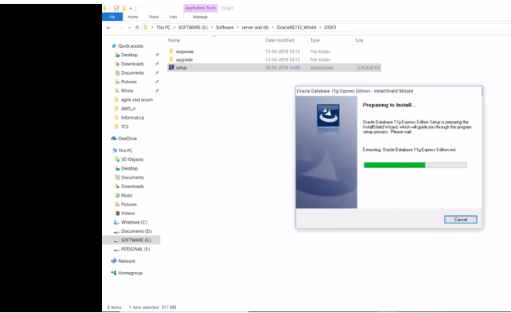
Oracle Installation
Notes:
Once install the Oracle database run it as system administrator.

Slide 4
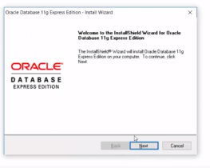
Oracle Installation
Notes:
Then click next

Slide 5
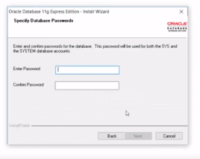
Oracle Installation
Notes:
During installation you will asked for a password.

Slide 6
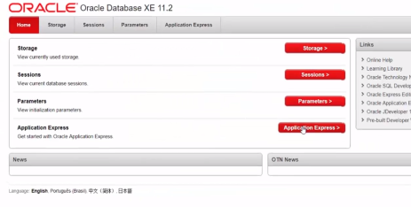
Oracle Installation
Notes:
Open the oracle shortcut in your desktop
Then click application express.

Slide 7
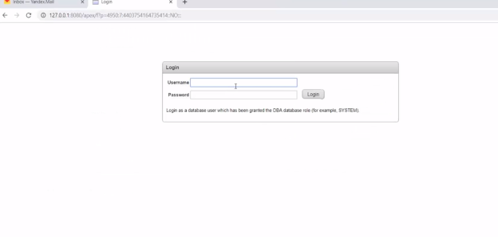
Oracle Installation
Notes:
Now give the user name and the password.

Slide 8
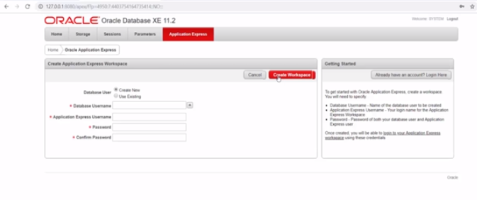
Oracle Installation
Notes:
Create the database.

Slide 9
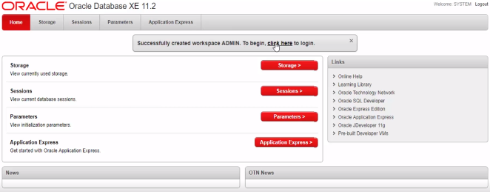
Oracle Installation
Notes:
Then click ..click here to login

Slide 10
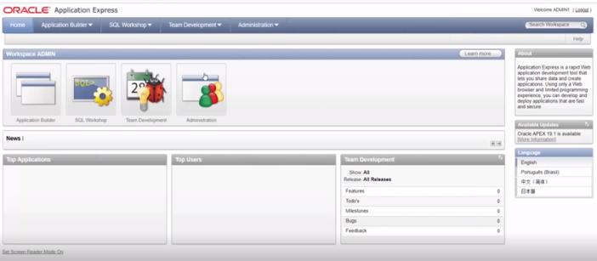
Oracle Installation
Notes:
In order to check

Slide 11

CREATE TABLE student
{
student_id number(10) NOT NULL,
student_name varchar2(50) NOT NULL,
student_city varchar2(50)
};
INSERT into student VALUES(101, 'ABC', 'Coimbatore');
select * from student;
1
2
3
4
5
6
7
8
9
10
11
12
13
14
15
16
17
18
19
20
21
22
Notes:
Type the code in sql workshop.
If you select the above code and run the program
Output:
Table is created

Slide 12
OUTPUT
Table is created
Notes:
Output

Slide 13
CREATE TABLE student
{
student_id number(10) NOT NULL,
student_name varchar2(50) NOT NULL,
student_city varchar2(50)
};
INSERT into student VALUES(101, 'ABC', 'Coimbatore');
select * from student;
1
2
3
4
5
6
7
8
9
10
11
12
13
14
15
16
17
18
19
20
21
22
Notes:
Output:
1 row is inserted

Slide 14
OUTPUT
1 row is inserted
Notes:
Output

Slide 15
CREATE TABLE student
{
student_id number(10) NOT NULL,
student_name varchar2(50) NOT NULL,
student_city varchar2(50)
};
INSERT into student VALUES(101, 'ABC', 'Coimbatore');
select * from student;
1
2
3
4
5
6
7
8
9
10
11
12
13
14
15
16
17
18
19
20
21
22

Slide 16
OUTPUT
STUDENT_ID | STUDENT_NAME | STUDENT_CITY
101 | ABC | Coimbatore
Notes:
Output

Slide 17

THANK YOU
Notes:
Thank you slide

