Slide 1

Notes:
1st slide (Mandatory)

Slide 2

Socket Programming
In Networking application mainly two programs are running one is Client program and another is Server program.
In Core java Client program can be design using Socket class and Server program can be design using ServerSocket class.
Notes:
Description:
Networking is a concept of connecting two or more computing devices together so that we can share resources like printer, scanner, memory.
Both Socket and ServerSocket classes are predefined in java.net package

Slide 3
Terms used in Socket Programming:
Port number
Port Name
Notes:
Description:
Port number: It is unique identification value represents residing position of a server in the computer. It is four digit +ve number.
Port Name: It is a valid user defined name to know about client system, the default port name for any local computer is localhost.. Port name should be the some value which is given at Server programming.

Slide 4
CLIENT
SERVER
socket
socket
bind
Open Client
listen
Connection request
connect
accept
write
read
Client /server Session
read
write
close
read
End of file
close
SOCKET API
Notes:
Description:
Here, we are going to make one-way client and server communication. In this application, client sends a message to the server, server reads the message and prints it. Here, two classes are being used: Socket and ServerSocket. The Socket class is used to communicate client and server. Through this class, we can read and write message. The ServerSocket class is used at server-side. The accept() method of ServerSocket class blocks the console until the client is connected. After the successful connection of client, it returns the instance of Socket at server-side.

Slide 5
Method of socket class:
public InputStream getInputStream()
public OutputStream getOutputStream()
public synchronized void close()
Notes:
Description:
public InputStream getInputStream():returns the InputStream attached with this socket.
public OutputStream getOutputStream():returns the OutputStream attached with this socket.
public synchronized void close():closes this socket.

Slide 6
getInputStream():
Syntax:
Socket s=new Socket("localhost", 8080);
OutputStream os=new s.getOutputStream(); DataOutputStream dos=new DataOutputStream(os);
Notes:
Description:
This method take the permission to write the data from client program to server program and server program to client program which returns OutputStream class object.

Slide 7
getOutputStream()
Syntax:
Socket s=new Socket("localhost", 8080);
InputStream is=new s.getInputStream();
DataInputStream dis=new DataInputStream(is);
Notes:
Description:
This method is used to take the permission to read data from client system by the server or from the server system by the client which returns InputStream class object.

Slide 8
getOutputStream()
Syntax:
Socket s=new Socket("localhost", 8080);
s.close();
Notes:
Description:
This method is used to take the permission to read data from client system by the server or from the server system by the client which returns InputStream class object.

Slide 9
ServerSocket class :
The ServerSocket class can be used to create a server socket.
This object is used to establish communication with the clients.

Slide 10
Syntax to call ServerSocket() Constructor:
ServerSocket ss=new ServerSocket(8080);
// 8080 -- port number
Notes:
Description:
Constructor:
ServerSocket class contain a constructor used to create a separate port number to run the server program.

Slide 11
ServerSocket Methods :
public Socket accept()
public InputStream getInputStream()
public OutputStream getOutputStream()
public synchronized void close()
Notes:
Description:
public Socket accept(): returns the socket and establish a connection between server and client.
public synchronized void close():closes the server socket.

Slide 12
accept():
Used to accept the client request it returns class reference.
ServerSocket ss=new ServerSocket(8080);
// 8080 -- port number

Slide 13
Rules to design server program:
Every server program should run accepted port number (any 4 digit +ve numeric value) It can set by relating an object for server socket class (In any used defined java program).
Accept client request.
Read input data from client using InputStream class.
Perform valid business logic operation
Send response (writing output data) back to client using OutputStream class.
close or terminate client request.

Slide 14

// Saved by Server.java
import java.net.*;
import java.io.*;
class Server{
public static void main(String[] args)
{
try
{
int pno=Integer.parseInt(args[0]);
ServerSocket ss=new ServerSocket(pno);
System.out.println("server is ready to accept clint request");
Socket s1=ss.accept();
InputStream is=s1.getInputStream();
DataInputStream dis=new DataInputStream(is);
int n=dis.readInt();
System.out.println("Value from client : "+n);
int res=n*n;
OutputStream os=s1.getOutputStream();
DataOutputStream dos=new DataOutputStream(os);
dos.writeInt(res);
s1.close();
}
1
2
3
4
5
6
7
8
9
10
11
12
13
14
15
16
17
18
19
20
21
22

Slide 15
catch (Exception e)
{
System.out.println(e);
}
}
}
1
2
3
4
5
6
7
8
9
10
11
12
13
14
15
16
17
18
19
20
21
22

Slide 16
Rules to design client program:
Obtain connection to the server from the client program (any user defined class) by passing port number and port name in the socket class.
Send request (writing input data) to the server using OutputStream class.
Read output data from the server using InputStream class.
Display output data

Slide 17
Output Stream
Input Stream
Cilent Program
Write
Input
Request
…..
…..
…..
Logic of program
Server
Program
Read
Output
Response
InputStream
OutputStream
Notes:
Note:
close the connection is optional.

Slide 18
// Saved by Client.java
import java.net.*;
import java.io.*;
import java.util.*;
class Client
{
public static void main(String[] args)
{
try
{
String pname=args[0];
int pno=Integer.parseInt(args[1]);
Socket s=new Socket(pname,pno);
System.out.println("clint obtailed connection from server");
System.out.println("Enter a number ");
Scanner sn=new Scanner(System.in);
int data=sn.nextInt();
OutputStream os=s.getOutputStream();
DataOutputStream dos=new DataOutputStream(os);
dos.writeInt(data);
InputStream is=s.getInputStream();
DataInputStream dis=new DataInputStream(is);
1
2
3
4
5
6
7
8
9
10
11
12
13
14
15
16
17
18
19
20
21
22

Slide 19
int res=dis.readInt();
System.out.println("Result from server : "+res);
}
catch (Exception e)
{
System.out.println(e);
}
}
}
1
2
3
4
5
6
7
8
9
10
11
12
13
14
15
16
17
18
19
20
21
22

Slide 20
Steps to run above program:
First open two command prompt window separately.
Compile Client program on one command prompt and compile server program on other command prompt.
First run Server program and pass valid port number.
Second run client program and pass valid port name and post number (which is already passed at server).
Finally give the request to server from client (from client command prompt).
Now you can get response from server.

Slide 21
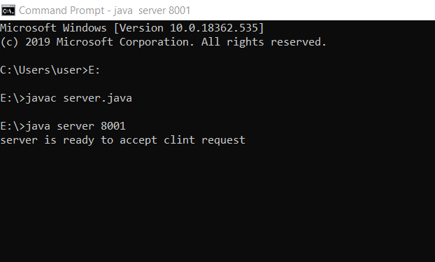
Compile and run server program:

Slide 22
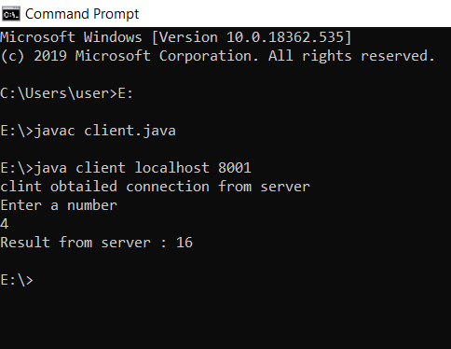
Compile and run client program:

Slide 23

MCQ

Slide 24


Question 01
Which class is used to create servers that listen for either local client or remote client programs?
A)
ServerSockets
B)
httpServer
C)
httpResponse
D)
HTML

Slide 25
Question 02
The client in socket programming must know which informations?
A)
IPaddress of Server
B)
Port number
C)
IPaddress of Server & Port number
D)
client

Slide 26
Question 03
Which constructor of DatagramSocket class is used that it creates a datagram socket and binds it with the given Port Number?
A)
DatagramSocket(int port)
B)
DatagramSocket(int port, InetAddress address)
C)
DatagramSocket()
D)
SocketServer

Slide 27
Question 04
Which class is message that can be sent or received. If you send multiple packet, it may arrive in any order , Moreover, packet delivery is not guaranteed?
A)
DatagramPacket
B)
DatagramSocket
C)
Both A & B
D)
None of the above
Notes:
Question + Normal Options

Slide 28
Question 05
Which methods are commonly used in ServerSocket class?
A)
public OutputStream getOutputStream()
B)
public Socket accept()
C)
public synchronized void close()
D)
None of the above

Slide 29

THANK YOU
Notes:
Thank you slide

