Slide 1

Notes:
1st slide (Mandatory)

Slide 2


FILE OPERATIONS
IO Packages
Operations and Methods
Streams
Directories
Notes:
Title + Text

Slide 3
IO PACKAGES
In Java Applications, to perform input and output operations we
have to use streams.
Stream: Stream is medium or channel.
Java has represented all the streams in the form of predefined classes in "java.io" package.
In Java IOStreams are divided into following ways:
1.Byte oriented Streams.
2.Character-Oriented Streams
Notes:
Stream : It will allow the data in continuous flow
from input devices to java program and from Java program to output
devices.
1.Byte-Oriented Streams
These are Streams, which will allow the data in the form of bytes from input devices to Java program and from java program to output devices.
The length of the data in byte-oriented streams is 1 byte. There are two types of Byte-Oriented Streams
1.InputStream
2.OutputStream
1.InputStream:
It will allow the data in the form of bytes from input devices to Java program.
Ex:ByteArrayInputStream
FilterInputStream
DataInputStream
ObjectInputStream
FileInputStream
StringBufferInputStream
BufferedInputStream
2.OutputStream:
It will allow the data in the form of bytes from Java programmes to output devices.
Ex:ByteArrayOutputStream
DataOutputStream
FileOutputStream
PrintStream
BufferedOutputStream..
Character-Oriented Streams:
It will allow the data in the form of characters from input devices to java program and form java program to output devices.
The length of the data in characters-oriented stream is 2 bytes. There are two bytes of character-oriented streams
1.Reader
2.Writer
1.Reader:
It will allow the data in the form of characters from input devices to java program.
Ex:CharArrayReader
FilterReader
BufferedReader
FileReader
InputStreamReader….
2.Writer:
It will allow the data in the form of characters from java program to output devices.
Ex:CharArrayWriter
FilterWriter
FileWriter
PrintWriter
BufferedWriter….

Slide 4
Byte-Oriented Streams
Allow the data in the form of bytes from input devices to Java program and from java program to output devices.
The length of the data in byte-oriented streams is 1 byte.
There are two types of Byte-Oriented Streams
1.InputStream
2.OutputStream
Notes:
Stream : It will allow the data in continuous flow
from input devices to java program and from Java program to output
devices.

Slide 5
Input Streams
It will allow the data in the form of bytes from input devices to Java program.
Ex:ByteArrayInputStream
FilterInputStream
DataInputStream
ObjectInputStream
FileInputStream
StringBufferInputStream
BufferedInputStream

Slide 6
Output Streams
It will allow the data in the form of bytes from Java programmes to output devices.
Ex:ByteArrayOutputStream
DataOutputStream
FileOutputStream
PrintStream
BufferedOutputStream..

Slide 7
Character Streams
It will allow the data in the form of characters from input devices to java program and form java program to output devices.
The length of the data in characters-oriented stream is 2 bytes. There are two bytes of character-oriented streams
1.Reader
2.Writer

Slide 8
Reader
It will allow the data in the form of characters from input devices to java program.
Ex:CharArrayReader
FilterReader
BufferedReader
FileReader
InputStreamReader….

Slide 9
Writer
It will allow the data in the form of characters from java program to output devices.
Ex:CharArrayWriter
FilterWriter
FileWriter
PrintWriter

Slide 10
File Operations
When we work with stored files we need to follow following task.
1) Determine whether the file is there or not.
2) Open a file.
3) Read the data from the file.
4) Writing information to file.
5) Closing file.
There are four operations on a file. They are as follows:
Create a File
Get File Information
Write To a File
Read from a File
Topic/Course
Sub-Topic (Example: name of college)

Slide 11
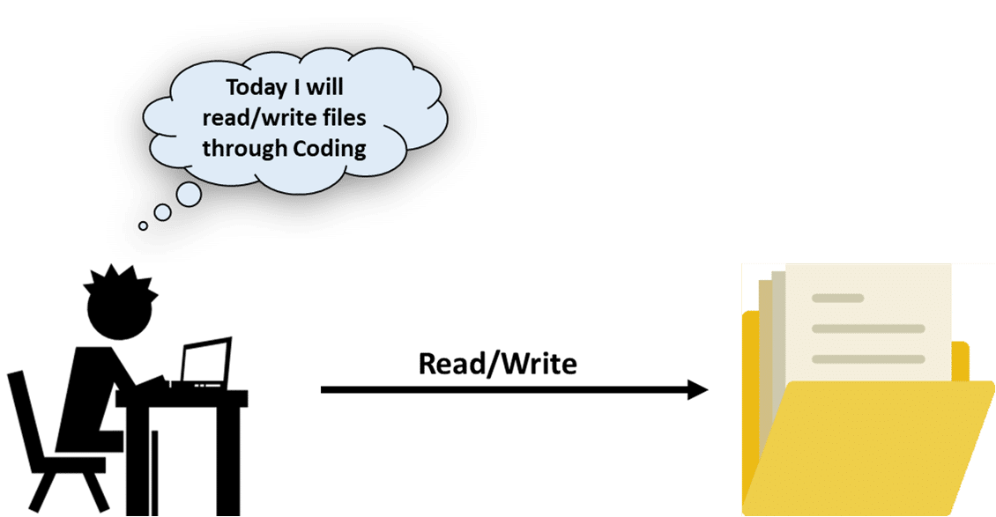
Methods Of File Operations
canRead()
canWrite()
createNewFile()
delete()
exists()
getName()
getAbsolutePath()
length()
list()
mkdir()
Notes:
Method
Type
Description
canRead()
Boolean
It tests whether the file is readable or not
canWrite()
Boolean
It tests whether the file is writable or not
createNewFile()
Boolean
This method creates an empty file
delete()
Boolean
Deletes a file
exists()
Boolean
It tests whether the file exists
getName()
String
Returns the name of the file
getAbsolutePath()
String
Returns the absolute pathname of the file
length()
Long
Returns the size of the file in bytes
list()
String[]
Returns an array of the files in the directory
mkdir()
Boolean
Creates a directory

Slide 12

// Predict the output
package FileHandling;
import java.io.File;
import java.io.IOException;
public class CreateFile {
public static void main(String[] args)
{
try
{
File myObj = new File("D:FileHandlingNewFilef1.txt");
if (myObj.createNewFile())
{
System.out.println("File created: " + myObj.getName());
}
else
{
System.out.println("File already exists.");
}
}
1
2
3
4
5
6
7
8
9
10
11
12
13
14
15
16
17
18
19
20
21
22
Notes:
Create a File
To create a file you can use the createNewFile() method. This method returns true if the file was successfully created, and false if the file already exists.
In order to use the File class, you need to create an object of the class and specify the filename or directory name.
// Import the File class
import java.io.File
// Specify the filename
File obj = new File("filename.txt");

Slide 13
catch (IOException e)
{
System.out.println("An error occurred.");
e.printStackTrace();
}
}
}
1
2
3
4
5
6
7
8
9
10
11
12
13
14
15
16
17
18
19
20
21
22
Notes:
In the above code, a file named NewFilef1 gets created in the specified location. If there is an error, then it gets handled in the catch block. Let’s check the output on executing the above code:
Output:
File created: NewFilef1.txt

Slide 14
// Predict the output
package FileHandling;
import java.io.File;
public class FileInformation
{
public static void main(String[] args)
{
File myObj = new File("NewFilef1.txt");
if (myObj.exists())
{
System.out.println("File name: " + myObj.getName());
System.out.println("Absolute path: " + myObj.getAbsolutePath());
System.out.println("Writeable: " + myObj.canWrite());
System.out.println("Readable " + myObj.canRead());
System.out.println("File size in bytes " + myObj.length());
}
1
2
3
4
5
6
7
8
9
10
11
12
13
14
15
16
17
18
19
20
21
22
Notes:
Get a file Information:
When you execute the above program, you will get the file information as shown in the output below:

Slide 15
else
{
System.out.println("The file does not exist.");
}
}
}
1
2
3
4
5
6
7
8
9
10
11
12
13
14
15
16
17
18
19
20
21
22
Notes:
Output:
File name: NewFilef1.txt
Absolute path: D:FileHandlingNewFilef1.txt
Writable: true
Readable true
File size in bytes 52
This is how you need to write a program to get the information of the specific file.

Slide 16
// Predict the output
package FileHandling;
import java.io.FileWriter;
import java.io.IOException;
public class WriteToFile
{
public static void main(String[] args)
{
try
{
FileWriter myWriter = new FileWriter("D:FileHandlingNewFilef1.txt");
myWriter.write(Java is the prominent programming language of the millenium!");
myWriter.close();
System.out.println("Successfully wrote to the file.");
}
1
2
3
4
5
6
7
8
9
10
11
12
13
14
15
16
17
18
19
20
21
22
Notes:
Write a File

Slide 17
catch (IOException e)
{
System.out.println("An error occurred.");
e.printStackTrace();
}
}
}
1
2
3
4
5
6
7
8
9
10
11
12
13
14
15
16
17
18
19
20
21
22
Notes:
Output:
Successfully wrote to the file
When you run the file, the above text, “Java is the prominent programming language of the millennium!” will be entered in the file that you have created. You can cross check it by opening the file in the specified location.

Slide 18
// Predict the output
import java.io.File;
import java.io.FileNotFoundException;
import java.util.Scanner;
public class ReadFromFile
{
public static void main(String[] args)
{
try
{
File myObj = new File("D:FileHandlingNewFilef1.txt");
Scanner myReader = new Scanner(myObj);
while (myReader.hasNextLine())
{
String data = myReader.nextLine();
System.out.println(data);
}
myReader.close();
}
1
2
3
4
5
6
7
8
9
10
11
12
13
14
15
16
17
18
19
20
21
22
Notes:
Read from a file
When you execute the above program, it will display the content present in the given file.

Slide 19
catch (FileNotFoundException e)
{
System.out.println("An error occurred.");
e.printStackTrace();
}
}
}
1
2
3
4
5
6
7
8
9
10
11
12
13
14
15
16
17
18
19
20
21
22
Notes:
Read from a file
When you execute the above program, it will display the content present in the given file.

Slide 20

streams
Byte Streams
Java byte streams are used to perform input and output of 8-bit bytes.
FileInputStream
FileOutputStream.
Notes:
Stream can be defined as a sequence of data. There are two kinds of Streams .
InPutStream − The InputStream is used to read data from a source.
OutPutStream − The OutputStream is used for writing data to a destination.

Slide 21
// Predict the output
import java.io.*;
public class CopyFile
{
public static void main(String args[]) throws IOException
{
FileInputStream in = null;
FileOutputStream out = null;
try
{
in = new FileInputStream("input.txt");
out = new FileOutputStream("output.txt");
int c;
while ((c = in.read()) != -1)
{
out.write(c);
}
}
1
2
3
4
5
6
7
8
9
10
11
12
13
14
15
16
17
18
19
20
21
22
Notes:
Following is an example which makes use of these two classes to copy an input file into an output file −

Slide 22
finally
{
if (in != null)
{
in.close();
}
if (out != null)
{
out.close();
}
}
}
}
1
2
3
4
5
6
7
8
9
10
11
12
13
14
15
16
17
18
19
20
21
22
}
}
Notes:
Now let's have a file input.txt with the following content −
This is test for copy file.
As a next step, compile the above program and execute it, which will result in creating output.txt file with the same content as we have in input.txt. So let's put the above code in CopyFile.java file and do the following −
$javac CopyFile.java
$java CopyFile

Slide 23
Character streams
Constructors:
FileWriterfw=new FileWriter(String name);
FileWriterfw=new FileWriter(File f);
FileWariterfw=new FileWriter(String name,boolean append);
FileWriterfw=new FileWriter(File f,boolean append);
Methods:
write(intch);
write(char[] ch);
write(String s);
flush();
close();
Notes:
Java Character streams are used to perform input and output for 16-bit unicode. Though there are many classes related to character streams but the most frequently used classes are, FileReader and FileWriter. If we want append operation then we should go for the following 2
constructors.(FileWriterfw=new FileWriter(String name,boolean append);FileWriterfw=new FileWriter(File f,boolean append);)
Methods:
1. write(intch);
To write a single character to the file.
2. write(char[] ch);
To write an array of characters to the file.
3. write(String s);
To write a String to the file.
4. flush();
To give the guarantee the total data include last character also written to the file.
5. close();
To close the stream.

Slide 24
// Predict the output
import java.io.*;
public class CopyFile
{
public static void main(String args[]) throws IOException
{
FileReader in = null;
FileWriter out = null;
try
{
in = new FileReader("input.txt");
out = new FileWriter("output.txt");
int c;
while ((c = in.read()) != -1)
{
out.write(c);
}
}
}
1
2
3
4
5
6
7
8
9
10
11
12
13
14
15
16
17
18
19
20
21
22
Notes:
We can re-write the above example, which makes the use of these two classes to copy an input file (having unicode characters) into an output file −
Now let's have a file input.txt with the following content −
This is test for copy file.
As a next step, compile the above program and execute it, which will result in creating output.txt file with the same content as we have in input.txt. So let's put the above code in CopyFile.java file and do the following −
$javac CopyFile.java
$java CopyFile

Slide 25
finally
{
if (in != null)
{
in.close();
}
if (out != null)
{
out.close();
}
}
}
}
1
2
3
4
5
6
7
8
9
10
11
12
13
14
15
16
17
18
19
20
21
22
Notes:
We can re-write the above example, which makes the use of these two classes to copy an input file (having unicode characters) into an output file −
Now let's have a file input.txt with the following content −
This is test for copy file.
As a next step, compile the above program and execute it, which will result in creating output.txt file with the same content as we have in input.txt. So let's put the above code in CopyFile.java file and do the following −
$javac CopyFile.java
$java CopyFile

Slide 26
Standard Streams
Standard Input
Standard Output
Standard Error
Notes:
Java provides the following three standard streams −
Standard Input − This is used to feed the data to user's program and usually a keyboard is used as standard input stream and represented as System.in.
Standard Output − This is used to output the data produced by the user's program and usually a computer screen is used for standard output stream and represented as System.out.
Standard Error − This is used to output the error data produced by the user's program and usually a computer screen is used for standard error stream and represented as System.err

Slide 27
// Predict the output
import java.io.*;
public class ReadConsole
{
public static void main(String args[]) throws IOException
{
InputStreamReader cin = null;
try
{
cin = new InputStreamReader(System.in);
System.out.println("Enter characters, 'q' to quit.");
char c;
do
{
c = (char) cin.read();
System.out.print(c);
} while(c != 'q');
}
finally {
if (cin != null) {
cin.close();
}
}
}
}
1
2
3
4
5
6
7
8
9
10
11
12
13
14
15
16
17
18
19
20
21
22
Notes:
Following is a simple program, which creates InputStreamReader to read standard input stream until the user types a "q" −
the above code in ReadConsole.java file and try to compile and execute it as shown in the following program. This program continues to read and output the same character until we press 'q' −
$javac ReadConsole.java
$java ReadConsole
Enter characters, 'q' to quit.
1
1
e
e
q
q

Slide 28
finally
{
if (cin != null)
{
cin.close();
}
}
}
}
1
2
3
4
5
6
7
8
9
10
11
12
13
14
15
16
17
18
19
20
21
22
Notes:
Following is a simple program, which creates InputStreamReader to read standard input stream until the user types a "q" −
the above code in ReadConsole.java file and try to compile and execute it as shown in the following program. This program continues to read and output the same character until we press 'q' −
$javac ReadConsole.java
$java ReadConsole
Enter characters, 'q' to quit.
1
1
e
e
q
q

Slide 29
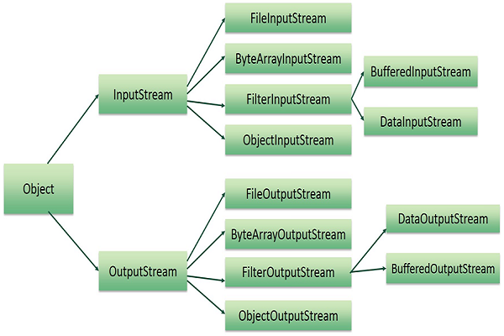
Reading and Writing Files
Notes:
A stream can be defined as a sequence of data. The InputStream is used to read data from a source and the OutputStream is used for writing data to a destination.Here is a hierarchy of classes to deal with Input and Output streams.

Slide 30
FileInputStream
This stream is used for reading data from the files. Objects can be created using the keyword new .
First we create a file object using File() method as follows
File f = new File("C:/java/hello");
InputStream f = new FileInputStream(f);
FileOutputStream
File f = new File("C:/java/hello");
OutputStream f = new FileOutputStream(f);
Notes:
public void close() throws IOException{}
This method closes the file output stream. Releases any system resources associated with the file. Throws an IOException.
protected void finalize()throws IOException {}
This method cleans up the connection to the file. Ensures that the close method of this file output stream is called when there are no more references to this stream. Throws an IOException.
public int read(int r)throws IOException{}
This method reads the specified byte of data from the InputStream. Returns an int. Returns the next byte of data and -1 will be returned if it's the end of the file.
public int read(byte[] r) throws IOException{}
This method reads r.length bytes from the input stream into an array. Returns the total number of bytes read. If it is the end of the file, -1 will be returned.
public int available() throws IOException{}
Gives the number of bytes that can be read from this file input stream. Returns an int.
OutputStream:
public void close() throws IOException{}
This method closes the file output stream. Releases any system resources associated with the file. Throws an IOException.
protected void finalize()throws IOException {}
This method cleans up the connection to the file. Ensures that the close method of this file output stream is called when there are no more references to this stream. Throws an IOException.
public void write(int w)throws IOException{}
This methods writes the specified byte to the output stream.
public void write(byte[] w)
Writes w.length bytes from the mentioned byte array to the OutputStream.

Slide 31
// Predict the output
import java.io.*;
public class fileStreamTest
{
public static void main(String args[])
{
try
{
byte bWrite [] = {11,21,3,40,5};
OutputStream os = new FileOutputStream("test.txt");
for(int x = 0; x < bWrite.length ; x++) {
os.write( bWrite[x] );
}
os.close();
InputStream is = new FileInputStream("test.txt");
int size = is.available();
}
1
2
3
4
5
6
7
8
9
10
11
12
13
14
15
16
17
18
19
20
21
22
Notes:
Following is the example to demonstrate InputStream and OutputStream −
The above code would create file test.txt and would write given numbers in binary format. Same would be the output on the stdout screen.

Slide 32
for(int i = 0; i < size; i++)
{
System.out.print((char)is.read() + " ");
}
is.close();
}
catch (IOException e)
{
System.out.print("Exception");
}
}
}
1
2
3
4
5
6
7
8
9
10
11
12
13
14
15
16
17
18
19
20
21
22
Notes:
Following is the example to demonstrate InputStream and OutputStream −
The above code would create file test.txt and would write given numbers in binary format. Same would be the output on the stdout screen.

Slide 33
Directories in Java
A directory is a File which can contain a list of other files and directories.
Creating Directories
mkdir( )
mkdirs()
Listing Directories
list( )
Notes:
There are two useful File utility methods, which can be used to create directories −
The mkdir( ) method creates a directory, returning true on success and false on failure. Failure indicates that the path specified in the File object already exists, or that the directory cannot be created because the entire path does not exist yet.
The mkdirs() method creates both a directory and all the parents of the directory.
use list( ) method provided by File object to list down all the files and directories available in a directory

Slide 34
//Predict the output
import java.io.File;
public class CreateDir
{
public static void main(String args[])
{
String dirname = "/tmp/user/java/bin";
File d = new File(dirname);
d.mkdirs();
}
}
}
1
2
3
4
5
6
7
8
9
10
11
12
13
14
15
16
17
18
19
20
21
22
Notes:
Compile and execute the above code to create "/tmp/user/java/bin".
Note − Java automatically takes care of path separators on UNIX and Windows as per conventions. If you use a forward slash (/) on a Windows version of Java, the path will still resolve correctly.

Slide 35
//predict the output
import java.io.File;
public class ReadDir
{
public static void main(String[] args) {
File file = null;
String[] paths;
try
{
file = new File("/tmp");
paths = file.list();
for(String path:paths)
{
System.out.println(path);
}
}
catch (Exception e)
{
e.printStackTrace();
}
}
}
}
1
2
3
4
5
6
7
8
9
10
11
12
13
14
15
16
17
18
19
20
21
22
Notes:
This will produce the following result based on the directories and files available in your /tmp directory −
Output
test1.txt
test2.txt
ReadDir.java
ReadDir.class

Slide 36

Question 1
Which of these class is not related to input and output stream in terms of functioning?
A) File
B) Writer
C) Input Stream
D) Reader
Notes:
Options
a Explanation: A File describes properties of a file, a File object is used to obtain or manipulate the information associated with a disk file, such as the permissions, time date, and directories path, and to navigate subdirectories.

Slide 37
Question 2
Which of these values is returned by read() method is end of file (EOF) is encountered?
A) 0
B) 1
C)-1
D)null
Notes:
Options
c Explanation: Each time read() is called, it reads a single byte from the file and returns the byte as an integer value. read() returns -1 when the end of the file is encountered.

Slide 38
Question 3
What is the name of the abstract base class for streams dealing with character input?
A) InputStream
B) Reader
C) writer
D)OutputStream
Notes:
Options
B )Reader

Slide 39
Question 4
The input/output package usually used with Java is:
A) java.input
B) java.io
C) java.inout
D)java.file
Notes:
Options
b)java.io

Slide 40
Question 5
What are the types of Streams?
A) 1
D)4
B) 2
C) 3
Notes:
Options
B ) 2

Slide 41

THANK YOU
Notes:
Thank you slide

