Slide 1

Notes:
1st slide (Mandatory)

Slide 2

Basic steps to use a database in Java
Establish a connection
Create JDBC Statements
Execute SQL Statements
GET ResultSet
Close connections
Notes:
Title + Text

Slide 3
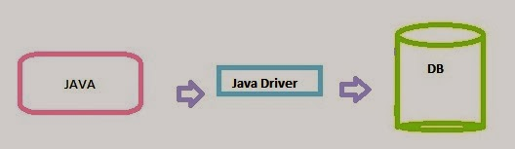
Driver Manager
JDBC Driver :
Is a set of classes and interfaces, written according to JDBC API to communicate with a database.
Notes:
Title + Text

Slide 4
Driver Manager
The JDBC API defines a set of interfaces that encapsulate major database functionality like
Running queries
Processing results
Determining configuration information
Notes:
Note:
A database vendor or third-party developer writes a JDBC driver, which is a set of classes that implements these interfaces for a particular database system
• An application can use a number of drivers interchangeably
• JDBC drivers are available for most database platforms, from a number of vendors and in a number of different flavors

Slide 5
Driver Manager
The DriverManager class acts as an interface between user and drivers
Methods of DriverManager class:
public static void registerDriver(Driver driver)
public static void registerDriver(Driver driver)
public static Connection getConnection(String url)
public static Connection getConnection(String url,String userName,String password)
Notes:
Note:
The DriverManager class maintains a list of Driver classes that have registered themselves by calling the method DriverManager.registerDriver().
public static void registerDriver(Driver driver) : To register the given driver with DriverManager.
public static void registerDriver(Driver driver) : To deregister the given driver (drop the driver from the list) with DriverManager.
public static Connection getConnection(String url) : To establish the connection with the specified url.
public static Connection getConnection(String url,String userName,String password) : To establish the connection with the specified url, username and password.

Slide 6
Establish a connection
import java.sql.*;
Load the vendor specific driver :
Class.forName("oracle.jdbc.driver.OracleDriver");
What do you think this statement does, and how?
- Dynamically loads a driver class, for Oracle database

Slide 7
Connection
Connect
Register the driver
Query
Connect to the database
Process
results
Close
Notes:
Note:
The first thing you need to do is establish a connection with the DBMS (Database Management System) you want to use.
This involves two steps:
(1)loading the driver and
(2)making the connection.

Slide 8
Establish a connection
Make the connection :
Connection con = DriverManager.getConnection( "jdbc:oracle:thin:@oracle-prod:1521:OPROD", username, passwd);
What do you think this statement does?
- Establishes connection to database by obtaining a Connection object
Notes:
Note:
The java.sql.Connection object, which encapsulates a single connection to a particular database, forms the basis of all JDBC data-handling code.
The DriverManager.getConnection( ) method creates a connection:
Connection con = DriverManager.getConnection("url", "user","password");
You pass three arguments to getConnection( ): a JDBC URL, a database username, and a password. For databases that don't
require explicit logins, the user and password strings should be left blank
When the method is called, the DriverManager queries each registered driver, asking if it understands the URL
If a driver recognizes the URL, it returns a Connection object. Because the getConnection( ) method checks each driver in
turn, you should avoid loading more drivers than are necessary for your application

Slide 9
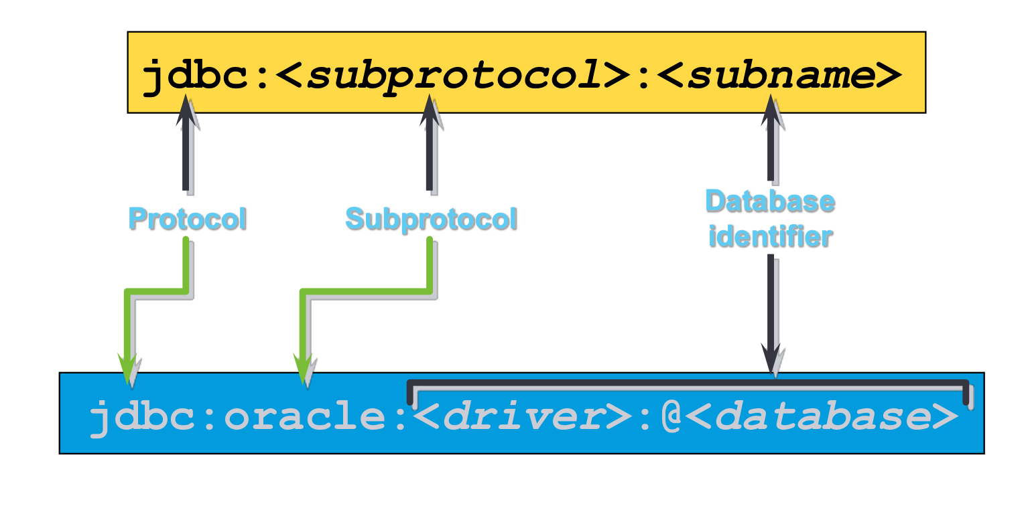
URL represents a protocol to connect to the database

Slide 10
About JDBC URL
A JDBC driver uses a JDBC URL to identify and connect to a particular database.
These URLs are generally of the form:
jdbc:<subprotocol>:<subname>
or
jdbc:driver:databasename

Slide 11
About JDBC URL
For example, the Oracle JDBC-Thin driver uses a URL of the form:
jdbc:oracle:thin:@site:port:database
while the JDBC-ODBC Bridge uses:
jdbc:odbc:datasource:odbcoptions
The only requirement is that a driver be able to recognize
its own URLs
Notes:
Note :
The actual standard is quite fluid, however, as different databases require different information to connect
successfully

Slide 12
Host Details
You should be aware of the IP address of the system or the host name, from where Oracle Database is being accessed.
If your Oracle database is running on the same system, where you are executing your jdbc program, then you can use @localhost (in place of the IP address), in your JDBC URL
jdbc:oracle:thin:@localhost
Notes:
Note :
If the Oracle database is running on a different system, then you need to find out the IP address of that system and include @IP Address in your JDBC URL
• For e.g. if the IP address of the system hosting Oracle database is 192.168.10.5, then your JDBC
URL, will begin with
jdbc:oracle:thin:@192.168.10.5

Slide 13
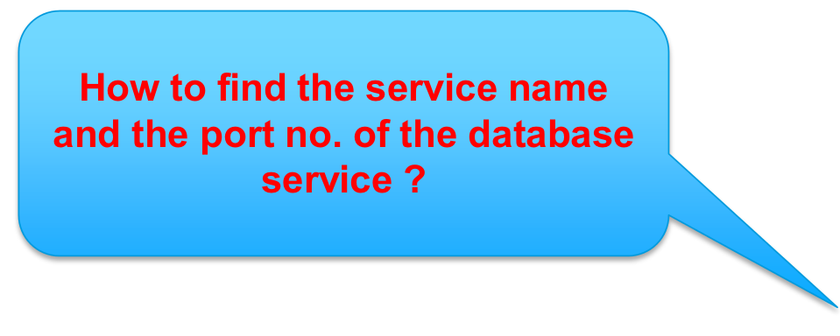
Service Name and Port No.
You should be aware of the service name and port no. on which oracle service is running :
Notes:
Note :
If the Oracle database is running on a different system, then you need to find out the IP address of that system and include @IP Address in your JDBC URL
• For e.g. if the IP address of the system hosting Oracle database is 192.168.10.5, then your JDBC
URL, will begin with
jdbc:oracle:thin:@192.168.10.5

Slide 14
Service Name and Port No.
Find the service name and the port no. of the database that you want to connect, by opening a file called tnsnames.ora
This file will be found within one of the subdirectories of Oracle installation directory. You will have to look for a folder called app, which contains files and folders related to Oracle Software. In one of the sub-directories in this hierarchy, ADMIN, you will find tnsnames.ora file
For e.g. in my machine, tnsnames.ora is found within the following path :
E:\app\harb\product\11.1.0\db_1\NETWORK\ADMIN
Notes:
Note :
Please do not change any configuration parameters stored within this file.
Even a small change in this file could disrupt the Oracle Service. Just open the file, note down the configuration parameters for port no. and service_name and close the file without saving it

Slide 15
Statement
Connect
Create a statement
Query
Query the database
Process
results
Close
Notes:
Note:
Once a connection is established, it is used to pass SQL statements to its underlying database.
A Statement object is used to send SQL statements to a database. The Statement interface provides basic methods for executing statements and
retrieving results.

Slide 16
The Statement Object
To execute SQL statements use Statement Object.
• You need an active connection to create a JDBC statement
• Statement object has three methods to execute a SQL statements:
executeQuery() for SELECT statements
executeUpdate()for INSERT, UPDATE, DELETE, or DDLstatements
execute() for either type of statement

Slide 17
How to Query the Database?
To execute SQL statement , we should first create Statement
object, as:
Statement stmt = conn.createStatement();
To execute the query on the database :
ResultSet rset = stmt.executeQuery(statement);
int count = stmt.executeUpdate(statement);
boolean isquery = stmt.execute(statement);
Notes:
Note:
Once a connection to a particular database is established, that connection can be used to send SQL statements.
A Statement object is created with the Connection method createStatement, as in the following code fragment:
Statement stmt = conn.createStatement();
• The SQL statement that will be sent to the database is supplied as the argument to one of the execute methods on a Statement object.
• This is demonstrated in the following example, which uses the method executeQuery:

Slide 18
Result Set
Connect
Step through the results
Query
Assign results to Java
variables
Process
results
Close
Notes:
Note:
Now that we have obtained the results of querying the database in the ResultSet object, we need to iterate through this object
and retrieve its contents for further processing in the Java program.

Slide 19
The ResultSet Object
ResultSet is an object that contains the results of executing a SQL statement
A ResultSet maintains a cursor pointing to its current row of
data
Use next() to step through the result set row by row
To retrieve the data from the columns, we can use getXXX() method
Notes:
Note :
The results are available in ResultSet object. In other words, it contains the rows that satisfy the conditions of the query.
The data stored in a ResultSet object is retrieved through a set of get methods that allows access to the various columns of the current row.

Slide 20
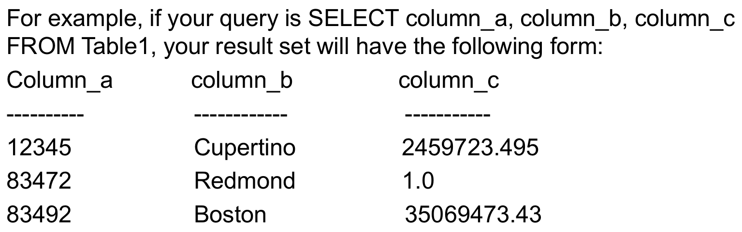
The ResultSet Object
The ResultSet.next() method moves the cursor to the next row in the ResultSet object.
The general form of a result set is a table with column headings and the corresponding values returned by a query.
Notes:
Note :
We can retrieve the results using the methods of ResultSet interface.
Each of these getXXX() methods attempts to convert the column value to the specified Java type and returns a suitable Java value.
For example, getInt() method gets the column value as an int value, getString() method gets the column value as a String value, and geLong() method returns the column value as a long value.

Slide 21
How to Process the Result?
while (rset.next()) { ... }
String val =
rset.getString(colname);
String val =
rset.getString(colIndex);
while (rset.next()) {
String name = rset.getString(“NAME");
String supervisor = rset.getString(“SUPERVISOR");
... // Process or display the data
}

Slide 22
How to Process the Result?
A ResultSet object maintains a cursor, which points to its current row of data.
The cursor moves down one row each time the method next is called. When a ResultSet object is first created, the cursor is positioned before the first row, so the first call to the next method puts the cursor on the first row, making it the current row.
ResultSet rows can be retrieved in sequence from top to bottom as the cursor moves down one row with each successive call to the method next.
Notes:
Note :
When a cursor is positioned on a row in a ResultSet object (not before the first row or after the last row), that row becomes the current row.
This means that any methods called while the cursor is positioned on that row will operate on values in that row (methods such as getXXX).
A cursor remains valid until the ResultSet object or its parent Statement object is closed.

Slide 23
Get ResultSet
ResultSet rs = Stmt.executeQuery(query);
//What does this statement do?
while (rs.next()) {
int ssn = rs.getInt("SSN");
String name = rs.getString("NAME");
int marks = rs.getInt("MARKS");
}

Slide 24
Close connection
stmt.close();
con.close();
Class.forName("oracle.jdbc.driver.OracleDriver");
Connection con=DriverManager.getConnection("jdbc:oracle:thin:@localhost:1 521:xe","system","oracle");
Statement stmt=con.createStatement();
ResultSet rs=stmt.executeQuery("select * from emp765");
System.out.println(rs.getString(1)+" "+rs.getString(2)+" "+rs.getString(3));
con.close();
}}

Slide 25


Question 1
Which one of the following statements is used to register the
jdbc driver
A)
Claas.Forname(“oracle.jdbc.driver.OracleDriver”);
B)
Class.forName(“oracle.jdbc.driver.OracleDriver”);
C)
class.forname(“oracle.jdbc.driver.OracleDriver”);
D)
Class.ForName(“oracle.jdbc.driver.OracleDriver”);
Notes:
Question + Large Options (2Lines)

Slide 26
Question 2
Which is the correct syntax for creating the Connection object
A)
Connection.getConnection(URL, username, password);
B)
Connection.createConnection(URL, username, password);
C)
DriverManager.createConnection(URL, username, password);
D)
DriverManager.getConnection(URL, username, password);
Notes:
Question + Large Options (2Lines)

Slide 27

THANK YOU
Notes:
Thank you slide

