Slide 1
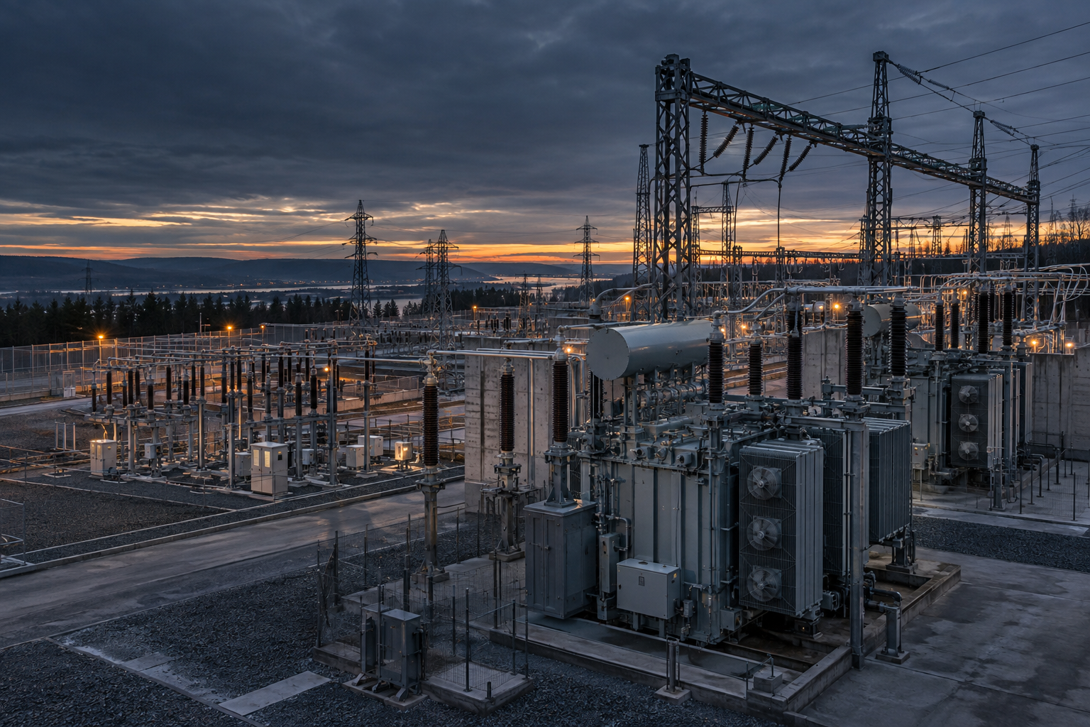
IBM BOBATHON 2026
GRIDWATCH
Power outage prediction
& equipment failure advisor
A working prototype for U1
Track: AI
Team Name : GridWatch
GRIDWATCH / U1
01
Notes:
GridWatch is a local U1 prototype. It helps an operator examine equipment risk, compare weather scenarios and prepare a maintenance plan. The substation image is an AI-generated illustration of a fictional facility, not a monitored asset.

Slide 2

IBM BOBATHON 2026
The maintenance decision
A sensor warning does not explain which asset should be serviced first.
U1 / THE CHALLENGE
Operators need one view of:
01
Equipment condition: temperature, vibration, partial discharge and oil quality
02
Weather exposure: wind and rainfall can change near-term risk
03
Grid impact: customers, critical sites and backup coverage
04
Response capacity: crew skills, shift hours and staging
GRIDWATCH / U1
02
Notes:
The supplied U1 problem statement asks for a solution that combines asset-health sensors, weather forecasts and historical incidents, then ranks equipment and areas by grid impact and creates a maintenance and crew pre-positioning plan. The photo is an AI-generated illustration.

Slide 3
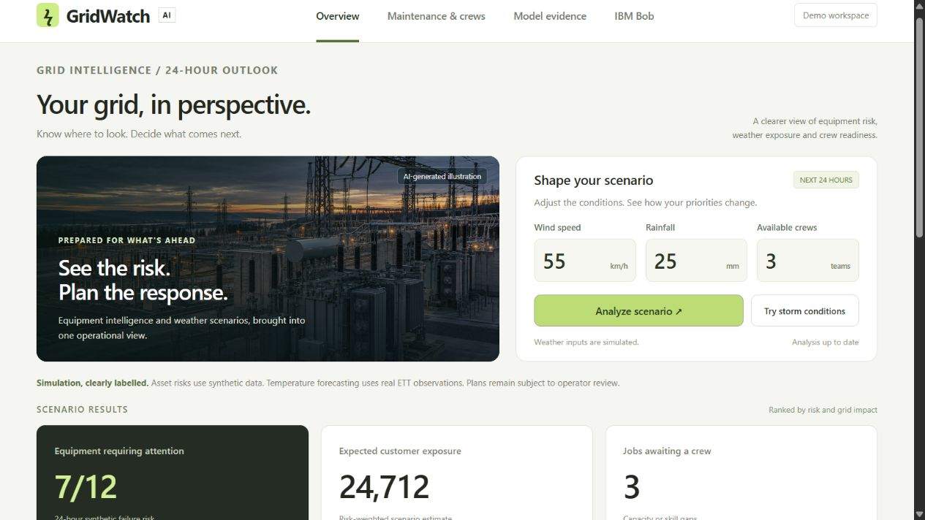
IBM BOBATHON 2026
A decision surface for the next 24 hours
GridWatch turns risk signals into a reviewable plan.
INPUTS
Weather scenario
Wind + rainfall
Asset signals
Sensor snapshot
Resources
Crew count + skills
↓
OUTPUT
Risk, priorities & crews
GRIDWATCH / U1
03
Notes:
The screenshot shows the real running GridWatch interface. An operator edits wind, rainfall and crew availability, then runs the scenario. The backend scores twelve fictional assets, calculates impact-weighted priority and produces a capacity-constrained maintenance queue. The screenshot itself is captured from the local prototype.

Slide 4
IBM BOBATHON 2026
Architecture
One Python engine, two interfaces, two evidence tracks.
01
02
03
04
ETTh1 observations
→
Failure simulator
→
Shared advisor
→
Operator surfaces
Real hourly transformer data
Synthetic sensor + weather events
Risk, impact and crew plan
Browser dashboard + IBM Bob MCP
Models are trained first. The advisor is the shared contract between prediction and action.
REAL DATA → temperature forecast | SYNTHETIC DATA → failure demonstration
GRIDWATCH / U1
04
Notes:
The real ETTh1 track forecasts oil temperature 24 hours ahead. It has no outage labels. The synthetic track creates failure labels so the complete advisor workflow can be demonstrated. The browser server and the MCP server call the same engine.py implementation. This separation prevents us from presenting temperature accuracy as outage accuracy.

Slide 5
IBM BOBATHON 2026
Demo: from storm scenario to crew plan
The same asset risk can produce a different work queue when capacity changes.
STORM SCENARIO
85 km/h wind · 65 mm rain
10 / 12
38,904
6
assets flagged
risk-weighted exposure
jobs unassigned with 3 crews
Add three crews → unassigned jobs fall to 1. Risk does not change; response capacity does.
Operator review remains required. The planner does not dispatch crews or optimize road routes.
GRIDWATCH / U1
05
Notes:
These values were verified in the running application. At the storm scenario, three crews leave six jobs unassigned. With six crews, the same risk state leaves one unassigned job. Crew skills and an eight-hour shift constrain assignment. The result is a proposed queue, not a dispatch instruction.

Slide 6
IBM BOBATHON 2026
IBM Bob integration
Bob explains the model-backed result through the Model Context Protocol.
LOCAL MCP SERVER
IBM Bob
GridWatch tools
→
A grounded operator brief
assess_grid_risk
Probabilities · evidence · crew plan
Top priorities
Why they are high risk
Which crews are available
What remains unassigned
get_model_evaluation
Holdout metrics · provenance · limits
MCP handshake + both tool calls passed protocol tests.
GRIDWATCH / U1
06
Notes:
IBM Bob is not the prediction model. The local MCP server exposes the already-tested analysis engine. Bob can call assess_grid_risk and get_model_evaluation, then write a brief grounded in tool output. Protocol tests passed. A signed-in Bob application demonstration is still a separate verification step. Source: https://bob.ibm.com/docs/ide/configuration/mcp/mcp-in-bob.

Slide 7
IBM BOBATHON 2026
Results and impact
Measured evidence, with the boundary between demonstration and deployment kept visible.
REAL TEMPERATURE FORECAST
1.63°C
GRIDWATCH vs BASELINE
Temperature MAE (°C)
1.63
test MAE · Ridge Regression
1.71
vs 1.71°C persistence baseline
Failure accuracy
72.03%
SYNTHETIC FAILURE CLASSIFIER
56.77%
72.03%
GridWatch
Baseline
test accuracy · Logistic Regression
80.72% recall at the 35% alert threshold
Accuracy metrics are synthetic; temperature error is real ETTh1 forecasting. Neither establishes field outage accuracy.
GRIDWATCH / U1
07
Notes:
Real ETTh1 test MAE is 1.6345°C versus 1.7144°C persistence. Synthetic failure test accuracy is 72.03%, versus 56.77% majority-class accuracy; recall is 80.72%. The synthetic test prevalence is 43.23%, so these are not rare-event utility estimates. Source: models/metrics.json and the saved accuracy calculation.

Slide 8
IBM BOBATHON 2026
Team and next steps
A working prototype with a clear path to field validation.
TEAM
GridWatch
Team Details
Vivaa Rathod (24EE055)/Leader - Backend/API
Aryan Chanpa (24CS011) - ML/Data
Krishna Patel (24EC107) - Frontend/UI
Yesha Parsana (24EC091) - Product & Integration
GRIDWATCH / U1
08
Notes:
The repository currently has the project build, documentation and technical verification. Team identity fields are intentionally pending. The next technical step is a real data contract: asset histories, sensor timestamps, maintenance and failure events, forecast-issued times, topology version and customer impact. Field validation should measure false alerts, lead time, calibration and recall at a crew budget. The engineer image is an AI-generated illustration.

