Slide 1

IIIT BHOPAL • MINOR PROJECT
Rolling-Horizon
CFDRP Implementation
Dynamic order assignment and
interactive delivery simulation
A practical implementation of the Crowdsourced Freight Delivery Routing Problem, combining one-hour planning horizons with a browser-based fleet visualisation.
Aryan Jaiswal (24U020130) • Karan Sahu (24U020127)
Under the guidance of Dr. Neeta Anna Eapen

Slide 2
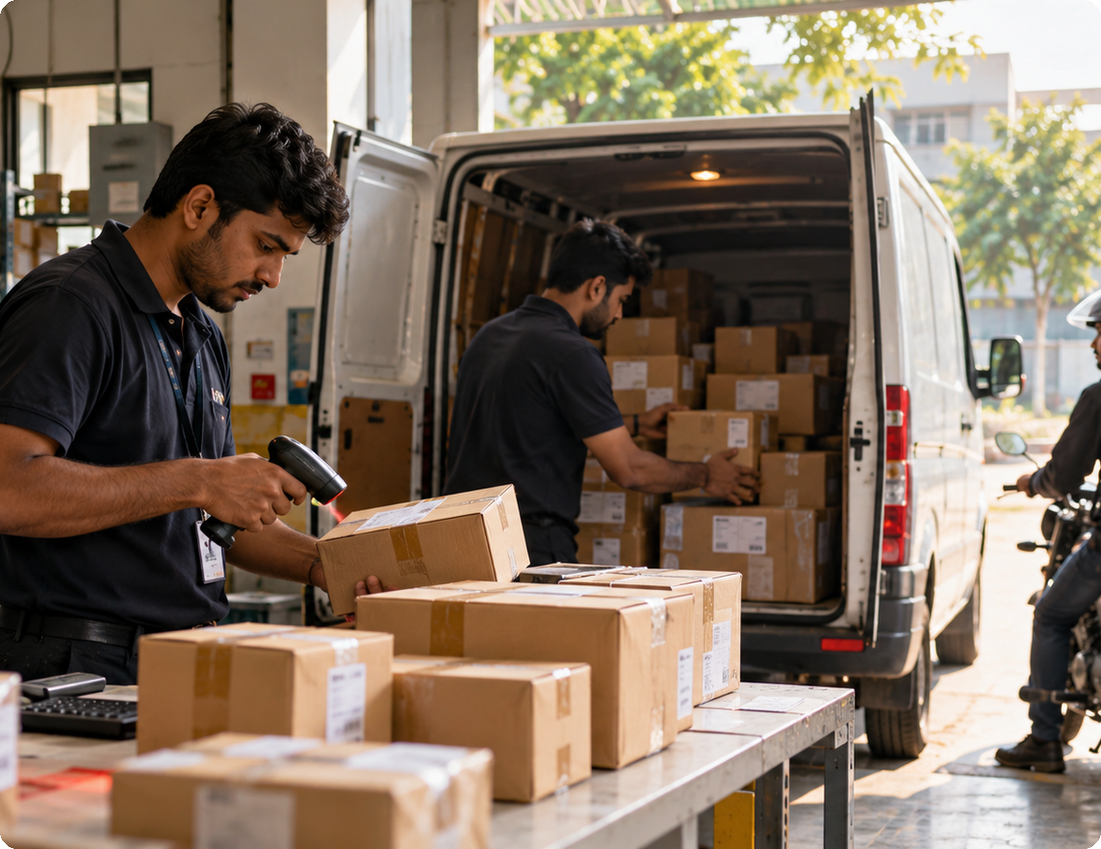
02 / INTRODUCTION
A delivery plan must keep adapting at each epoch as new orders arrives .
CFDRP combines order assignment with paired pickup-and-delivery routing under changing demand and vehicle positions.
Crowdsourced freight delivery
Orders arrive at different times. Drivers are updated as they move. Each request connects a merchant pickup to a customer delivery.
1
Dynamic orders
Only orders already called- in are visible to the planner.
2
Changing fleet
Vehicle position updates are applied at decision epochs.
3
Paired stops
Every scheduled request has a pickup and a delivery event.
ROLLING-HORIZON CFDRP • IIIT BHOPAL

Slide 3
03 / LITERATURE REVIEW / BACKGROUND
The project includes four research themes.
C
Crowdshipping
P
Dynamic pickup & delivery
Occasional or non-dedicated drivers expand delivery capacity, but make driver availability uncertain.
A request has two linked stops; pickup must precede delivery while new demands continue to arrive.
T
Time-window routing
R
Rolling horizon
The plan must respect early and late service bounds while accounting for travel and handling time.
Instead of fixing the whole day once, the schedule is revisited as current information changes.
ROLLING-HORIZON CFDRP • IIIT BHOPAL

Slide 4

04 / PROBLEM STATEMENT
The Challenge of Dynamic Order Assignment and Time window .
The problem involves dispatching crowdsourced vehicles to cover all customer orders that arrive randomly over the entire planning horizon within the time window.
CORE QUESTION
Which vehicle should serve each order — and in what sequence?
The decision must account for:
New order arrivals
Call-in time determines when an order becomes visible.
Vehicle capacity
Nominal single-vehicle capacity is 7.2 m³.
Pickup / delivery windows
Both events have early and late service limits.
Travel and service time
Travel estimates and handling durations affect ETA.
VEHICLE START
MERCHANT PICKUP
CUSTOMER DELIVERY
Position update
Collect parcel
Complete order
ROLLING-HORIZON CFDRP • IIIT BHOPAL

Slide 5
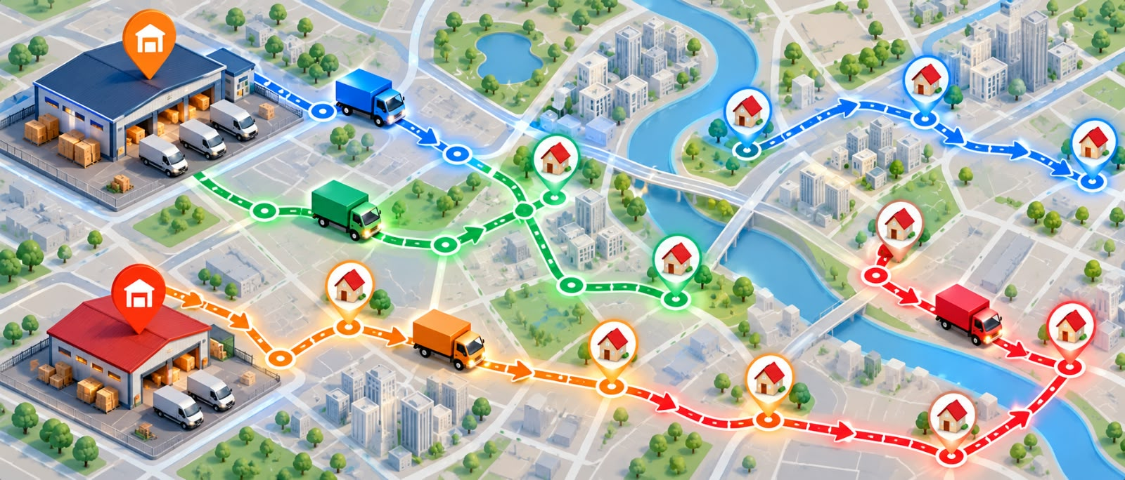

05 / PROPOSED METHODOLOGY / PROPOSED WORK
The plan refreshes as fleet conditions change.
Completed events are processed, vehicle positions are refreshed and only arrived orders are reconsidered.
01
02
03
04
Process events
Refresh fleet
Reveal orders
Re-optimise
Mark deliveries complete when their estimated arrival is reached.
Apply updated vehicle positions; retain routes already in progress.
Include only orders whose call-in time has been reached.
Evaluate candidate plans with IPGA-style search and simulated annealing.
ROLLING-HORIZON CFDRP • IIIT BHOPAL

Slide 6
06 / SYSTEM DIAGRAM / PROPOSED ALGORITHM
Two search paths compete under the same priority rules.
Both candidate schedules are evaluated on the same visible order set; the lower lexicographic score is selected.
ORDER + VEHICLE DATA
VALIDATE + INITIALISE
CURRENT EPOCH STATE
Orders, call-in times and vehicle updates
Required fields, IDs and capacity
Visible pending orders + vehicle positions
SEARCH TRACK A
SEARCH TRACK B
IPGA
Simulated Annealing
LEXICOGRAPHIC SELECTOR
1 Violations → 2 Total lateness → 3 Estimated cost
ROUTE AND DELIVERY VISUALIZATION
The planner compares IPGA and SA; the companion browser page visualises fleet movement and delivery progress.
ROLLING-HORIZON CFDRP • IIIT BHOPAL

Slide 7
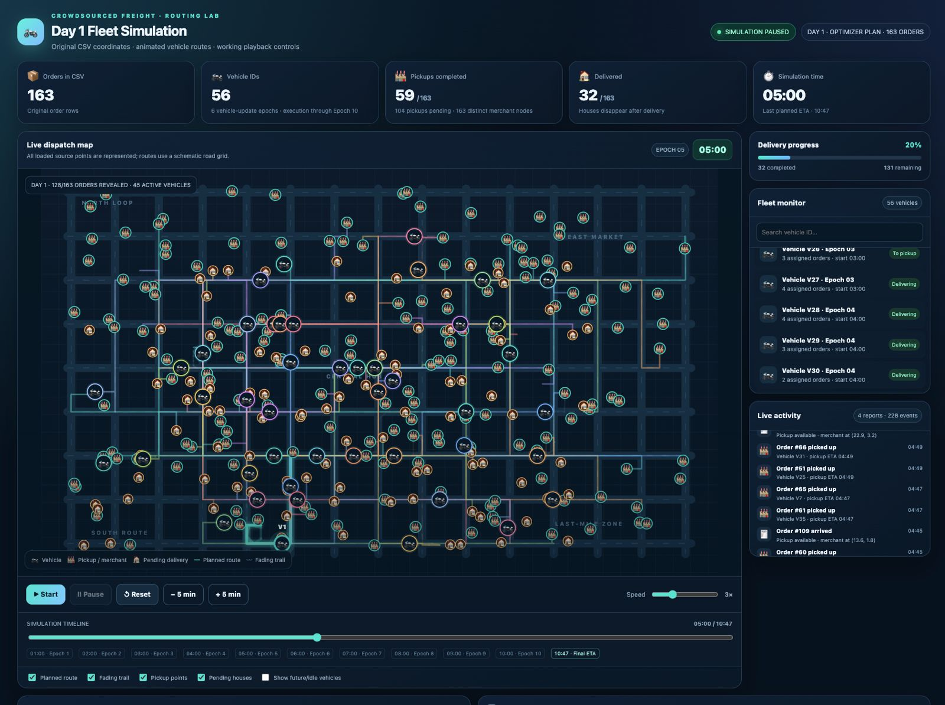
07 / IMPLEMENTATION / HTML SIMULATION
The browser makes fleet movement visible at a glance.
One full view of the supplied HTML simulation — Day 1 snapshot paused at 05:00.
WHAT THE OPERATOR CAN SEE
01
Dispatch map
Vehicle markers, pickup points, pending deliveries, planned paths and fading trails.
02
Fleet monitor
Search and select a vehicle; inspect state and assigned orders.
03
Live activity
Follow arrivals, pickup events, deliveries and hourly checkpoints.
04
Playback controls
Start, pause, reset, jump ±5 minutes, change speed and scrub the timeline.
05
Data controls
uploaded new orders and vehicles csv files
05:00 • 59 pickups • 32 delivered
ROLLING-HORIZON CFDRP • IIIT BHOPAL

Slide 8
08 / RESULTS, COMPARISON & ANALYSIS
1,316 source orders received a planned driver and ETA.
1,316
1,156
160
87.84%
orders assigned
within late-window bounds
with ≥1 violation
overall compliance
TIME-WINDOW COMPLIANCE BY DATASET
Compliant
Violation
Day 1
149 / 163
91.4%
Day 2
148 / 167
88.6%
Day 3
63 / 82
76.8%
Day 4
63 / 82
76.8%
Day 5
59 / 77
76.6%
Day 6
149 / 163
91.4%
Day 7
60 / 76
79.0%
Day 8
157 / 168
93.5%
Day 9
155 / 169
91.7%
Day 10
153 / 169
90.5%
Day 8 highest · 93.5%
Day 5 lowest · 76.6%
ROLLING-HORIZON CFDRP • IIIT BHOPAL

Slide 9
09 / CONCLUSION & FUTURE WORK
A working prototype — with clear next steps.
Conclusion
1
Rolling-horizon planning
Future scope
The plan is revised using the information visible at each one-hour epoch.
Road-aware routing
Use an actual road network / distance matrix and traffic-aware travel estimates.
2
Hybrid search
IPGA-style population search and simulated annealing are compared under one objective hierarchy.
Richer fleet model
Extend multi-order and heterogeneous vehicle handling.
3
Visual execution
The HTML page exposes vehicle movement, route state, pickup and delivery progress.
Robustness tests
Test repeated IDs, oversized orders, late arrivals and epochs with no available vehicle.
KEY TAKEAWAY • The HTML interface makes the route plan understandable.
ROLLING-HORIZON CFDRP • IIIT BHOPAL

Slide 10
10 / REFERENCES
Research sources used in the project report.
Selected bibliography from the supplied report; formatting condensed for presentation readability.
[1] J. Zhang, “Pickup and delivery planning for the crowdsourced freight delivery routing problem,” PLoS ONE, vol. 20, no. 2, e0318432, 2025. doi: 10.1371/journal.pone.0318432.
[8] A. M. Arslan, N. Agatz, L. Kroon, and R. Zuidwijk, “Crowdsourced delivery—a dynamic pickup and delivery problem with ad hoc drivers,” Transportation Science, vol. 53, no. 1, pp. 222–235, 2019. doi: 10.1287/trsc.2017.0803.
[2] Y. Dai, S. He, and Z. Ma, “Pricing decisions for an on-demand crowdsourced delivery platform with differentiated service levels,” IEEE Transactions on Engineering Management, vol. 71, pp. 14350–14364, 2024. doi: 10.1109/TEM.2024.3450574.
[9] I. Dayarian and M. Savelsbergh, “Crowdshipping and same-day delivery: employing in-store customers to deliver online orders,” Production and Operations Management, vol. 29, no. 9, pp. 2153–2174, 2020. doi: 10.1111/poms.13219.
[3] M. Savelsbergh and M. W. Ulmer, “Challenges and opportunities in crowdsourced delivery planning and operations—an update,” Annals of Operations Research, vol. 343, pp. 639–661, 2024. doi: 10.1007/s10479-024-06249-1.
[10] W. Qi, L. Li, S. Liu, and Z. J. Shen, “Shared mobility for last-mile delivery: design, operational prescriptions, and environmental impact,” Manufacturing & Service Operations Management, vol. 20, no. 4, pp. 737–751, 2018. doi: 10.1287/msom.2017.0683.
[4] L. Glomb, F. Liers, and F. Rosel, “A rolling-horizon approach for multi-period optimization,” European Journal of Operational Research, vol. 300, no. 1, pp. 189–206, 2022. doi: 10.1016/j.ejor.2021.07.043.
[11] H. Bathke and C. Münch, “From occasional to active crowdshippers: the significance of couriers’ characteristics,” IEEE Transactions on Engineering Management, vol. 71, pp. 12094–12109, 2024. doi: 10.1109/TEM.2023.3244422.
[5] A. Alnaggar, F. Gzara, and J. H. Bookbinder, “Crowdsourced delivery: a review of platforms and academic literature,” Omega, vol. 98, 102139, 2021. doi: 10.1016/j.omega.2019.102139.
[12] F. Torres, M. Gendreau, and W. Rei, “Crowdshipping: an open VRP variant with stochastic destinations,” Transportation Research Part C, vol. 140, 103677, 2022. doi: 10.1016/j.trc.2022.103677.
[6] C. Archetti, M. Savelsbergh, and M. G. Speranza, “The vehicle routing problem with occasional drivers,” European Journal of Operational Research, vol. 254, no. 2, pp. 472–480, 2016. doi: 10.1016/j.ejor.2016.03.049.
[13] F. Torres, M. Gendreau, and W. Rei, “Vehicle routing with stochastic supply of crowd vehicles and time windows,” Transportation Science, vol. 56, 2022.
[7] G. Macrina, L. Di Puglia Pugliese, F. Guerriero, and D. Laganà, “The vehicle routing problem with occasional drivers and time windows,” Springer Proceedings in Mathematics & Statistics, vol. 217, pp. 577–587, 2017. doi: 10.1007/978-3-319-67308-0_58.
PRIMARY CFDRP STUDY • Zhang (2025), PLoS ONE • DOI: 10.1371/journal.pone.0318432
ROLLING-HORIZON CFDRP • IIIT BHOPAL

Slide 11


