Slide 1
DS PGC-C4-Final Project
NAME → Aryan Singh
E-MAIL → aryansingh19461@gmail.com

Slide 2
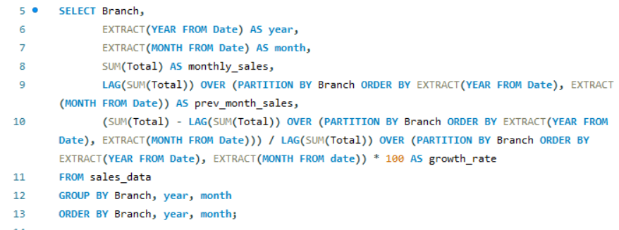

TASK 1
Identifying the Top Branch by Sales Growth Rate
Walmart wants to identify which branch has exhibited the highest sales growth over time. Analyze the total sales
for each branch and compare the growth rate across months to find the top performer.

Slide 3
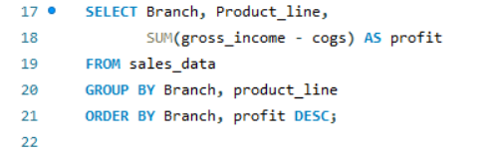
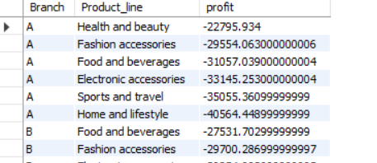
TASK 2
Finding the Most Profitable Product Line for Each Branch
Walmart needs to determine which product line contributes the highest profit to each branch. The profit margin
should be calculated based on the difference between the gross income and cost of goods sold.

Slide 4
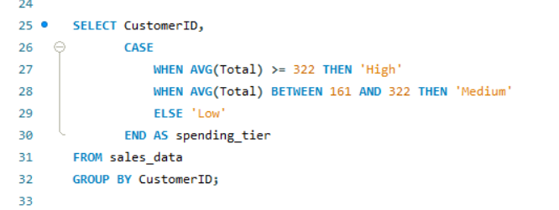
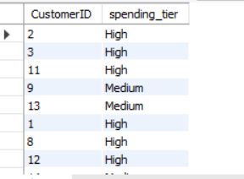
TASK 3
Analyzing Customer Segmentation Based on Spending
Walmart wants to segment customers based on their average spending behavior. Classify customers into three
tiers: High, Medium, and Low spenders based on their total purchase amounts.

Slide 5
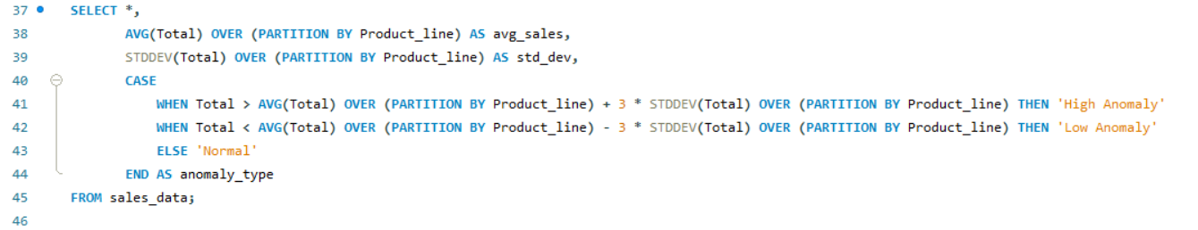
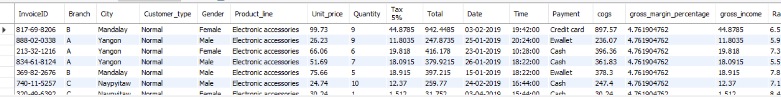
TASK 4
Detecting Anomalies in Sales Transactions
Walmart suspects that some transactions have unusually high or low sales compared to the average for the
product line. Identify these anomalies.

Slide 6
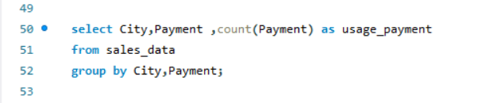
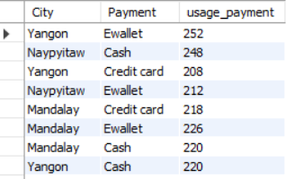
TASK 5
Most Popular Payment Method by City
Walmart needs to determine the most popular payment method in each city to tailor marketing strategies

Slide 7
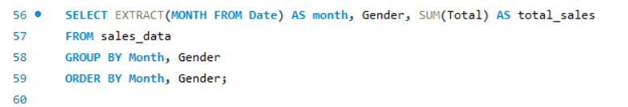
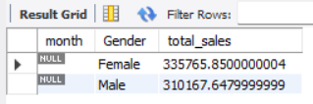
TASK 6
Monthly Sales Distribution by Gender (6 Marks)
Walmart wants to understand the sales distribution between male and female customers on a monthly basis.

Slide 8
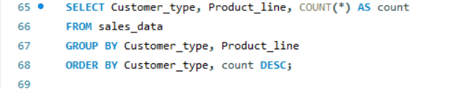
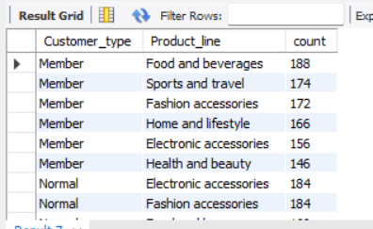
TASK 7
Best Product Line by Customer Type
Walmart wants to know which product lines are preferred by different customer types(Member vs. Normal).

Slide 9
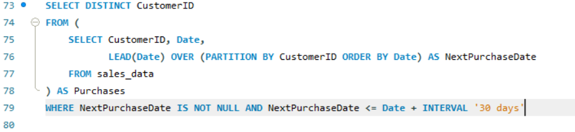
TASK 8
Identifying Repeat Customers
Walmart needs to identify customers who made repeat purchases within a specific time frame (e.g., within 30

Slide 10
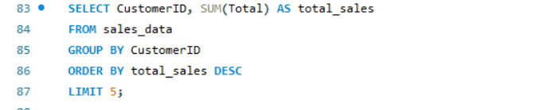
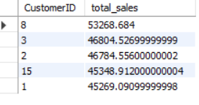
TASK 9
Finding Top 5 Customers by Sales Volume
Walmart wants to reward its top 5 customers who have generated the most sales Revenue.

Slide 11
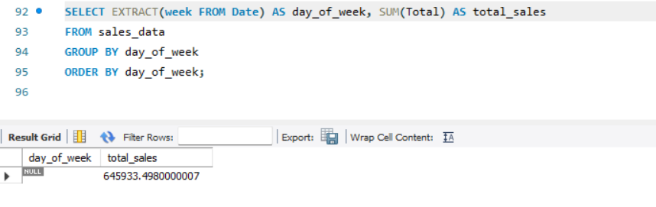
TASK 10
Analyzing Sales Trends by Day of the Week
Walmart wants to analyze the sales patterns to determine which day of the week brings the highest sales.

Slide 12
TASK 11
LINK TO VIDEO PRESENTATION
https://drive.google.com/file/d/1LrRZiui7TfdwwxkqVeyjZW71ficHY15H/view?usp=sharing

Slide 13
THANK YOU

