Slide 1
MUTUAL FUND
Technologies Used
ANALYTICS PLATFORM
Python
Pandas
Transforming Raw Data into Actionable Investment Insights
SQLite
Power BI
Prepared by: Aryan Kunal
aryankunal112233@gmail.com
GitHub
Bluestock Fintech Capstone Project
40
10
5K+
32K+
Funds
Houses
Investors
Transactions
Notes:
Opening slide. Introduce the project: an end-to-end mutual fund analytics platform built for Bluestock Fintech capstone. Mention the scale: 40 funds, 5,000+ investors, 32,000+ transactions.

Slide 2
PROBLEM STATEMENT & OBJECTIVES
THE PROBLEM
PROJECT OBJECTIVES
!
Large mutual fund datasets are extremely difficult to analyze manually at scale
1
ETL Pipeline Ingest, clean & transform raw data
2
EDA Explore fund and investor patterns
!
Investors need clear performance, risk, and behavioral insights in one place
3
Performance Metrics CAGR, Sharpe, Sortino, Alpha, Beta
4
Risk Analytics VaR, CVaR, Drawdown analysis
!
No centralized reporting solution exists for multi-fund analysis
5
Investor Behavior Cohort, SIP, transaction profiling
6
BI Dashboard 4-page interactive Power BI report
Notes:
Explain the business problem: analysts spend hours in Excel trying to compare dozens of funds. This platform automates that entirely. Walk through the 6 objectives.

Slide 3
DATA SOURCES & PROJECT SCALE
40
10
5,000+
32,000+
Fund Schemes
Fund Houses
Investors
Transactions
Fund Master
40 scheme metadata, categories, benchmarks
NAV History
Daily NAV values for return computation
Transactions
32K+ investor trades: SIP, Lumpsum, Redeem
Industry AUM
Monthly AUM by fund house 2022–2025
SIP Inflows
Systematic investment flows by category
Benchmarks
Index data for alpha & beta calculation
Portfolio Holdings
Sector weights for HHI concentration
Notes:
Walk through the 7 datasets. Emphasize that all data was cleaned, validated, and loaded into SQLite before any analytics ran.

Slide 4
PROJECT ARCHITECTURE
1
2
3
4
5
6
Raw Data
ETL Pipeline
SQLite DB
Analytics Engine
Power BI
Insights
CSV files
Python / Pandas
Structured storage
Metrics & Risk
4-page dashboard
Business value
Technologies:
Python 3.x
Pandas & NumPy
SQLite
Power BI
GitHub
Notes:
Describe the pipeline: raw CSVs → ETL in Python → SQLite storage → analytics engine computes all metrics → Power BI visualizes → delivers business insights.

Slide 5
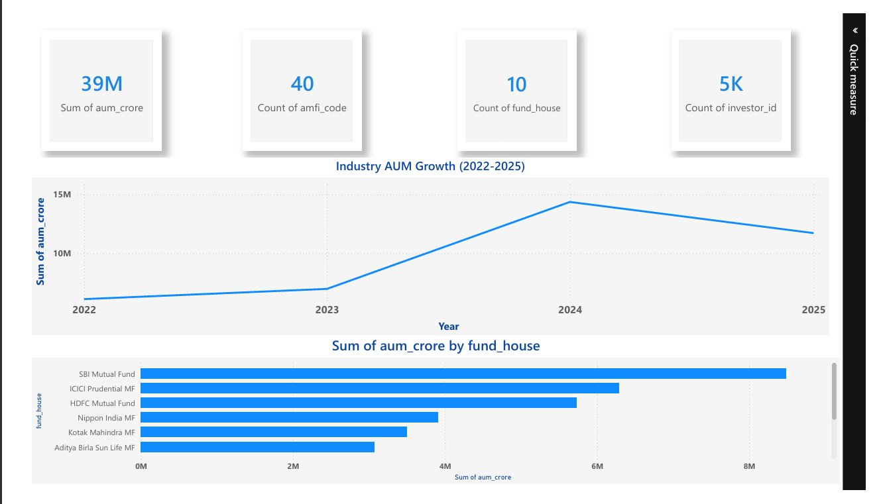
INDUSTRY ANALYSIS — AUM TRENDS & FUND HOUSES
KEY FINDINGS
39M
Total AUM
(₹ Crore)
2024
Peak AUM
Year
SBI MF
Largest
Fund House
3 Houses
Control >50%
of AUM
INSIGHT: A small number of fund houses manage the majority of industry assets. The 2024 AUM surge reflects a bull run period — analysts should watch 2025 moderation closely.
Notes:
Point out the AUM growth chart showing near-tripling from 2022 to 2024. Then note the fund house bar chart: SBI dominates, followed by ICICI Prudential and HDFC.

Slide 6
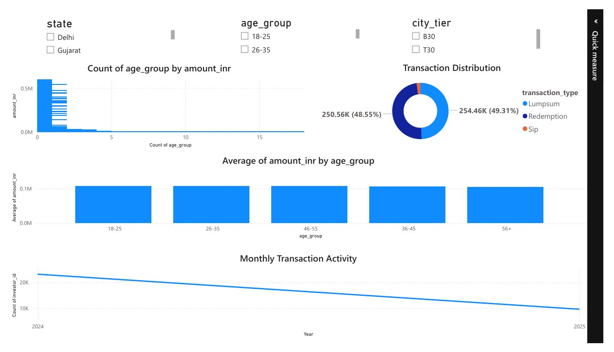
INVESTOR ANALYTICS — BEHAVIOR & TRANSACTIONS
49.3%
Lumpsum
Transactions
48.6%
Redemption
Transactions
~2%
SIP
Transactions
5 Groups
Age Segments
Analyzed
INSIGHT: The near-equal split between lumpsum purchases and redemptions signals high portfolio turnover. Platforms should deploy SIP nudges to convert one-time investors into recurring SIP participants.
Notes:
Highlight the donut chart: lumpsum vs redemption are almost equal. This is concerning — it suggests investors are redeeming as fast as they invest. The SIP share is very small and is an opportunity.

Slide 7
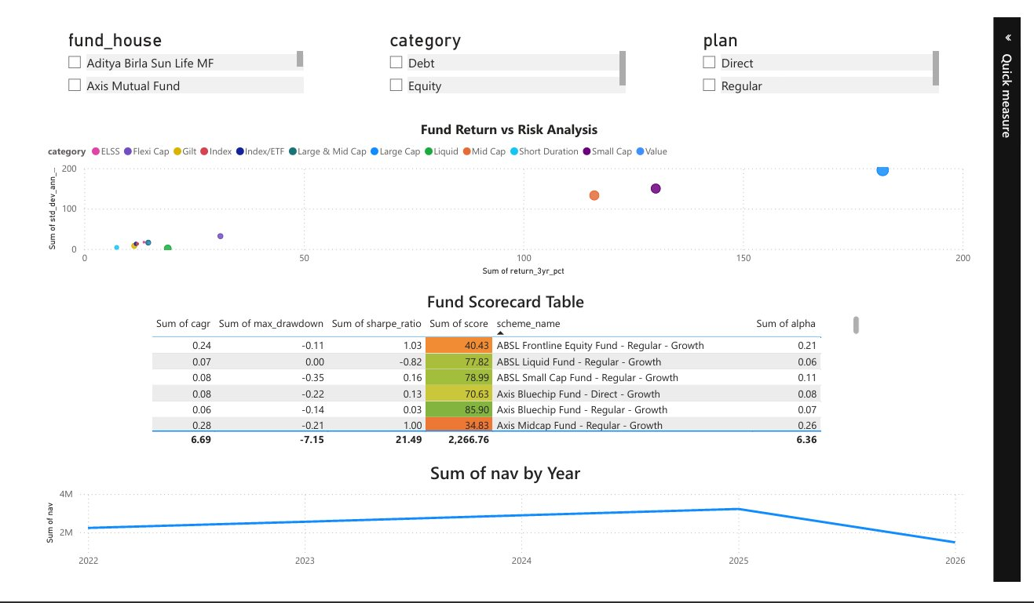
FUND PERFORMANCE ANALYTICS & SCORECARD
Metrics Computed
Top 5 Ranked Funds
CAGR
Sharpe
#1
102886
UTI Mid Cap – Regular
100.00
Compound Annual Growth Rate
Return per unit of total risk
Sortino
Alpha
#2
100016
HDFC Top 100 – Regular
99.10
Return per unit of downside risk
Excess return above benchmark
Beta
Max DD
#3
119095
Axis Small Cap – Regular
93.43
Market sensitivity coefficient
Peak-to-trough decline
#4
119599
SBI Small Cap – Direct
86.87
#5
119092
Axis Bluechip – Regular
85.90
Notes:
Walk through the 6 metrics. Emphasize that the composite scorecard combines all of them into a single normalized score out of 100. UTI Mid Cap Fund scored a perfect 100.

Slide 8
ADVANCED RISK ANALYTICS
Value at Risk
(VaR 95%)
Cond. VaR
(CVaR 95%)
Max Drawdown
Rolling Sharpe
Max expected loss
at 95% confidence
Avg loss in worst
5% of scenarios
Peak-to-trough
decline measure
Time-varying
risk-adj. return
Highest Downside Risk — Top 5 Funds
AMFI Code
Fund Name
VaR (95%)
CVaR (95%)
119599
SBI Small Cap Fund – Direct – Growth
-2.69%
-3.24%
119095
Axis Small Cap Fund – Regular – Growth
-2.62%
-3.17%
101207
ABSL Small Cap Fund – Regular – Growth
-2.60%
-3.25%
118634
Nippon India Small Cap – Regular
-2.54%
-3.23%
119598
SBI Small Cap Fund – Regular – Growth
-2.45%
-3.06%
Observation: All top-5 highest-risk funds are Small Cap equity schemes — consistent with their higher volatility profiles.
Notes:
Explain VaR: 'at 95% confidence, we expect to lose no more than 2.69% on any given day.' CVaR tells us what happens in the worst 5% — the tail risk. All top-5 are Small Cap.

Slide 9
ADVANCED ANALYTICS — COHORTS & RECOMMENDATIONS
Investor Cohort Analysis
Fund Recommendation Engine
2024 Cohort
2025 Cohort
Low Risk
Sharpe > 0, Drawdown > -10%
Avg Investment
Avg Investment
→ Debt / Liquid / Short Duration
₹1,07,423
₹1,09,159
Moderate Risk
Sharpe > -0.5, DD > -25%
Total Invested
Total Invested
₹3.49 Billion
₹30.46 Million
→ Large Cap / Flexi Cap / Hybrid
Top Fund
Top Fund
SBI Liquid – Direct
SBI Small Cap – Direct
High Risk
Top CAGR, Alpha > 0
→ Small Cap / Mid Cap / ELSS
2025 investors average ₹1,736 more per transaction — indicating growing ticket sizes and financial confidence.
Outputs Top 3 fund recommendations per risk profile using quantitative metrics.
Notes:
Two key advanced features: cohort analysis reveals behavioral changes across investor vintages. The recommendation engine makes the platform investor-facing, not just analyst-facing.

Slide 10
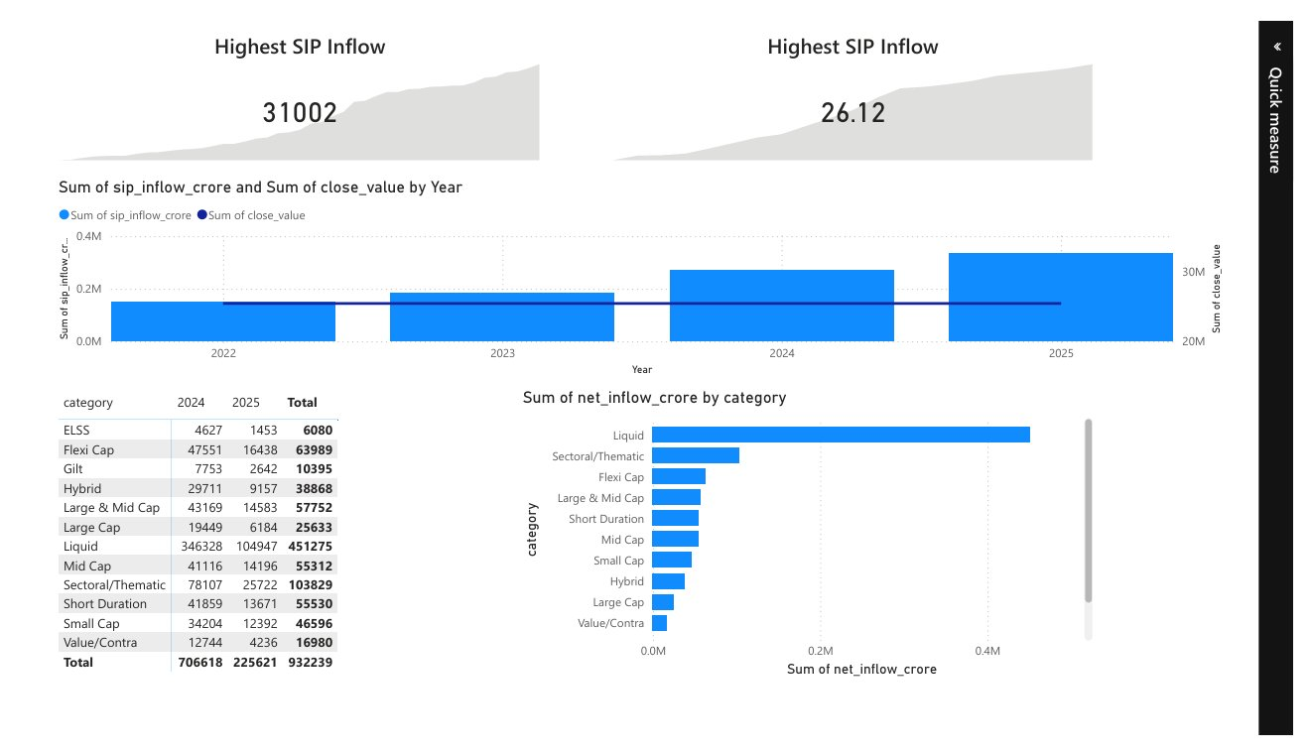
SECTOR CONCENTRATION & SIP MARKET TRENDS
HHI Sector Concentration
HHI = Σ(sector_weight²)
Sectoral / Thematic
0.85
Mid Cap
0.52
Large & Mid Cap
0.38
Large Cap
0.28
Flexi Cap
0.22
Index / ETF
0.12
Top SIP Inflow Categories
Liquid
451,275 Cr
High HHI = Concentrated | Low HHI = Diversified
Sectoral/Thematic
103,829 Cr
Flexi Cap
63,989 Cr
Notes:
HHI shows how concentrated a portfolio is. Sectoral/thematic funds are near 1.0 — very concentrated. Pair this with SIP data: liquid funds dominate inflows, but retail is gravitating toward sectoral/flexi categories.

Slide 11
POWER BI DASHBOARD — 4 INTERACTIVE PAGES
Page 1 — Industry Overview
Page 2 — Fund Performance
KPI Cards
Interactive Slicers
Drill Through
Tooltips
Trend Analysis
Page 3 — Investor Analytics
Page 4 — SIP & Market Trends
Notes:
Show the 4 dashboard pages. Emphasize that all charts have interactive slicers for fund_house, category, and plan. Users can drill through to individual fund details.

Slide 12
KEY FINDINGS, ACHIEVEMENTS & CONCLUSION
Key Findings
Project Achievements
1
Industry AUM showed consistent growth; 2024 was peak year
✓
ETL Pipeline
✓
Performance Analytics
2
SIP is the dominant long-term investment channel
✓
Risk Analytics
✓
Investor Analytics
3
UTI Mid Cap (102886) achieved highest composite score: 100.00
All top-5 highest-risk funds are Small Cap equity schemes
✓
Recommendation Engine
✓
Power BI Dashboard
4
5
2025 cohort invests ₹1,736 more per transaction vs 2024
6
HHI analysis reveals Sectoral funds have highest concentration
THANK YOU
aryankunal112233@gmail.com
Transforming Mutual Fund Data into Actionable Investment Insights
Notes:
Summarize: 6 key findings, 6 project deliverables all complete. Close with the tagline: this platform proves that rigorous analytics + visualization bridges data science and real-world financial decisions.

