Slide 1

Presenting
BachatBuddy
Your Personal Finance Assistant
WaffleHacks ‘24
Hackers With Hearts
Team : INNOVATION NEXUS
Aryan Arora
aroraaryan997@gmail.com
Anchal Batra
anchalbatra49@gmail.com

Slide 2



Problem Statement
The Financial Management Dilemma
Managing personal finances can be a daunting and tedious task for many individuals. The complexity of budgeting, tracking expenses, and saving often leads to financial stress and poor money management. How can we create an innovative solution that simplifies personal finance management, making it intuitive, engaging, and even fun, encouraging users to take control of their financial well-being?

Slide 3
Our Solution
Introducing BachatBuddy
Bachat Buddy revolutionizes personal finance management by making it simple, engaging, and fun. Our app helps users effortlessly budget, track expenses, and save, transforming financial stress into financial confidence.
Key Features:
User-Friendly Interface: Easy navigation with interactive dashboards.
Expense Tracking: Real-time tracking and categorization of transactions.
Daily/Weekly/Monthly Analysis:
Comprehensive analysis of spending and saving habits.
Detailed reports and insights delivered daily, weekly, and monthly.
Why Bachat Buddy?
Engaging: Turns financial management into a fun activity.
Empowering: Provides actionable insights and tools.
Effortless: Simplifies complex financial tasks for all users.

Slide 4
Tools & Tech Stack Used
Front-End:
HTML5: Ensures semantic, well-structured content.
CSS: Enhances user interface aesthetics and responsiveness.
JavaScript: Enables rich, interactive user experiences and functionality.
Backend:
Flask: Micro web framework for Python.
Data Analysis:
Python: Extensive libraries for data manipulation and analysis, easy integration with other technologies.
Pandas: High-performance data structures and easy-to-use data analysis tools.
NumPy: Efficient array operations, mathematical functions, and tools.
Matplotlib: High-quality 2D plots and extensive customization options.
Seaborn: Attractive statistical graphics and simplified plotting functions.
Streamlit: Quick and easy app development, interactive user interfaces.
Version Control:
Git: Tracks changes, facilitates collaboration, and maintains a history of code changes.
GitHub: Enables collaborative development, code review, and continuous integration.

Slide 5
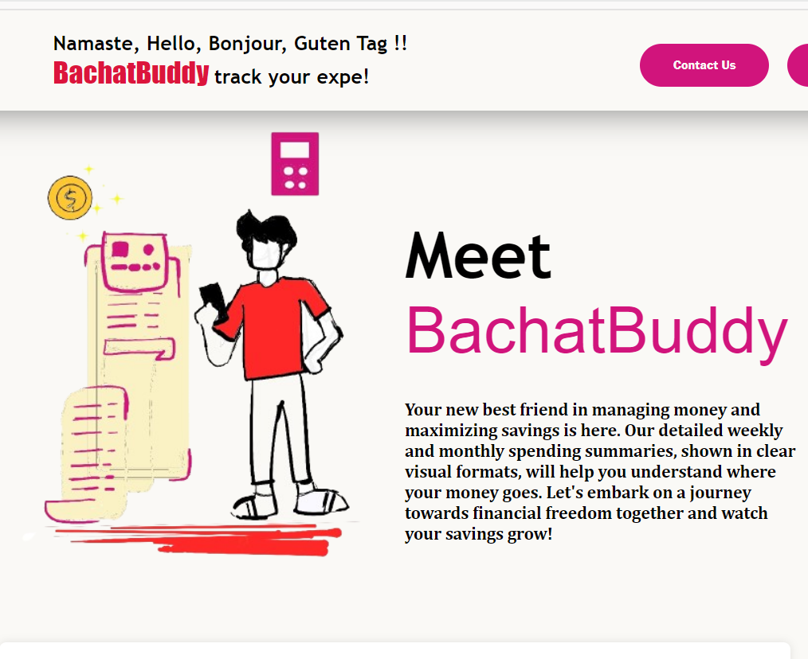
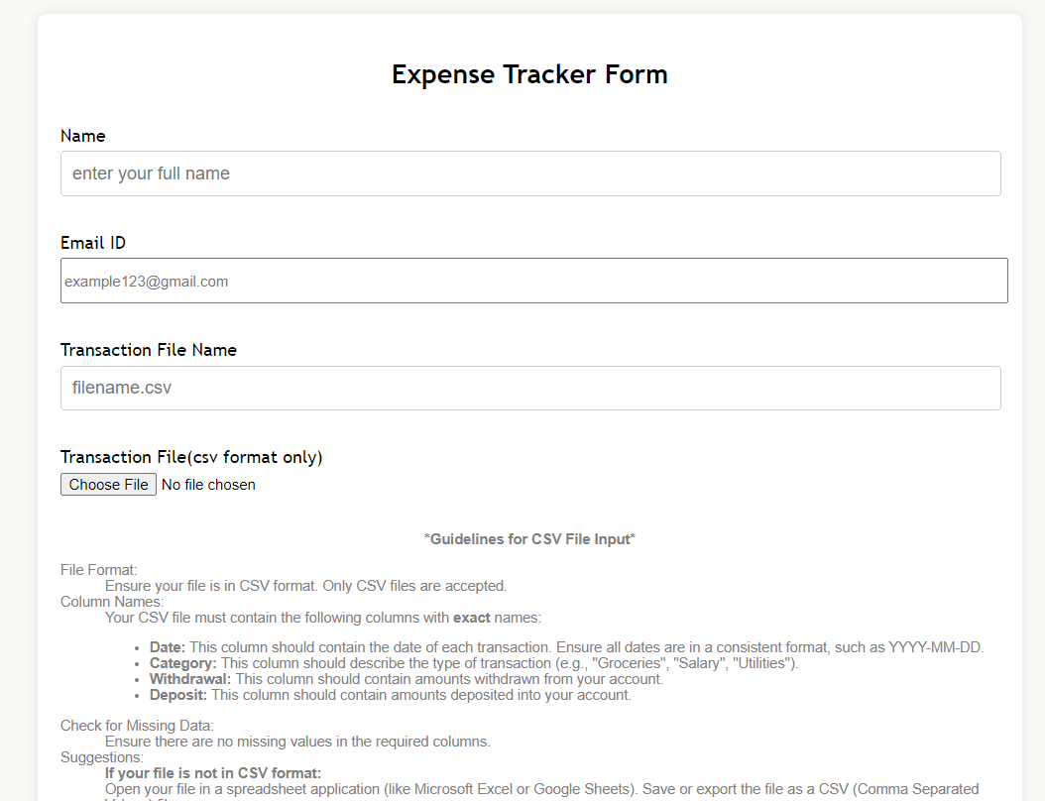
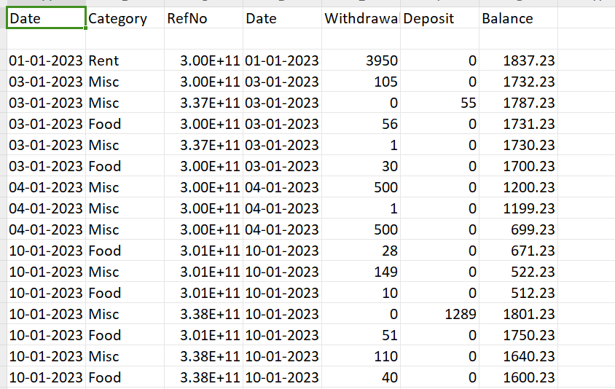
How to use BachatBuddy ?
Step 1: Visit the home page
and fill the form to Input CSV File
Note: Run app.py(Flask file) and
dashboard.py(Streamlit dashboard)
simultanously to load input file
Sample dataset:

Slide 6
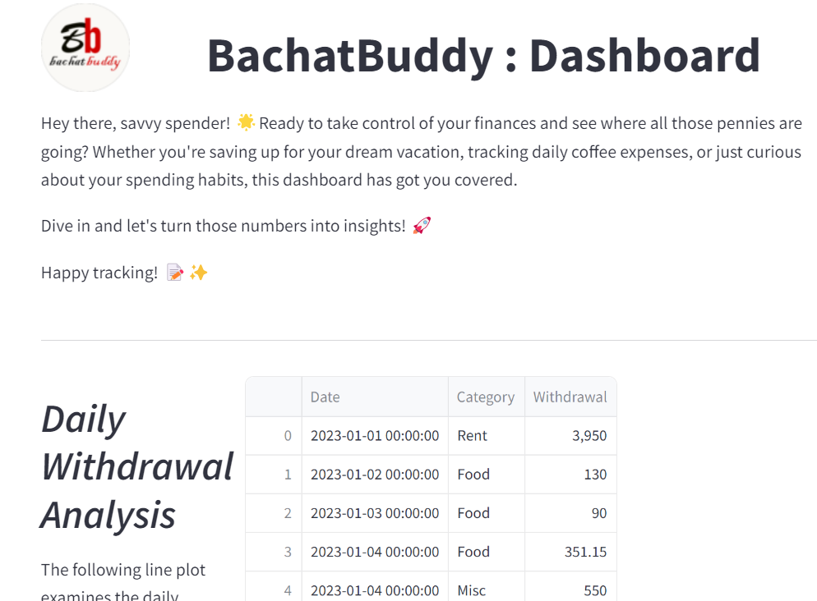
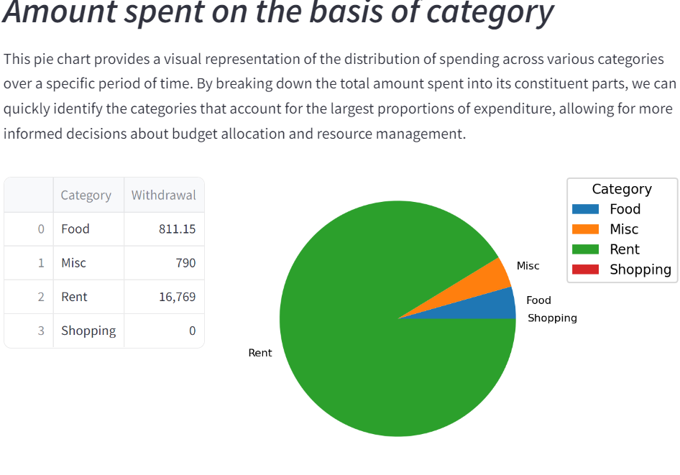
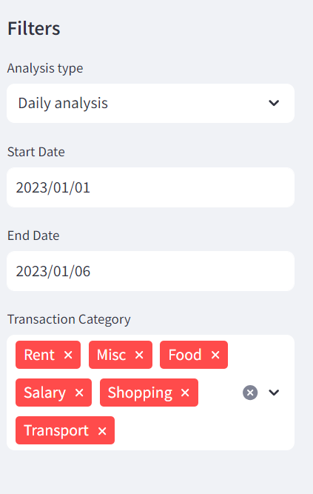
How to use BachatBuddy ?
Step 2: Dashboard Display
View your personalized financial dashboard.

Slide 7
Message from Creators
Aryan Arora - Frontend & Backend Developer
"In developing Bachat Buddy's frontend, I've gained invaluable insights into creating responsive and intuitive user interfaces. Collaborating on a project of this scale taught me the importance of communication and iterative development.
Moving forward, ensuring seamless integration between frontend and backend components is crucial. Continuous testing and feedback loops can enhance user experience and overall system reliability. Let's keep innovating to meet evolving user needs!”
Anchal Batra - Data Analysis & Backend Developer
"Working on Bachat Buddy's data analysis and backend using Flask has been enriching. Harnessing Python libraries like Pandas for data manipulation and Streamlit for visualization provided a deeper understanding of data-driven decision-making. Collaborating with diverse teams highlighted the significance of adaptable solutions and efficient problem-solving.
As we advance, enhancing data security measures and optimizing algorithms for faster processing can elevate user trust and application performance. Let's continue leveraging analytics to deliver personalized insights that empower users in their financial journey.”

Slide 8



Contact Us
Aryan Arora - Frontend & Backend Developer
LinkedIn:
https://www.linkedin.com/in/aryan-arora-064082208
Github:
https://github.com/aryan22csu031
EmailId:
aroraaryan997@gmail.com
Anchal Batra - Data analysis & Backend Developer
LinkedIn:
https://www.linkedin.com/in/anchal-batra/
Github:
https://github.com/achlbatra
EmailId:
anchalbatra49@gmail.com

