Slide 1



Project :
Credit Card Fraud
Detection

Slide 2



Introduction
The challenge is to recognize fraudulent credit card transactions so that the customers of credit card companies are not charged for items that they did not purchase.

Slide 3



Dataset
The dataset contains transactions made by credit cards in September 2013 by European cardholders. This dataset presents transactions that occurred in two days, where we have 492 frauds out of 284,807 transactions. The dataset is highly unbalanced, the positive class (frauds) account for 0.172% of all transactions.
It contains only numerical input variables which are the result of a PCA transformation. Unfortunately, due to confidentiality issues, we cannot provide the original features and more background information about the data. Features V1, V2, … V28 are the principal components obtained with PCA, the only features which have not been transformed with PCA are 'Time' and 'Amount'. Feature 'Time' contains the seconds elapsed between each transaction and the first transaction in the dataset. The feature 'Amount' is the transaction Amount, this feature can be used for example-dependant cost-sensitive learning.
Feature 'Class' is the response variable and it takes value 1 in case of fraud and 0 otherwise.

Slide 4
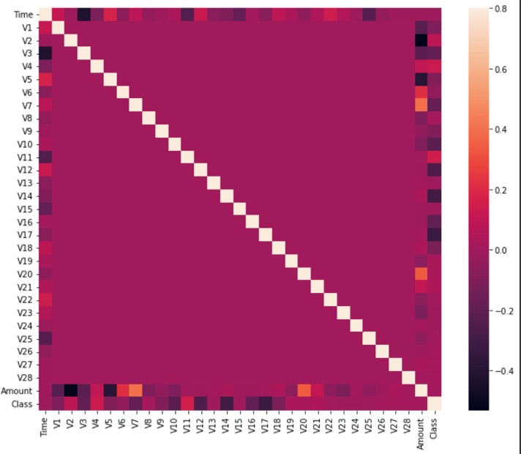
Correlation Matrix
The correlation matrix graphically gives us an idea of how features correlate with each other and can help us predict what are the features that are most relevant for the prediction.
In the HeatMap we can clearly see that most of the features do not correlate to other features but there are some features that either has a positive or a negative correlation with each other. For example, V2 and V5 are highly negatively correlated with the feature called Amount. We also see some correlation with V20 and Amount. This gives us a deeper understanding of the Data available to us.

Slide 5
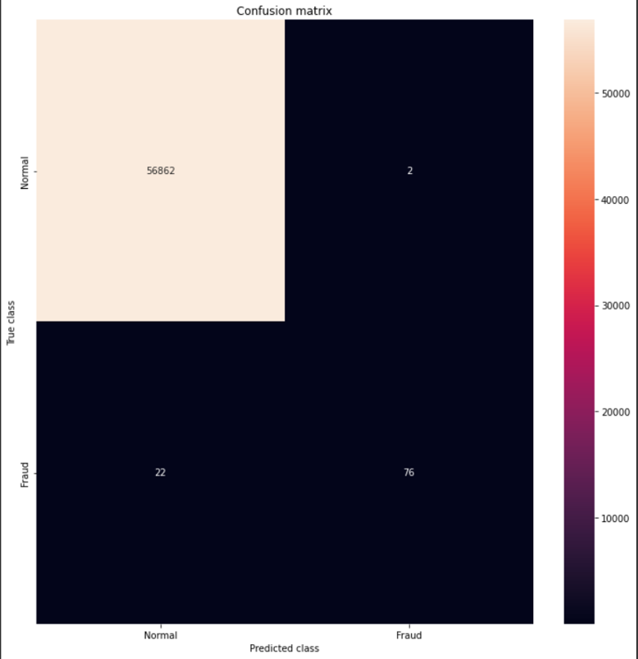
Conclusion :

Slide 6


Team Member
Aryan Italiya 200050131005
Ghanshyam Vagh
200050131120

Slide 7






Thank You

