Slide 1

Problem Statement ID – [ Enter PS ID ]
Problem Statement Title – Automated Road Obstruction & Hazard Mapping from Street/Dashcam Video
Team Name – Team UniVerse
Team Leader Name – [ Enter team leader name ]
Members Names – [ Enter member names ]
Our solution

Slide 2
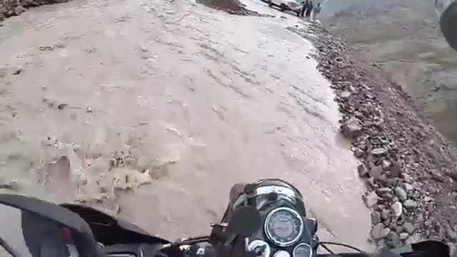
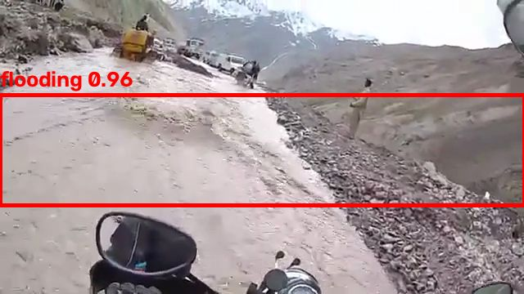
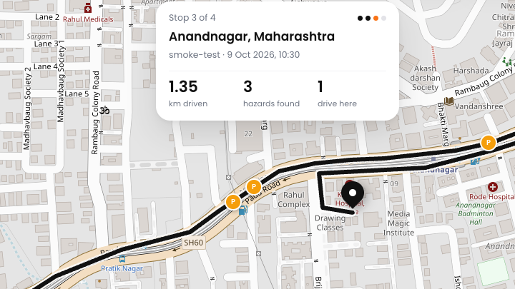



IDEA TITLE: TerraTrace
Proposed solution: dashcams become hazard sensors; every hazard becomes a tracked case.
1 Camera sees the road
2 AI spots the hazard
3 Mapped & tracked
Helmet/dash camera on NH3, Himachal
Water across the road: flooding, 96%
Route, exact pins, case for the department
Sees what satellites miss
Floods, landslides, fallen trees, potholes under canopies & overpasses
Exact hazard location
Camera geometry pins the hazard itself, not just the car
Detection → resolution
Each hazard is a case: priority, department, deadline, status

Slide 3






TECHNICAL APPROACH
How it works, in five steps
1. Capture
2. Detect
3. Locate
4. Map
5. Act
Phone or dashcam video with GPS
AI finds potholes, cracks, floods, landslides
Camera angle + GPS → exact map point
Live map, routes, closures & detours
Case per hazard, routed to a department
MP4 + GPX
YOLOv8 + CLIP
Geometry + GPS
Leaflet + GeoJSON
Case workflow
Built with
Python
YOLOv8
YOLO-World
CLIP
OpenCV
FastAPI
SQLite
Leaflet
GeoJSON
Runs on a laptop GPU (Apple M5): no cloud needed. Three ways in: upload a drive, replay it live, or stream a phone camera.

Slide 4
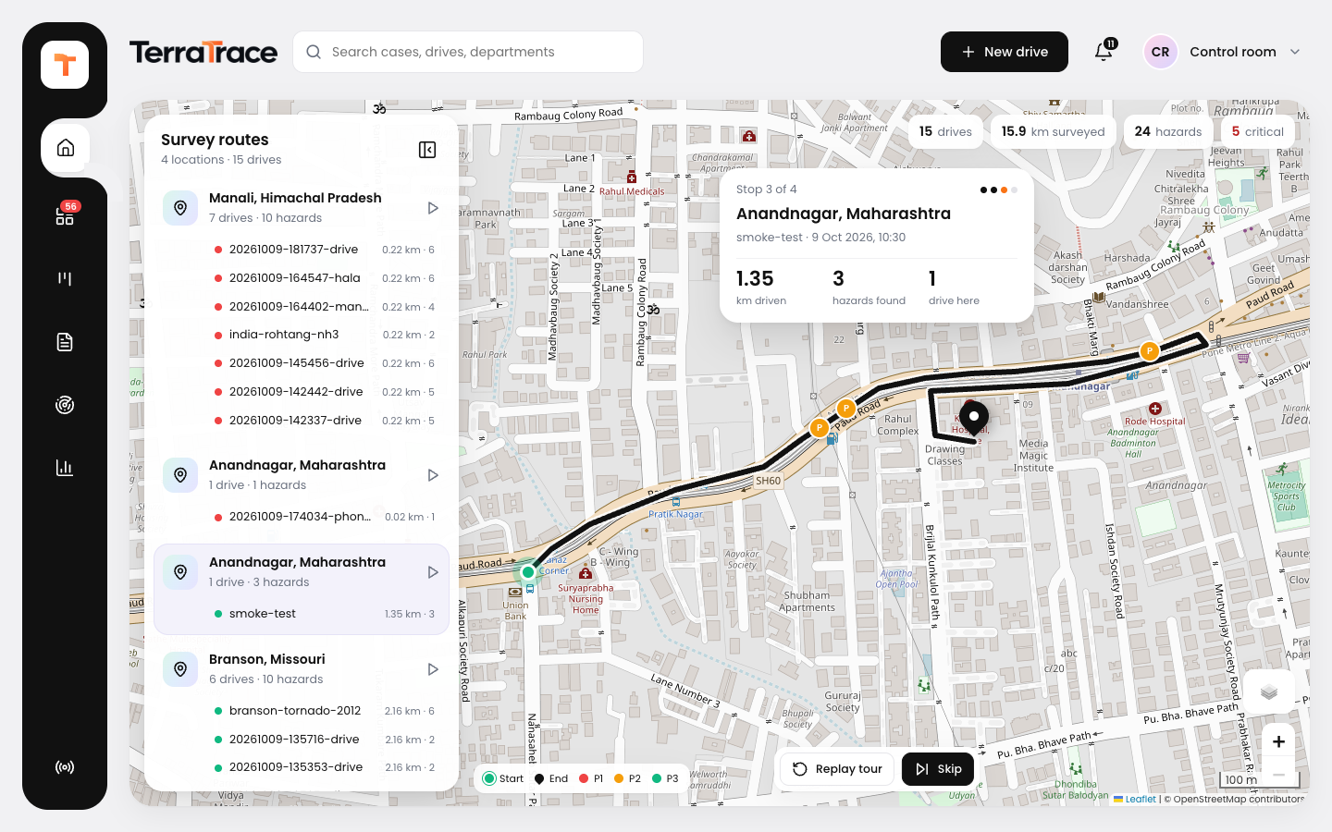
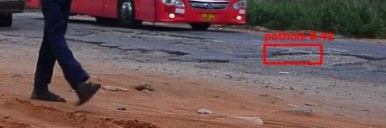
TECHNICAL APPROACH — WORKING PROTOTYPE
22 fps
AI speed on a laptop GPU
4×
faster than real time
3
inputs: upload · live replay · phone
16/16
test checks on 3 real clips
TerraTrace Home: an animated tour draws every analysed route from start to end and drops hazard pins as it passes them.
Evidence photo saved with every hazard

Slide 5
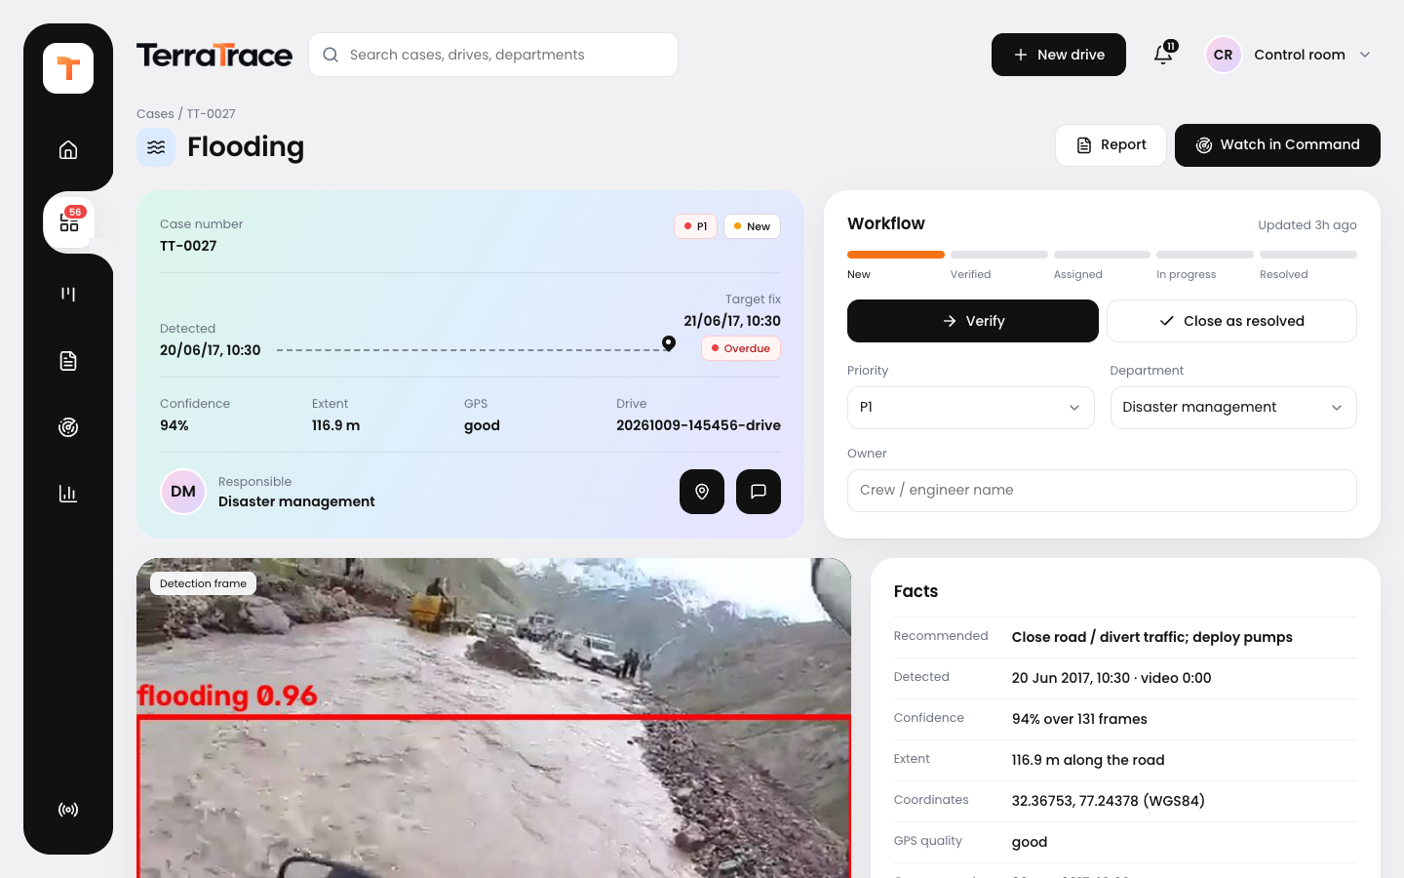
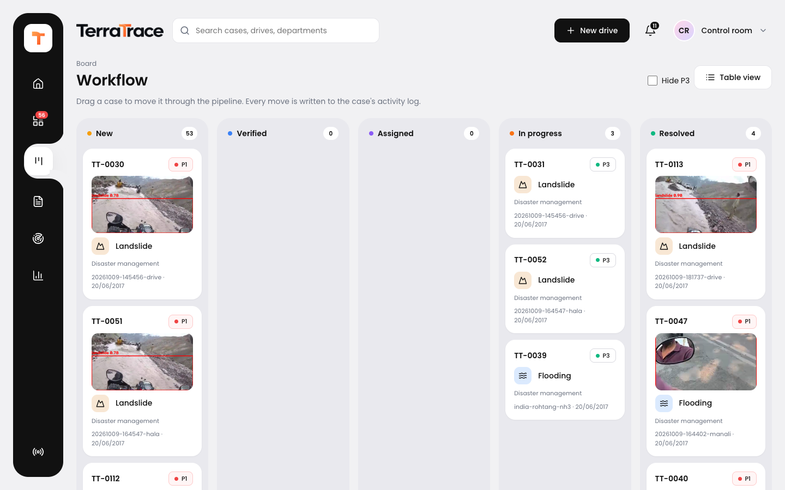
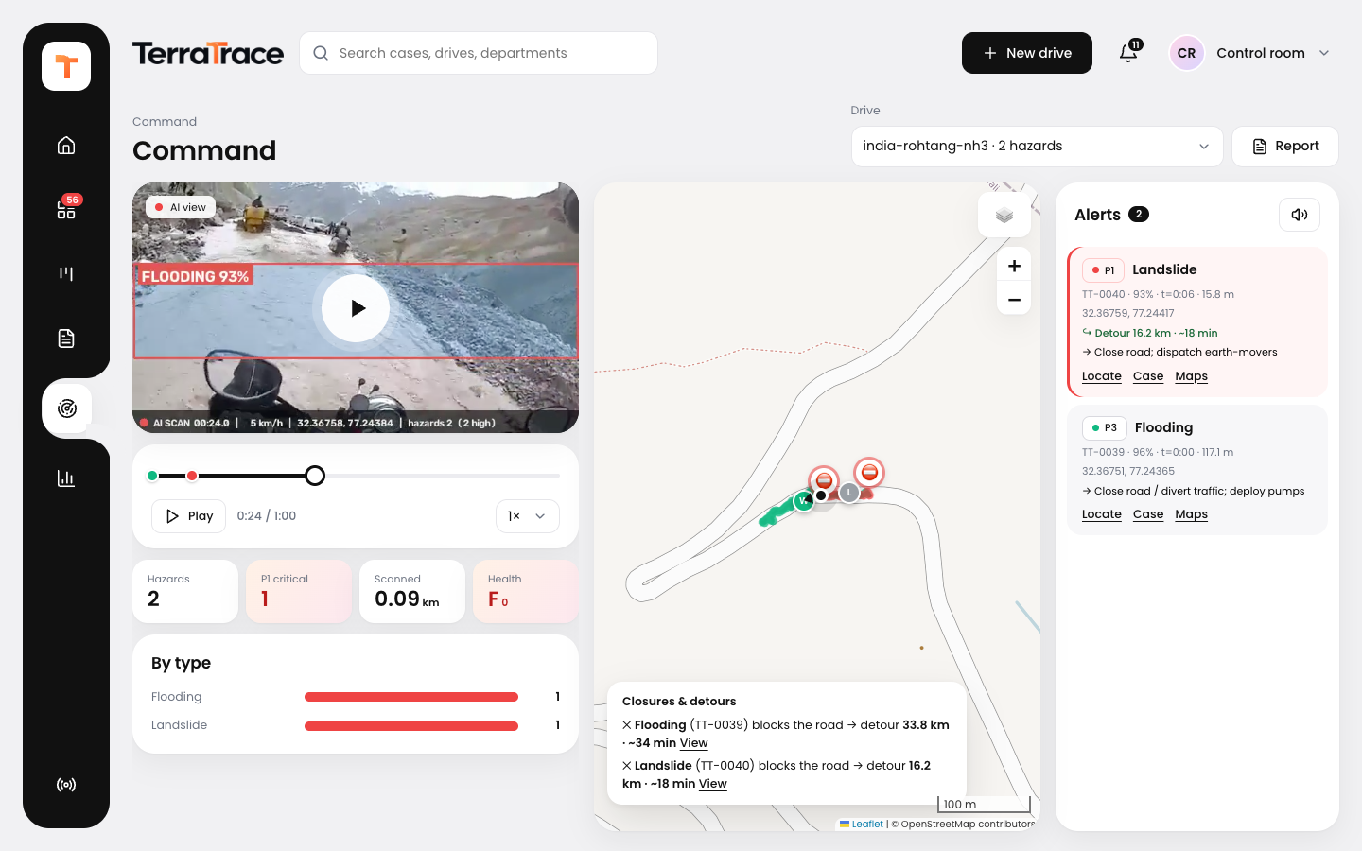
TECHNICAL APPROACH — PLATFORM
From detection to resolution: one platform for the control room
Case tracking
Workflow board
Command
Detected → target fix, priority, department, evidence, notes
New → Verified → Assigned → In progress → Resolved
AI-view video synced with the map; live alerts & detours
Also: one-click incident report (PDF) for authorities · road health grade per drive · GeoJSON / CSV export for any GIS · phone-as-dashcam live mode

Slide 6


FEASIBILITY AND VIABILITY
Feasibility analysis
Already working end-to-end
Upload, live replay & phone streaming → mapped cases with a full workflow
No special hardware
Runs on a laptop GPU; any phone or dashcam is the sensor
Open data & models
Pretrained on RDD2022 (47k+ images); open-source stack, no licence cost
Challenges & risks → our strategies
Challenge / risk | Strategy
AI misses or invents hazards | Whole-road CLIP scene check finds floods & landslides; dry roads and hillsides are filtered out; fine-tune next
Intermittent / noisy GPS | Time interpolation + heading smoothing; GPS-gap flag on every hazard
Unknown camera mounting | Camera presets (phone / dashcam / helmet) + automatic tilt from the horizon
Same hazard seen many times | Object tracking + spatial clustering → one case per real hazard
Phone can't reach the laptop | Single HTTPS server; phone hotspot fallback

Slide 7



IMPACT AND BENEFITS
Municipal corporations
Disaster response teams
Citizens & commuters
Pothole & road-damage inventory from buses, garbage trucks, taxis; repairs prioritised and tracked to closure
Within hours of a storm or landslide: which roads are blocked or flooded, and the detour around them
Safer routing, fewer accidents and vehicle damage; transparent public hazard map
Key benefits
Low cost — reuses phones & dashcams already on the road
Fast — hazard map in minutes, not days of surveys
Accountable — every hazard has an owner, a deadline and a status
Interoperable — standard GeoJSON for any GIS or city dashboard
Tested on an Indian highway (NH3, Rohtang): flooding detected, road closed, detour found

Slide 8
RESEARCH AND REFERENCES
1
RDD2022 road damage dataset
Arya et al., arXiv:2209.08538 · github.com/sekilab/RoadDamageDetector
7
DBSCAN density clustering
Ester et al., KDD 1996
2
comma2k19 driving dataset (video + GNSS)
github.com/commaai/comma2k19
8
GeoJSON · Leaflet · OpenStreetMap
IETF RFC 7946 · leafletjs.com · openstreetmap.org
3
YOLOv8 / YOLO-World (Ultralytics)
docs.ultralytics.com · Cheng et al., CVPR 2024
9
OSRM routing · Nominatim geocoding
project-osrm.org · nominatim.org (detours, place names)
4
RDD-trained YOLOv8s weights
github.com/oracl4/RoadDamageDetection
10
TerraTrace source code
github.com/aryan270506/Team-UniVerse-Geo-AI
5
CLIP: zero-shot image–text matching
Radford et al., ICML 2021 · github.com/openai/CLIP
11
Indian road footage (NH3 demo)
KSOFTECH, CC BY 3.0, via Wikimedia Commons
6
ByteTrack multi-object tracking
Zhang et al., ECCV 2022

