Slide 1
Problem Statement ID – [ Enter PS ID ]
Problem Statement Title – Automated Road Obstruction & Hazard Mapping from Street/Dashcam Video
Team Name – Team UniVerse
Team Leader Name – [ Enter team leader name ]
Members Names – [ Enter member names ]

Slide 2
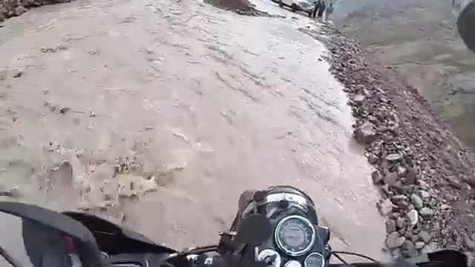
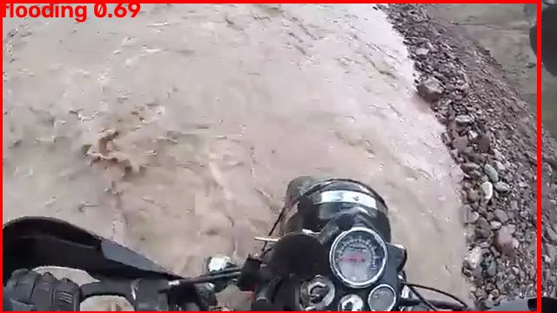
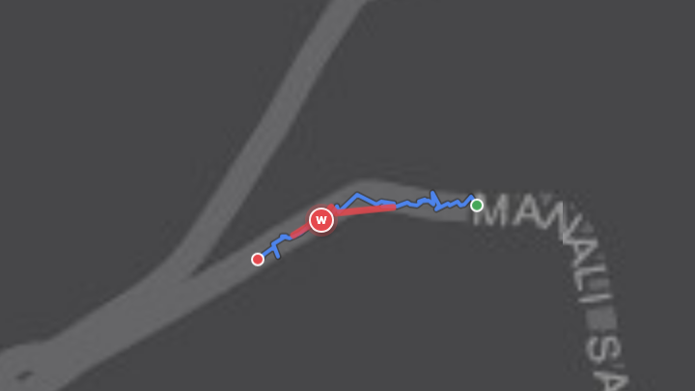



IDEA TITLE: HazardMap
Proposed solution: any phone or dashcam becomes a road-hazard sensor.
1 Camera sees the road
2 AI spots the hazard
3 Pinned on the map
Helmet/dash camera on NH3, Himachal
Water flowing across road: flooding
High-severity line, exact GPS location
Sees what satellites miss
Fallen trees, wires, waterlogging under canopies & overpasses
Exact hazard location
Camera geometry pins the hazard itself, not just the car
Live & standard
Real-time map for responders + GeoJSON for any GIS

Slide 3





TECHNICAL APPROACH
How it works — in four steps
1. Capture
2. Detect
3. Locate
4. Map
Phone or dashcam records video with GPS
AI finds potholes, cracks, floods, debris in each frame
Camera angle + GPS turn each hazard into a map point
Live dashboard; one-click GeoJSON export
MP4 + GPX
YOLOv8 + CLIP
Geometry + GPS
Leaflet + FastAPI
Built with
Python
YOLOv8
YOLO-World
CLIP
OpenCV
FastAPI
Leaflet
GeoJSON
Runs on a laptop GPU (Apple M5) — no cloud needed. Three ways in: upload a drive, replay it live, or stream a phone camera.

Slide 4
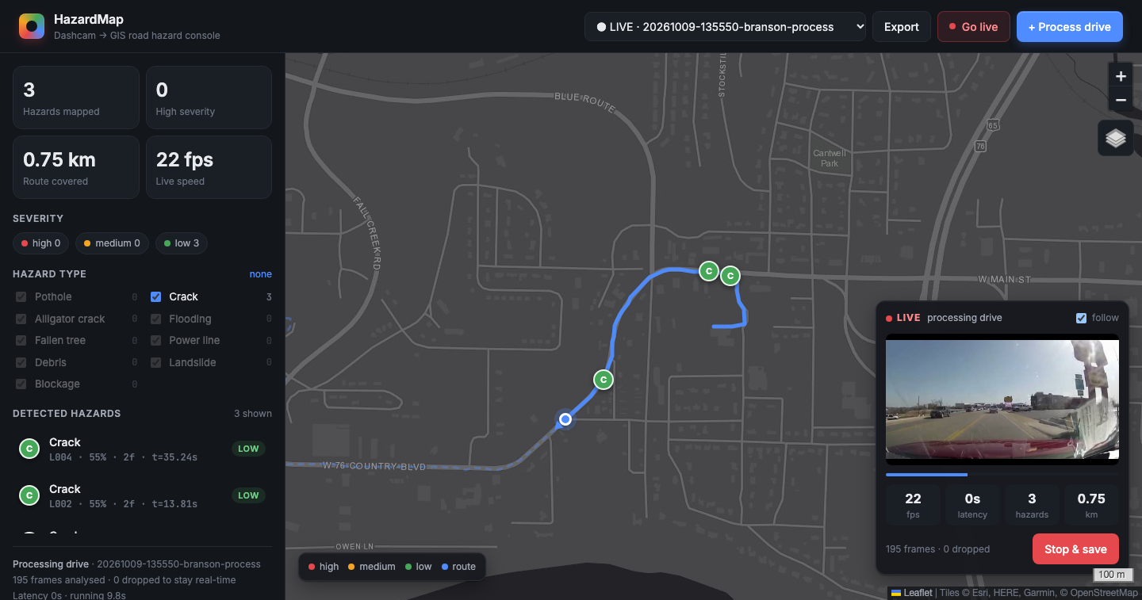
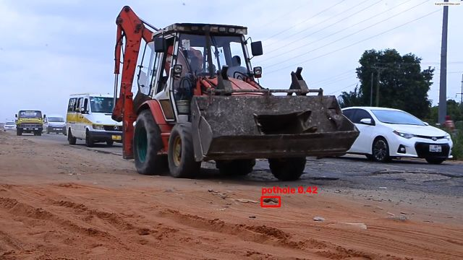
TECHNICAL APPROACH — WORKING PROTOTYPE
22 fps
AI speed on a laptop GPU
4×
faster than real time
3
inputs: upload · live replay · phone
Live view while a drive is processed: the vehicle moves along the route and hazards appear on the map as they are found.
Evidence photo saved with every hazard

Slide 5


FEASIBILITY AND VIABILITY
Feasibility analysis
Already working end-to-end
Prototype built & tested, incl. live mode and a phone-as-dashcam
No special hardware
Runs on a laptop GPU; any phone/dashcam is the sensor
Open data & models
Pretrained on RDD2022 (47k+ images); open-source stack, zero licence cost
Challenges & risks → our strategies
Challenge / risk | Strategy
AI misses some hazards (trees, debris) | Fine-tune on labelled disaster photos; a CLIP double-check already stops false flood alarms on dry roads
Intermittent / noisy GPS | Time interpolation + heading smoothing; gap flag per hazard; road map-matching next
Unknown camera mounting | Configurable height / pitch / FOV; auto-calibration from horizon & lane lines
Same hazard seen in many frames | ByteTrack identities + DBSCAN clustering → one feature per real hazard

Slide 6



IMPACT AND BENEFITS
Municipal corporations
Disaster response teams
Citizens & commuters
Continuous pothole & road-damage inventory from buses, garbage trucks, taxis — prioritise repairs by severity
Within hours of a storm or landslide: which roads are blocked, flooded or hit by fallen lines
Safer routing, fewer accidents and vehicle damage; transparent public hazard map
Key benefits
Low cost — reuses phones & dashcams already on the road
Fast — hazard map in minutes, not days of surveys
Interoperable — standard GeoJSON for any GIS or city dashboard
Scalable — every vehicle adds coverage; repeat drives confirm
Tested on an Indian highway (NH3, Rohtang): flooding detected, high severity

Slide 7
RESEARCH AND REFERENCES
1
RDD2022 road damage dataset
Arya et al., arXiv:2209.08538 · github.com/sekilab/RoadDamageDetector
6
ByteTrack multi-object tracking
Zhang et al., ECCV 2022
2
comma2k19 driving dataset (video + GNSS)
github.com/commaai/comma2k19
7
DBSCAN density clustering
Ester et al., KDD 1996
3
YOLOv8 / YOLO-World (Ultralytics)
docs.ultralytics.com · Cheng et al., YOLO-World, CVPR 2024
8
GeoJSON format · Leaflet maps
IETF RFC 7946 · leafletjs.com
4
RDD-trained YOLOv8s weights
github.com/oracl4/RoadDamageDetection
9
Our prototype source code
github.com/aryan270506/Team-UniVerse-Geo-AI
5
CLIP: zero-shot image–text matching
Radford et al., ICML 2021 · github.com/openai/CLIP
10
Indian road footage (NH3 demo)
KSOFTECH, CC BY 3.0, via Wikimedia Commons

