Slide 1
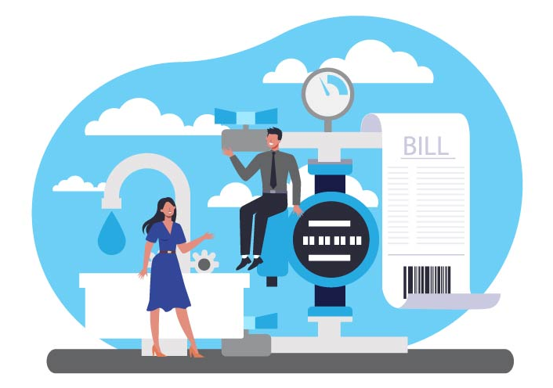
Utility Billing System
A Secure Full-Stack Web Application using ASP.NET Core & Angular
Presented By: Aryan Raj
Guide: Mr. Munish Arora

Slide 2
Project Overview
What is Utility Billing System?
A comprehensive web-based application designed to automate and streamline the complete utility billing lifecycle for electricity, water, gas, and other utility services.
Purpose
Transform traditional manual billing processes into a modern, efficient, and user-friendly digital solution that benefits both utility providers and consumers.
Scope
User Management with role-based access control
Consumer & Connection Management
Automated Meter Reading & Bill Generation
Online & Offline Payment Processing
Comprehensive Reporting & Analytics
Automated Notification System
Target Users
✓ Administrators - System management
✓ Billing Officers - Meter reading & bill generation
✓ Account Officers - Payment processing & reports
✓ Consumers - Self-service portal

Slide 3
SLIDE 3: PROBLEM STATEMENT
Challenges in Traditional Billing Systems
1. Manual Processes
Physical meter reading visits consuming time and resources
Manual bill calculations prone to arithmetic errors
Paper-based record keeping with risk of data loss
2. Operational Inefficiencies
Delayed bill generation and distribution
Long queues for payment collection
Difficulty in tracking outstanding dues
3. Poor Customer Experience
No visibility into consumption patterns
Delayed bill delivery through postal service-
No access to historical billing data
4. Limited Analytics
Difficulty in generating reports
Cannot identify consumption patterns
Manual data aggregation is time-consuming
5. Data Security Concerns
Physical records susceptible to damage/loss
No audit trails for accountability
Difficult to maintain data consistency

Slide 4
SLIDE 4: SOLUTION AND KEY FEATURES
Our Solution: Complete Digital Transformation
Role-Based Architecture with Four User Roles:
ADMIN FEATURES
User role assignment (Consumer, Billing Officer, Account Officer)
View all consumers and staff members
Create & manage utility types (Electricity, Water, Gas)
Configure billing cycles (Monthly/Quarterly)
Define tariff slabs with rates
Establish consumer-utility connections
BILLING OFFICER FEATURES
View all meter readings history
Enter new meter readings with validation
Generate bills automatically based on consumption
View unbilled meter readings
ACCOUNT OFFICER FEATURES
View all payments and outstanding dues
Record offline payments (Cash/Cheque)
Generate consumption reports
Create consumer summary reports
Track payment collections
CONSUMER FEATURES
View profile and connection details
Access current and historical bills
Make online payments 24/7
Download payment receipts
View payment history
🔔 AUTOMATED NOTIFICATIONS
Bill generation alerts
Due date reminders (3 days before)
Overdue notifications

Slide 5
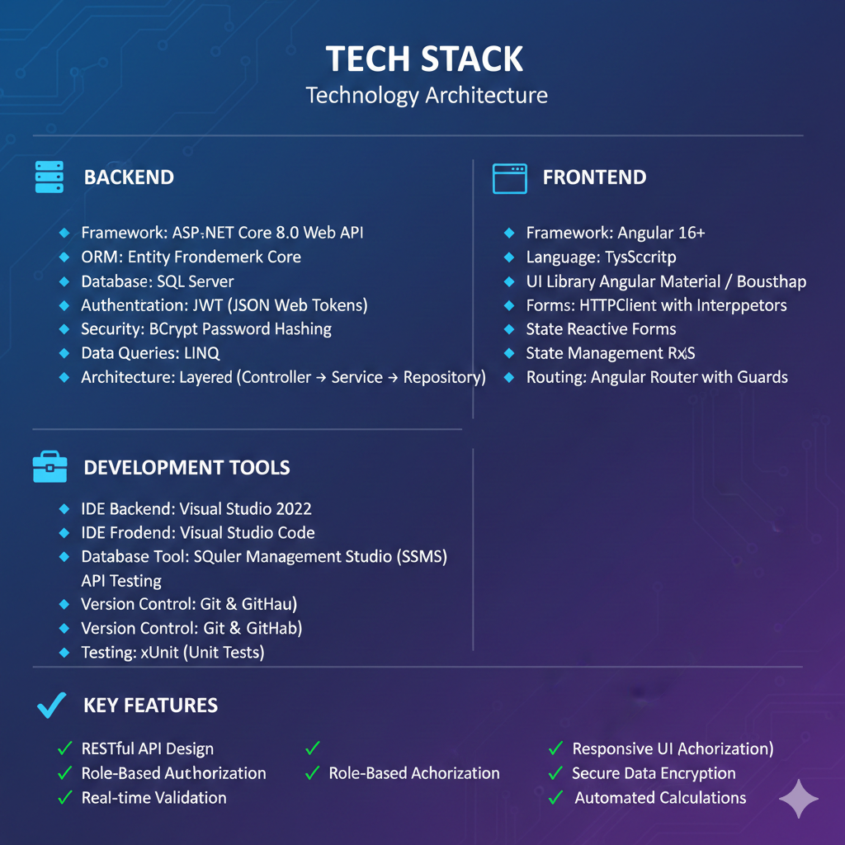

Slide 6
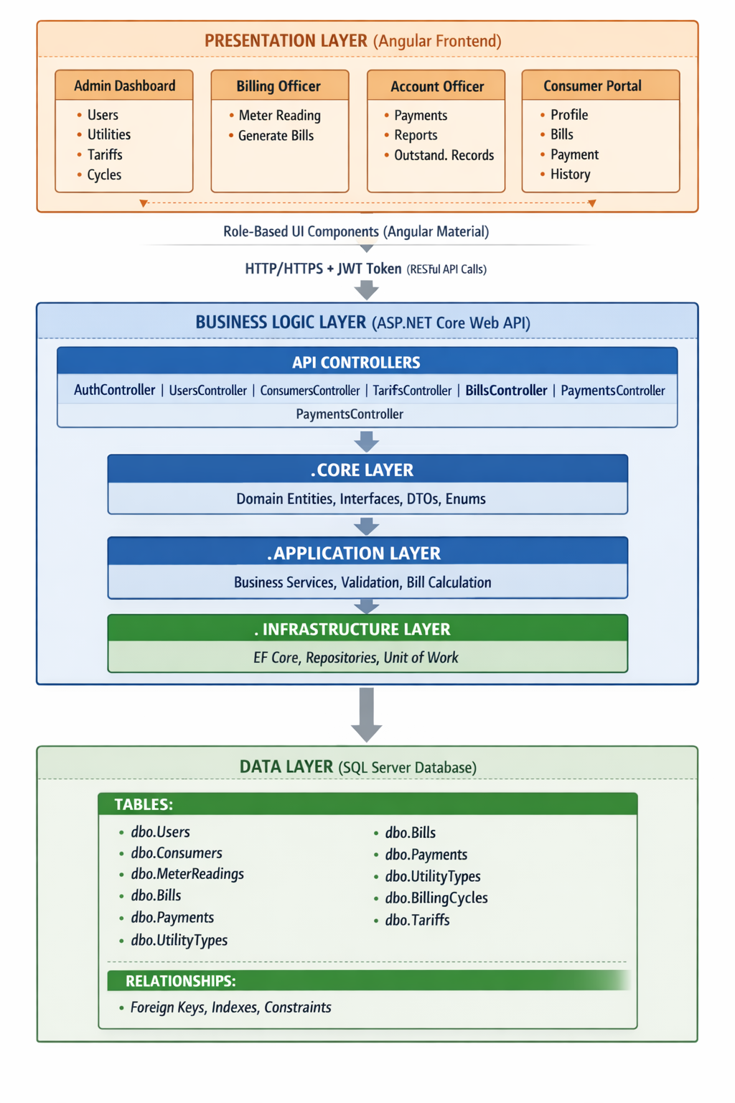
System
Architecture

Slide 7
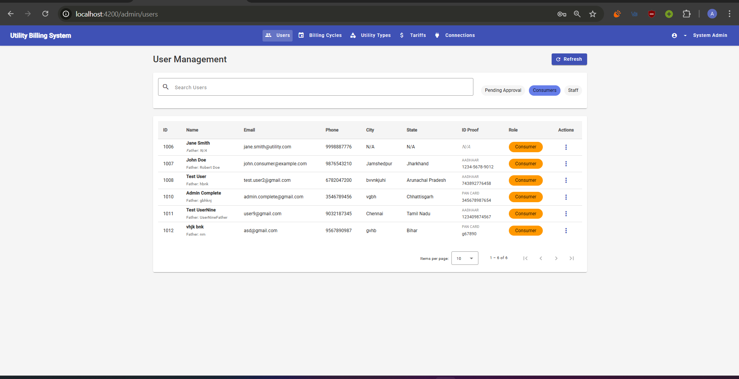
Admin Dashboard
Admins assign roles to registered users, manage all consumers and staff, create utility types with charges, configure billing cycles, define tariff slabs, and establish connections between consumers and utilities. The dashboard provides complete system control with statistics on total consumers, active connections, and pending bills.

Slide 8
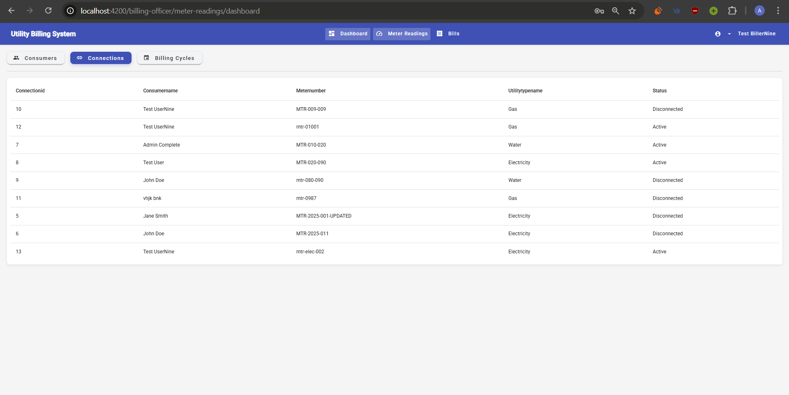
Billing Officer Dashboard
Billing officers enter meter readings with automatic validation (current > previous), view complete reading history, and generate bills with one click where the system automatically calculates amounts using tariff slabs and sets due dates. Dashboard shows readings entered today, pending unbilled readings, and bills generated this month.

Slide 9
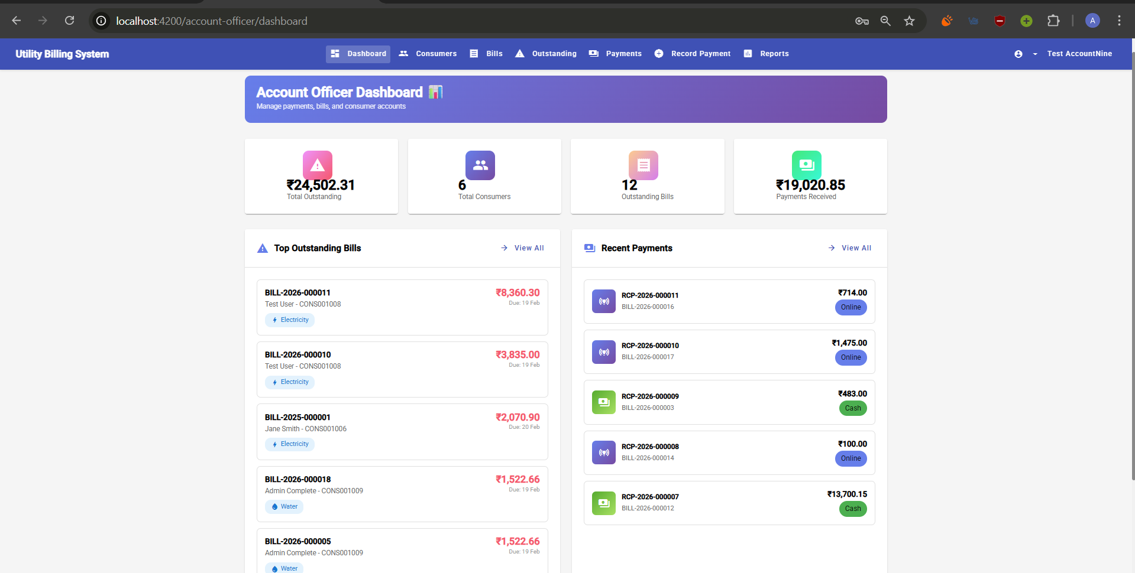
Account Officer Dashboard
Account officers view all payments received, track outstanding and overdue bills in real-time, record offline payments (cash/cheque) at the office, and generate comprehensive financial reports including collection summaries and consumption analytics. Dashboard displays today's collections, total outstanding amount, and payment trends.

Slide 10
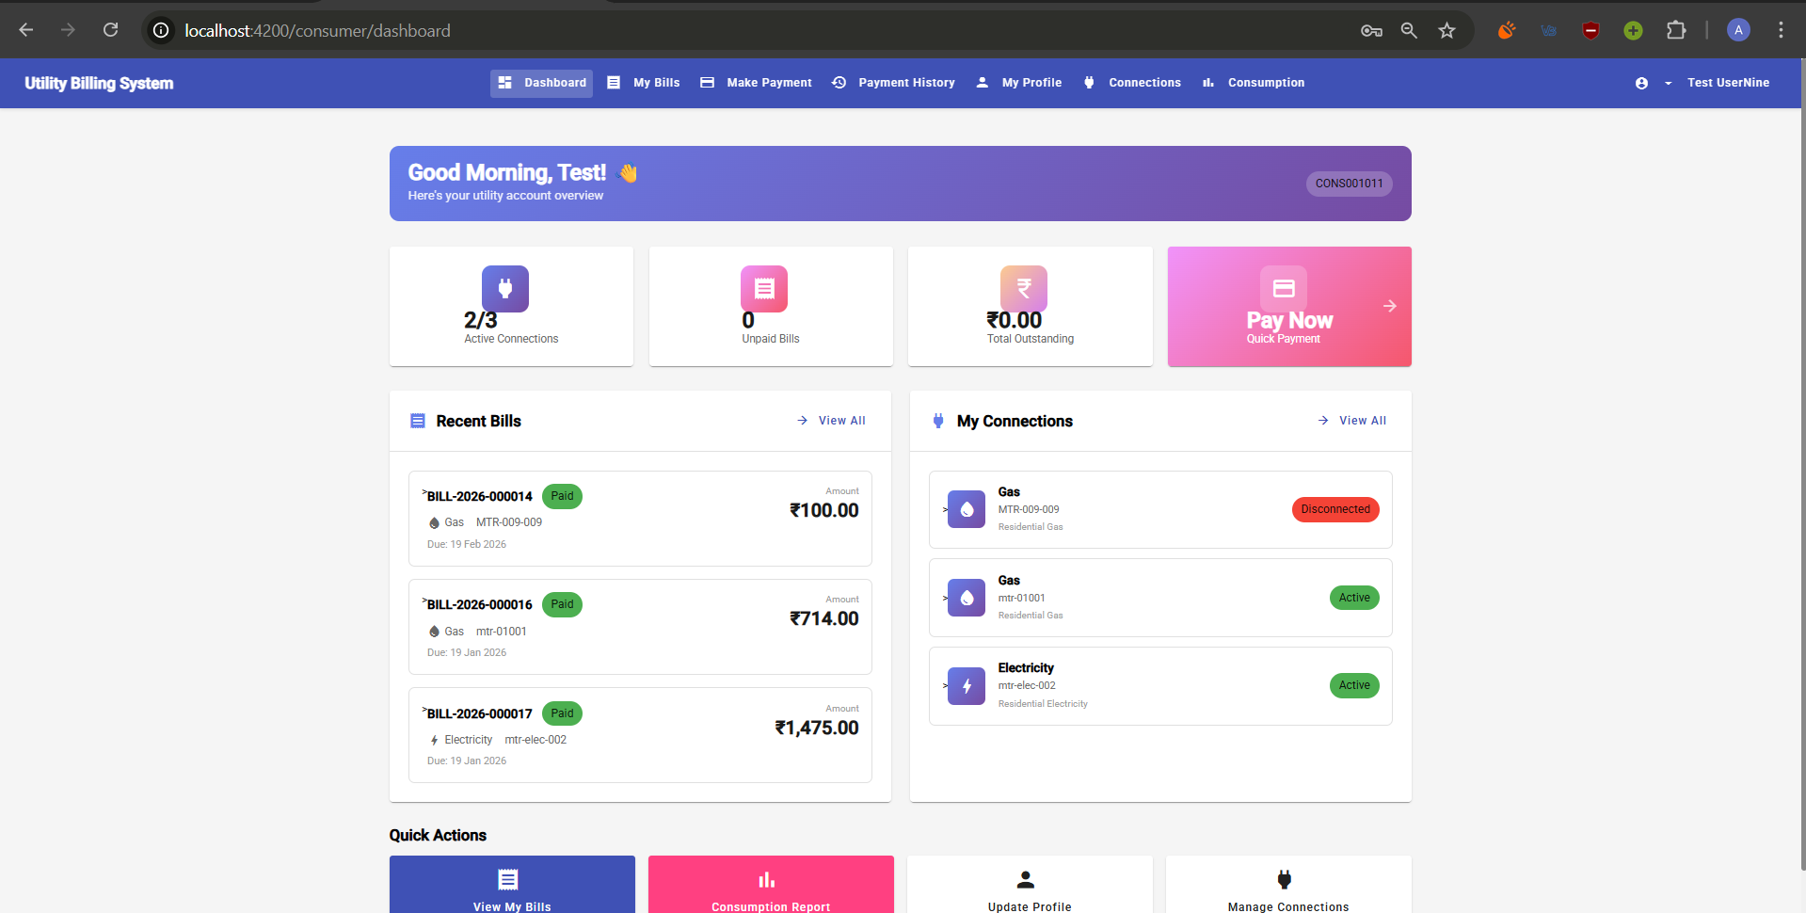
Consumer Dashboard
Consumers view their profile and connections, access current and historical bills, make online payments 24/7, download payment receipts, view complete payment history, and track consumption patterns with visual graphs. They receive automated notifications for bill generation, due date reminders, and payment confirmations.

Slide 11
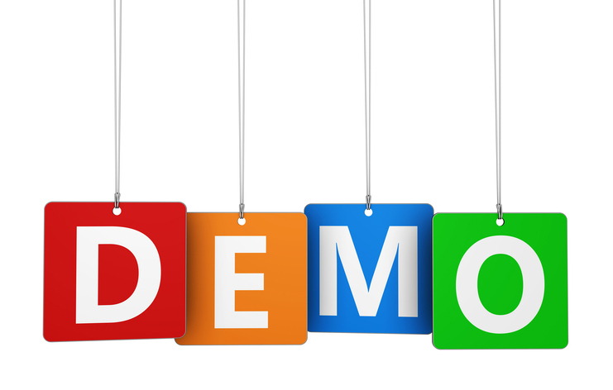
LIVE DEMO

Slide 12
Thank You

