Slide 1


SMART INDIA HACKATHON 2026
Problem Statement ID: SIH26182
Problem Statement Title:
Automated Attribution of Unknown Cryptocurrency Wallets to Nearest Virtual Asset Service Providers (VASPs) through Blockchain Intelligence APIs
Theme: Blockchain & Cybersecurity
PS Category: Software
Team ID: To be finalized on SIH Portal
Team Name (Registered): CodeMesh
Project / Solution: CryptoGuard AI
CRYPTOGUARD AI — SOLUTION BRIEF
An automated, auditable blockchain investigation console empowering Indian Law Enforcement Agencies (LEAs) to trace illicit crypto flows and identify cashout exchanges.
• Multi-Chain Tracing: Directed BFS graph walk across Ethereum, BSC, Polygon, Tron, and Bitcoin.
• 4-Factor VASP Scoring: Proximity (40%), Volume (30%), Recency (20%), and Registry Trust (10%).
• 10-Signal AML Engine: Sanctions, mixers, peel chains, rapid exit, and structuring heuristics.
• Legal Workflow Integration: Automated Section 91 CrPC requisition notices & court-admissible PDF reports.

Slide 2
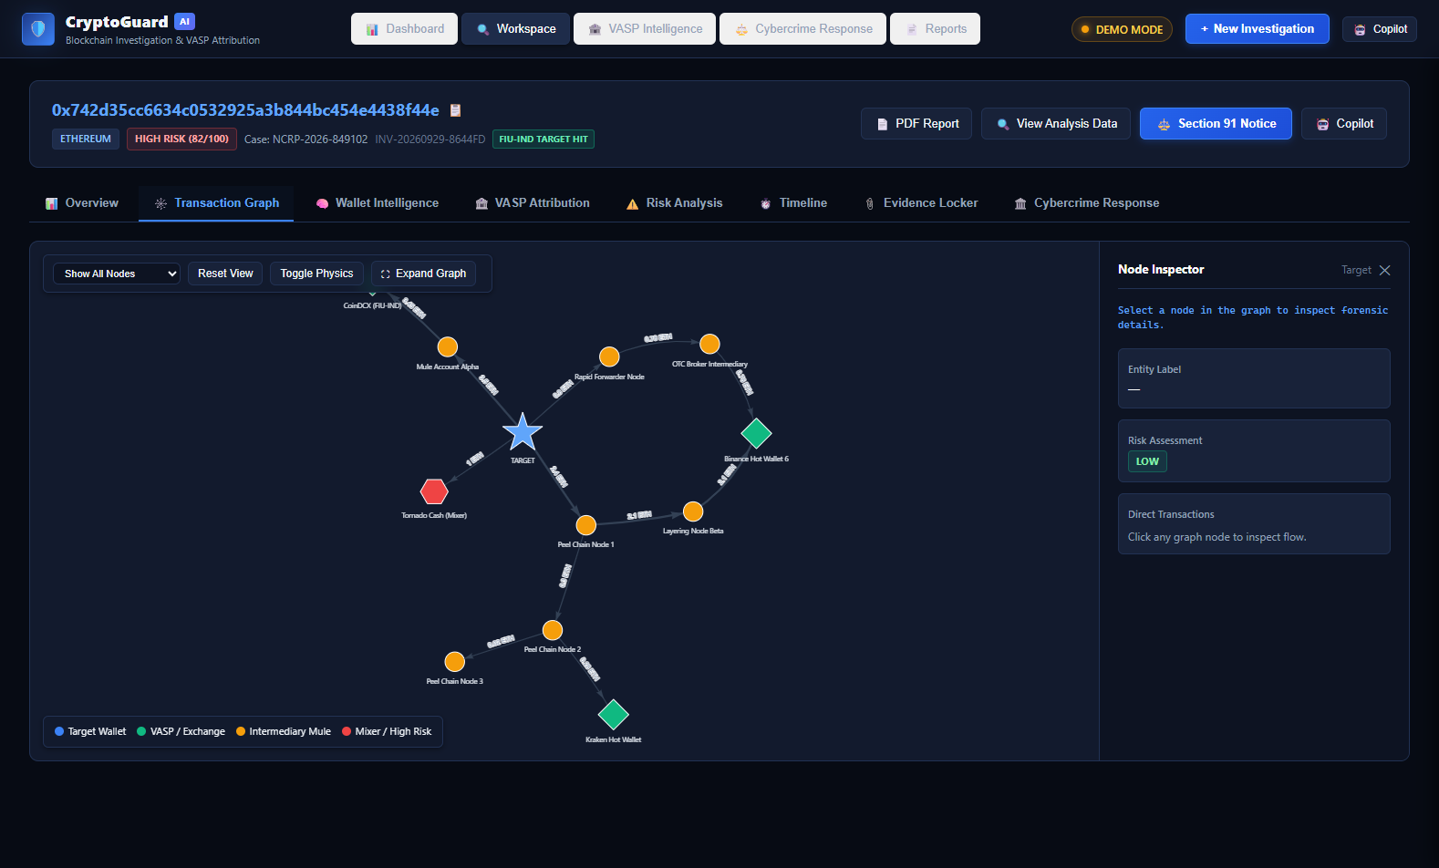
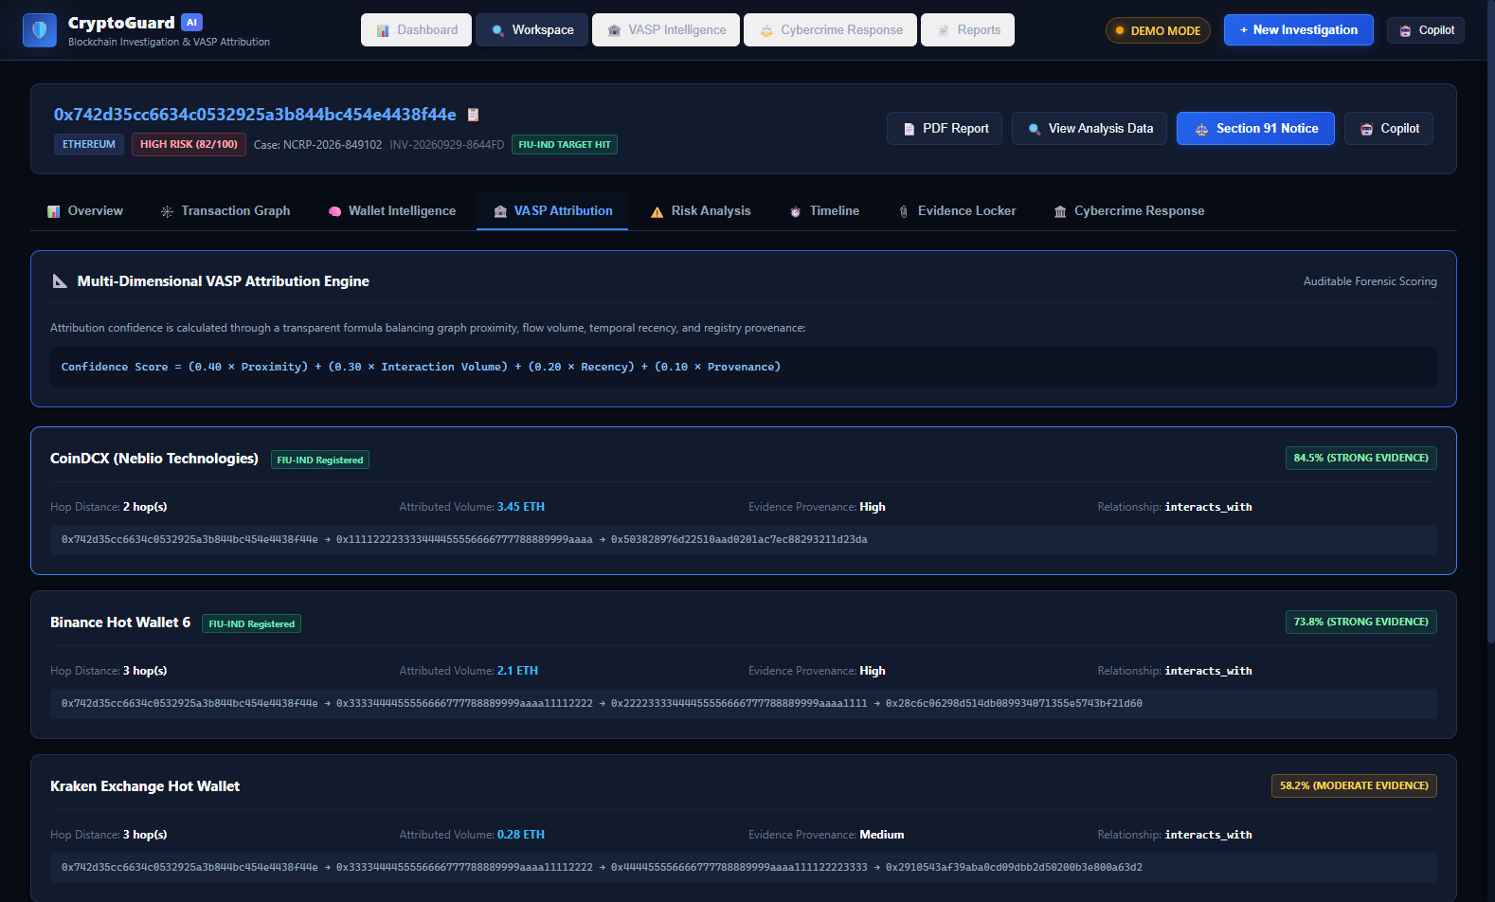
IDEA TITLE: CryptoGuard AI
CodeMesh
1. BLOCKCHAIN INVESTIGATION
• Multi-chain: Ethereum, BSC, Polygon, Tron, Bitcoin
• Directed Breadth-First Search (BFS) multi-hop tracing
• Interactive Vis.js force-directed transaction graph
• Node Inspector with real-time inflow/outflow metrics
2. VASP ATTRIBUTION ENGINE
• Curated FIU-IND registered & global VASP registry
• 4-Factor: Proximity 40%, Volume 30%, Recency 20%, Trust 10%
• Strict evidence rule: interacts_with vs controlled_by
• Full hop-walk explanation from suspect to deposit node
3. RISK & FORENSIC INTEL
• 10-Signal weighted AML risk engine (0–100 score)
• Active typologies: Peel chains, Mixer hops, Rapid exit
• Behavioral archetypes: Exchange, Mule, Scam, Stash
• Forensic Copilot: Rule engine + optional LLM integration
4. INVESTIGATION & RESPONSE
• Evidence Locker with SHA-256 integrity hash tracking
• Reconstructed multi-chain chronological timeline
• 1-Click statutory Section 91 CrPC notice generator
• ReportLab court-ready PDF & SAHYOG-ready workflow
DEMO MODE: Interactive Vis.js Multi-Hop Transaction Graph (12 Nodes, Mule Peeling, VASP Hops)
DEMO MODE: VASP Attribution Console (CoinDCX 84.5% FIU-IND, Binance 73.8%, Kraken 58.2%)
FLOW: UNKNOWN WALLET -> BLOCKCHAIN ADAPTERS -> MULTI-HOP GRAPH -> WALLET INTEL -> VASP ATTRIBUTION -> RISK SCORING -> EVIDENCE + REPORT

Slide 3
TECHNICAL APPROACH: CryptoGuard AI Forensic Pipeline
CodeMesh
END-TO-END INVESTIGATION WORKFLOW & METHODOLOGY
1. TARGET INPUT: Investigator inputs suspect address, selects chain (ETH, BSC, Polygon, Tron, BTC), and sets max hops (1–6).
2. BLOCKCHAIN ADAPTERS: Modular REST clients (Etherscan v2, TronGrid, Blockstream) fetch raw on-chain transaction records.
3. TRANSACTION NORMALIZATION: Address checksum validation, wei/satoshi conversion, ERC-20 parsing, and chronological indexing.
4. GRAPH ANALYSIS (BFS): Directed Breadth-First Search builds multi-hop fund flow graph; pruned cycles rendered via Vis.js.
5. VASP ATTRIBUTION ENGINE: 4-Factor scoring (Proximity 40%, Volume 30%, Recency 20%, Provenance 10%) identifies nearest VASP.
6. RISK & AML ENGINE: 10-Signal explainable risk calculation (OFAC sanctions, mixers, peel chains, structuring) outputs 0–100 score.
7. FORENSIC WORKSPACE: Reconstructs chronological timeline, SHA-256 evidence locker, behavioral classification, & Node Inspector.
8. RESPONSE & LEGAL EXPORT: Automated Section 91 CrPC requisition notice generation, ReportLab PDF report, & SAHYOG-ready stub.
TECHNOLOGY STACK ARCHITECTURE
• Frontend: Vanilla HTML5, CSS3, ES6 JavaScript (Zero CDN / 100% offline)
• Graph Visualization: Vis-network v9.1.2 (Bundled force-directed physics engine)
• Backend Framework: Python 3.10+ / FastAPI v0.141 on Starlette & Uvicorn ASGI
• Forensic Database: SQLite3 persistent store (cryptoguard.db, 7 indexed tables)
• Blockchain APIs: Etherscan v2 API, TronGrid REST, Blockstream Bitcoin REST
• Investigation Copilot: Explainable Rule-Based Engine + Optional LLM Integration
• Report Generation: ReportLab v5.0 Binary PDF Engine with SHA-256 verification
OFFICIAL LINKS & DELIVERABLES
GITHUB LINK: https://github.com/aryan311007w-ux/SIH-codeMesh
WEBSITE LINK: To be updated after deployment
DEMO VIDEO: To be updated after deployment

Slide 4
FEASIBILITY AND VIABILITY: Problem, Solution & Scalability
CodeMesh
OPERATIONAL CHALLENGES
• Rapid Fund Dissipation: Stolen crypto structured & layered across peel chains in minutes.
• Multi-Hop Graph Complexity: Obfuscation through multiple intermediate mule accounts.
• Cross-Chain Fragmentation: Criminals hopping across Ethereum, Tron, BSC, Polygon, Bitcoin.
• Attribution Uncertainty: Unreliable clustering without verified VASP registries or legal distinction.
• Opaque Black-Box Forensics: Defense challenges in court against unexplainable proprietary scores.
• Manual Paperwork Overhead: Hours spent compiling Section 91 CrPC notices and chain of custody.
CRYPTOGUARD AI SOLUTION
• Automated BFS Traversal: Traces complex multi-hop fund flows in sub-second graph walks.
• Transparent 4-Factor Scoring: Mathematical confidence (Proximity, Interaction, Recency, Provenance).
• Unified Multi-Chain Schema: Standardized investigation across 5 major blockchain ecosystems.
• Explainable Evidence: Strict legal separation of on-chain hops from behavioral heuristics.
• Instant Statutory Requisitions: 1-Click Section 91 CrPC notices populated with VASP nodals.
• Tamper-Evident Reporting: ReportLab generated PDF with cryptographic SHA-256 evidence logs.
FEASIBILITY & SCALABILITY PILLARS
• Technical Feasibility: Lightweight Python/FastAPI + Vis.js stack; deterministic execution with zero heavy GPU overhead.
• Practical Implementability: Repeatable workflow; built-in high-fidelity Demo Mode for offline evaluation; zero compilation.
• Sustainable Impact: Aligned with FIU-IND reporting guidelines, PMLA 2002, and LEA standard operating procedures.
• Scalability by Design: Current MVP can evolve toward PostgreSQL, production blockchain APIs, institutional authentication, & live government portals.
RISK IDENTIFICATION & MITIGATION STRATEGY
• API Rate Limits: Handled via deterministic demo fixture fallback & key rotation | • Blockchain Data Quality: Addressed via volume thresholds & node deduplication | • Attribution Uncertainty: Explicitly separated into interacts_with vs controlled_by | • Institutional Hardening: Architecture ready for JWT auth & role-based access control (RBAC).

Slide 5
IMPACT AND BENEFITS: Stakeholder Value & Long-Term Transformation
CodeMesh
LAW ENFORCEMENT & INVESTIGATORS
• Accelerates preliminary tracing from days to minutes
• Unified multi-chain graph eliminates portal switching
• Structured evidence locker maintains chain of custody
• Repeatable, reproducible forensic investigation workflow
CYBERCRIME CELLS & PROSECUTION
• Automated statutory Section 91 CrPC notice drafting
• Transparent mathematical scores defensible in court
• Court-admissible PDF reports with cryptographic hashes
• Response-ready workflow aligned with national SOPs
VASPS & COMPLIANCE OFFICERS
• Requisitions contain exact hop paths, tx hashes, & times
• Direct identification of deposit aggregators cuts delays
• Fulfills Prevention of Money Laundering Act obligations
• Streamlines communication with FIU-IND registered entities
FINANCIAL & LEGAL ECOSYSTEM
• Lowers friction for recovering stolen proceeds of crime
• Establishes a transparent benchmark for crypto attribution
• Multi-chain extensible architecture adaptable to new tokens
• Open, auditable codebase fostering institutional trust
LONG-TERM SYSTEMIC EFFECTS ON NATIONAL BLOCKCHAIN FORENSICS
1. Accelerated Asset Freezing
Minimizes the critical time window before illicit funds are cashed out to fiat through domestic exchanges.
2. Standardized Digital Requisitions
Replaces fragmented informal queries with statutory Section 91 CrPC notices containing full evidentiary trails.
3. Cross-Chain Investigative Parity
Empowers investigators to track assets across EVM, Tron, and Bitcoin inside a single consolidated workspace.
4. Institutional Evidentiary Memory
Persistent SQLite storage guarantees repeatable, verifiable re-analysis and audit trails for cold cyber cases.
5. Low-Cost Station Deployment
Zero heavy ML dependency allows rapid deployment across district cybercrime police stations without server clusters.
6. National Integration-Ready
Native data schemas aligned with the Indian Cybercrime Coordination Centre (I4C) and SAHYOG portal.

Slide 6
RESEARCH AND REFERENCES: Regulatory, Protocol & Academic Foundations
CodeMesh
STATUTORY & REGULATORY FRAMEWORKS
• FATF Virtual Assets Guidance (2021/2023): Financial Action Task Force, Updated Guidance for a Risk-Based Approach to Virtual Assets and VASPs, Recommendation 15 & 16 (Travel Rule).
• FIU-IND AML/CFT Guidelines (2023): Financial Intelligence Unit - India, Anti-Money Laundering & Countering Financing of Terrorism Guidelines for Virtual Digital Asset Service Providers (PMLA compliance).
• Section 91 CrPC / Section 94 BNSS: Code of Criminal Procedure, 1973 (Section 91) & Bharatiya Nagarik Suraksha Sanhita, 2023 (Section 94) — Legal summons for digital evidence.
• Prevention of Money Laundering Act (2002): PMLA 2002 Section 12 — Maintenance of records, identification of clients, & furnished information by crypto Reporting Entities.
BLOCKCHAIN APIS & FORENSIC PROTOCOLS
• Etherscan V2 API Developer Protocol: Etherscan API documentation for EVM chains (Ethereum, BSC, Polygon) account transaction tracing, token events, & internal transfers (docs.etherscan.io).
• TronGrid Protocol Specification: Tron Network TronGrid REST API for TRC-20 token tracking and account transaction history (developers.tron.network).
• Blockstream Bitcoin REST API: Blockstream.info public Bitcoin explorer and UTXO graph query API specification (blockstream.info/api).
• Vis.js Network Force-Directed Graph Engine: Vis.js open-source visualization library for force-directed physical graph rendering and dynamic node physics (visjs.github.io).
FORENSIC HEURISTICS & RESEARCH
• Meiklejohn et al., ACM IMC (2013): A Fistful of Bitcoins: Characterizing Payments Among Men with No Names. Foundational paper on multi-input heuristic clustering & change address detection.
• Friedhelm Victor, Springer (2020): Address Clustering Heuristics for Ethereum. Financial Cryptography & Data Security. Heuristic rules for deposit address identification & exchange attribution.
• OFAC SDN Sanctioned Entity Lists: U.S. Department of the Treasury, Specially Designated Nationals (SDN) cryptocurrency address blacklist & Tornado Cash sanctioned smart contracts.
• UNODC Cybercrime Typology Manual: United Nations Office on Drugs and Crime, Cryptocurrency Laundering Typologies: Peel Chains, Structuring, and Nested Exchange Services.
PROJECT REPOSITORY & DEMONSTRATION ACCESS
GitHub Repository: https://github.com/aryan311007w-ux/SIH-codeMesh | Website: To be updated after deployment | Demo Video: To be updated after deployment

