Slide 1

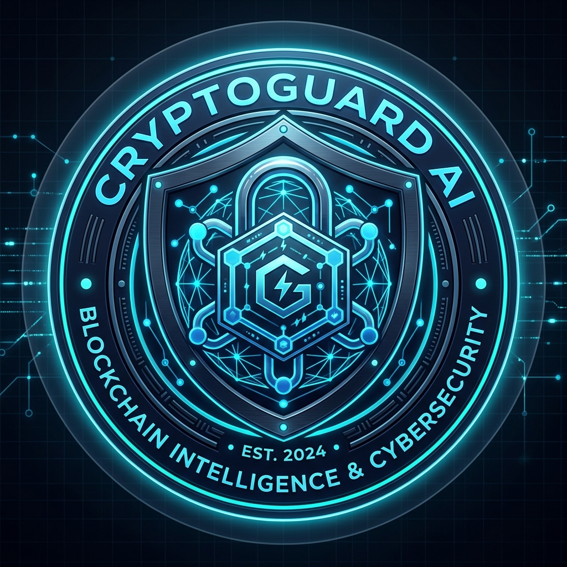

SMART INDIA HACKATHON 2026
Problem Statement ID: SIH26182
Problem Statement Title:
Automated Attribution of Unknown Cryptocurrency Wallets to Nearest Virtual Asset Service Providers (VASPs) through Blockchain Intelligence APIs
Theme: Blockchain & Cybersecurity
PS Category: Software
Team ID: To be finalized on SIH Portal
Team Name (Registered): CodeMesh
Project / Solution: CryptoGuard AI
CORE PILLARS: Multi-Chain Tracing | 4-Factor VASP Scoring | 10-Signal AML Engine | Section 91 CrPC Notice
CRYPTOGUARD AI — SOLUTION BRIEF
• Primary Goal: Automatically attribute unknown crypto wallets to nearest VASPs.
• Target Users: Indian LEAs, State Cyber Cells, I4C, and FIU-IND compliance units.
• Regulatory Scope: PMLA 2002 Reporting Entities & Section 91 CrPC requisitions.
• Repository: github.com/aryan311007w-ux/SIH-codeMesh

Slide 2
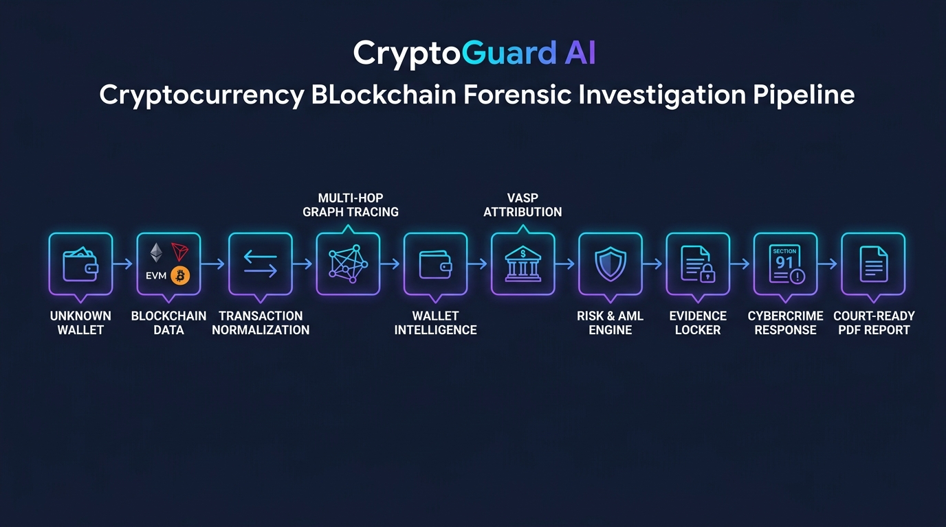
IDEA TITLE: CryptoGuard AI — Solution Overview
CodeMesh
THE FORENSIC CHALLENGE
• Rapid Fund Dissipation: Stolen crypto structured across peel chains & mixers in minutes.
• Opaque Attribution: Lack of explainable VASP matching leads to legal dismissal.
• Manual Delays: Slow notice preparation allows suspects to cashout to fiat unhindered.
1. Multi-Chain Tracing
Directed BFS graph walk across Ethereum, BSC, Polygon, Tron, Bitcoin.
2. 4-Factor VASP Scoring
Proximity 40%, Volume 30%, Recency 20%, Registry Trust 10%.
3. 10-Signal AML Engine
Sanctions, mixers, peel chains, rapid exit, structuring typologies.
4. Legal Response Export
Section 91 CrPC notice generator, SHA-256 evidence, PDF report.
CORE ARCHITECTURE: UNKNOWN WALLET -> NORMALIZATION -> MULTI-HOP BFS GRAPH -> VASP ATTRIBUTION -> RISK ENGINE -> SECTION 91 NOTICE

Slide 3
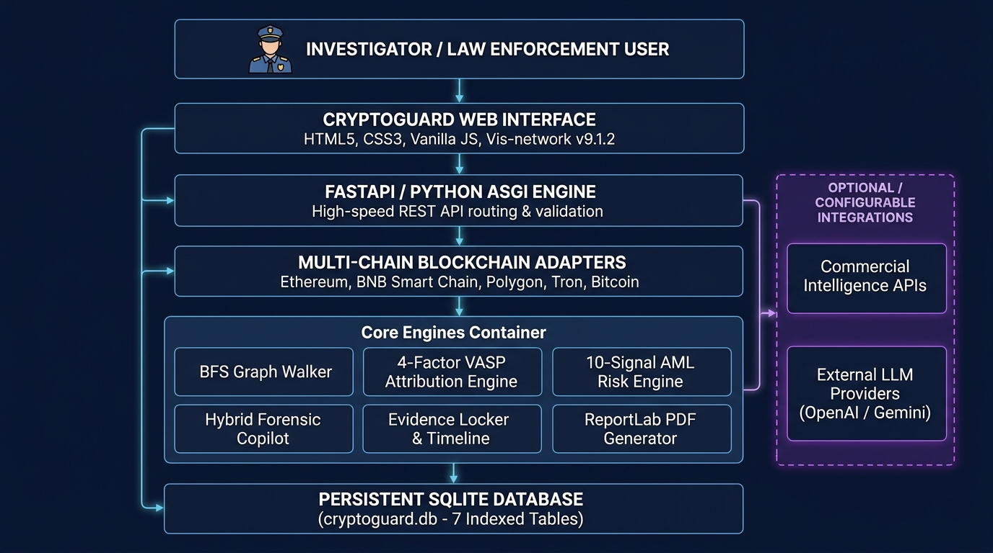
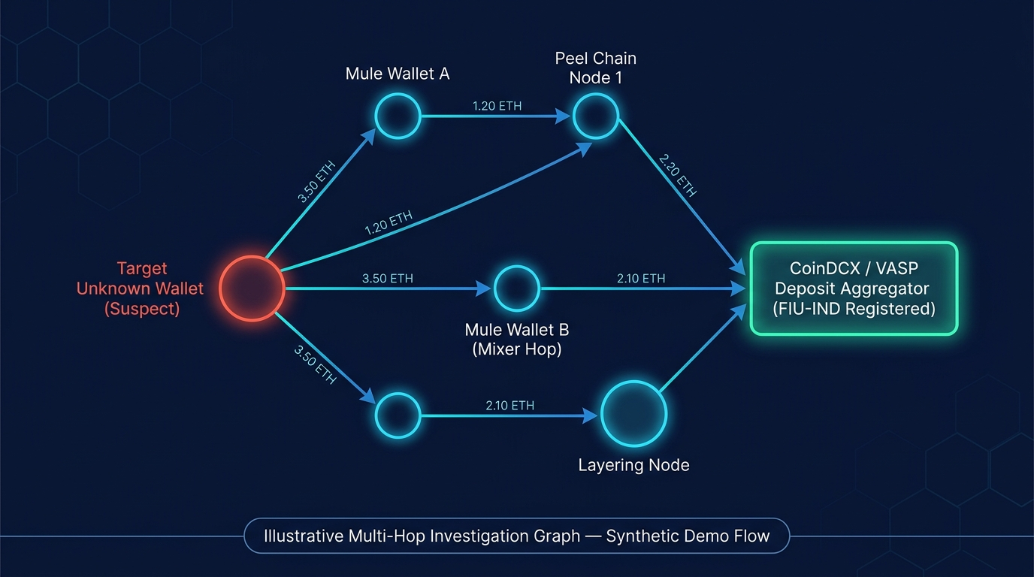
TECHNICAL APPROACH: Architecture & Investigation Prototype
CodeMesh
SYSTEM ARCHITECTURE: 4-Tier Forensic Stack with SQLite Persistence & Configurable Integrations
PROTOTYPE GRAPH: Directed BFS Walk Traversal (1–6 Hops) with Mule Peeling & VASP Attribution
Frontend Engine
Vanilla HTML5 / CSS3 / ES6 JS / Vis-network v9.1.2 (100% Offline / Zero CDN)
Backend ASGI
Python 3.10+ / FastAPI v0.141 / Uvicorn ASGI Server with Pydantic validation
Forensic Store
Persistent SQLite3 (cryptoguard.db - 7 indexed relational tables)
Official Link
GitHub Repository: github.com/aryan311007w-ux/SIH-codeMesh

Slide 4
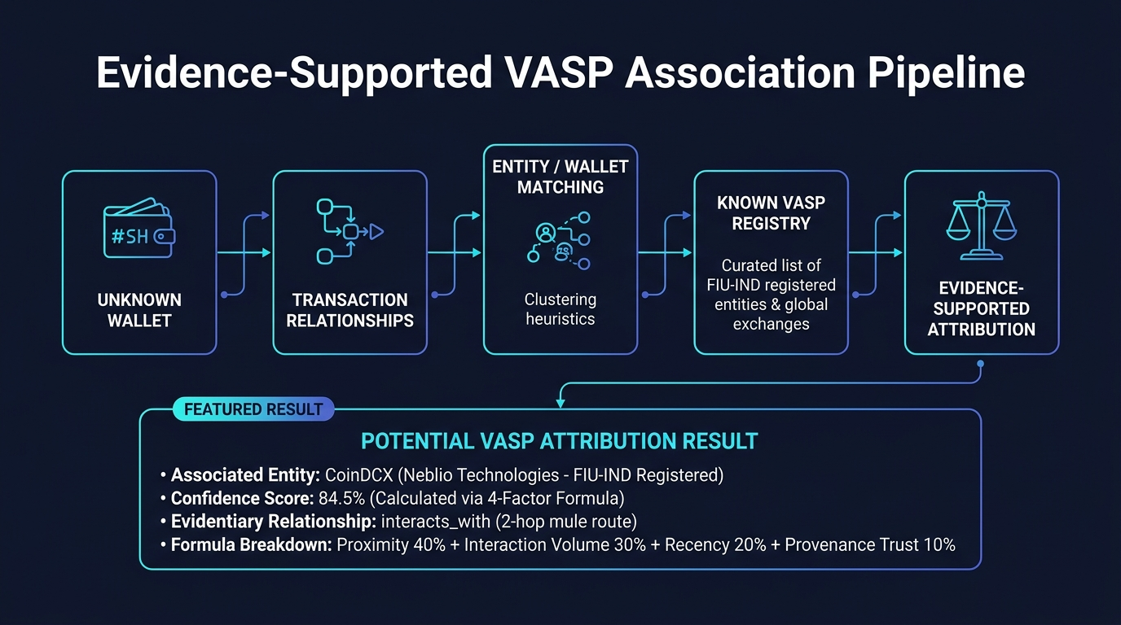
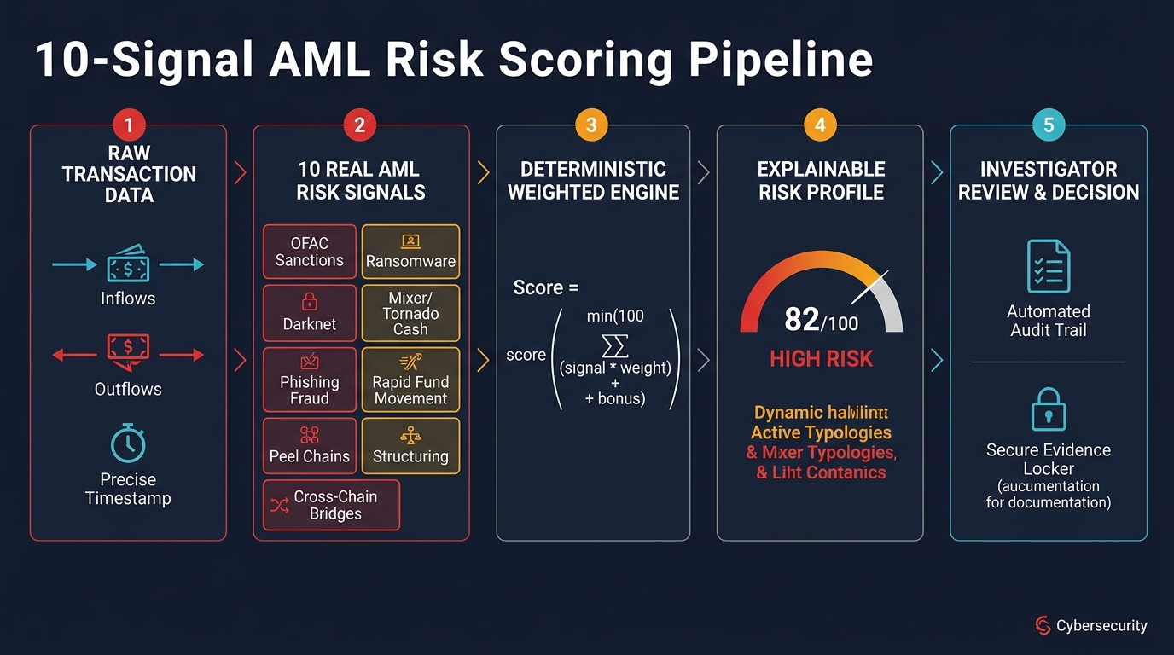
FEASIBILITY AND VIABILITY: Operational Analysis & Engine Validation
CodeMesh
OPERATIONAL CHALLENGES
• Rapid Fund Layering: Illicit structuring across peel chains in <15 minutes.
• Cross-Chain Fragmentation: Obfuscation spanning EVM, Tron, and Bitcoin.
• Opaque Black Boxes: Unexplainable scores fail legal defense scrutiny in court.
• Manual Paperwork: Hours lost manually drafting Section 91 notices.
CRYPTOGUARD AI SOLUTIONS
• Automated BFS Traversal: Traces multi-hop fund flows in sub-second walks.
• Unified Data Schema: Normalized schema across 5 major blockchains.
• Transparent 4-Factor Scoring: Mathematical confidence across 4 dimensions.
• 1-Click Section 91 Notices: Pre-populated with verified VASP compliance nodals.
FEASIBILITY & SCALABILITY
• Technical Feasibility: Lightweight Python/FastAPI runs on standard laptops.
• Practical Implementability: Built-in Demo Mode runs 100% offline without API keys.
• Production Scalability: SQLite schema is 1-to-1 portable to PostgreSQL.
• Security Hardening: Architecture ready for JWT auth and role-based access control.

Slide 5
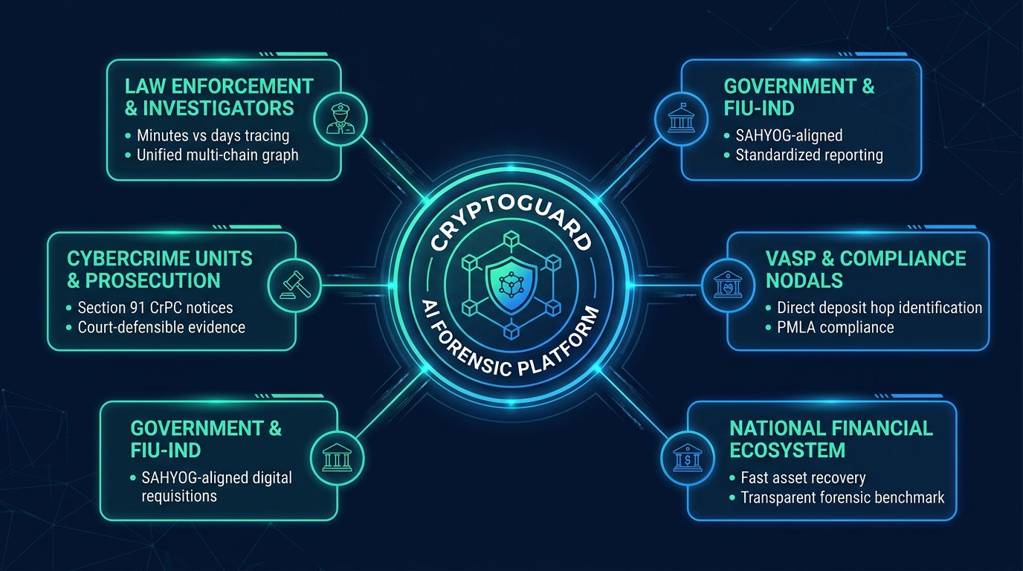
IMPACT AND BENEFITS: Stakeholder Value & National Transformation
CodeMesh
FOR INVESTIGATORS & LEAs
• Tracing in minutes vs days across complex multi-hop peel chains.
• Unified multi-chain view eliminates portal switching overhead.
• Cryptographic SHA-256 evidence maintains unblemished chain of custody.
• Standardized Section 91 notices ready for judicial summons.
FOR VASPs & REGULATORS
• Requisitions contain precise hop walks, tx hashes, & timestamps.
• Direct identification of deposit aggregators cuts verification delays.
• Fulfills Prevention of Money Laundering Act (PMLA) obligations.
• Schema natively aligned with national cybercrime reporting portals.
1. Accelerated Asset Freezing
Minimizes the critical time window before illicit funds are cashed out to fiat through exchanges.
2. Standardized Requisitions
Replaces informal queries with statutory Section 91 CrPC notices containing full evidentiary trails.
3. Cross-Chain Investigative Parity
Empowers investigators to track assets across EVM, Tron, and Bitcoin inside a single consolidated workspace.
4. Institutional Evidentiary Memory
Persistent SQLite storage guarantees repeatable, verifiable re-analysis and audit trails for cold cyber cases.
5. Low-Cost Station Deployment
Zero heavy ML dependency allows rapid deployment across district cybercrime police stations without server clusters.
6. National Integration-Ready
Native data schemas aligned with the Indian Cybercrime Coordination Centre (I4C) and SAHYOG portal.

Slide 6
RESEARCH AND REFERENCES: Regulatory, Protocol & Academic Foundations
CodeMesh
STATUTORY & REGULATORY FRAMEWORKS
• FATF Virtual Assets Guidance (2021/2023): Financial Action Task Force, Updated Guidance for a Risk-Based Approach to Virtual Assets and VASPs, Recommendation 15 & 16 (Travel Rule).
• FIU-IND AML/CFT Guidelines (2023): Financial Intelligence Unit - India, Anti-Money Laundering & Countering Financing of Terrorism Guidelines for Virtual Digital Asset Service Providers (PMLA compliance).
• Section 91 CrPC / Section 94 BNSS: Code of Criminal Procedure, 1973 (Section 91) & Bharatiya Nagarik Suraksha Sanhita, 2023 (Section 94) — Legal summons for digital evidence.
• Prevention of Money Laundering Act (2002): PMLA 2002 Section 12 — Maintenance of records, identification of clients, & furnished information by crypto Reporting Entities.
BLOCKCHAIN APIS & FORENSIC PROTOCOLS
• Etherscan V2 API Developer Protocol: Etherscan API documentation for EVM chains (Ethereum, BSC, Polygon) account transaction tracing, token events, & internal transfers (docs.etherscan.io).
• TronGrid Protocol Specification: Tron Network TronGrid REST API for TRC-20 token tracking and account transaction history (developers.tron.network).
• Blockstream Bitcoin REST API: Blockstream.info public Bitcoin explorer and UTXO graph query API specification (blockstream.info/api).
• Vis.js Network Force-Directed Graph Engine: Vis.js open-source visualization library for force-directed physical graph rendering and dynamic node physics (visjs.github.io).
FORENSIC HEURISTICS & RESEARCH
• Meiklejohn et al., ACM IMC (2013): A Fistful of Bitcoins: Characterizing Payments Among Men with No Names. Foundational paper on multi-input heuristic clustering & change address detection.
• Friedhelm Victor, Springer (2020): Address Clustering Heuristics for Ethereum. Financial Cryptography & Data Security. Heuristic rules for deposit address identification & exchange attribution.
• OFAC SDN Sanctioned Entity Lists: U.S. Department of the Treasury, Specially Designated Nationals (SDN) cryptocurrency address blacklist & Tornado Cash sanctioned smart contracts.
• UNODC Cybercrime Typology Manual: United Nations Office on Drugs and Crime, Cryptocurrency Laundering Typologies: Peel Chains, Structuring, and Nested Exchange Services.
DEPLOYMENT MATURITY: CURRENT MVP -> ENTERPRISE SCALE ROADMAP
[Current Tested MVP] Offline Vis.js UI + FastAPI + SQLite + 4-Factor VASP Scoring + Section 91 CrPC Notice + Deterministic Demo Dataset.
[Near-Term Scale] PostgreSQL migration + multi-tenant police station hierarchy + JWT/RBAC authentication hardening.
[Institutional Production] Direct secure webhook integration with Indian Cybercrime Coordination Centre (I4C) & national SAHYOG portal.
OFFICIAL REPOSITORY: https://github.com/aryan311007w-ux/SIH-codeMesh | WEBSITE: To be updated after deployment | DEMO VIDEO: To be updated after deployment

