Slide 1
EXECUTIVE SUMMARY / 2026
FLIPKART SALES DASHBOARD,
EXPLAINED SIMPLY
A plain-language guide to 1,000 orders, six key metrics, and nine chart views.
Notes:
Welcome everyone. Today we are walking through the Flipkart sales dashboard without any complicated buzzwords or data jargon. We will explain what the metrics mean, how the charts work, and what decisions they point toward.

Slide 2


01 — DASHBOARD OVERVIEW
ONE SCREEN, NINE WAYS TO READ OUR SALES
The dashboard condenses 1,000 Flipkart customer orders into six headline cards and six visual charts.
Executive KPIs
Six summary numbers show total sales, revenue, profit, and order volume.
Focused chart breakdowns
Each visual answers one practical question about category, city, or channel performance.
Flipkart Sales Dashboard, Explained Simply
2
Notes:
Point out the dashboard structure on screen: KPI cards span the top row for instant orientation, while regional pies, rating columns, and category bars give deeper diagnostic context below.

Slide 3
02 — HEADLINE METRICS
SIX BIG NUMBERS TELL THE HEADLINE STORY
Together, these six cards capture top-line commercial scale and bottom-line delivery across all 1,000 orders.
TOTAL REVENUE
NET PROFIT
VOLUME SOLD
13.89M
3.18M
~3,000
Total sales value generated in INR across all customer categories.
Actual profit retained in INR, delivering healthy net margins.
Total physical items dispatched and delivered to buyers nationwide.
UNIT PRICE TOTAL
RATING SUM
DISCOUNT TOTAL
Catalogue sum
Review aggregate
Promo pool
List prices aggregated across every SKU sold in the dataset.
Customer review stars totaled across all recorded transactions.
Total percentage points conceded across sales campaigns.
Flipkart Sales Dashboard, Explained Simply
3
Notes:
Clarify that while the first three numbers are standard financial totals, the bottom three cards show running arithmetic sums used for quick dashboard aggregation.

Slide 4
03 — PROFIT GAUGE
PROFIT GAUGE: WE ARE HALFWAY TO THE DIAL'S MAXIMUM
A gauge works exactly like a car speedometer: the needle tracks current performance against an upper boundary.
CURRENT POSITION ON DIAL
PROFIT CONVERSION
3.18M INR / 6.36M Max (50%)
~23% Margin
For every 100 INR in gross sales, Flipkart pockets roughly 23 INR as net operating profit (3.18M of 13.89M INR).
The gauge target is calibrated to double current profit, positioning the pointer dead-center at 50%.
Flipkart Sales Dashboard, Explained Simply
4
Notes:
Emphasize the 23% conversion rate so the audience connects the abstract gauge dial to real pocketed cash flow per transaction.

Slide 5
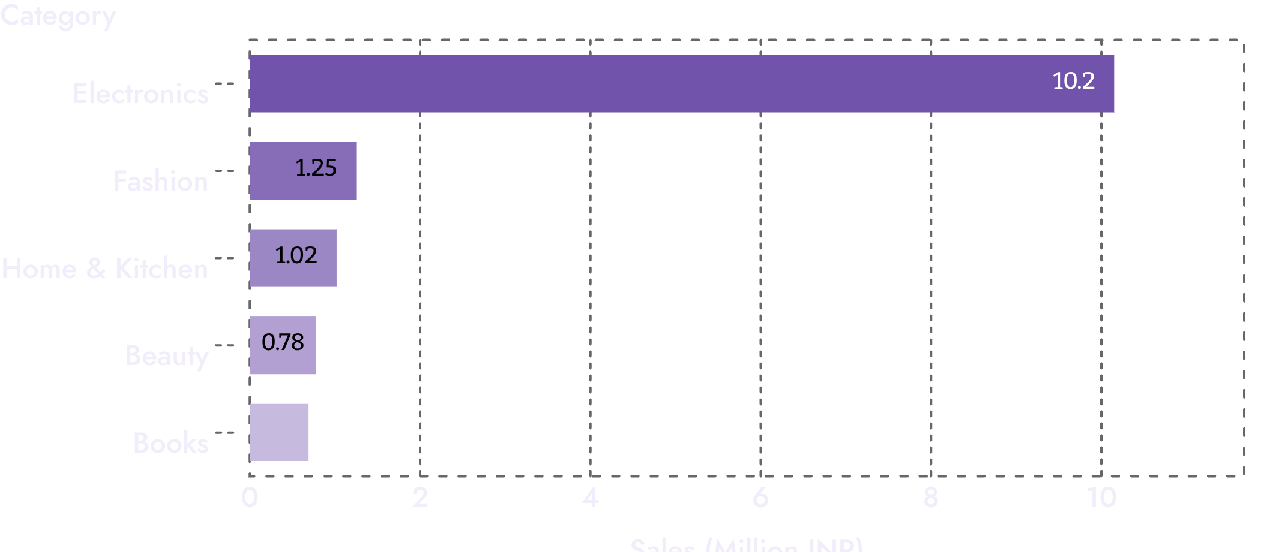
04 — CATEGORY BREAKDOWN
ELECTRONICS EARNS FAR MORE THAN ANY OTHER CATEGORY
WHY THE GAP IS SO HUGE
High ticket prices drive volume
Electronics alone easily clears 10M INR, dwarfing Fashion, Home, Beauty, and Books combined.
Plain explanation: Laptops, smartphones, and smart TVs cost tens of thousands of rupees each, meaning a handful of checkout clicks out-earn thousands of book orders.
Flipkart Sales Dashboard, Explained Simply
5
Notes:
Remind the room that Electronics' lead is not necessarily about having more customers, but about the high unit prices typical in consumer tech.

Slide 6
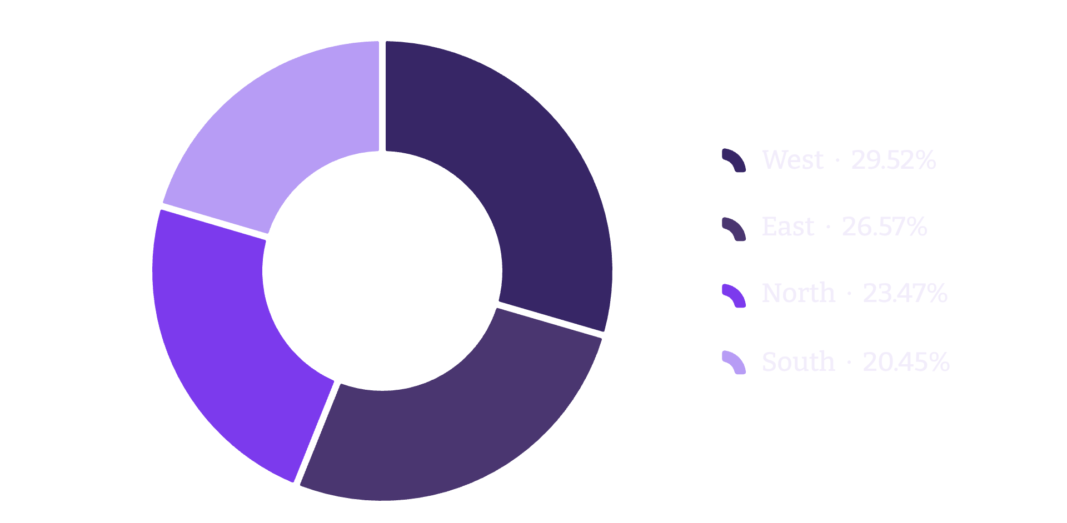
05 — GEOGRAPHIC DISTRIBUTION
THE WEST LEADS, BUT EVERY REGION CONTRIBUTES
TERRITORY CONTRIBUTION
A balanced national footprint
West: 4.10M INR (29.5%)
East: 3.69M INR (26.6%)
North: 3.26M INR (23.5%)
South: 2.84M INR (20.5%)
No region falls below one-fifth (20%) of overall sales. The commercial base is soundly diversified rather than overly reliant on one territory.
Flipkart Sales Dashboard, Explained Simply
6
Notes:
Highlight that the difference between first-place West (29.5%) and fourth-place South (20.5%) is only 9 percentage points—proving broad national adoption.

Slide 7
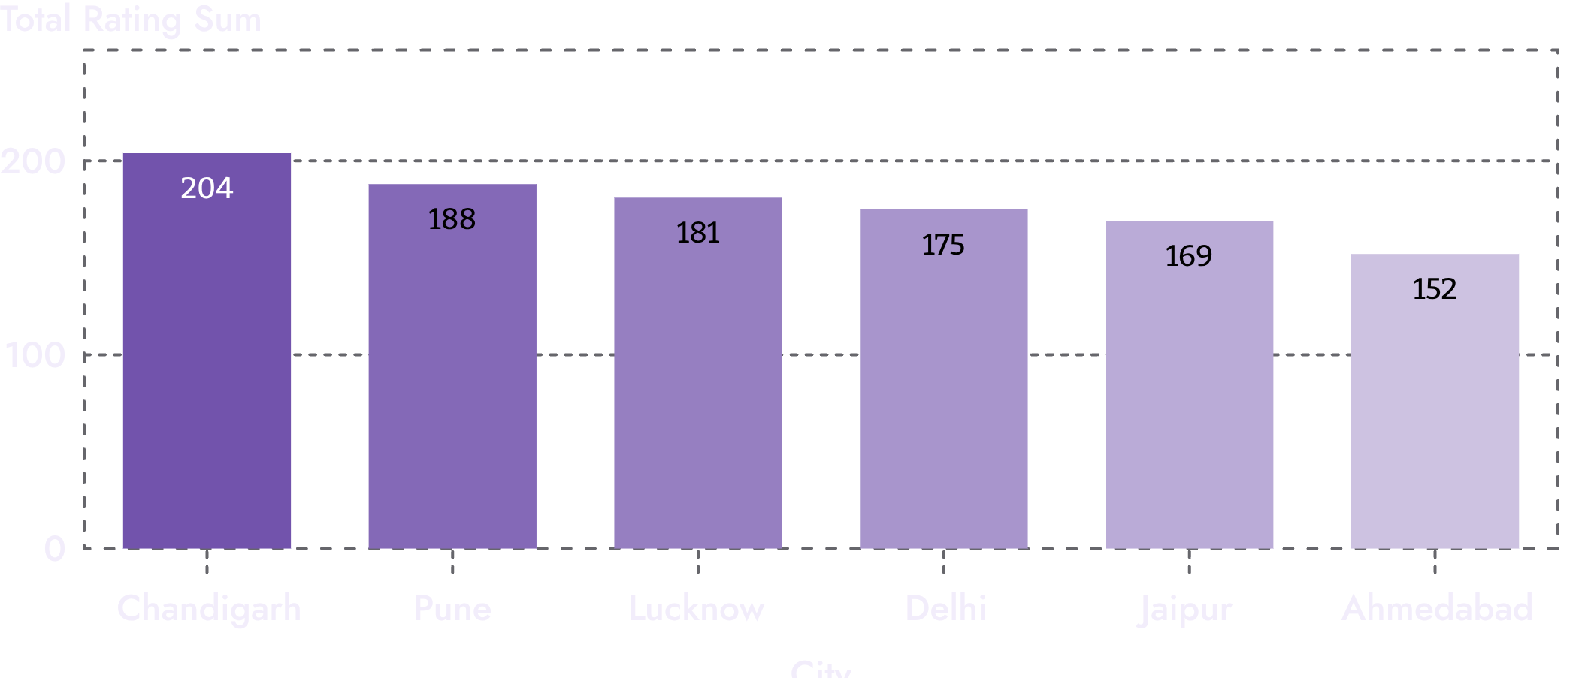
06 — METRO RATINGS
CUSTOMER RATINGS BY CITY ARE CLOSE, WITH CHANDIGARH ON TOP
ANALYST CAUTION
Sum vs. Average trap
Chandigarh, Pune, and Lucknow hold top spots, while Ahmedabad sits at the bottom.
Important data nuance: The chart tallies total rating points, not customer averages. High-order cities automatically get bigger bars. A true per-order average would offer a fairer quality check.
Flipkart Sales Dashboard, Explained Simply
7
Notes:
Make sure the audience understands this dashboard caveat: high totals can simply reflect order volume rather than customer satisfaction.

Slide 8
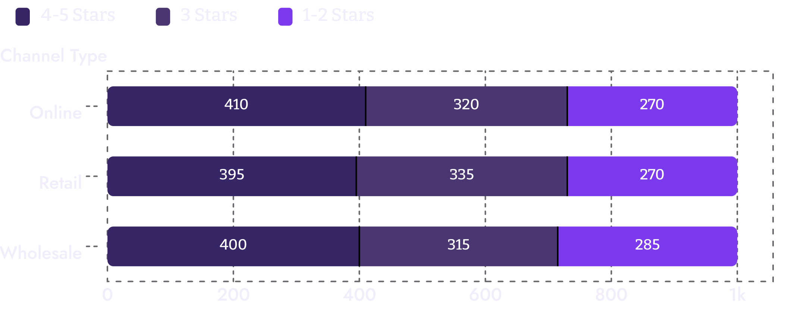
07 — CHANNEL RATINGS
ONLINE, RETAIL AND WHOLESALE RATE US ABOUT THE SAME
UNIFORM SATISFACTION
Consistent channel experience
Across all three segments, the stacked rating blocks remain nearly equal in length and proportion.
Whether a customer orders via the mobile app, walks into an omnichannel partner outlet, or procures in bulk, customer happiness stays consistent.
Flipkart Sales Dashboard, Explained Simply
8
Notes:
Point out that no single channel shows an alarming concentration of low ratings, indicating consistent delivery and packaging standards.

Slide 9
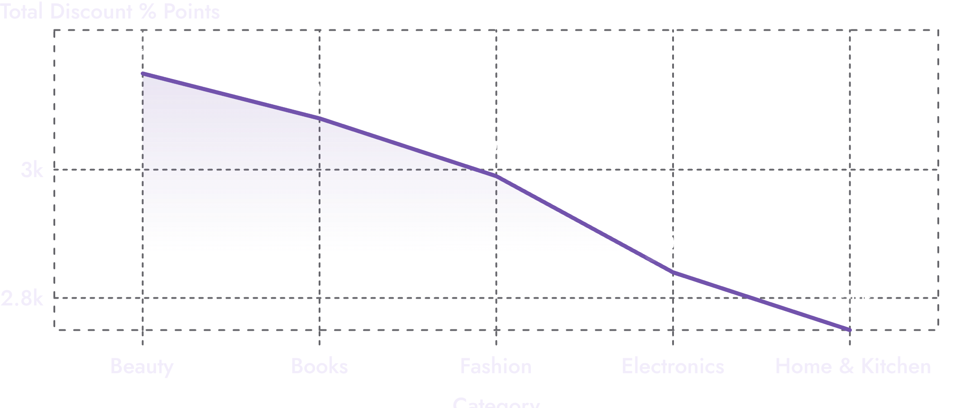
08 — PROMOTION STRATEGY
DISCOUNTS ARE HIGHEST FOR BEAUTY AND BOOKS, LOWEST FOR HOME & KITCHEN
HOW TO READ THIS LINE
Side-by-side comparison
The slope drops from 3,150 in Beauty down to 2,750 in Home & Kitchen.
Reading tip: Do not confuse this line with a time trend. These are five distinct categories arranged side-by-side. Low-cost impulse buys take heavy discounts; high-ticket home appliances do not.
Flipkart Sales Dashboard, Explained Simply
9
Notes:
Emphasize the chart reading caution: lines often imply time, but here the dashboard designer used a line simply to connect discrete product groups.

Slide 10
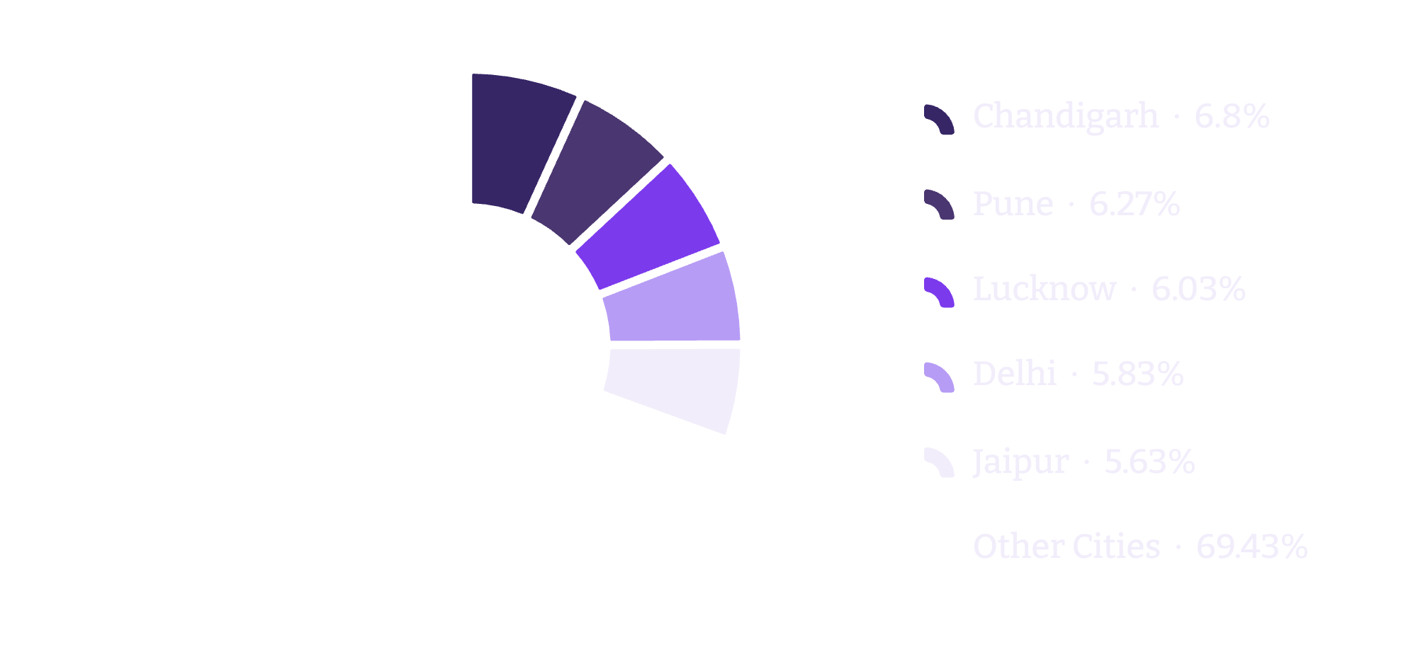
09 — ORDER DISPERSION
QUANTITY SOLD IS SPREAD ACROSS MANY CITIES
BROAD REACH
No single hub dominates
Chandigarh represents the single largest slice with 204 items (6.7%), while most individual cities hover between 3% and 6%.
Strategic conclusion: E-commerce demand is genuinely decentralized. Flipkart's supply chain serves dozens of active Tier-1 and Tier-2 clusters rather than relying on a few mega-cities.
Flipkart Sales Dashboard, Explained Simply
10
Notes:
Wrap up by connecting back to the opening: 1,000 orders spanning 13.89M INR are supported by stable margins, multi-category reach, and balanced national demand.

