Slide 1

Advanced Multimodal Federated Learning: A Privacy-Focused Approach to Social Network Systems
Department of Computer Science and Engineering (Data Science)
Guide: Dr. Kriti Srivastava
Candidates
Aryan Rajpurkar: 60009220144
Aaditya Malani: 60009220192
Advait Sankhe: 60009220024
Krish Jain :
Date:
October 25, 2024

Slide 2
Introduction
Need for Privacy-Preserving Recommendations ( NEED )
Data Privacy Concerns: Rising incidents of data breaches and stringent regulations (e.g., GDPR, CCPA) necessitate secure data handling.
User Trust: Enhancing user confidence by safeguarding personal interactions and content.
Impact of Federated Multimodal Learning in Social Media (USECASE)
Personalized Experience: Integrates diverse data types (images, text, interactions) for more accurate and relevant recommendations.
Enhanced Privacy: Keeps user data localized on devices, minimizing exposure and potential misuse.
Scalability: Supports large-scale deployments across millions of users without centralized data bottlenecks.

Slide 3
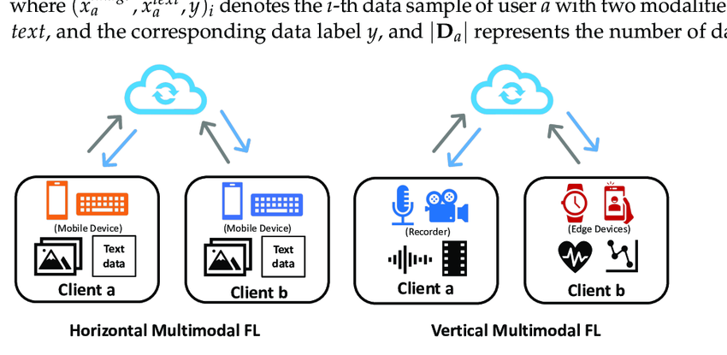
Horizontal multimodal federated learning involving two clients. Both hold image and text data.
The vertical multimodal federated learning example includes two clients with exclusive modalities. Client a has audio and video data, while client b holds heat rate and acceleration sensor data.
Che, Liwei & Wang, Jiaqi & Zhou, Yao & Ma, Fenglong. (2023). Multimodal Federated Learning: A Survey. Sensors. 23. 6986. 10.3390/s23156986.

Slide 4
Sr. No. | Name of the Paper | Conference/ Journal | Algorithm | Gap Analysis
1 | A Deep Reinforcement Learning Framework for the Financial Portfolio Management Problem | IEEE | -Policy gradient framework to directly learn trading policy -EIIE topology where each network evaluates a single asset -PVM stores previous portfolio to incorporate transaction costs -Model-free approach, no price prediction -Tested with CNN, RNN and LSTM networks | -Only tested on cryptocurrency data, performance on traditional stocks unclear -Market impact and slippage not considered, assumptions may not match real trading -No additional constraints like cardinality, quantity, position limits etc imposed -Does not handle extreme events like flash crashes, exchange outages etc.
2 | Adversarial Deep Reinforcement Learning in Portfolio Management | IEEE | -DDPG, PPO, policy gradient frameworks -Adversarial training by adding N(0,0.002) noise to prices -Residual network structure for DDPG and policy gradient | -Limited live trading experiments -Reward engineering not fully explored -Focused only on single stock market (China)

Slide 5
3 | Explainable Deep Reinforcement Learning for Portfolio Management: An Empirical Approach | IEEE | -DRL algorithms: A2C and PPO -State: Price features, covariance matrix -Action: Portfolio weights -Reward: Portfolio return | -Data: Dow Jones 30 stocks from 2009-2021 -Metrics: Annual return, volatility, Sharpe ratio, drawdown, correlation coefficient -Risk aversion parameter lambda -Discount factor gamma | -Only evaluates for a specific portfolio management task setup and dataset. -Limited robustness analysis on how well explanations generalize -Does not consider more complex portfolio settings like multiple assets. | -Test explanation approach on different portfolio management tasks, algorithms and datasets -Perform more robustness checks with different processes for underlying assets -Extend to more complex portfolio settings with multiple assets and exotic derivatives
4 | Gamma and Vega Hedging Using Deep Distributional Reinforcement Learning | IEEE | -Distributional RL (D4PG with quantile regression) for hedging derivatives portfolio -Environment: Portfolio of options arriving stochastically -State: Portfolio gamma, vega, option gammas/vegas -Action: Position to take in hedging option -Reward: -Transaction cost + P&L | -Risk limits on gamma/vega -Transaction costs -Hedging option maturity | -Considers simplified assumptions for single hedging option, option arrivals, asset price process etc. -Limited analysis of profitability from client options vs. hedging costs -Does not test different hedging instruments beyond calls | -Evaluate performance under different assumptions like exotic options, stochastic bid-ask spreads -Perform more detailed profitability analysis -Consider other hedging instruments like puts, futures etc.

Slide 6
5 | Reinforcement Learning for Portfolio Management | ScienceDirect | -Environment - 12 stocks from the S&P 500 -Action space - Portfolio weights for each stock (continuous between 0-1) -State space - Historical log price data for each stock -Reward - Average logarithmic cumulative returns -Agents - DSRQN (value-based), Monte-Carlo Policy Gradient (REINFORCE) | -Log returns lookback window -Neural network hyperparameters (layers, units, activation functions) -Training epochs -Learning rate | -Small 12-stock universe may not generalize well -Tested only on S&P 500 stocks -No transaction costs considered -No details provided on neural network architecture -Limited analysis of learned trading strategies | -
6 | Reinforcement- Learning based Portfolio Management with Augmented Asset Movement Prediction States | IEEE | State Augmented Reinforcement Learning (SARL) framework for portfolio management (PM) | -Bitcoin: Past 30 days prices for state, movement predictions from past prices for augmentation -HighTech: Past 30 days prices for state, average news embeddings from past 12 days for augmentation | -Handling highly imbalanced distribution of news across assets and time. -Noisy information in news not fully filtered out. -Incorporating more advanced NLP techniques for improved news understanding. -Testing on more real-world datasets from different markets. -Evaluating performance over longer testing periods to better assess robustness. | -

Slide 7
7 | Hypergraph-Based Reinforcement Learning for Stock Portfolio Selection | ScienceDirect | -State: Historical stock prices, industry-based stock hypergraph -Action: Portfolio weight allocation -Reward: Average portfolio log return | -Data: 758 stocks from China A-share market 2013-2019 -Benchmarks: ONS, Anticor, EIIE+CNN/LSTM, RAT -Metrics: Accumulated portfolio value, Sharpe ratio, max drawdown | -Considers simplified portfolio selection problem with only log return maximization -Limited analysis on impact of different hypergraph constructions -Ignores many real-world trading constraints | -Test different hypergraph constructions based on other attributes -Incorporate real-world constraints like transaction costs, risk limits etc. -Enhance reward to capture other objectives beyond return maximization

Slide 8
Gaps in existing survey | Gap Resolution
No paper has used real time dataset | We will do that using data from yahoo finance
No paper has taken into consideration- Influence of human opinion propagated through media coverage and social ways (eg: Harshad Mehta) | We understand its immense importance and resolve it in our NLP (vaderSentiment 3.3.2) model
All the papers only look at stocks; whereas portfolio management is comprised of taking care of several other things like bonds, debts, options etc | We will make our model multi-asset by implementing RL model for several assets (A2C, PPO and DDPG) + Feature Reduction using Neural Network Autoencoder

Slide 9
Problem Definition
This project aims to resolve problems of absence of multi-asset models, influence of human opinion propagated through media coverage and social ways by implementing RL (A2C, PPO and DDPG) + Feature Reduction using Neural Network Autoencoder

Slide 10
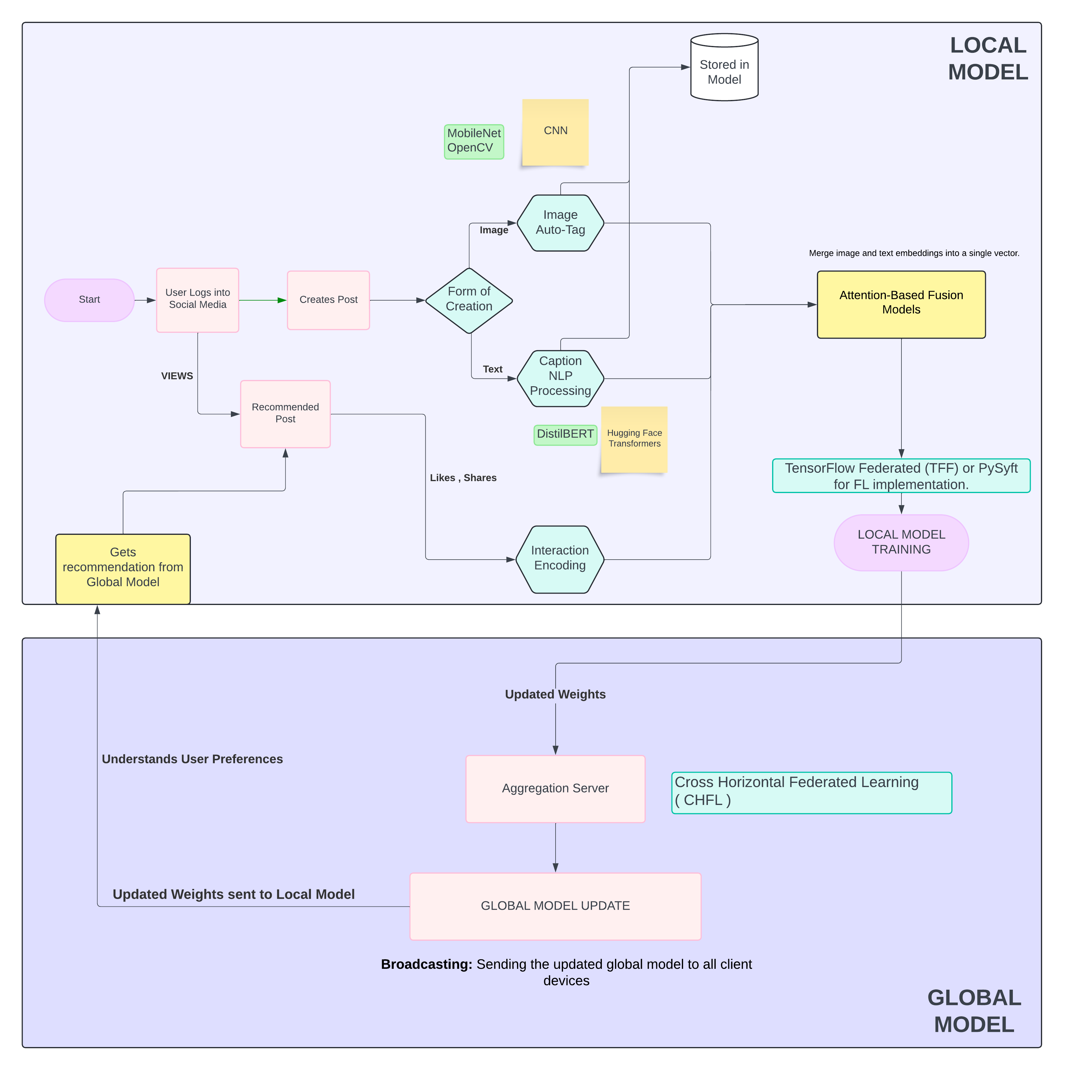
Proposed Design

Slide 11
Plan for Semester VI
IMPLEMENTATION OF:
-A3C
-NLP (Bert)
Drafting of the research paper
Explore Hypergraph Attention Module and Explainable AI

Slide 12
References
[1] Rushabh Chheda, Dhruv Bohara, Rishikesh Shetty, Siddharth Trivedi, Ruhina, “A Deep Reinforcement Learning Framework for the Financial Portfolio Management Problem”, 2023, ScienceDirect, 10.1016/j.procs.2023.01.021
[2] Adiyansjah, Alexander A S Gunawan, Derwin Suhartono, “Adversarial Deep Reinforcement Learning in Portfolio Management ”, 2019, ScienceDirect, 10.1016/j.procs.2019.08.146
[3] Ja-Hwung Su, Wei-Yi Chang, Vincent S. Tseng, ”Explainable Deep Reinforcement Learning for Portfolio Management: An Empirical Approach”, 2020, ScienceDirect, doi:10.1016/j.procs.2013.09.107
[4] Chien-Liang-Lui, Ying-Chuan-Chen, “Gamma and Vega Hedging Using Deep Distributional Reinforcement Learning”, 2019, Elsevier, 0950-7051
[5] Fang-Fei Kuo, Man-Kwan Shan, Suh-Yin Lee, “Reinforcement-Learning based Portfolio Management with Augmented Asset Movement Prediction States”, 2022, IEEE Xplore
[6] Anant Baijal, Vivek Agarwal, Danny Hyun, “Reinforcement Learning for Portfolio Management”, 2023, IEEE Xplore
[7] Jing Yi, Yaochen Zhu, Jiayi Xie, Zhenzhong Chen, “Hypergraph-Based Reinforcement Learning for Stock Portfolio Selection”, 2021, IEEE Xplore Vol 22

