Slide 1
Deep Learning CS60010
Abir Das
Computer Science and Engineering Department
Indian Institute of Technology Kharagpur
http://cse.iitkgp.ac.in/~adas/

Slide 2
Agenda
To brush up basics of Linear Algebra.

Slide 3
Resources
”Deep Learning”, I. Goodfellow, Y. Bengio, A. Courville. (Chapter 2)

Slide 4
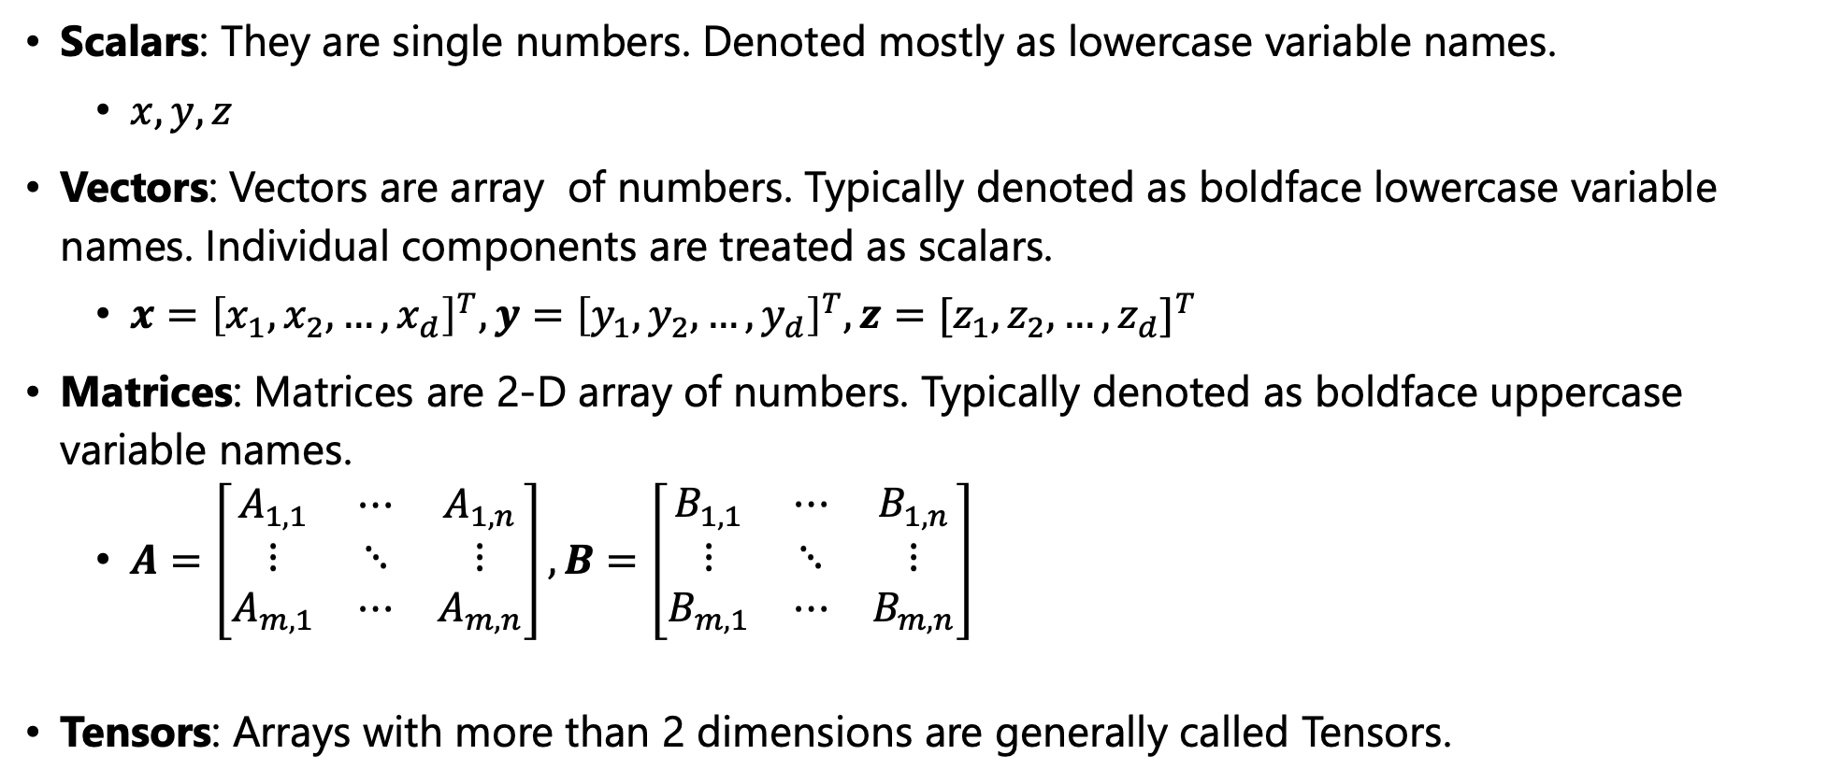
Scalars, Vectors, Matrices and Tensors
Scalars: They are single numbers. Denoted mostly as lowercase variable names.
$x, y, z$
Vectors: Vectors are array of numbers. Typically denoted as boldface lowercase variable names. Individual components are treated as scalars.
$x={\left[x_{1},x_{2},…,x_{d}\right]}^{T},y={\left[y_{1},y_{2},…,y_{d}\right]}^{T},z={[z_{1},z_{2},…,z_{d}]}^{T}$
Matrices: Matrices are 2-D array of numbers. Typically denoted as boldface uppercase variable names.
$A=\left[\begin{matrix}A_{1,1} & ⋯ & A_{1,n} \\ ⋮ & ⋱ & ⋮ \\ A_{m,1} & ⋯ & A_{m,n}\end{matrix}\right],B=\left[\begin{matrix}B_{1,1} & ⋯ & B_{1,n} \\ ⋮ & ⋱ & ⋮ \\ B_{m,1} & ⋯ & B_{m,n}\end{matrix}\right]$
Tensors: Arrays with more than 2 dimensions are generally called Tensors.

Slide 5
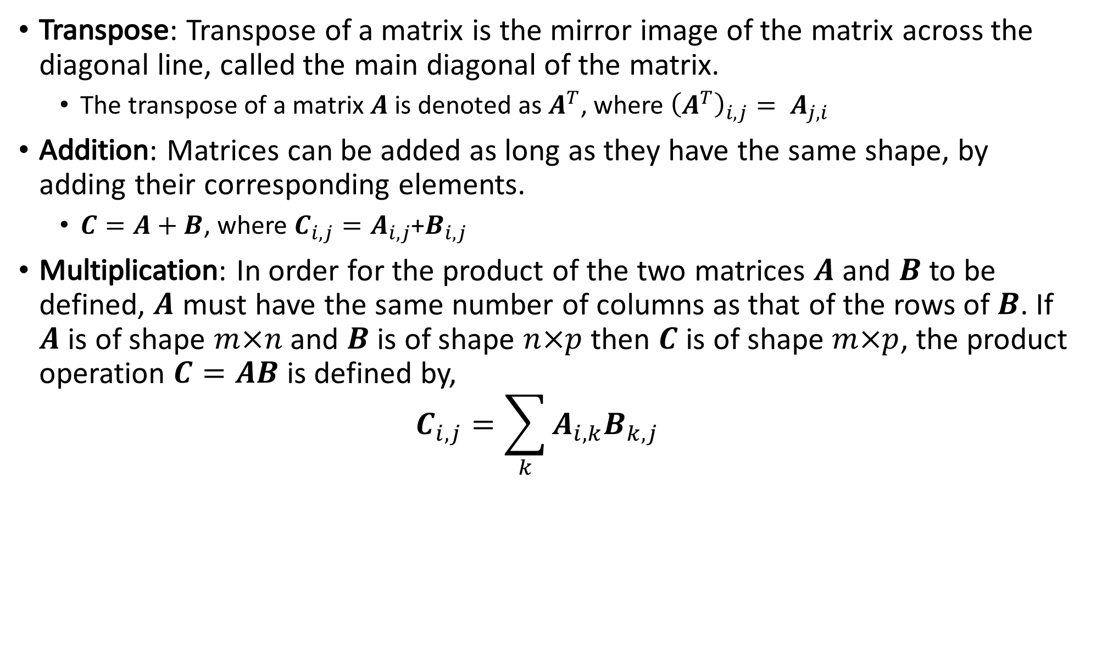
Matrix Operations
Transpose: Transpose of a matrix is the mirror image of the matrix across the diagonal line, called the main diagonal of the matrix.
The transpose of a matrix $A$ is denoted as $A^{T}$, where ${\left(A^{T}\right)}_{i,j}= A_{j,i}$
Addition: Matrices can be added as long as they have the same shape, by adding their corresponding elements.
$C=A+B$, where $C_{i,j}=A_{i,j}$+$B_{i,j}$
Multiplication: In order for the product of the two matrices $A$ and $B$ to be defined, $A$ must have the same number of columns as that of the rows of $B$. If $A$ is of shape $m×n$ and $B$ is of shape $n×p$ then $C$ is of shape $m×p$, the product operation $C=AB$ is defined by, $C_{i,j}=\sum_{k}{A_{i,k}B_{k,j}}$

Slide 6
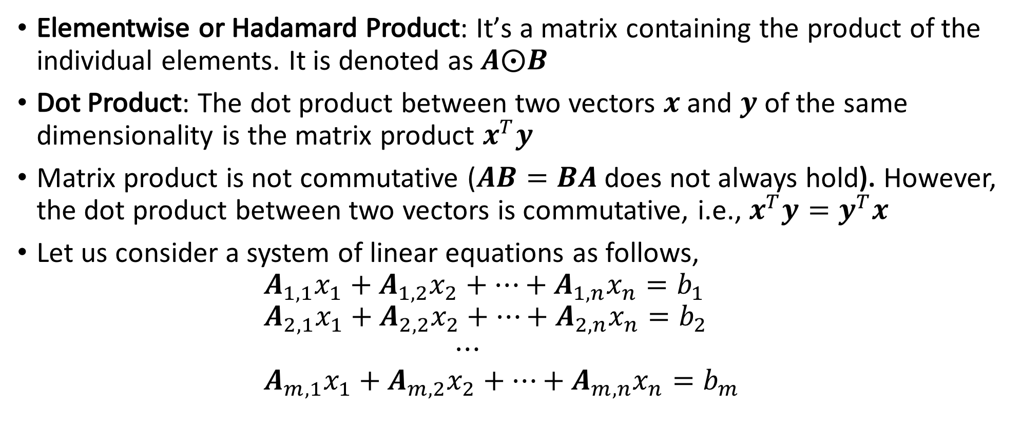
Matrix Operations
Elementwise or Hadamard Product: It’s a matrix containing the product of the individual elements. It is denoted as $A⨀B$
Dot Product: The dot product between two vectors $x$and $y$of the same dimensionality is the matrix product $x^{T}y$
Matrix product is not commutative ($AB=BA$ does not always hold). However, the dot product between two vectors is commutative, i.e., $x^{T}y=y^{T}x$
Let us consider a system of linear equations as follows, $A_{1,1}x_{1}+A_{1,2}x_{2}+⋯+A_{1,n}x_{n}=b_{1}$ $A_{2,1}x_{1}+A_{2,2}x_{2}+⋯+A_{2,n}x_{n}=b_{2}$ $⋯$ $A_{m,1}x_{1}+A_{m,2}x_{2}+⋯+A_{m,n}x_{n}=b_{m}$

Slide 7
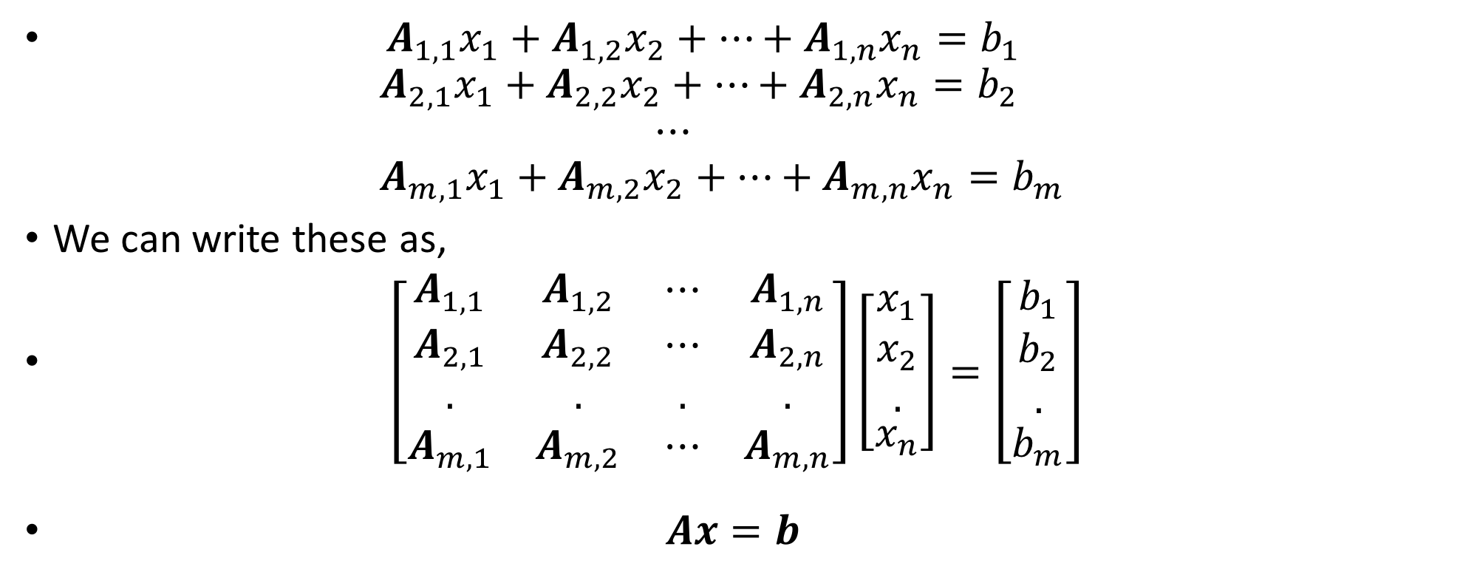
System of Linear Equations
$A_{1,1}x_{1}+A_{1,2}x_{2}+⋯+A_{1,n}x_{n}=b_{1}$ $A_{2,1}x_{1}+A_{2,2}x_{2}+⋯+A_{2,n}x_{n}=b_{2}$ $⋯$ $A_{m,1}x_{1}+A_{m,2}x_{2}+⋯+A_{m,n}x_{n}=b_{m}$
We can write these as,
$\left[\begin{matrix}A_{1,1} & A_{1,2} & ⋯ & A_{1,n} \\ A_{2,1} & A_{2,2} & ⋯ & A_{2,n} \\ . & . & . & . \\ A_{m,1} & A_{m,2} & ⋯ & A_{m,n}\end{matrix}\right]\left[\begin{aligned}\begin{matrix}x_{1} \\ x_{2} \\ .\end{matrix} \\ x_{n}\end{aligned}\right]=\left[\begin{aligned}\begin{matrix}b_{1} \\ b_{2} \\ .\end{matrix} \\ b_{m}\end{aligned}\right]$
$Ax=b$

Slide 8
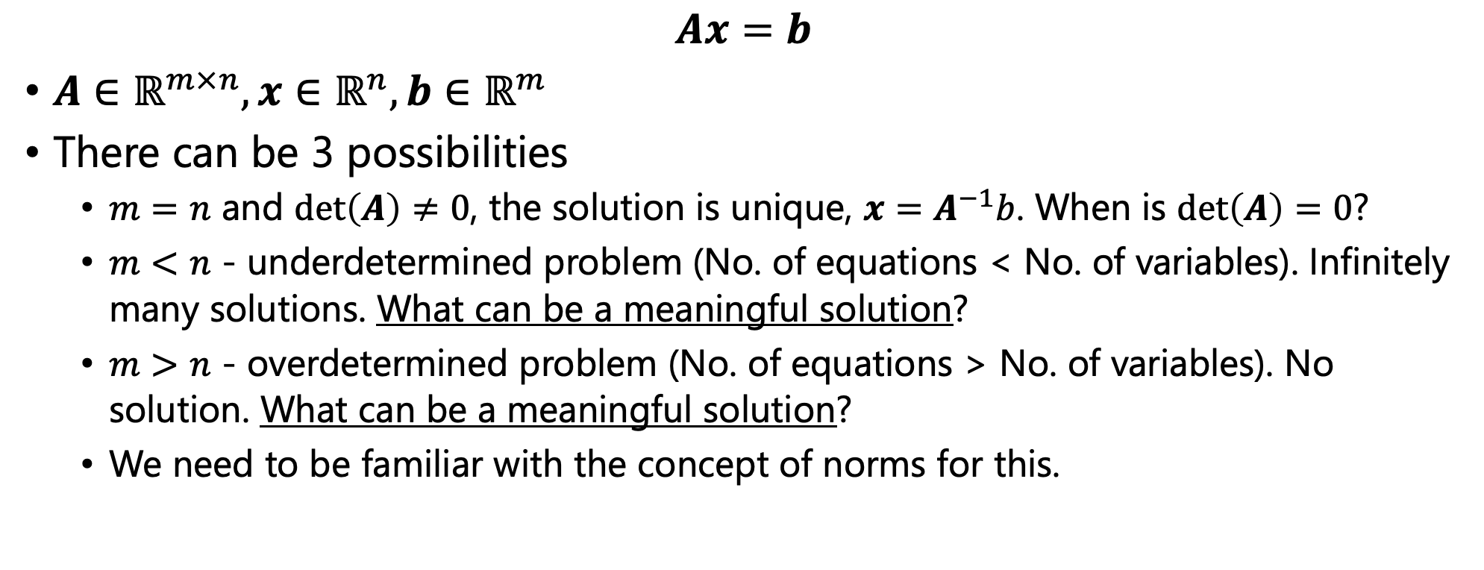
System of Linear Equations
$$Ax=b$$
$A∈ℝ^{m×n}, x∈ℝ^{n},b∈ℝ^{m}$
There can be 3 possibilities
$m=n$ and $\det\left(A\right)≠0$, the solution is unique, $x=A^{−1}b$. When is $\det\left(A\right)=0$?
$m<n$ - underdetermined problem (No. of equations < No. of variables). Infinitely many solutions. What can be a meaningful solution?
$m>n$ - overdetermined problem (No. of equations > No. of variables). No solution. What can be a meaningful solution?
We need to be familiar with the concept of norms for this.

Slide 9
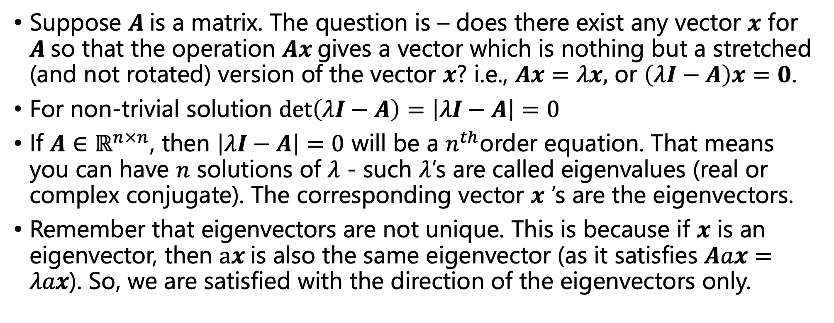
Eigenvalues and Eigenvectors
Suppose $A$is a matrix. The question is – does there exist any vector $x$ for $A$so that the operation $Ax$gives a vector which is nothing but a stretched (and not rotated) version of the vector $x$? i.e., $Ax=λx,$ or $\left(λI−A\right)x=0$.
For non-trivial solution $\det\left(λI−A\right)=\left|λI−A\right|=0$
If $A∈ℝ^{n×n}$, then $\left|λI−A\right|=0$ will be a $n^{th}$order equation. That means you can have $n$ solutions of $λ$ - such $λ$’s are called eigenvalues (real or complex conjugate). The corresponding vector $x$ ’s are the eigenvectors.
Remember that eigenvectors are not unique. This is because if $x$ is an eigenvector, then $ax$is also the same eigenvector (as it satisfies $Aax=λax$). So, we are satisfied with the direction of the eigenvectors only.

Slide 10
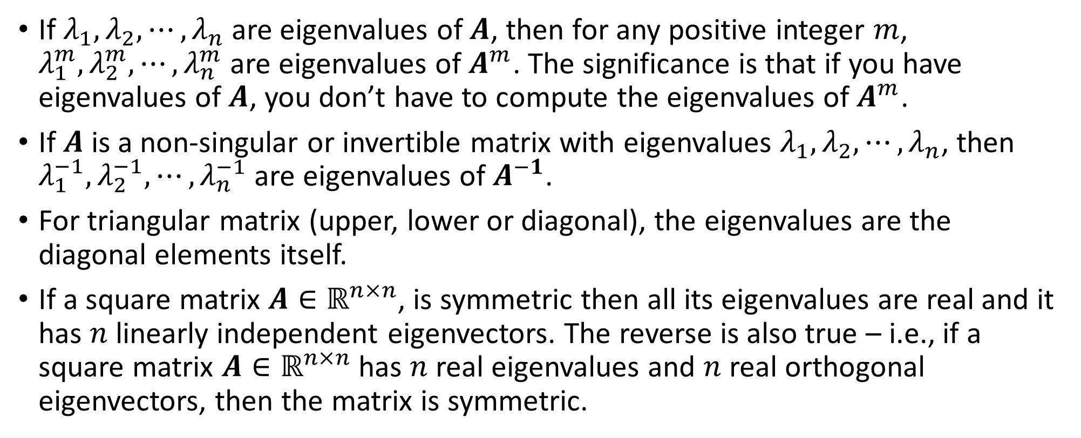
Standard Results on Eigenvalues and Eigenvectors
If $λ_{1},λ_{2},⋯,λ_{n}$ are eigenvalues of $A$, then for any positive integer $m$, $λ_{1}^{m},λ_{2}^{m},⋯,λ_{n}^{m}$ are eigenvalues of $A^{m}$. The significance is that if you have eigenvalues of $A$, you don’t have to compute the eigenvalues of $A^{m}$.
If $A$ is a non-singular or invertible matrix with eigenvalues $λ_{1},λ_{2},⋯,λ_{n}$, then $λ_{1}^{−1},λ_{2}^{−1},⋯,λ_{n}^{−1}$ are eigenvalues of $A^{−1}$.
For triangular matrix (upper, lower or diagonal), the eigenvalues are the diagonal elements itself.
If a square matrix $A∈ℝ^{n×n}$, is symmetric then all its eigenvalues are real and it has $n$ linearly independent eigenvectors. The reverse is also true – i.e., if a square matrix $A∈ℝ^{n×n}$ has $n$ real eigenvalues and $n$ real orthogonal eigenvectors, then the matrix is symmetric.

Slide 11
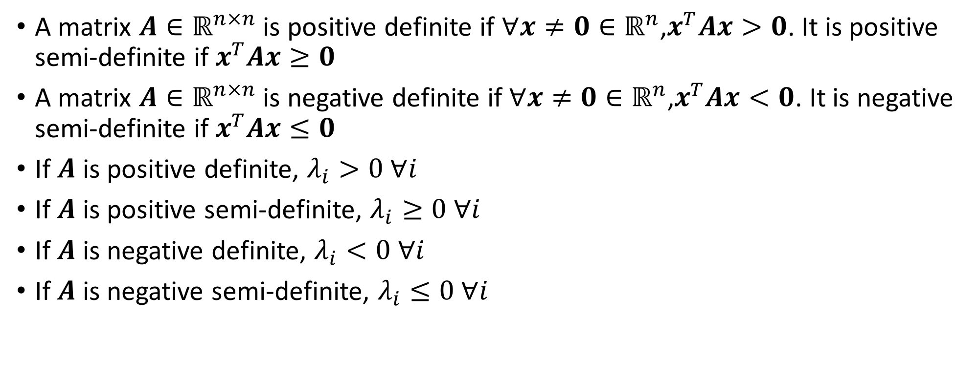
Standard Results on Eigenvalues and Eigenvectors
A matrix $A∈ℝ^{n×n}$ is positive definite if $∀x≠0∈ℝ^{n}$,$x^{T}Ax>0$. It is positive semi-definite if $x^{T}Ax≥0$
A matrix $A∈ℝ^{n×n}$ is negative definite if $∀x≠0∈ℝ^{n}$,$x^{T}Ax<0$. It is negative semi-definite if $x^{T}Ax≤0$
If $A$ is positive definite, $λ_{i}>0 ∀i$
If $A$ is positive semi-definite, $λ_{i}≥0 ∀i$
If $A$ is negative definite, $λ_{i}<0 ∀i$
If $A$ is negative semi-definite, $λ_{i}≤0 ∀i$

Slide 12
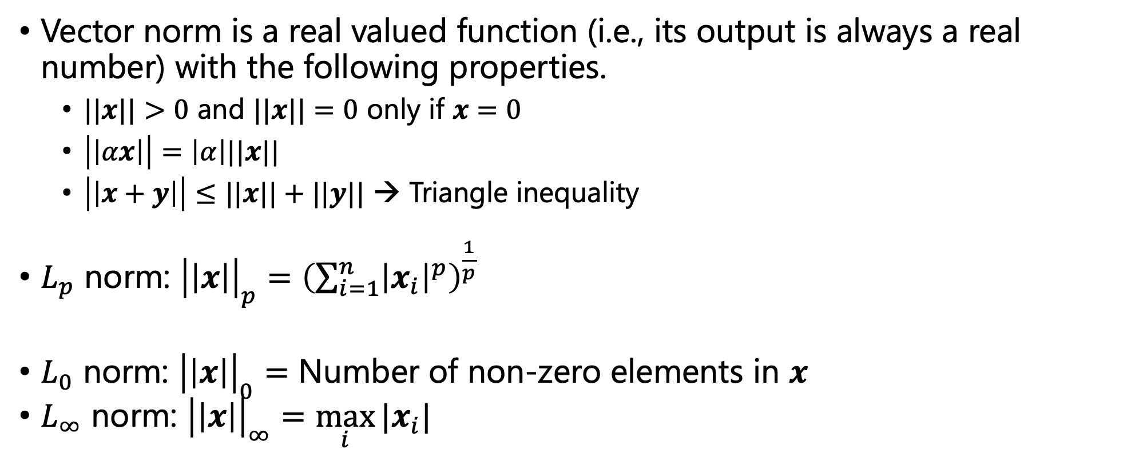
Vector Norms
Vector norm is a real valued function (i.e., its output is always a real number) with the following properties.
$||x||>0$ and $||x||=0$ only if $x=0$
$\left|\left|αx\right|\right|=\left|α\right|||x||$
$\left|\left|x+y\right|\right|≤||x||+||y||$ → Triangle inequality
$L_{p}$ norm: ${\left|\left|x\right|\right|}_{p}={\left(\sum_{i=1}^{n}{{\left|x_{i}\right|}^{p}}\right)}^{\frac{1}{p}}$
$L_{0}$ norm: ${\left|\left|x\right|\right|}_{0}=$ Number of non-zero elements in $x$
$L_{∞}$ norm: ${\left|\left|x\right|\right|}_{∞}=\max_{i}{{|x}_{i}|}$

Slide 13
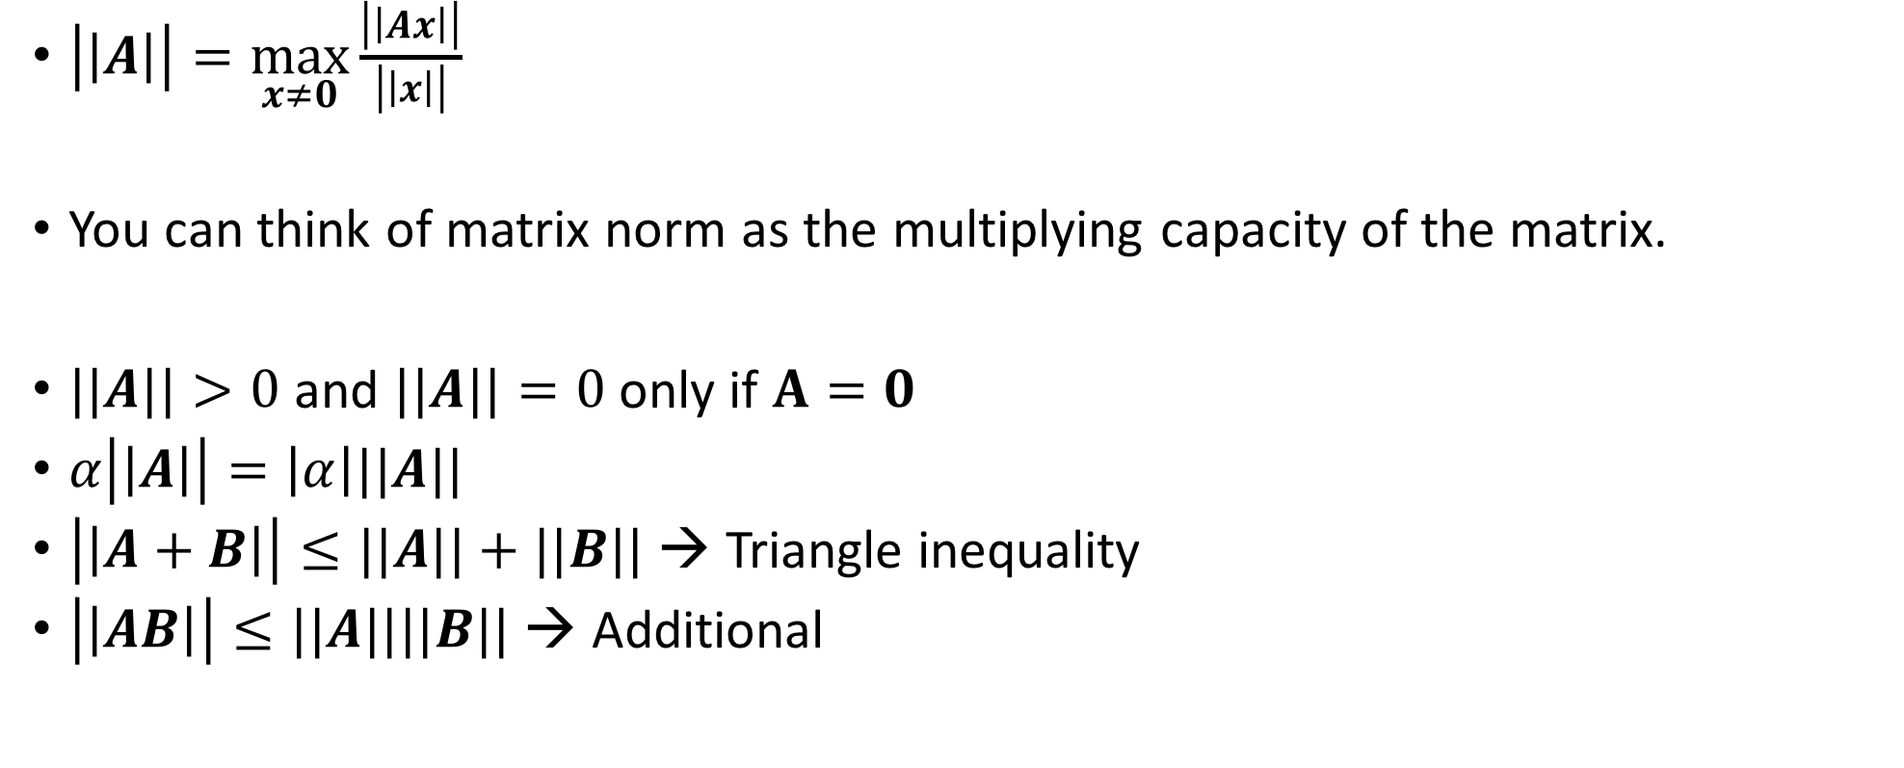
Matrix/Induced Norms
$\left|\left|A\right|\right|=\max_{x≠0}{\frac{\left|\left|Ax\right|\right|}{\left|\left|x\right|\right|}}$
You can think of matrix norm as the multiplying capacity of the matrix.
$||A||>0$ and $||A||=0$ only if $A=0$
$α\left|\left|A\right|\right|=\left|α\right|||A||$
$\left|\left|A+B\right|\right|≤||A||+||B||$ → Triangle inequality
$\left|\left|AB\right|\right|≤||A||||B||$ → Additional

Slide 14
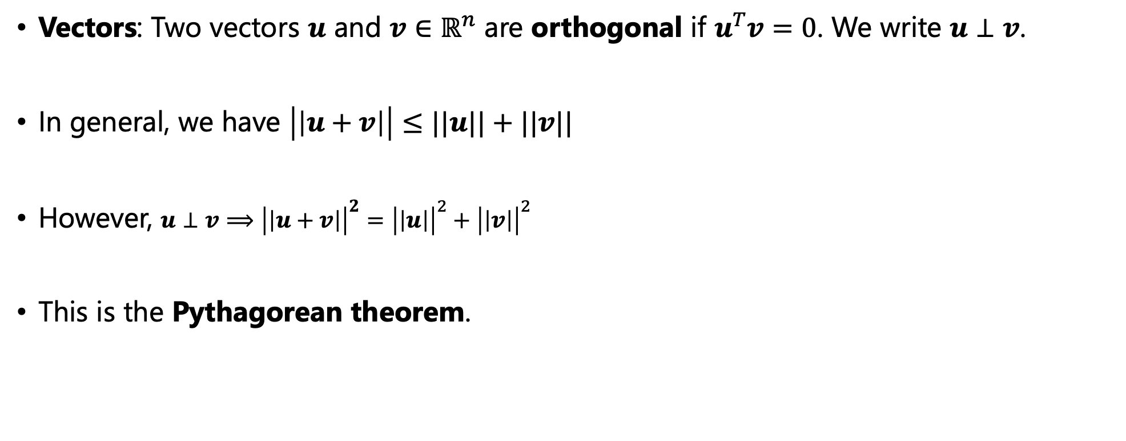
Orthogonality
Vectors: Two vectors $u$ and $v∈ℝ^{n}$ are orthogonal if $u^{T}v=0$. We write $u⊥v$.
In general, we have $\left|\left|u+v\right|\right|≤||u||+||v||$
However, $u⊥v⟹$ ${\left|\left|u+v\right|\right|}^{2}={\left|\left|u\right|\right|}^{2}+{\left|\left|v\right|\right|}^{2}$
This is the Pythagorean theorem.

Slide 15
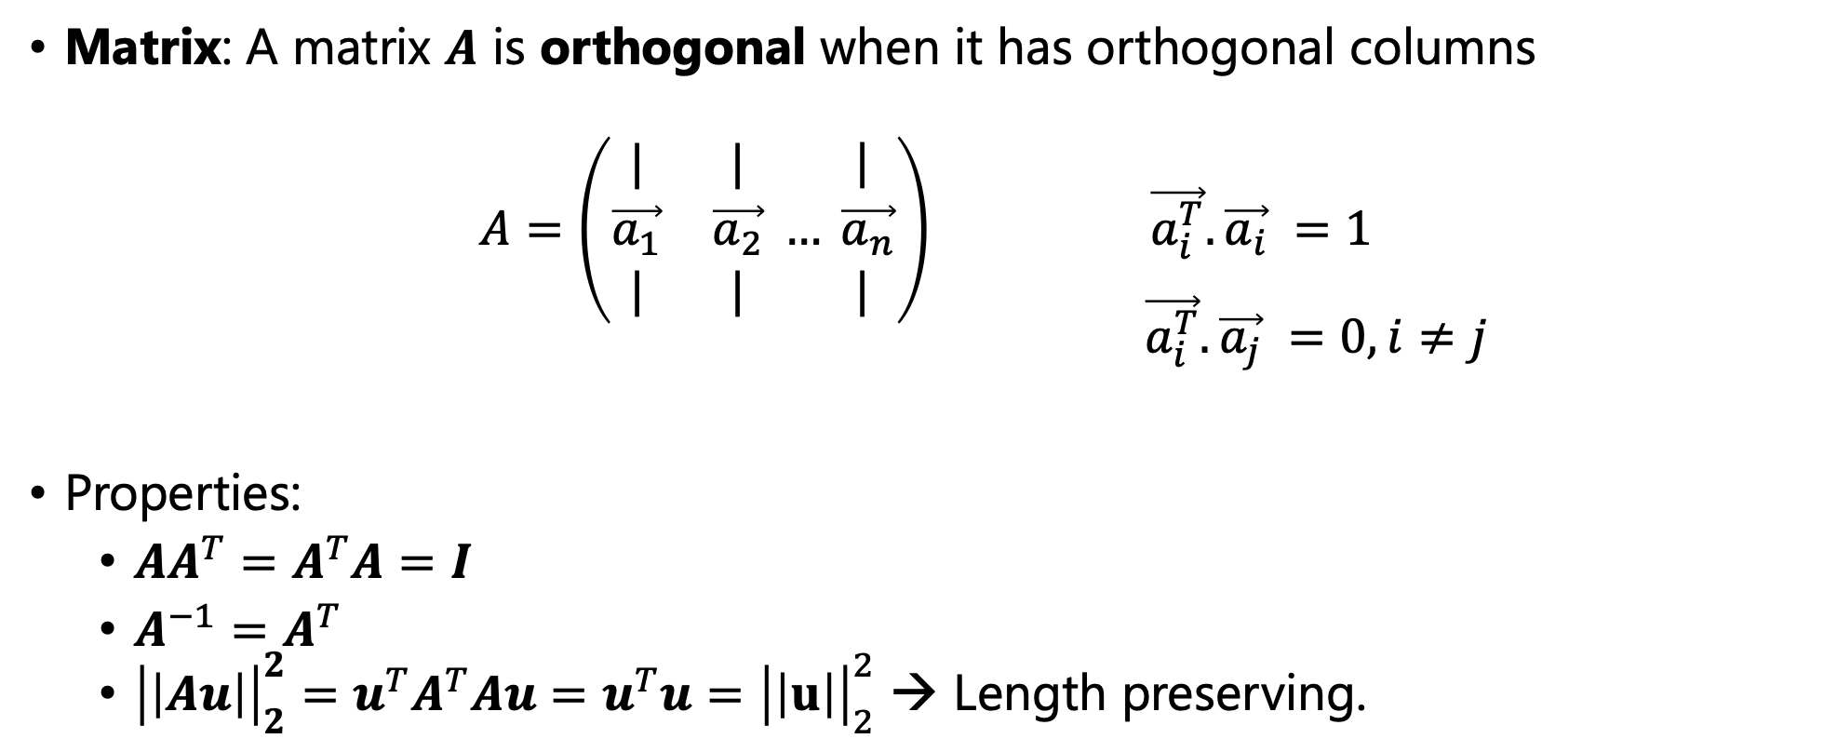
Orthogonality
Matrix: A matrix $A$ is orthogonal when it has orthogonal columns
$$A=\left(\begin{matrix}| & | \\ \vec{a_{1}} & \vec{a_{2}} \\ | & |\end{matrix} …\begin{matrix}| \\ \vec{a_{n}} \\ |\end{matrix}\right) \vec{a_{i}^{T}}. \vec{a_{i}} =1$$
$\vec{a_{i}^{T}}. \vec{a_{j}} =0, i≠j$
Properties:
$AA^{T}=A^{T}A=I$
$A^{−1}=A^{T}$
${\left|\left|Au\right|\right|}_{2}^{2}=u^{T}A^{T}Au=u^{T}u={\left|\left|u\right|\right|}_{2}^{2}$ → Length preserving.

Slide 16
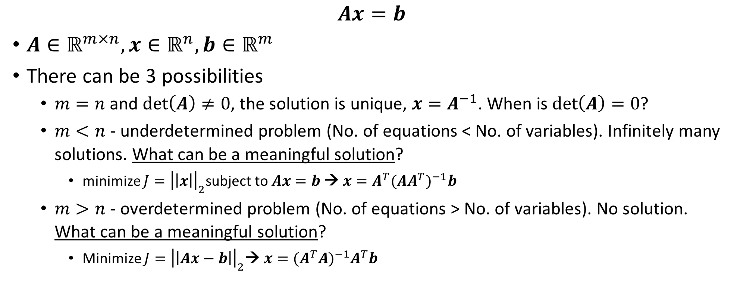
System of Linear Equations
$$Ax=b$$
$A∈ℝ^{m×n}, x∈ℝ^{n},b∈ℝ^{m}$
There can be 3 possibilities
$m=n$ and $\det\left(A\right)≠0$, the solution is unique, $x=A^{−1}$. When is $\det\left(A\right)=0$?
$m<n$ - underdetermined problem (No. of equations < No. of variables). Infinitely many solutions. What can be a meaningful solution?
minimize $J={\left|\left|x\right|\right|}_{2}$subject to $Ax=b$ → $x=A^{T}{(AA^{T})}^{−1}b$
$m>n$ - overdetermined problem (No. of equations > No. of variables). No solution. What can be a meaningful solution?
Minimize $J={\left|\left|Ax−b\right|\right|}_{2}$→ $x={(A^{T}A)}^{−1}A^{T}b$

Slide 17
Thank You!!

