Slide 1
Deep Learning
Abir Das
Assistant Professor
Computer Science and Engineering Department
Indian Institute of Technology Kharagpur
http://cse.iitkgp.ac.in/~adas/

Slide 2
Agenda
Introduce the concepts of
Regularization
Dropout
Batch normalization
Resource: Goodfellow Book (Chapter 7)

Slide 3
Regularization
Machine learning is concerned more about the performance on the test data than on the training data
According to the Goodfellow book, chapter 7 – “Many strategies used in Machine Learning are explicitly designed to reduce the test error, possibly at the expense of increased training error. These strategies are collectively known as Regularization”.
Also – in the book, regularization is defined as – “Any modification we make to a learning algorithm that is intended to reduce its generalization error but not its training error”.

Slide 4
Regularization Strategies
Adding restrictions on parameter values
Adding constraints that are designed to encode specific kinds of prior knowledge
Use of ensemble methods/dropout
Dataset augmentation
In practical Deep Learning scenarios, we almost do find – the best fitting model (in the sense of minimizing generalization error) is a large model that has been regularized appropriately

Slide 5
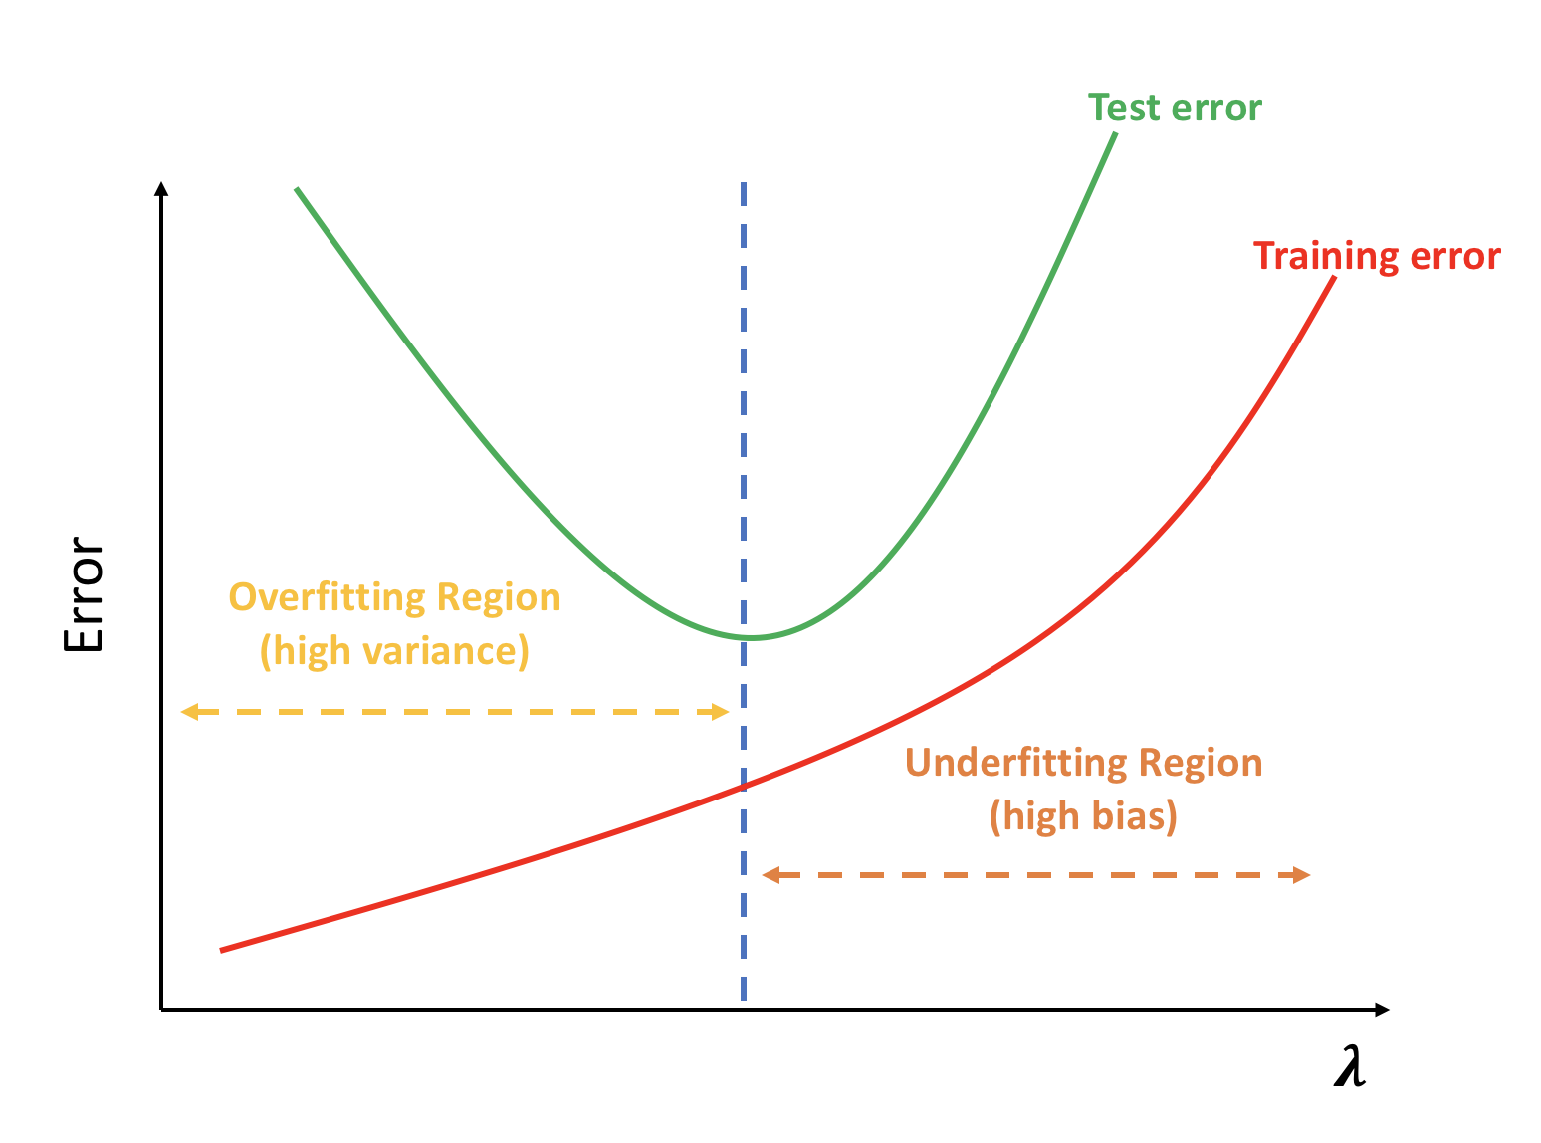
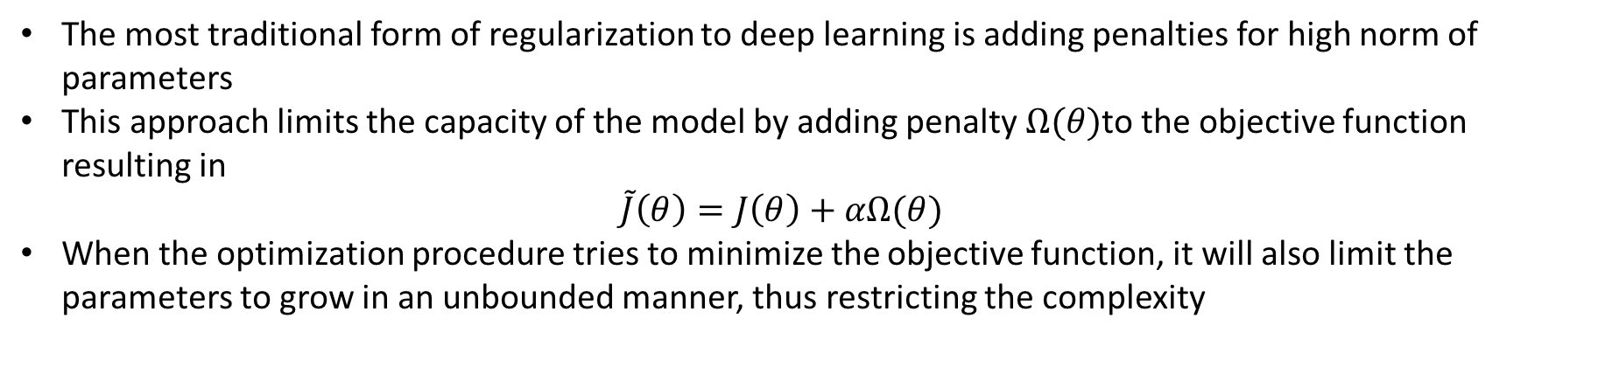

Parameter Norm Penalties
The most traditional form of regularization to deep learning is adding penalties for high norm of parameters
This approach limits the capacity of the model by adding penalty $Ω(θ)$to the objective function resulting in $\tilde{J}\left(θ\right)=J\left(θ\right)+αΩ(θ)$
When the optimization procedure tries to minimize the objective function, it will also limit the parameters to grow in an unbounded manner, thus restricting the complexity
$$α$$

Slide 6
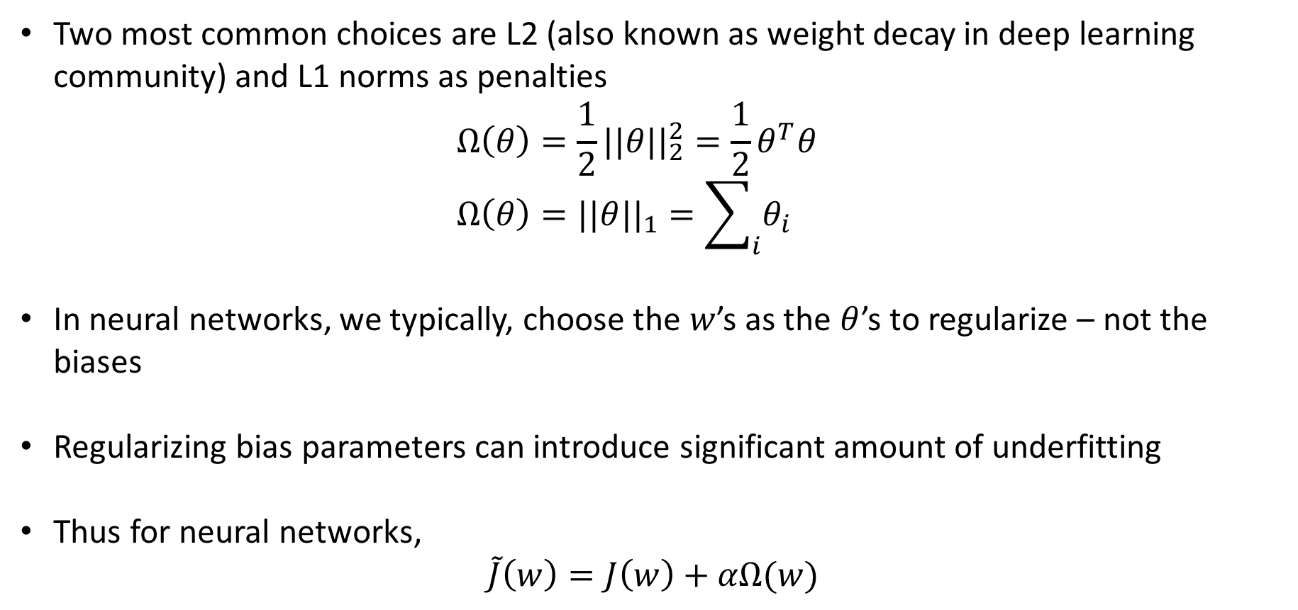
Parameter Norm Penalties
Two most common choices are L2 (also known as weight decay in deep learning community) and L1 norms as penalties $Ω\left(θ\right)=\frac{1}{2}{||θ||}_{2}^{2}=\frac{1}{2}θ^{T}θ$ $Ω\left(θ\right)={||θ||}_{1}=\sum_{i}{θ_{i}}$
In neural networks, we typically, choose the $w$’s as the $θ$’s to regularize – not the biases
Regularizing bias parameters can introduce significant amount of underfitting
Thus for neural networks, $\tilde{J}\left(w\right)=J\left(w\right)+αΩ(w)$

Slide 7
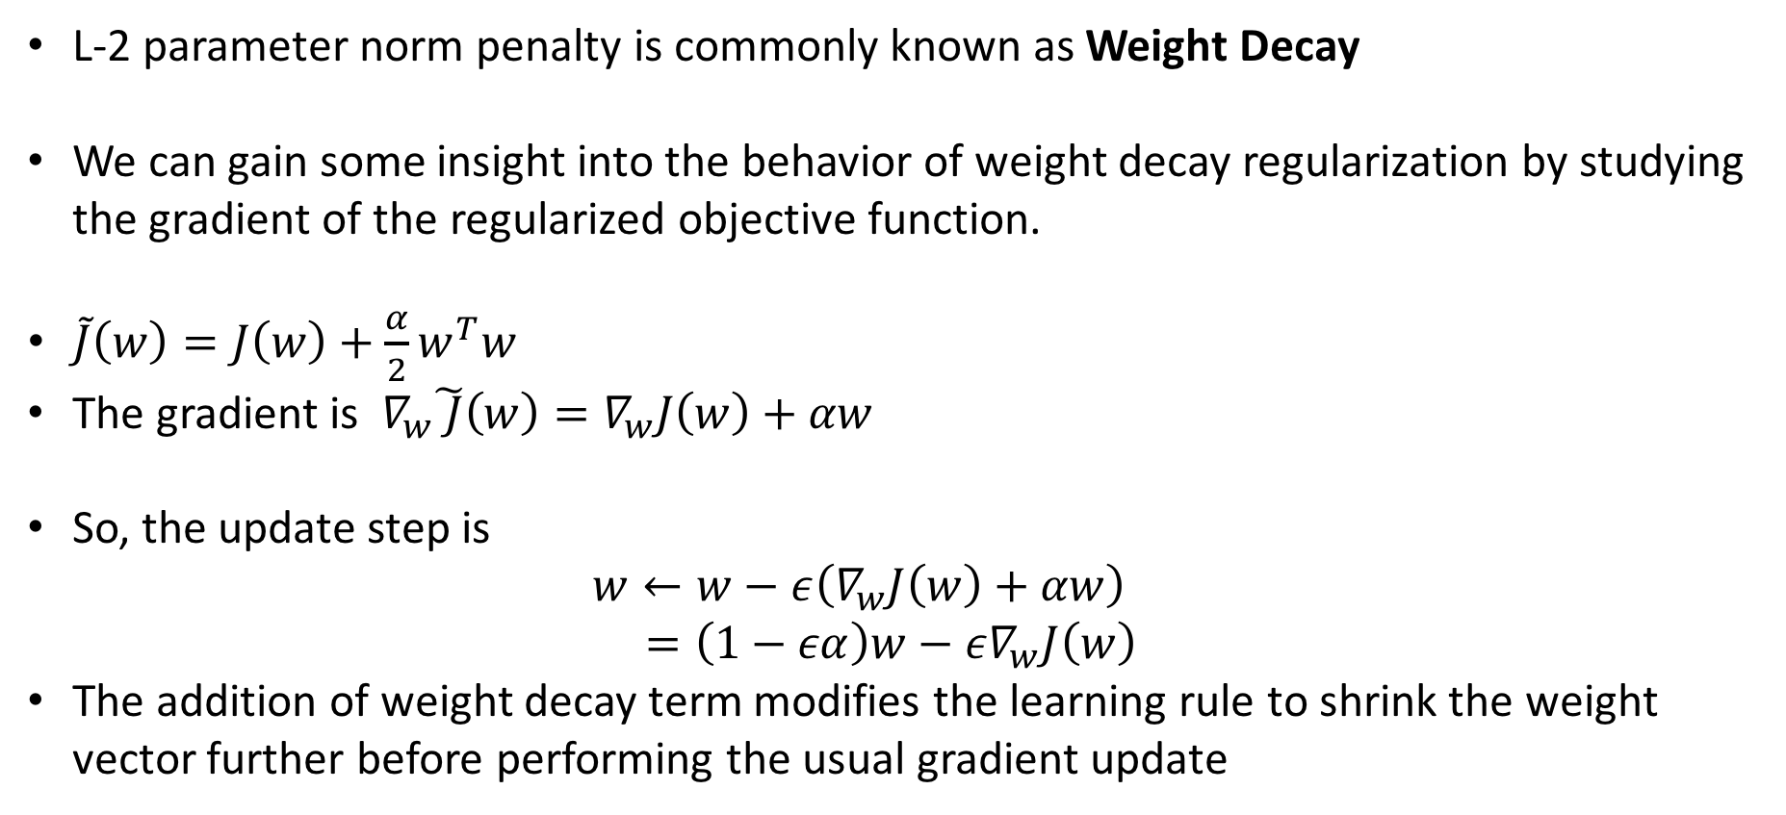
L-2 Parameter Norm Regularization
L-2 parameter norm penalty is commonly known as Weight Decay
We can gain some insight into the behavior of weight decay regularization by studying the gradient of the regularized objective function.
$\tilde{J}\left(w\right)=J\left(w\right)+\frac{α}{2}w^{T}w$
The gradient is $∇_{w}\tilde{ J}\left(w\right)=∇_{w}J\left(w\right)+αw$
So, the update step is $w←w−ε\left(∇_{w}J\left(w\right)+αw\right)$ $=\left(1−εα\right)w−ε∇_{w}J\left(w\right)$
The addition of weight decay term modifies the learning rule to shrink the weight vector further before performing the usual gradient update

Slide 8
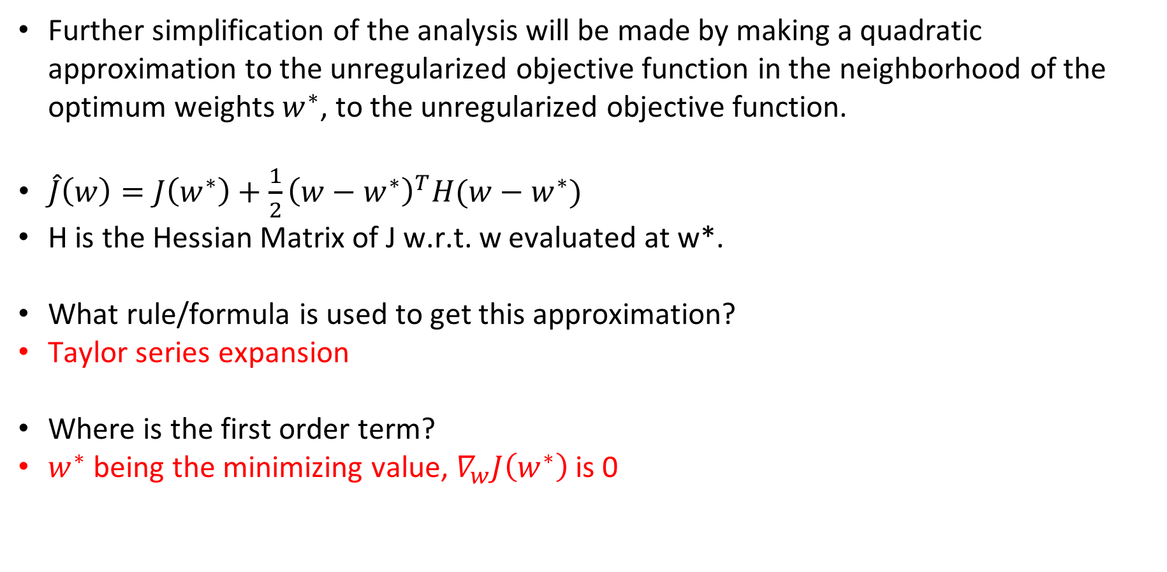
L-2 Parameter Norm Regularization
Further simplification of the analysis will be made by making a quadratic approximation to the unregularized objective function in the neighborhood of the optimum weights $w^{∗}$, to the unregularized objective function.
$\hat{J}\left(w\right)=J\left(w^{∗}\right)+\frac{1}{2}{\left(w−w^{∗}\right)}^{T}H(w−w^{∗})$
H is the Hessian Matrix of J w.r.t. w evaluated at w*.
What rule/formula is used to get this approximation?
Taylor series expansion
Where is the first order term?
$w^{∗}$ being the minimizing value, $∇_{w}J\left(w^{∗}\right)$ is 0

Slide 9
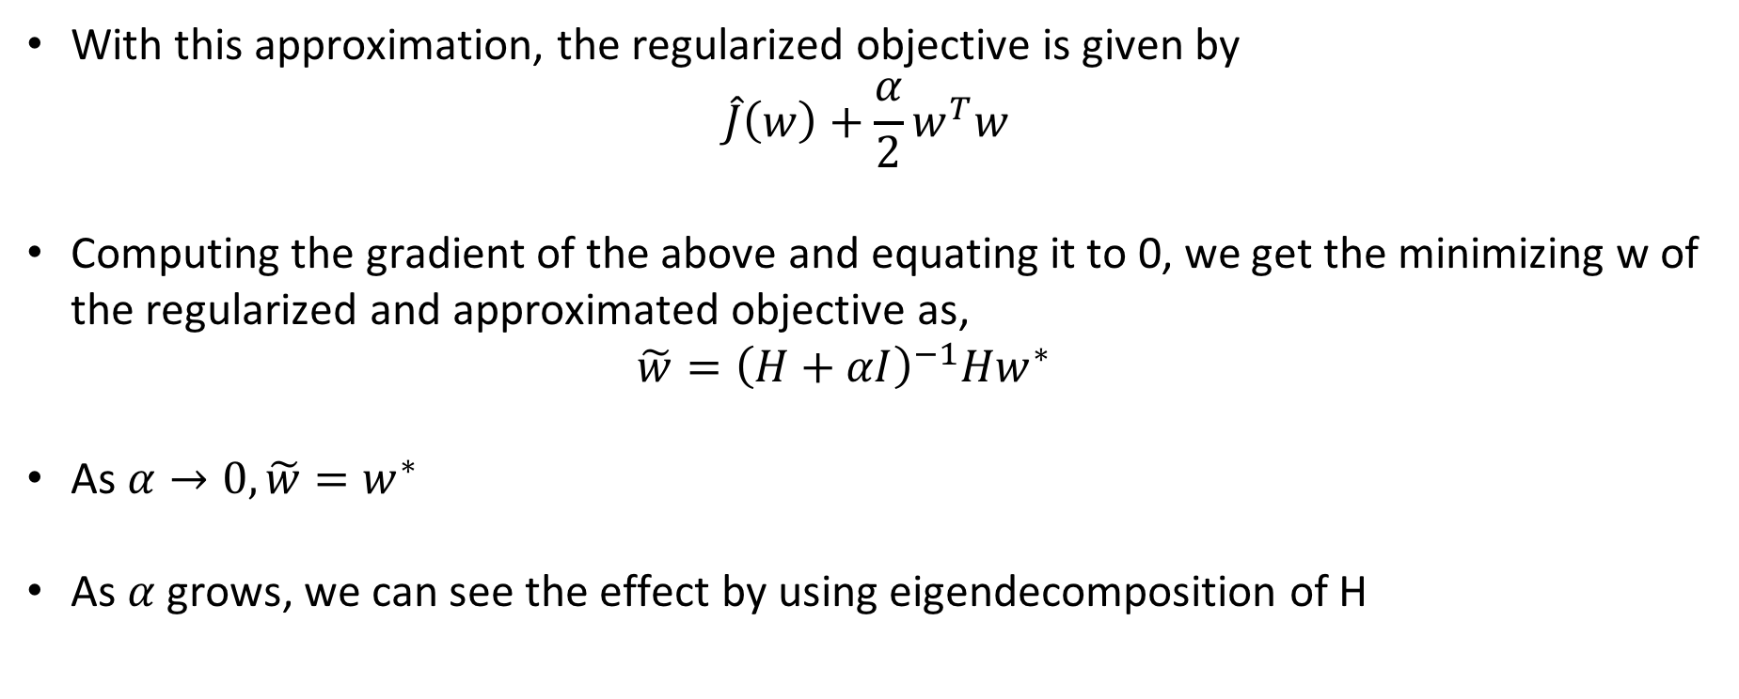
L-2 Parameter Norm Regularization
With this approximation, the regularized objective is given by $\hat{J}\left(w\right)+\frac{α}{2}w^{T}w$
Computing the gradient of the above and equating it to 0, we get the minimizing w of the regularized and approximated objective as, $\tilde{w}={\left(H+αI\right)}^{−1}Hw^{∗}$
As $α→0,\tilde{w}=w^{∗}$
As $α$ grows, we can see the effect by using eigendecomposition of H

Slide 10
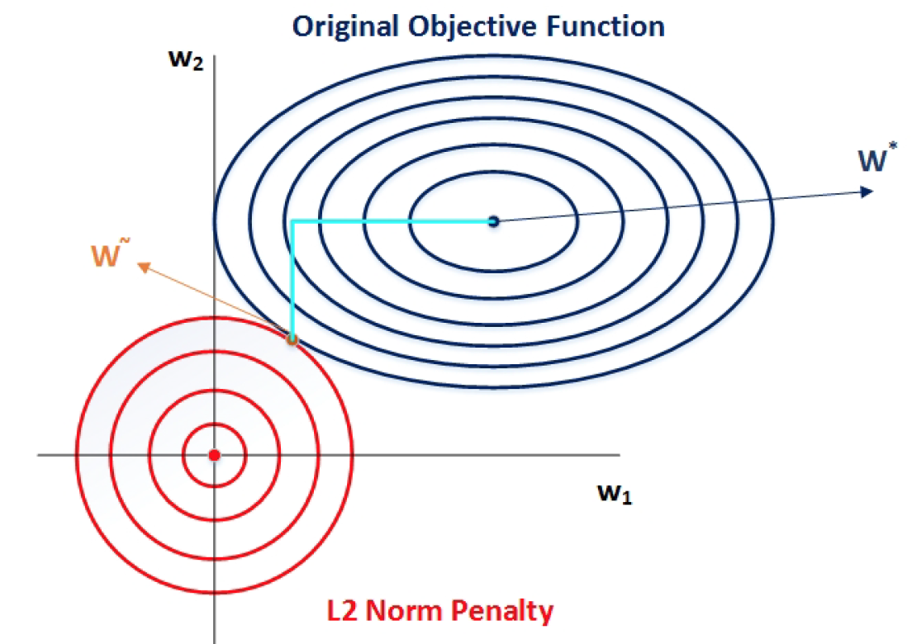
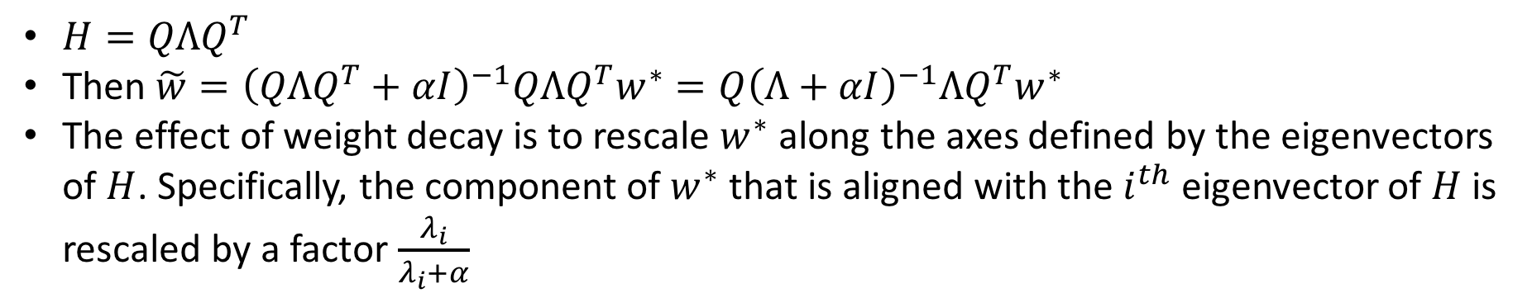
L-2 Parameter Norm Regularization
$H=QΛQ^{T}$
Then $\tilde{w}={\left(QΛQ^{T}+αI\right)}^{−1}QΛQ^{T}w^{∗}=Q{\left(Λ+αI\right)}^{−1}ΛQ^{T}w^{∗}$
The effect of weight decay is to rescale $w^{∗}$ along the axes defined by the eigenvectors of $H$. Specifically, the component of $w^{∗}$ that is aligned with the $i^{th}$ eigenvector of $H$ is rescaled by a factor $\frac{λ_{i}}{λ_{i}+α}$

Slide 11


Regularization Strategies: Dataset Augmentation
One way to get better generalization is to train on more data.
But under most circumstances, data is limited. Furthermore, labelling is an extremely tedious task.
Dataset Augmentation provides a cheap and easy way to increase the amount of training data.
Color Jitter
And many many more
Horizontal Flip

Slide 12
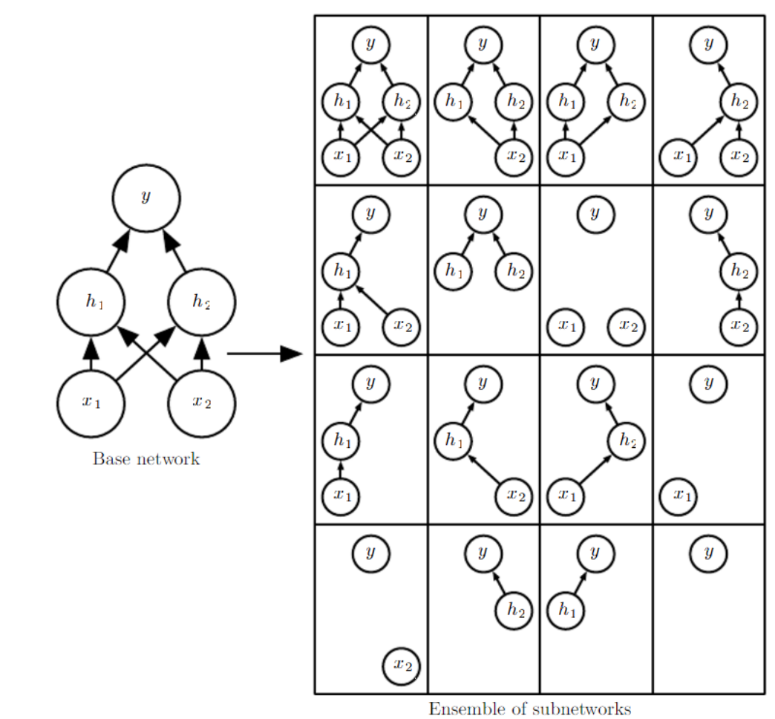
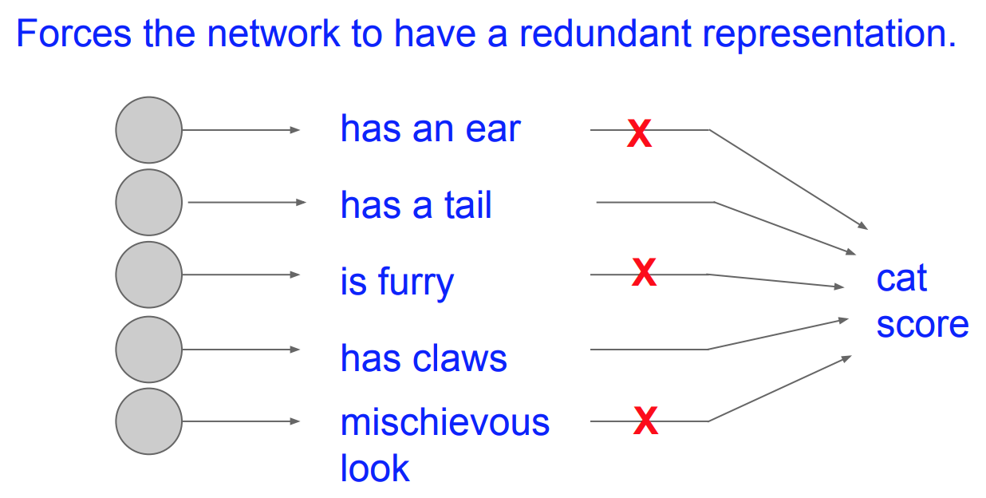
Regularization Strategies: Dropout
Bagging is a technique for reducing generalization error through combining several models (Breiman, 1994)
Bagging: (1) Train k different models on k different subsets of training data, constructed to have the same number of examples as the original dataset through random sampling from that dataset with replacement
Bagging: (2) Have all of the models vote on the output for test examples
Dropout is a computationally inexpensive but powerful extension of Bagging
Training with dropout consists of training sub-networks that can be formed by removing non-output units from an underlying base network
Images courtesy: Goodfellow et. al., Karpathy et. al.
Notes:
TELL ABOUT BAGGING FROM THE SLIDE.
In Dropout, we drop some neurons off – i.e., we randomly choose a few neurons and set the weights coming into and from them to 0. So during the forward pass, the final output is a function of different weights [of different sets of neurons] even for the same input. Again during the backward pass, note that, we have to keep note of the neurons that were dropped off. As the weights to and from these neurons do not play a part in getting the final loss, these weights are not updated during the backward pass. Remember that the neurons that are ‘on’, their weights get updated. This simple idea translates to simulate many different neural networks whose ensemble gives the output for test inputs during test time.
Another way to view dropout is to see it as preventing too biased to some particular features. Suppose, you have a neural network that learns to identify a cat. Say there is a neuron which really fires whenever it sees ears of a cat. That is - it learns to recognize ears. Similarly there may be some neuron which learned to recognize that cats are furry and so on. What dropout enables is that the network does not become too dependent on such few traits only to recognize a cat image. By dropping such neurons off and training the netork, it forces the network to pick up on other traits of a cat also - e.g., some neuron may slowly start to pick up that cats also have tails, they have claws etc. So, such a network will be more robust as it can identify a cat image even if the ear is not captured in a cat image. On the other hand, any animal with ear may not be readily given a high cat score as it might have very low activation for a tail or claws.

Slide 13
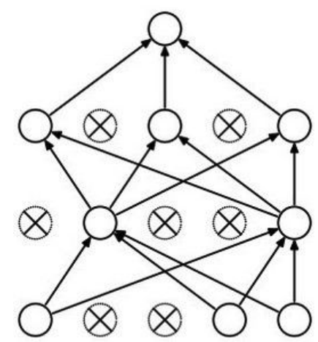
Dropout – At Test Time
Ideally, the randomness would have to be integrated out.
Monte Carlo approximation: Do many forward passes with different random neurons dropped out. Then average out all predictions.
An approximation to this approximation:
Can this be done in a single forward pass!
Can this be done without dropping out any neuron during forward pass at test time!
1st way: Get the output of the network at test time with all neurons on. Scale down this by multiplying it with the probability value with which neurons are dropped during training.
2nd way: During training compute the output of the network that you get after dropping out neurons with probability ‘p’. During training itself, scale up this by multiplying it with (1/p). At test time, get the output as what is coming by keeping all the neurons on.
Images courtesy: Goodfellow et. al., Karpathy et. al.

Slide 14
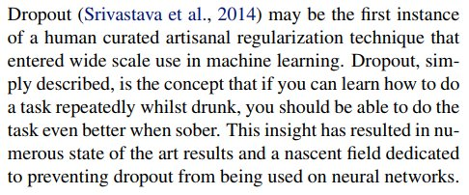
Dropout (Fun Intuition)

Slide 15


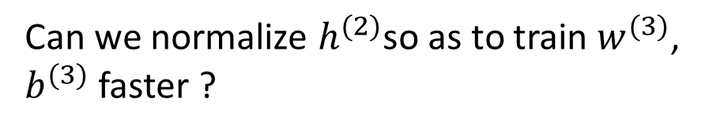




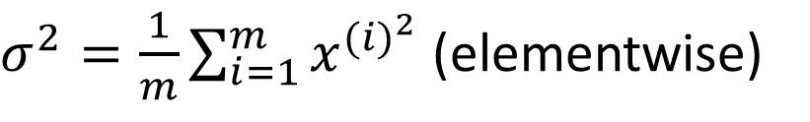

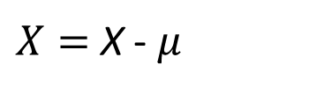






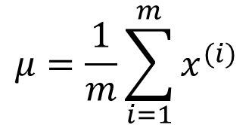



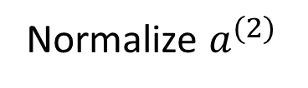







Batch Normalization
$$x_{1}$$
$$w_{1}$$
$$μ=\frac{1}{m}\sum_{i=1}^{m}{x^{(i)}}$$
$$w_{2}$$
$$a(x)$$
$$x_{2}$$
$$g(a)$$
$$y$$
$X=$ X - $μ$
$$W_{0}=b$$
$σ^{2}=\frac{1}{m}\sum_{i=1}^{m}{x^{{(i)}^{2}}}$ (elementwise)
$$x_{d}$$
$$w_{d}$$
$$1$$
$$x_{1}$$
$$a_{1}^{(2)}$$
$$a_{1}^{(1)}$$
$$h_{1}^{(1)}$$
$$h_{1}^{(2)}$$
Can we normalize $h^{(2)}$so as to train $w^{(3)}$, $b^{(3)}$ faster ?
$$x_{2}$$
$$\hat{y}$$
$$a_{2}^{(2)}$$
Normalize $a^{(2)}$
$$x_{3}$$
$$a_{2}^{(1)}$$
$$h_{2}^{(1)}$$
$$h_{2}^{(2)}$$
Notes:
In training a logistic regression model, you might remember, that normalizing the input features speeds up the training. This in effect, turns possibly elongated contours of the cost function to a more well-behaved circular contours which is easy to optimize.
Now, how about a multi-layer neural network. You don’t just have input features x, but also pre-activations and activations at these intermediate layers. So, the question is for any hidden layer say for layer 3, can we normalize $h^{(2)}$so as to train $w^{(3)}$, $b^{(3)}$ faster ?
However, in practice, it is seen that normalizing the preactivation values [a] is more useful than normalizing the activation values i.e., [h]. The technique through which we do this is called ‘Batch normalization’ or simply ‘BatchNorm’.

Slide 16
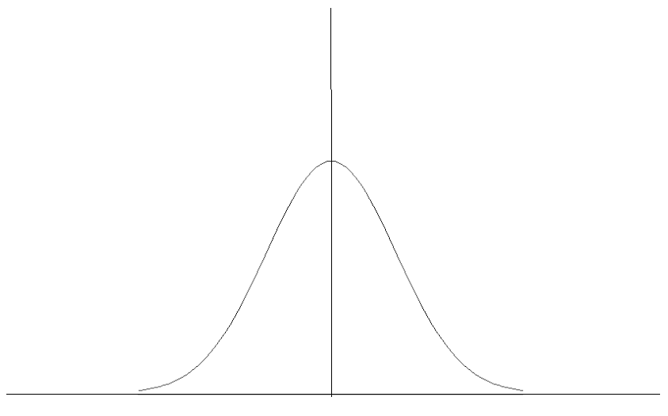
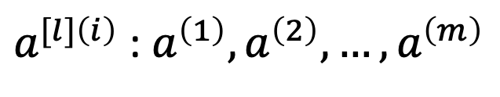
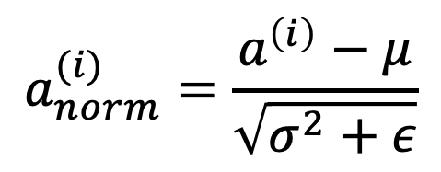
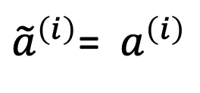
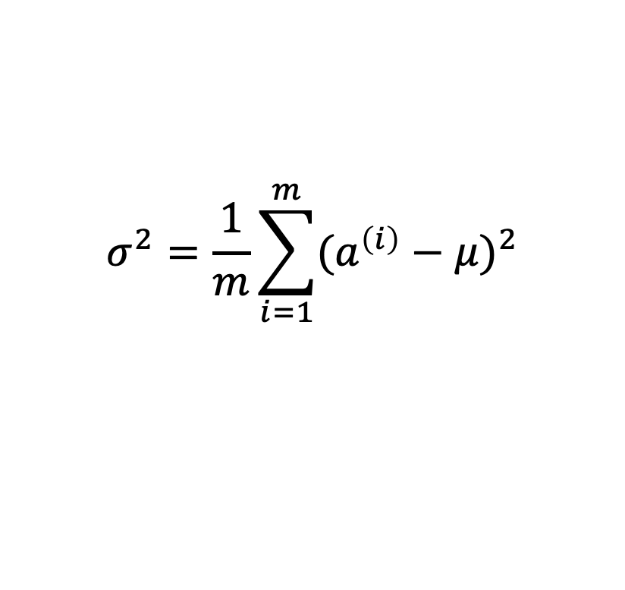
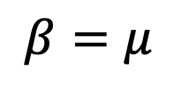
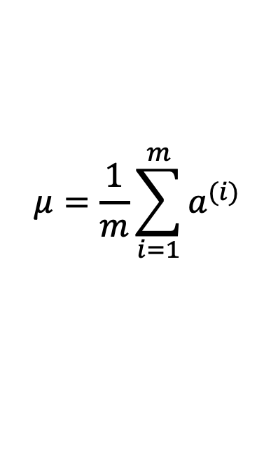
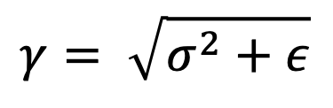
Implementing BatchNorm
$a^{[l]\left(i\right)}$ : $a^{\left(1\right)},a^{\left(2\right)}, …,a^{\left(m\right)}$
Given some intermediate values in NN,
$$μ=\frac{1}{m}\sum_{i=1}^{m}{a^{(i)}}$$
If,
$$γ= \sqrt{σ^{2}+ε}$$
$$σ^{2}=\frac{1}{m}\sum_{i=1}^{m}{{(a^{\left(i\right)}−μ)}^{2}}$$
$$β=μ$$
then,
$$a_{norm}^{(i)}=\frac{a^{\left(i\right)}−μ}{\sqrt{σ^{2}+ε}}$$
${\tilde{a}}^{\left(i\right)}$= ${ a}^{\left(i\right)}$
${\tilde{a}}^{\left(i\right)}= γa_{norm}^{(i)}+β$ , $γ and β$ are the learnable parameters of the model
Use${\tilde{a}}^{[l]\left(i\right)} instead of{ a}^{\left[l\right]\left(i\right)} in further calculations$
Notes:
Here is how you implement batchnormalization. THINGS ON LEFT HAND SIDE OF THE SLIDE.
$a_{norm}^{(i)}$ will have mean=0 and variance=$σ^{2}$ . However, we also want to give the network the flexibility to have mean and variance values other than these. The idea is that the network will learn from data, what mean and variance values of these intermediate features are good for the task in hand. For this, two more hyperparameters $γ$ and $β$ are introduced. As shown on the right, if $γ$ and values are these, then putting these values we can see that the normalized preactivation values are same as the unnormalized values. The role of $γ$ and is to scale and shift the mean and variance of the normalized feature values.
One advantage of having an option of different mean and variances other than 0 and $σ^{2}$ respectively can be seen in the figure. The bottom plot shows feature distribution with mean=0 and some variance $σ^{2}$. Now, this will mean, after passing through a nonlinearity say, sigmoid it will not undergo that much of non-linearity [as the nature of sigmoid is close to linear there]. So, such a constrained normalization would not be able to handle nonlinearity of the task good.

Slide 17
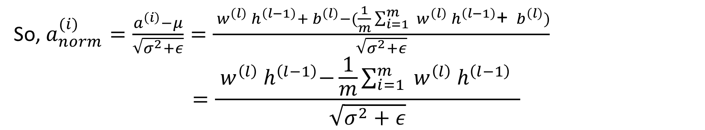

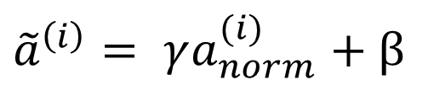

Effect of Batch Normalization on Biases
$${ a}^{\left(l\right)}={ w}^{\left(l\right)}{ h}^{\left(l−1\right)}+{ b}^{\left(l\right)}$$
We know, $μ=\frac{1}{m}\sum_{i=1}^{m}{a^{(l)}}$
$=\frac{1}{m}\sum_{i=1}^{m}{{ w}^{\left(l\right)}{ h}^{\left(l−1\right)}}$+ $\frac{1}{m}\sum_{i=1}^{m}{{ b}^{\left(l\right)}}$
$=\frac{1}{m}\sum_{i=1}^{m}{{ w}^{\left(l\right)}{ h}^{\left(l−1\right)}}$+ ${ b}^{\left(l\right)}$
So, $a_{norm}^{(i)}=\frac{a^{\left(i\right)}−μ}{\sqrt{σ^{2}+ε}}=\frac{{ w}^{\left(l\right)}{ h}^{\left(l−1\right)}+{ b}^{\left(l\right)}−(\frac{1}{m}\sum_{i=1}^{m}{{ w}^{\left(l\right)}{ h}^{\left(l−1\right)}}\text{+ }{ b}^{\left(l\right)})}{\sqrt{σ^{2}+ε}}$
$$=\frac{{ w}^{\left(l\right)}{ h}^{\left(l−1\right)}−\frac{1}{m}\sum_{i=1}^{m}{{ w}^{\left(l\right)}{ h}^{\left(l−1\right)}} }{\sqrt{σ^{2}+ε}}$$
${\tilde{a}}^{\left(i\right)}= γa_{norm}^{(i)}+β$
Notes:
This shows that the biases does not need to be considered while computing the batchnorm values.

