Slide 1
CA-3 · AGENTIC AI PROOF OF CONCEPT
InternAgent
PLAN
MATCH
VERIFY
Internship Matching &
Eligibility Assistant
A transparent multi-agent workflow for planning, retrieval, matching and validation.
Python · Streamlit · Pandas
No paid API required
Aryan Gawande · Education & Career Development

Slide 2
The problem — and our solution
A small, specific workflow that saves repeated manual checking.
Today’s friction
InternAgent workflow
• Compare listings across multiple sources
• Interpret academic year and CGPA requirements
• Estimate skill fit and identify missing skills
• Trust recommendations without transparent checks
• Collect a profile and preferences
• Retrieve candidates from a synthetic CSV
• Apply hard eligibility rules before ranking
• Explain scores and ask a Critic Agent to verify them
Outcome: a ranked, explainable shortlist with eligibility evidence and skill gaps.
INTERNAGENT · CA-3 AGENTIC AI PoC · SYNTHETIC DATA
02

Slide 3
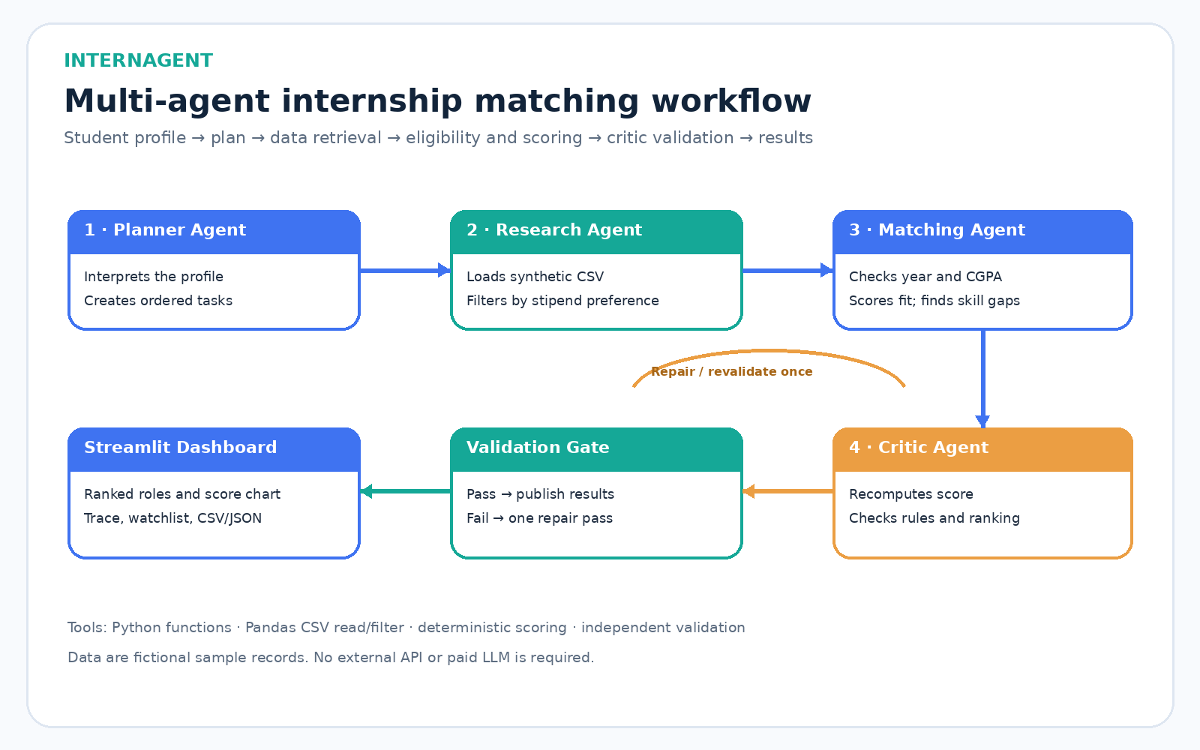
Architecture and data flow
Agents exchange structured outputs; the Critic can trigger one repair/revalidation pass.
INTERNAGENT · CA-3 AGENTIC AI PoC · SYNTHETIC DATA
03

Slide 4
Agent responsibilities
Separate stages with explicit inputs, outputs and validation responsibilities.
1 · Planner Agent
2 · Research Agent
Creates an ordered plan: profile → retrieval → eligibility → score → validate.
Loads the fictional CSV and applies the minimum-stipend preference.
3 · Matching & Eligibility Agent
4 · Critic / Validation Agent
Applies year/CGPA hard gates, computes match components and surfaces skill gaps.
Independently recomputes scores and checks eligibility, bounds, order, IDs and top-k.
Orchestrator: runs stages in order and permits one bounded repair/revalidation pass.
INTERNAGENT · CA-3 AGENTIC AI PoC · SYNTHETIC DATA
04

Slide 5
Explainable scoring — eligibility is separate
Score is a fit heuristic, not a probability of getting hired.
55%
Required skills
Hard eligibility gate
Academic year must be within the role range and CGPA must meet the minimum.
Missing skills reduce ranking fit but do not automatically disqualify.
20%
Domain interest
10%
Location / work mode
15%
CGPA buffer
Scores are clamped to 0–100; ranked roles include skill gaps and score components.
INTERNAGENT · CA-3 AGENTIC AI PoC · SYNTHETIC DATA
05

Slide 6
PoC demonstration and validation
Default demo profile: Year 2 · CGPA 7.5 · Python / ML / Pandas / Scikit-learn / SQL
12 source records
Ranked shortlist
Critic 5 / 5
All listings and organization names are synthetic.
Up to three eligible results with explanations and skill gaps.
Five checks validate the returned recommendations.
Six unit tests passed in the authoring environment.
Live demo sequence: run workflow → inspect score chart → expand a role → show validation and execution trace → inspect ineligible roles → download CSV/JSON.
INTERNAGENT · CA-3 AGENTIC AI PoC · SYNTHETIC DATA
06

Slide 7
Limitations, future scope and close
Built to demonstrate meaningful orchestration without unnecessary complexity.
Current limitations
Future scope
• Synthetic and small dataset
• Exact normalized skill labels
• Simplified academic rules
• No live postings or application submission
• Verified, refreshed internship sources
• Semantic skill matching
• LangGraph orchestration
• Local-model explanations and application tracking
Agentic value = planning + tool use + decisions + independent verification.
Thank you · Questions?
INTERNAGENT · CA-3 AGENTIC AI PoC · SYNTHETIC DATA
07

