Slide 1
C
ChurnGuardAI
PROJECT REPORT
Customer Churn Prediction System
Using Machine Learning and Predictive Analytics
Submitted By: Aryan Sharma
Technology: Python · Flask · Scikit-learn
Year: 2026
RANDOM FOREST
GRADIENT BOOSTING
LOGISTIC REGRESSION
FLASK WEB APP

Slide 2
WHAT WE'LL COVER
Agenda
01
Introduction & Problem Statement
05
Implementation
Business context, objectives, scope
Flask app, training pipeline, code
02
System Requirements & Architecture
06
Testing, Results & Business Impact
Functional needs, design, data flow
Model comparison, ROI analysis
03
Dataset & Exploratory Analysis
07
Deployment & Security
7,043 records, 21 features
Local/production considerations
04
Methodology & ML Pipeline
08
Conclusion & Future Work
Preprocessing, algorithms, metrics
Limitations, roadmap, references
ChurnGuard AI | Customer Churn Prediction System
2

Slide 3
CHAPTER 1 · INTRODUCTION
Background & Context
The telecommunications industry operates in one of the most fiercely competitive markets globally, characterized by low switching costs and aggressive pricing. Customer churn — when a customer discontinues service — has emerged as a critical business metric directly impacting revenue and long-term sustainability. Industry churn rates range 15%–25% annually, translating to billions in lost revenue worldwide.
5–25×
Cost to acquire a new
customer vs. retaining one
25–95%
Proactive retention — identifying at-risk customers before they leave — is significantly more cost-efficient than reactive win-back campaigns. Machine learning enables companies to analyze customer data at scale and surface the patterns that precede churn with remarkable accuracy.
Profit increase from a
5% rise in retention
Source: Harvard Business Review
ChurnGuard AI | Customer Churn Prediction System
3

Slide 4
CHAPTER 1 · INTRODUCTION
Problem Statement & Objectives
THE PROBLEM
OBJECTIVES
Despite vast customer data, telecom companies struggle to accurately identify at-risk customers from a complex, multi-dimensional dataset spanning demographics, service subscriptions, and billing. Class imbalance — churned customers form a minority — further complicates modeling and evaluation.
This project builds an end-to-end ML system that not only predicts churn accurately, but is deployed in a user-friendly web application so business stakeholders can act on the insights in real time.
Conduct comprehensive EDA on the Telco Customer Churn dataset
Engineer features: encoding, missing values, scaling
Train & evaluate Random Forest, Gradient Boosting, Logistic Regression
Build a production-ready Flask app with secure authentication
Deploy the model for real-time churn prediction
Surface feature-importance insights for retention strategy
ChurnGuard AI | Customer Churn Prediction System
4

Slide 5
CHAPTER 1 · INTRODUCTION
Project Scope — Five Functional Modules
ChurnGuard AI delivers the full ML lifecycle through five integrated web modules.
1
2
3
4
5
Dashboard
Predict Churn
Analytics
Dataset Explorer
Methodology
Overview KPIs & churn/contract visual summaries
Real-time individual customer risk scoring
Advanced visualizations & model insights
Paginated browsing of all 7,043 records
ML pipeline stages & mathematical formulas
ChurnGuard AI | Customer Churn Prediction System
5

Slide 6
CHAPTER 2 · LITERATURE REVIEW
Grounding in Prior Research
Hadden et al. (2007)
Surveyed churn techniques; ML consistently outperformed statistical methods.
Vafeiadis et al. (2015)
Ensembles (RF, GB) outperformed individual classifiers — ROC AUC > 0.80 on benchmarks.
Breiman (2001) · Friedman (2001)
Foundational papers behind Random Forest and Gradient Boosting.
Lundberg & Lee (2017) · Ribeiro et al. (2016)
SHAP and LIME — model interpretability for business-critical decisions.
Zheng & Casari (2018)
Well-engineered features can lift performance 10–30% over raw features.
ChurnGuard AI | Customer Churn Prediction System
6

Slide 7
CHAPTER 3 · REQUIREMENTS
System Requirements
FUNCTIONAL REQUIREMENTS
NON-FUNCTIONAL
FR-01
Secure login (username/password authentication)
Prediction response < 2 seconds
FR-02
Dashboard with KPIs: customers, churn rate, charges
Responsive UI on standard browsers
FR-03
Real-time churn prediction with probability score
Modern dark-theme design system
FR-04
Interactive analytics — 6+ visualization types
PEP 8-compliant codebase
FR-05
Paginated dataset explorer
Graceful handling of missing artifacts
FR-06
Methodology page with algorithm explanations
FR-07
Session-based logout
Encrypted session secret keys
FR-08
Auto-train model if none found on startup
Python 3.9+ · 4GB+ RAM · Chrome/Firefox/Edge 90+
ChurnGuard AI | Customer Churn Prediction System
7

Slide 8
CHAPTER 4 · SYSTEM DESIGN
System Architecture Overview
A three-layer MVC-style architecture built on Flask.
Presentation Layer
HTML5 + Jinja2 templates, custom dark-theme CSS, Plotly.js charts
Application Layer
Flask routes, session auth (login_required), business logic, REST API
Data / ML Layer
Training pipeline, serialized model artifacts (pickle), CSV & JSON storage
The Flask app is the central orchestrator — handling HTTP requests, sessions, ML artifact loading, predictions, and a RESTful chart-data API consumed by Plotly.js on the client.
ChurnGuard AI | Customer Churn Prediction System
8

Slide 9
CHAPTER 4 · SYSTEM DESIGN
Data Flow — Training & Prediction
TRAINING PHASE
Generate /
Load Data
→
Preprocess
(encode, scale)
→
Train 3
Models
→
Select Best
(ROC AUC)
→
Serialize
Artifacts
PREDICTION PHASE
User Input
(Form)
→
Build
DataFrame
→
Encode +
Scale
→
Align to
Features
→
Model
Predict()
→
Show Result
+ Probability
Storage: file-based — CSV (telco_churn.csv), JSON (stats.json), and Pickle (churn_model.pkl, scaler.pkl, feature_names.pkl) — chosen for portability and simplicity over a managed database.
ChurnGuard AI | Customer Churn Prediction System
9

Slide 10
CHAPTER 4 · SYSTEM DESIGN
Directory Structure & API Design
PROJECT STRUCTURE
REST API — /api/chart-data/<type>
ChurnGuard-AI/
├── app.py
├── config.py
├── train_model.py
├── report_config.py
├── requirements.txt
├── templates/
│ ├── base.html
│ ├── login.html
│ ├── dashboard.html
│ ├── predict.html
│ ├── analytics.html
│ ├── dataset.html
│ └── methodology.html
├── static/css/style.css
├── data/
│ ├── telco_churn.csv
│ └── stats.json
└── models/
├── churn_model.pkl
├── scaler.pkl
└── feature_names.pkl
churn_distribution
tenure_distribution
contract_churn
monthly_charges
internet_service
payment_method
feature_importance
model_comparison
Decoupled from server-rendered HTML — dashboard, analytics, and methodology pages load their layout immediately and populate charts via async fetch() calls, improving perceived responsiveness. Protected by the same login_required decorator as the rest of the app.
ChurnGuard AI | Customer Churn Prediction System
10

Slide 11
CHAPTER 5 · DATASET & EDA
Dataset Overview
7,043
21
29.86%
35.89
Customer Records
Features
Churn Rate
Avg. Tenure (mo.)
A synthetic Telco Customer Churn dataset generated to mirror the statistical properties of the widely-used IBM Telco Customer Churn dataset. Feature categories span demographics (gender, senior citizen, partner, dependents), account details (tenure, contract, billing), services (phone, internet, add-ons), and billing amounts. Correlations are calibrated so month-to-month contracts, fiber optic service, and electronic check payment carry elevated churn risk — mirroring real-world telecom patterns.
Demographics: 51.4% Male / 48.6% Female
Contract: 55.3% Month-to-month
Internet: 44.4% Fiber optic
Payment: 33.5% Electronic check
ChurnGuard AI | Customer Churn Prediction System
11

Slide 12
CHAPTER 5 · DATASET & EDA
Target Variable Distribution
KEY OBSERVATIONS
4,940
customers retained — 70.14% of the base
2,103
customers churned — 29.86% of the base
1 : 2.3
imbalance ratio — representative of real-world churn data
→
Accuracy alone is misleading; precision, recall, F1, ROC AUC used
ChurnGuard AI | Customer Churn Prediction System
12

Slide 13
CHAPTER 5 · DATASET & EDA
Feature Categories
Category | Features | Notes
Demographic | gender, SeniorCitizen, Partner, Dependents | 16% senior citizens; 30% have dependents
Account | tenure, Contract, PaperlessBilling, PaymentMethod | Tenure 0–72 months
Services | PhoneService, InternetService + 6 add-ons | OnlineSecurity, TechSupport, Streaming, etc.
Billing | MonthlyCharges, TotalCharges | $18.25–$118.75 monthly range
Target | Churn | Yes / No — 29.86% positive class
ChurnGuard AI | Customer Churn Prediction System
13

Slide 14
CHAPTER 5 · DATASET & EDA
Data Quality & Validation
Completeness
All 7,043 records carry non-null values for 20 of 21 features. TotalCharges nulls (tenure = 0, new customers) are imputed with the column median rather than dropped.
✓
Consistency
Categorical values conform to expected sets (e.g. Contract restricted to 3 values) — no stray whitespace, casing, or encoding variants that would fragment one-hot categories.
✓
Range Validity
tenure within 0–72 months; MonthlyCharges $18.25–$118.75; TotalCharges $18.80–$8,684.80 — all within plausible telecom billing bounds.
✓
Referential Consistency
Customers with InternetService = 'No' correctly show 'No internet service' for all 6 dependent add-ons; PhoneService = 'No' correctly shows 'No phone service' for MultipleLines.
✓
ChurnGuard AI | Customer Churn Prediction System
14

Slide 15
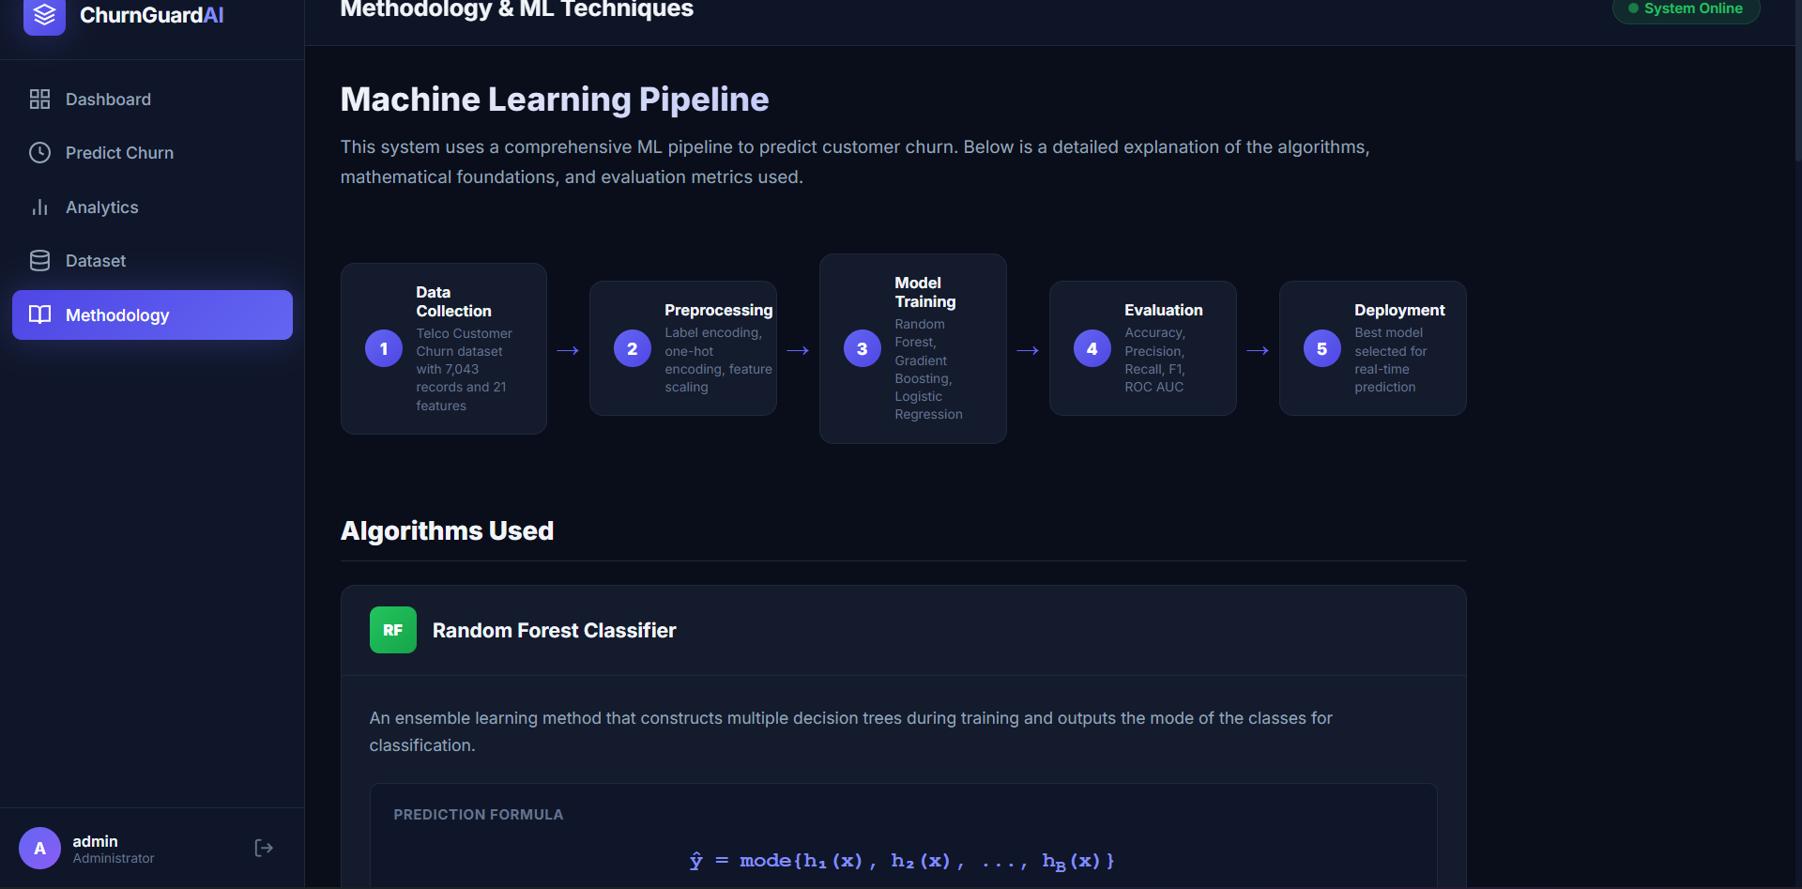
CHAPTER 6 · METHODOLOGY
Machine Learning Pipeline
Five sequential stages, from raw data to a live prediction endpoint.
1
→
2
→
3
→
4
→
5
Data
Collection
Preprocessing
Model
Training
Evaluation
Deployment
ChurnGuard AI | Customer Churn Prediction System
15

Slide 16
CHAPTER 6 · METHODOLOGY
Data Preprocessing Pipeline
Label Encoding
Binary categoricals — gender, Partner, Dependents, PhoneService, PaperlessBilling, Churn — mapped to 0/1 via scikit-learn's LabelEncoder.
1
One-Hot Encoding
Multi-category variables (MultipleLines, InternetService, security/support add-ons, Contract, PaymentMethod) expanded with pd.get_dummies(drop_first=True) to avoid multicollinearity.
2
Standard Scaling
All features scaled to zero mean, unit variance: z = (x − μ) / σ, via StandardScaler.
3
Train/test split: 80% / 20% with stratified sampling — preserves the churn class ratio in both sets (5,634 train / 1,409 test).
ChurnGuard AI | Customer Churn Prediction System
16

Slide 17
CHAPTER 6 · METHODOLOGY
Classification Algorithms
RF
Random Forest
GB
Gradient Boosting
LR
Logistic Regression
200 trees · max_depth 15 · Gini impurity
150 trees · depth 5 · learning rate 0.1
L2 (C=1.0) · LBFGS · max_iter 1000
ŷ = mode{h₁(x), h₂(x), …, h_B(x)}
F_m(x) = F_{m-1}(x) + η·h_m(x)
σ(z) = 1 / (1 + e^-z)
All three trained on identical preprocessed data and compared on the same held-out test set for fairness.
ChurnGuard AI | Customer Churn Prediction System
17

Slide 18
CHAPTER 6 · METHODOLOGY
Evaluation Metrics
Accuracy
Precision
Recall
F1-Score
ROC AUC
(TP+TN) / (TP+TN+FP+FN)
TP / (TP+FP)
TP / (TP+FN)
2·(P·R) / (P+R)
Area under ROC curve
Overall correctness
Correctness of churn predictions
Coverage of actual churners
Harmonic mean of precision & recall
Threshold-independent discrimination
Why ROC AUC for model selection?
ROC AUC is threshold-independent and robust to class imbalance — critical here, given the dataset's 1:2.3 churn ratio. A score of 1.0 indicates perfect discrimination; 0.5 is equivalent to random guessing.
ChurnGuard AI | Customer Churn Prediction System
18

Slide 19
CHAPTER 7 · IMPLEMENTATION
Technology Stack
Flask
Pandas
NumPy
v3.0.3
v2.2.2
v1.26.4
Web application framework
Data manipulation & analysis
Numerical computing
Scikit-learn
Plotly.js
Gunicorn
v1.5.1
v2.32.0
v22.0.0
ML algorithms & preprocessing
Interactive chart rendering
Production WSGI server
Frontend: HTML5 + Jinja2 templating, custom CSS dark-theme design system, Google Fonts (Inter). Backend uses a clean MVC-inspired separation across app.py (routes), config.py (settings), and train_model.py (ML pipeline).
ChurnGuard AI | Customer Churn Prediction System
19

Slide 20
CHAPTER 7 · IMPLEMENTATION
Configuration & Training Pipeline
config.py
train_model.py — model loop
class Config:
SECRET_KEY = os.environ.get(
'SECRET_KEY', 'churn...-2026')
DATA_PATH = os.path.join(BASE, 'data')
MODEL_PATH = os.path.join(BASE, 'models')
ADMIN_USERNAME = 'admin'
ADMIN_PASSWORD = 'admin123'
for name, model in models.items():
model.fit(X_train, y_train)
y_prob = model.predict_proba(X_test)
roc = roc_auc_score(y_test, y_prob)
if roc > best_score:
best_score = roc
best_model = model
Auth decorator — login_required
requirements.txt
def login_required(f):
@wraps(f)
def decorated(*a, **kw):
if not session.get('logged_in'):
return redirect(url_for('login'))
return f(*a, **kw)
return decorated
flask==3.0.3
pandas==2.2.2
numpy==1.26.4
scikit-learn==1.5.1
plotly==5.22.0
gunicorn==22.0.0
ChurnGuard AI | Customer Churn Prediction System
20

Slide 21
CHAPTER 7 · IMPLEMENTATION
Flask Application Routes
Route | Method | Purpose
/login | GET / POST | User authentication
/logout | GET | Session clearing
/ | GET | Dashboard — KPI stats
/predict | GET / POST | Real-time churn prediction
/analytics | GET | Advanced visualizations
/dataset | GET | Paginated data explorer
/methodology | GET | ML documentation
/api/chart-data/<type> | GET | JSON chart data (8 chart types)
All routes except /login are protected by the login_required decorator.
ChurnGuard AI | Customer Churn Prediction System
21

Slide 22
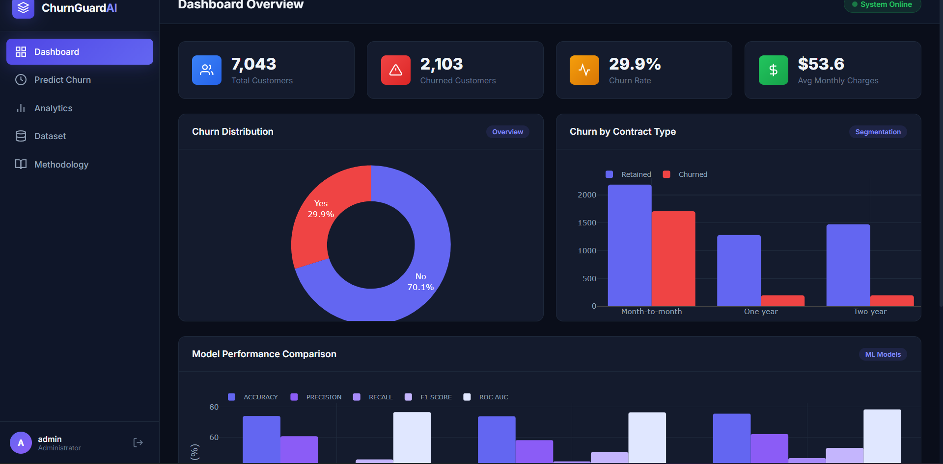
CHAPTER 7 · APPLICATION WALKTHROUGH
Dashboard Overview
KPI cards, churn distribution donut, contract-type breakdown, and live model comparison — all rendered from the /api/chart-data endpoint.
ChurnGuard AI | Customer Churn Prediction System
22

Slide 23
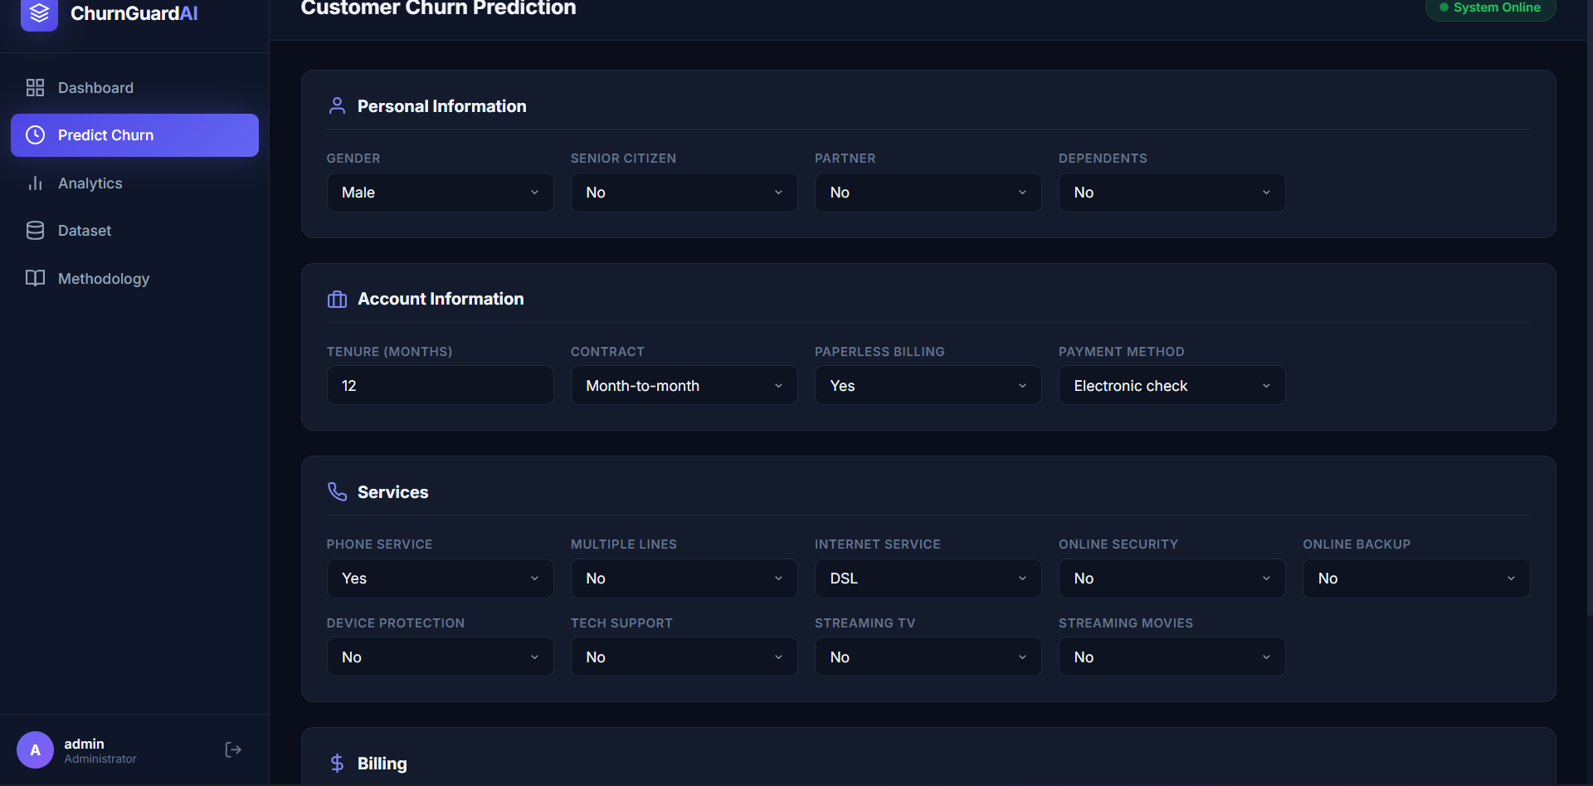
CHAPTER 7 · APPLICATION WALKTHROUGH
Predict Churn — Real-Time Scoring
A multi-section form captures 19 customer attributes; the trained model returns a Churn / No Churn label with a probability score.
ChurnGuard AI | Customer Churn Prediction System
23

Slide 24
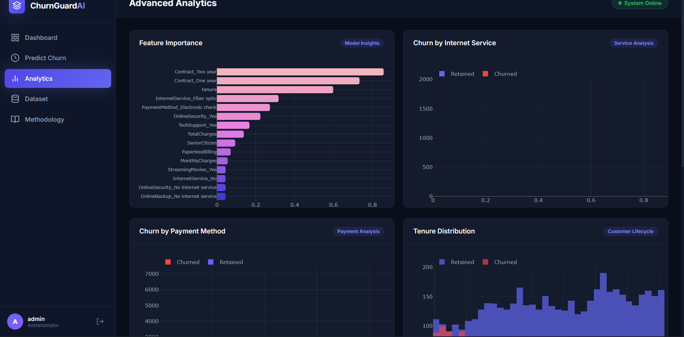
CHAPTER 7 · APPLICATION WALKTHROUGH
Advanced Analytics
Feature importance rankings alongside churn breakdowns by internet service, payment method, and tenure.
ChurnGuard AI | Customer Churn Prediction System
24

Slide 25
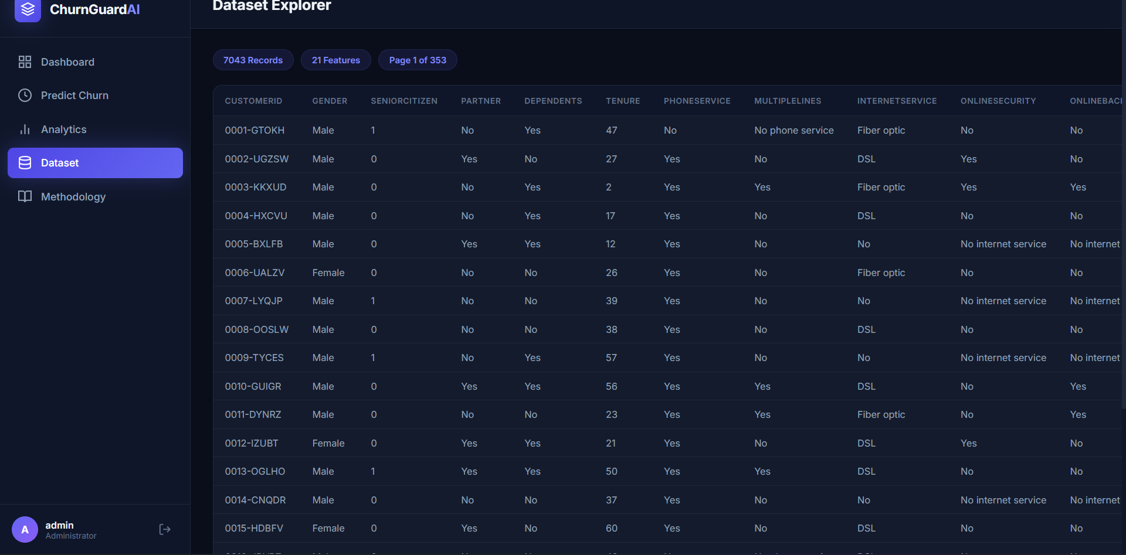
CHAPTER 7 · APPLICATION WALKTHROUGH
Dataset Explorer
Server-side paginated browsing of all 7,043 records across 21 features — 353 pages at 20 records each.
ChurnGuard AI | Customer Churn Prediction System
25

Slide 26
CHAPTER 8 · TESTING & RESULTS
Model Performance Comparison
ChurnGuard AI | Customer Churn Prediction System
26

Slide 27
CHAPTER 8 · TESTING & RESULTS
Detailed Performance & Confusion Matrices
Model | Accuracy | Precision | Recall | F1 | ROC AUC
Random Forest | 73.95% | 60.71% | 36.34% | 45.47% | 76.51%
Gradient Boosting | 73.81% | 58.13% | 44.18% | 50.20% | 76.39%
Logistic Regression ★ | 75.51% | 62.10% | 46.32% | 53.06% | 78.31%
CONFUSION MATRIX — LOGISTIC REGRESSION (BEST MODEL)
 | Predicted No | Predicted Yes | Total
Actual No | 869 | 119 | 988
Actual Yes | 226 | 195 | 421
869 true negatives · 195 true positives
226 false negatives · 119 false positives
High true-negative rate with moderate recall — the model correctly identifies most retained customers while catching nearly half of churners.
Trained on 5,634 samples (80%) · Evaluated on 1,409 samples (20%)
ChurnGuard AI | Customer Churn Prediction System
27

Slide 28
CHAPTER 8 · TESTING & RESULTS
Feature Importance Analysis
TOP INSIGHTS
Contract type dominates — Two-year and One-year contracts are the two strongest predictors.
Tenure ranks 3rd — newer customers churn more; onboarding period is critical.
Fiber optic & electronic check correlate with elevated churn.
Lack of Online Security / Tech Support increases risk.
ChurnGuard AI | Customer Churn Prediction System
28

Slide 29
CHAPTER 8 · BUSINESS IMPACT
Business Impact & ROI Analysis
Illustrative scenario: a mid-sized operator with 100,000 subscribers at this dataset's 29.86% churn rate.
29,860
13,831
2,766
$1.57M
Customers at risk annually
Correctly flagged by the model
(46.32% recall)
Additional customers retained
(20% save rate on flags)
Estimated preserved annual
revenue for this operator size
HOW THE MODEL DRIVES VALUE
Using a conservative retention-outreach cost of $30 per flagged customer against an average customer lifetime value of $600 (12 months at the dataset's average monthly charge of $53.59), each retained customer represents roughly $570 in preserved revenue net of outreach cost. The feature importance ranking (Ch. 8.3) doubles as a prioritization tool: contract-upgrade incentives for month-to-month subscribers and bundled OnlineSecurity/TechSupport offers are the two interventions most likely to move the needle — allowing a fixed retention budget to be targeted where it statistically pays off most.
ChurnGuard AI | Customer Churn Prediction System
29

Slide 30
CHAPTER 10 · CONCLUSION
Conclusion & Future Work
KEY FINDINGS
FUTURE WORK
Logistic Regression achieved the best ROC AUC (0.7831) among 3 models tested
Validate against real-world Kaggle Telco datasets
Add XGBoost, LightGBM & deep learning models
Contract type, tenure & internet service are the strongest churn predictors
SHAP-based individual prediction explanations
Role-based access control & OAuth 2.0
Month-to-month contracts + fiber optic + e-check ⇒ significantly higher churn
Automated retraining with drift detection
5 functional modules deployed via a modern, dark-themed Flask web app
RESTful integration with external CRM systems
ChurnGuard AI demonstrates a complete, reference-quality ML system — from raw data through deployment — bridging data science and business decision-making for proactive customer retention.
ChurnGuard AI | Customer Churn Prediction System
30

